Slide 1
Geometry Unit 10
11-1: Area of Rectangles and Squares

Slide 2
Warm-Up
Use the graph sheet and shapes to estimate the area of each shape. Count each square as one unit.

Slide 3
Area of rectangles
Content Objective: Students will be able to use postulates and theorems to find the area of rectangles and squares.
Language Objective: Students will be able to identify polygons and their appropriate area formulas.

Slide 4
Area of a Rectangle
Theorem 11-1: The area of a rectangle equals the product of its base and height.
Equation: $A=bh$
A
h
b

Slide 5
Postulates
Postulate 17: The area of a square is the square of the length of a side.
Equation: $A=s^{2}$
Postulate 18: If two figures are congruent, then they have the same area.
s
A

Slide 6
Postulates
Postulate 19: The area of a region is the sum of the areas of its non-overlapping parts.
D
C
A
B
Area of $ABCD=Area I+Area II+Area III$

Slide 7
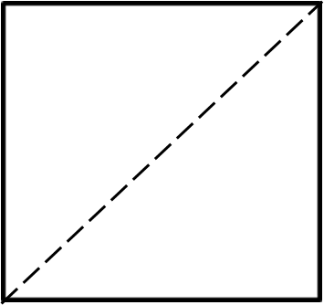



Practice
Given that consecutive sides of the figures are perpendicular. Find the area of each figure.
Solution:
Area of a Square
$$A={(4\sqrt{2})}^{2}$$
$$A=16×2=32$$
8
$$4\sqrt{2}$$
$$45°$$

Slide 8

Practice
Given that consecutive sides of the figures are perpendicular. Find the area of each figure.
Solution:
Area of a Rectangle
$$A=6×8$$
$$A=48$$
10
6
8

Slide 9
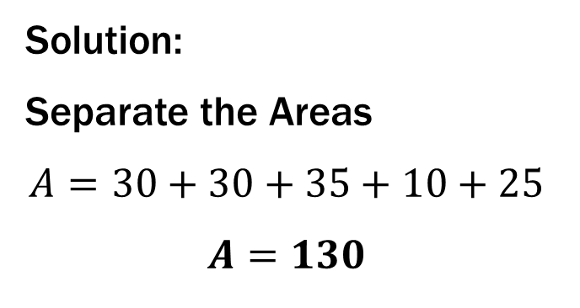
Practice
Given that consecutive sides of the figures are perpendicular. Find the area of each figure.
5
Solution:
Separate the Areas
$$A=30+30+35+10+25$$
$$A=130$$
7
7
6
6
5
5
2
2
5

Slide 10

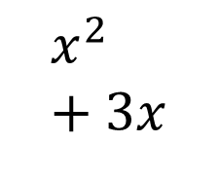
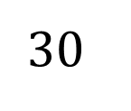
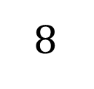
Practice
The table below outlines the parts of a rectangle. Complete the Table.
11
3
$$x^{2}+3x$$
24
4.8
$$6\sqrt{2}$$
$$8$$
$$30$$

Slide 11
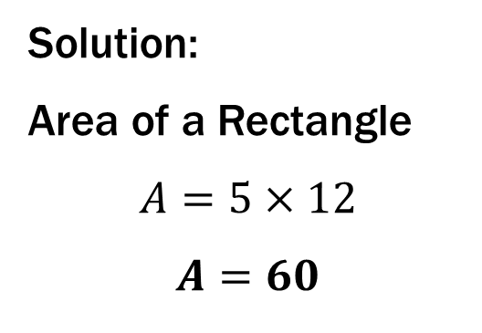
Group Practice
Find the area for the following diagrams in your groups.
1.)
Solution:
Area of a Rectangle
$$A=5×12$$
$$A=60$$
13
5
12

Slide 12
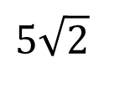
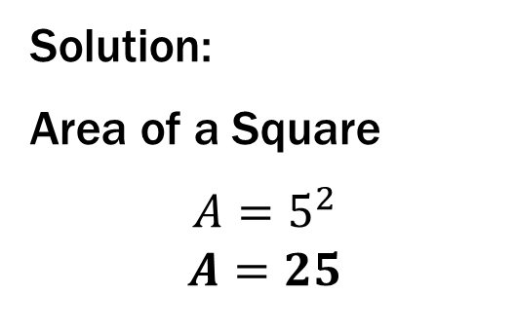
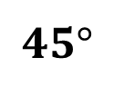
Group Practice
Find the area for the following diagrams in your groups.
2.)
$$45°$$
Solution:
Area of a Square
$$A=5^{2}$$
$$A=25$$
$$5\sqrt{2}$$
5

Slide 13
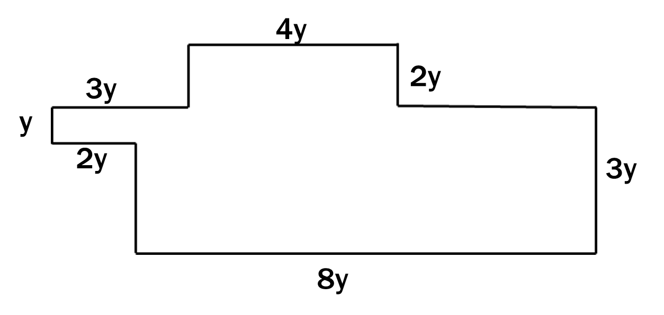
Group Practice
Find the area for the following diagrams in your groups.
3.)
Solution:
Separate the Areas
$$A={2y}^{2}+{24y}^{2}+{8y}^{2}$$
$$A={34y}^{2}$$

Slide 14
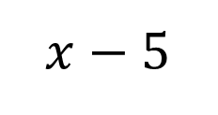
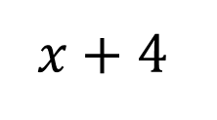
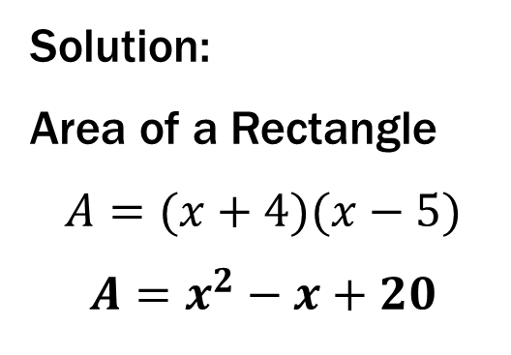
Group Practice
Find the area for the following diagrams in your groups.
4.)
$$x−5$$
$$x+4$$
Solution:
Area of a Rectangle
$$A=(x+4)(x−5)$$
$$A=x^{2}−x+20$$

Slide 15
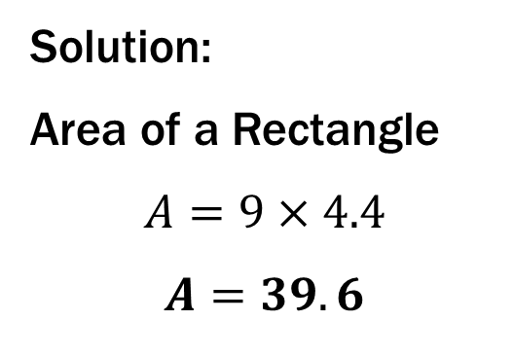
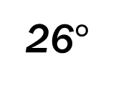
Group Practice
Find the area for the following diagrams in your groups.
5.)
10
4.4
26$°$
Solution:
Area of a Rectangle
$$A=9×4.4$$
$$A=39.6$$
9

Slide 16
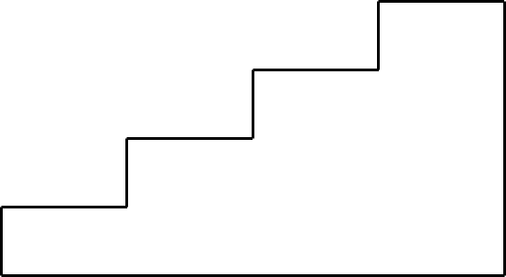
Group Practice
Find the area for the following diagrams in your groups.
6.)
4
2
4
4
2
2
4
2
Solution:
Separate the Areas
$$A=32+24+16+8$$
$$A=80$$
16

Slide 17
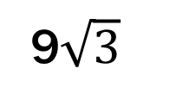
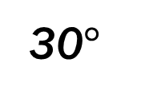
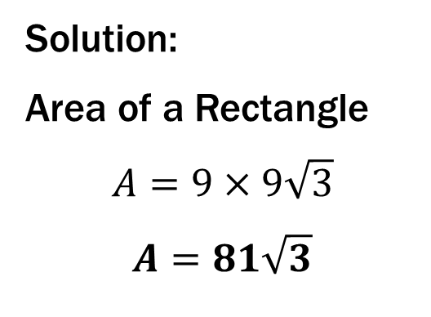
Group Practice
Find the area for the following diagrams in your groups.
7.)
9$\sqrt{3}$
30$°$
9
18
Solution:
Area of a Rectangle
$$A=9×9\sqrt{3}$$
$$A=81\sqrt{3}$$

Slide 18
Group Practice
Find the area for the following diagrams in your groups.
8.)
6
12
9
4
18
Solution:
Separate the Areas
$$A=48+54$$
$$A=102$$

Slide 19
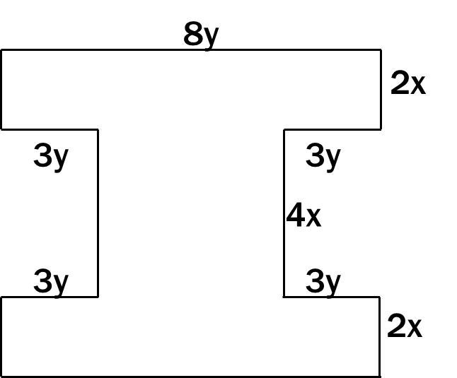
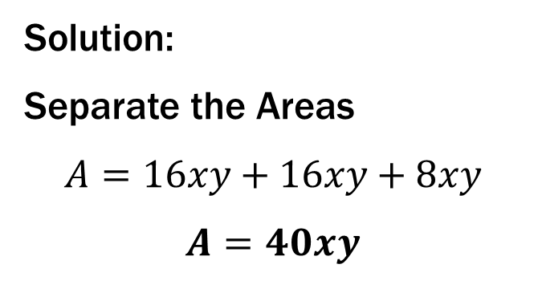
Group Practice
Find the area for the following diagrams in your groups.
9.)
Solution:
Separate the Areas
$$A=16xy+16xy+8xy$$
$$A=40xy$$

Slide 20

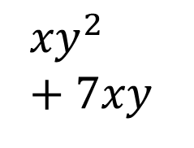
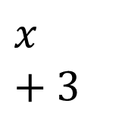

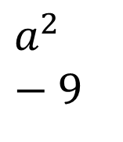
Practice
The table below outlines the parts of a rectangle. Complete the Table.
$$x+3$$
3
$$4$$
$$x^{2}+5x$$
$$a^{2}−9$$
$${xy}^{2}+7xy$$
36
400

