Slide 1
Geometry Unit 10
11-2: Areas of Parallelograms, Triangles, and Rhombuses

Slide 2
Warm-up
We are going to finish up the examples from yesterday.
Refer to the 11-1 Presentation for solutions to those problems.

Slide 3
More Areas
Content Objective: Students will be able to use postulates and theorems to find the area of parallelograms, triangles, and rhombuses.
Language Objective: Students will be able to identify polygons and their appropriate area formulas.

Slide 4
Refer to Number 3 on the 1-1 Introduction Sheet
Estimate the are using square units. Explain how you found it quickly (i.e. not just “counting squares”)
Just take a Guess.
No right or wrong with this one.

Slide 5
Area of a Parallelogram
Theorem 11-2: The area of a parallelogram equals the product of a base and the height to that base.
Equation: $A=bh$
h
b

Slide 6
Refer to Number 8 on the 1-1 Introduction Sheet
Estimate the are using square units. Explain how you found it quickly (i.e. not just “counting squares”)

Slide 7
Area of a Triangle
Theorem 11-3: The area of a triangle equals half the product of a base and the height to that base.
Equation: $A=\frac{1}{2}bh$
h
b

Slide 8
Refer to Number 5 on the 1-1 Introduction Sheet
Estimate the are using square units. Explain how you found it quickly (i.e. not just “counting squares”)

Slide 9
Area of a Rhombus
Theorem 11-4: The area of a Rhombus equals half the product of its diagonals.
Equation: $\frac{1}{2}d_{1}d_{2}$

Slide 10
Practice
Find the area of each figure.
6
3
$$1.5\sqrt{3}$$
3
60$°$
6
Solution:
Area of a Parallelogram
$$A=6×1.5\sqrt{3}$$
$$A=9\sqrt{3}$$

Slide 11
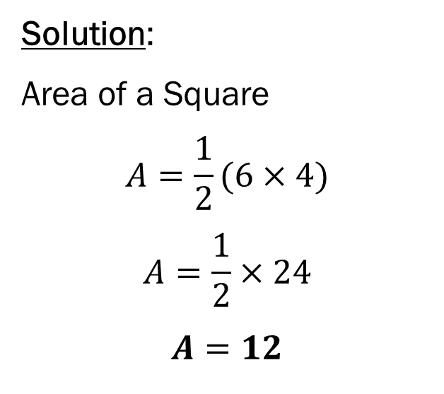
Practice
Find the area of each figure.
Solution:
Area of a Square
$$A=\frac{1}{2}(6×4)$$
$$A=\frac{1}{2}×24$$
$$A=12$$
5
4
3
6

Slide 12
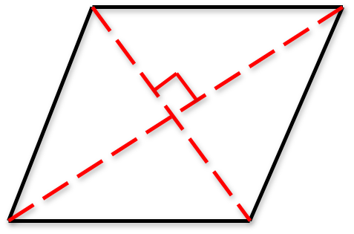

Practice
Find the area of each figure.
Solution:
Area of a Rhombus
$$A=\frac{1}{2}(8×6)$$
$$A=\frac{1}{2}×48$$
$$A=24$$
4
5
3
5

Slide 13
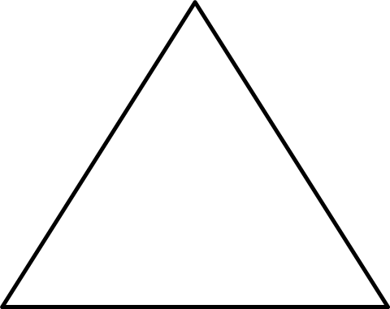
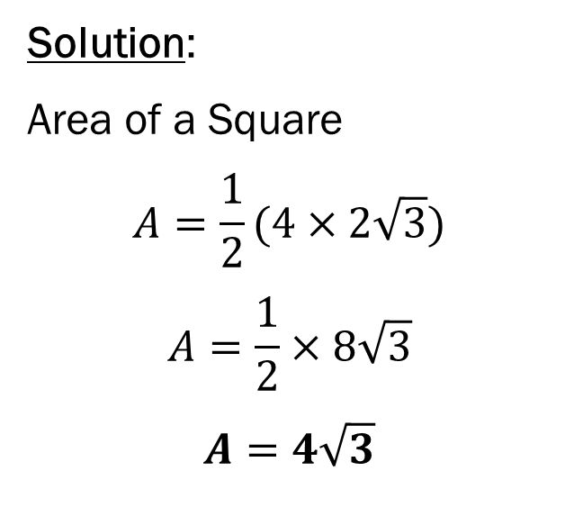
Group Practice
Find the area for the following diagrams in your groups.
1.)
Solution:
Area of a Square
$$A=\frac{1}{2}(4×2\sqrt{3})$$
$$A=\frac{1}{2}×8\sqrt{3}$$
$$A=4\sqrt{3}$$
4
4
$$2\sqrt{3}$$
4

Slide 14
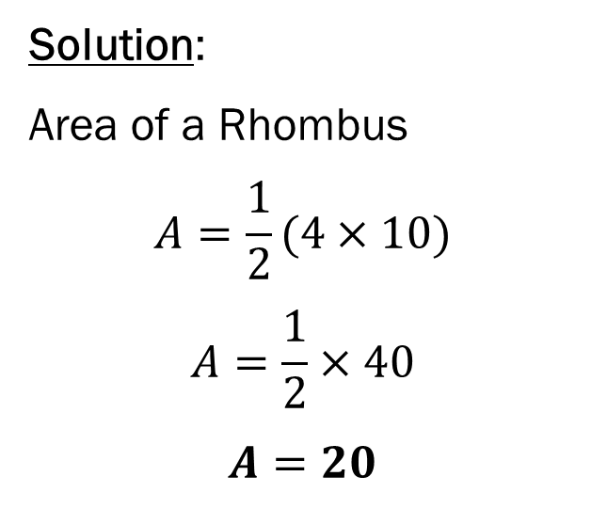
Group Practice
Find the area for the following diagrams in your groups.
2.)
Solution:
Area of a Rhombus
$$A=\frac{1}{2}(4×10)$$
$$A=\frac{1}{2}×40$$
$$A=20$$
2
5
5
2

Slide 15
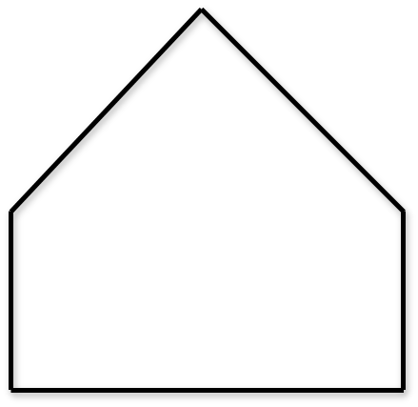
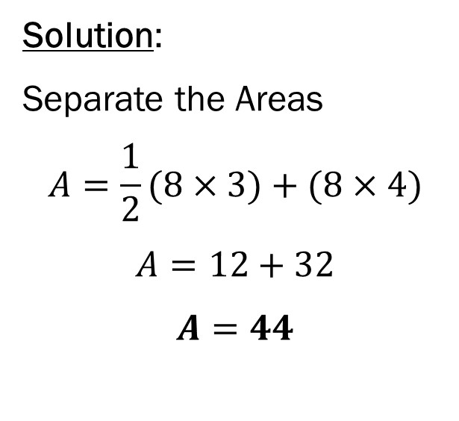
Group Practice
Find the area for the following diagrams in your groups.
3.)
5
5
3
Solution:
Separate the Areas
$$A=\frac{1}{2}(8×3)+(8×4)$$
$$A=12+32$$
$$A=44$$
4
4
8

Slide 16
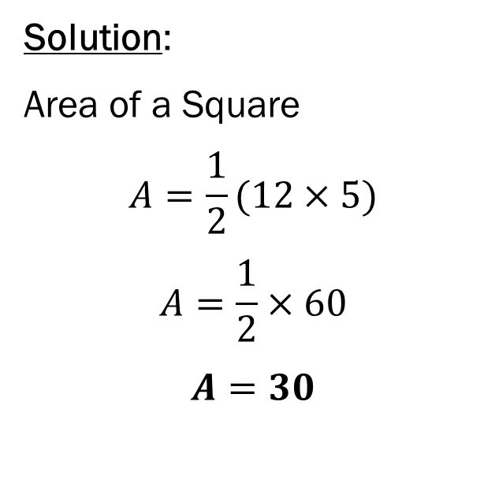
Group Practice
Find the area for the following diagrams in your groups.
4.)
Solution:
Area of a Square
$$A=\frac{1}{2}(12×5)$$
$$A=\frac{1}{2}×60$$
$$A=30$$
12
5
13

Slide 17
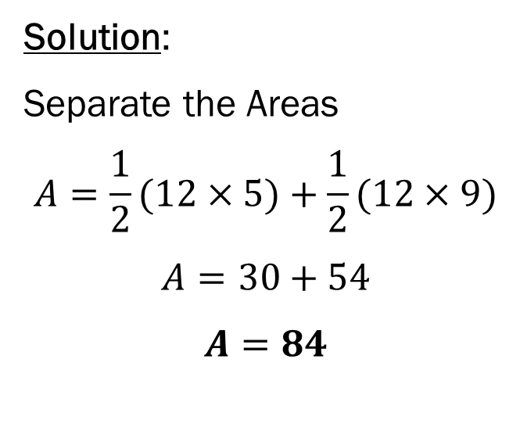
Group Practice
Find the area for the following diagrams in your groups.
5.)
Solution:
Separate the Areas
$$A=\frac{1}{2}(12×5)+\frac{1}{2}(12×9)$$
$$A=30+54$$
$$A=84$$
15
9
12
5
13

Slide 18
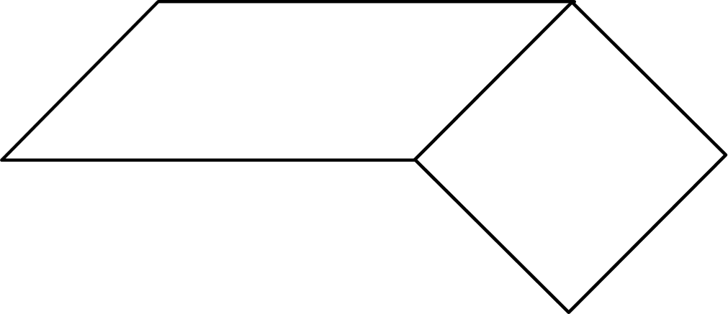
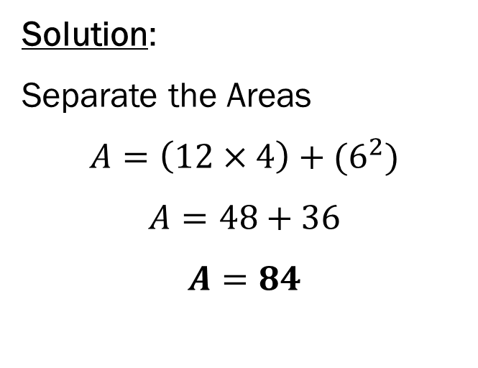
Group Practice
Find the area for the following diagrams in your groups.
6.)
12
6
4
Solution:
Separate the Areas
$$A=\left(12×4\right)+(6^{2})$$
$$A=48+36$$
$$A=84$$

Slide 19
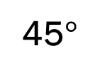
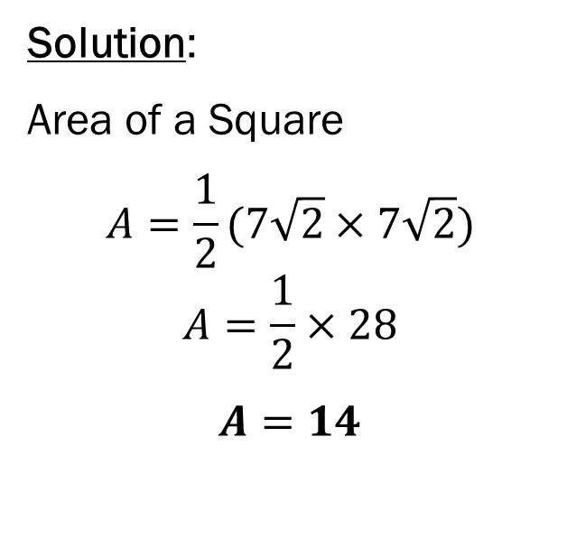
Group Practice
Find the area for the following diagrams in your groups.
7.)
Solution:
Area of a Square
$$A=\frac{1}{2}(7\sqrt{2}×7\sqrt{2})$$
$$A=\frac{1}{2}×28$$
$$A=14$$
45$°$
14
$$7\sqrt{2}$$
$$7\sqrt{2}$$

Slide 20
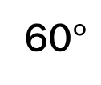
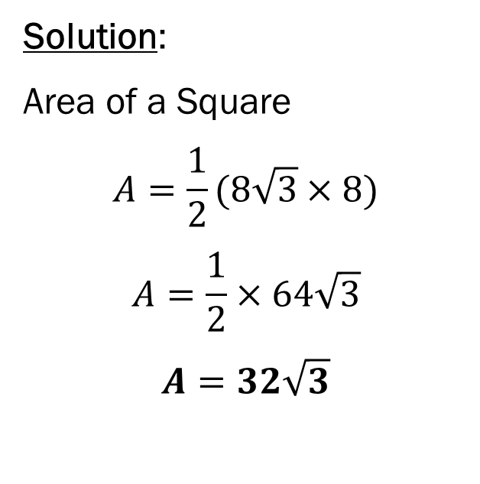
Group Practice
Find the area for the following diagrams in your groups.
8.)
Solution:
Area of a Square
$$A=\frac{1}{2}(8\sqrt{3}×8)$$
$$A=\frac{1}{2}×64\sqrt{3}$$
$$A=32\sqrt{3}$$
60$°$
16
8
$$8\sqrt{3}$$

Slide 21
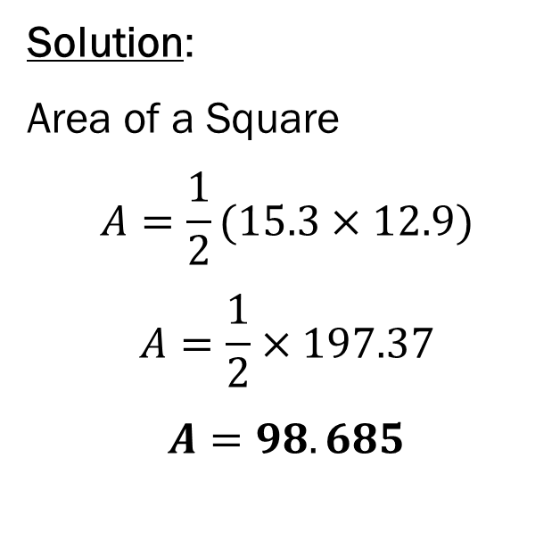
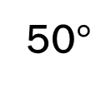
Group Practice
Find the area for the following diagrams in your groups.
9.)
Solution:
Area of a Square
$$A=\frac{1}{2}(15.3×12.9)$$
$$A=\frac{1}{2}×197.37$$
$$A=98.685$$
50$°$
20
12.9
15.3

