Slide 1
Geometry Unit 10
11-3: Area of Trapezoids

Slide 2


Warm-Up
On the whiteboards:
Give the Equations for the area of the following figures:
1.) Rectangle:
2.) Square:
3.) Parallelogram:
4.) Triangle:
5.) Rhombus:
$$A=bh$$
$$A=s^{2}$$
$$A=bh$$
$$A=\frac{1}{2}bh$$
$$A=\frac{1}{2}d_{1}d_{2}$$

Slide 3
Area of a Trapezoid
Content Objective: Students will be able to find the area of various trapezoids.
Language Objective: Students will be able to identify the parts of Trapezoids, using them in an equation to find the area of the Trapezoids.

Slide 4
Discover the Area of a trapezoid
Start with this example: Find the Area of this shape.
Recall how we took the area of a parallelogram, as well as how we took the area of a triangle.
$$8$$
$$6$$
$$10$$

Slide 5
Discover the Area of a trapezoid
1.) Draw a flipped version of the trapezoid next to your current trapezoid.
2.) Add the trapezoids together.
In the space provided, illustrate this addition by drawing the two shapes attached to each other.
$$8$$
$$8$$
$$6$$
$$+$$
$$6$$
$$10$$
$$10$$

Slide 6
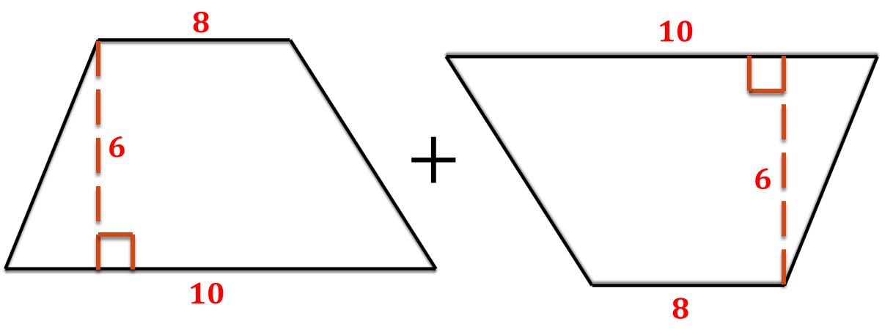
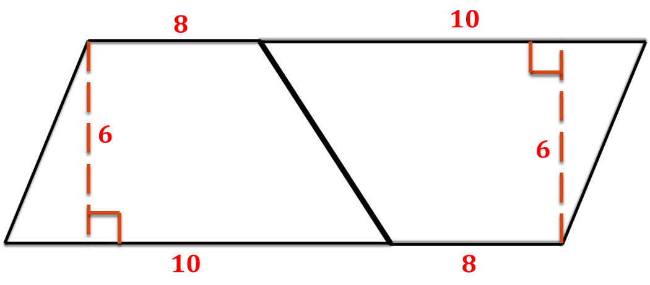
Discover the Area of a trapezoid
The final result should look like this:
$$=$$

Slide 7
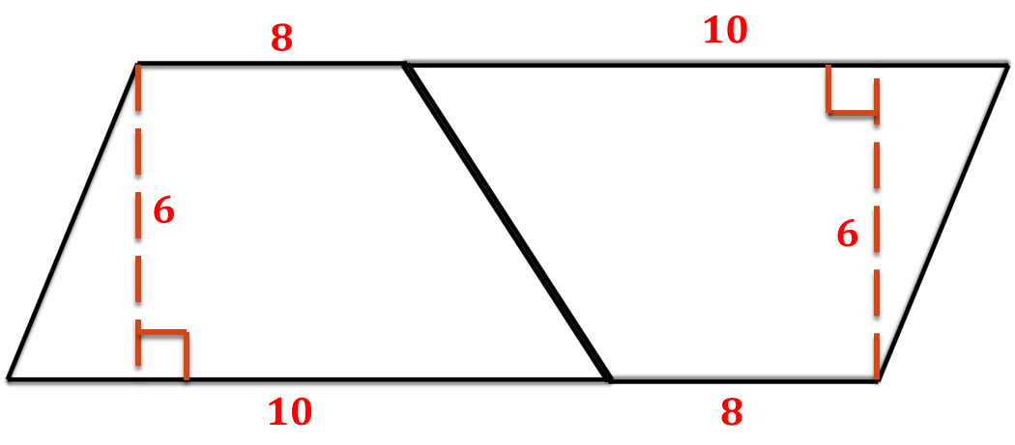

Discover the Area of a trapezoid
3.)The combined figure looks like a
Find its Area:
$A=6×\left(10+8\right)=6×18=108$
Parallelogram

Slide 8
Discover the Area of a trapezoid
4.) Recall However that you want this area:
To find this area:
$$8$$
This is only half the area you just took.
$$6$$
$$10$$
$$A=\frac{1}{2}×108=54$$

Slide 9
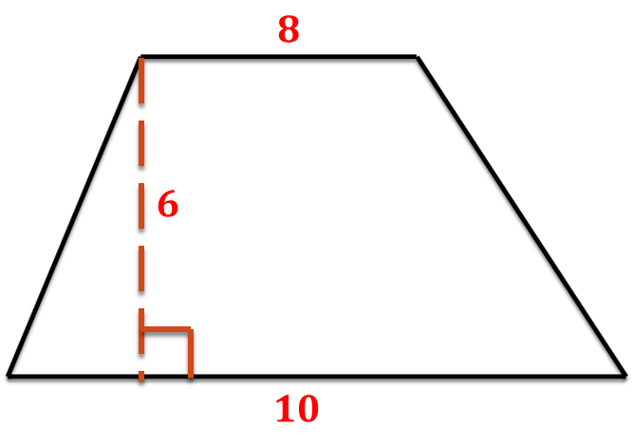
Discover the Area of a trapezoid
5.) Return to the original figure and examine its parts, comparing them to the constructed figure.
$$b_{2}$$
This takes us to the equation for the area of a trapezoid…
$$h$$
$$b_{1}$$
$$h$$
$$h$$
$$b_{1}$$
$$b_{2}$$

Slide 10
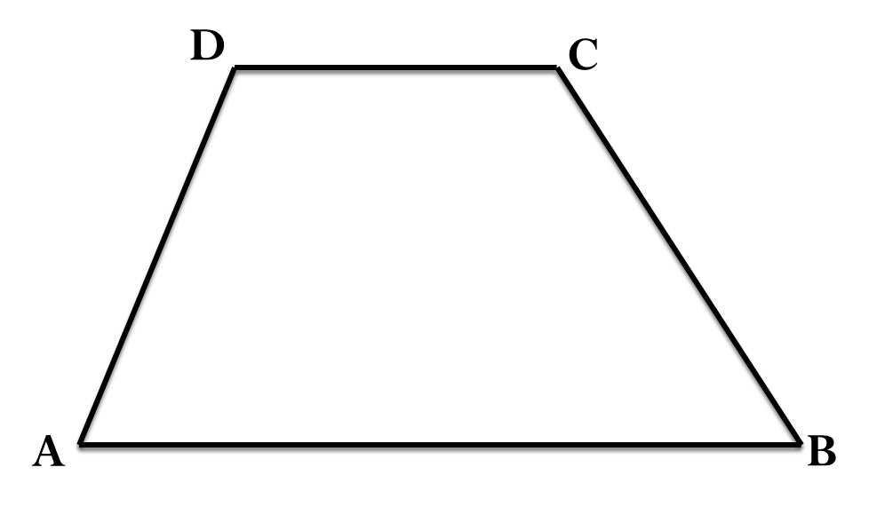
Area of a Trapezoid
Theorem 11-5: The area of a trapezoid equals half the product of the height and the sum of the bases.
Equation: $A=\frac{1}{2}h(b_{1}+b_{2})$
$$b_{1}$$
Try it on our original example.
$$h$$
$$b_{2}$$

Slide 11
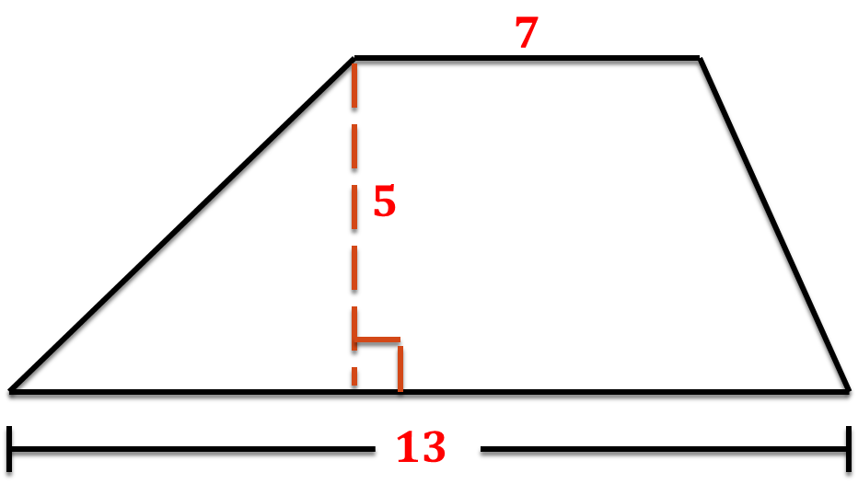
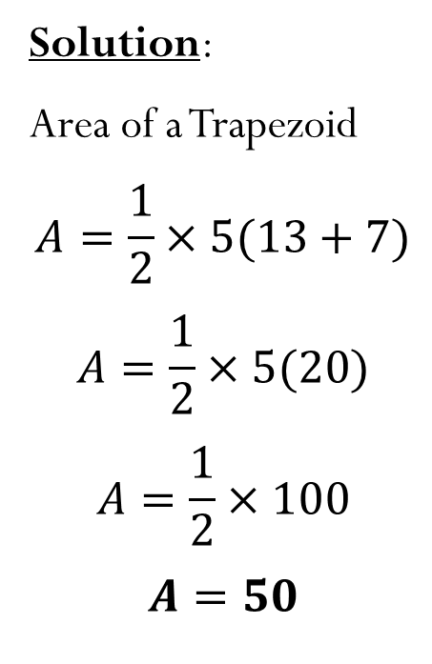
Practice Problems
Find the area of each trapezoid.
Solution:
Area of a Trapezoid
$$A=\frac{1}{2}×5(13+7)$$
$$A=\frac{1}{2}×5(20)$$
$$A=\frac{1}{2}×100$$
$$A=50$$

Slide 12
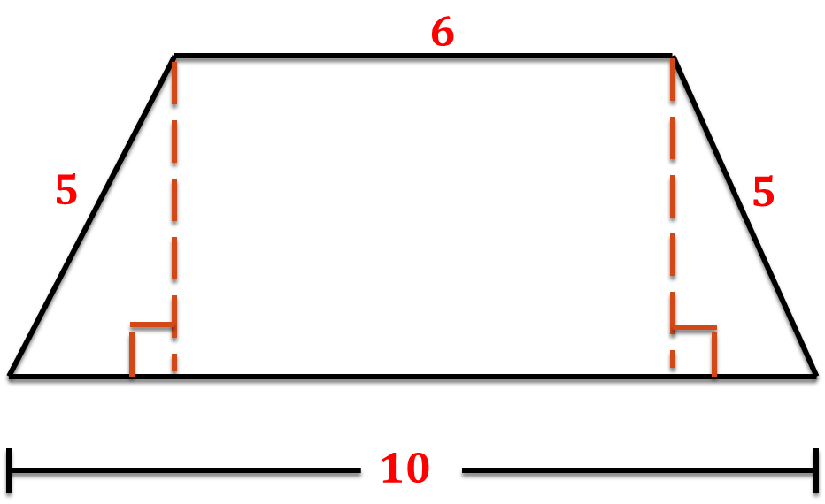
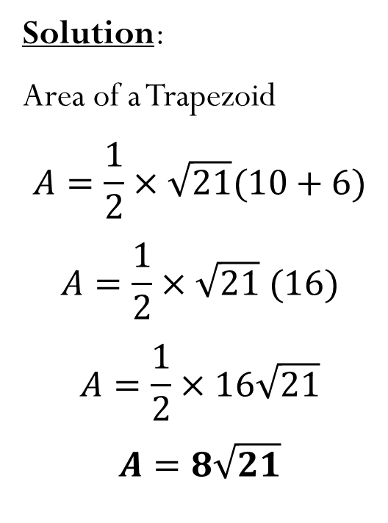
Practice Problems
Find the area of each trapezoid.
Solution:
Area of a Trapezoid
$$A=\frac{1}{2}×\sqrt{21}(10+6)$$
$$A=\frac{1}{2}×\sqrt{21} (16)$$
$$A=\frac{1}{2}×16\sqrt{21}$$
$$A=8\sqrt{21}$$
$$\sqrt{21}$$
$$2$$
$$2$$

Slide 13
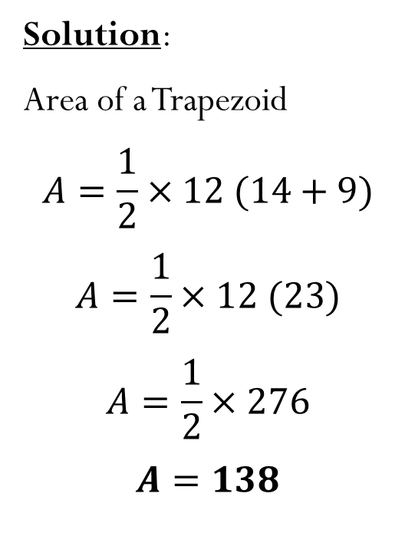
Practice Problems
Find the area of each trapezoid.
Solution:
Area of a Trapezoid
$$A=\frac{1}{2}×12 (14+9)$$
$$A=\frac{1}{2}×12 (23)$$
$$A=\frac{1}{2}×276$$
$$A=138$$
$$13$$
$$14$$
$$9$$
$$b_{1}$$
$$b_{2}$$
$$12$$
$$h$$

Slide 14
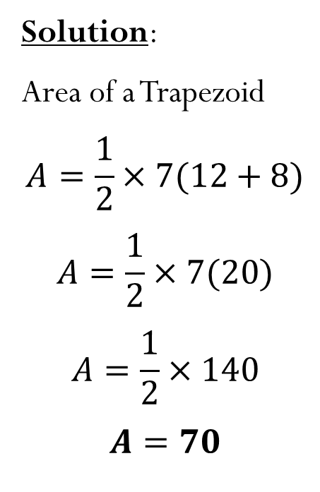
Group Practice
Find the area of each trapezoid in your groups.
1.)
Solution:
Area of a Trapezoid
$$A=\frac{1}{2}×7(12+8)$$
$$A=\frac{1}{2}×7(20)$$
$$A=\frac{1}{2}×140$$
$$A=70$$
$$8$$
$$7$$
$$12$$

Slide 15
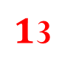
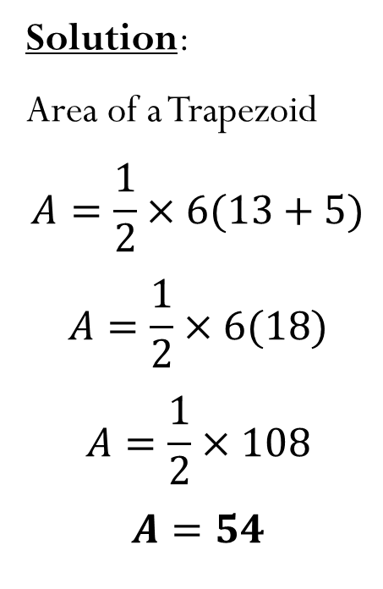
Group Practice
Find the area of each trapezoid in your groups.
2.)
$$5$$
$$b_{1}$$
Solution:
Area of a Trapezoid
$$A=\frac{1}{2}×6(13+5)$$
$$A=\frac{1}{2}×6(18)$$
$$A=\frac{1}{2}×108$$
$$A=54$$
$$h$$
$$10$$
$$6$$
$1$3
$$b_{2}$$

Slide 16
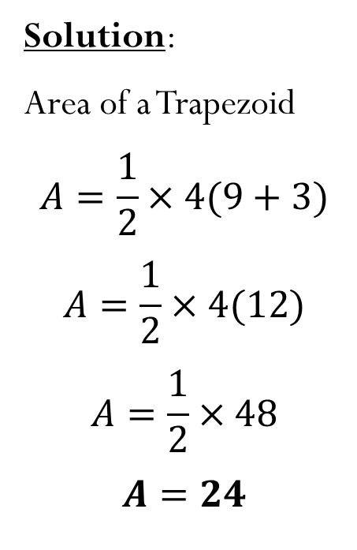
Group Practice
Find the area of each trapezoid in your groups.
3.)
Solution:
Area of a Trapezoid
$$A=\frac{1}{2}×4(9+3)$$
$$A=\frac{1}{2}×4(12)$$
$$A=\frac{1}{2}×48$$
$$A=24$$
$$3$$
$$4$$
$$5$$
$$5$$
$$3$$
$$3$$
$$9$$

Slide 17
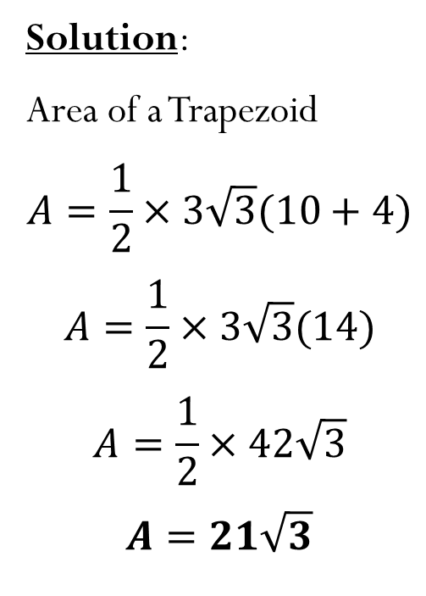
Group Practice
Find the area of each trapezoid in your groups.
4.)
Solution:
Area of a Trapezoid
$$A=\frac{1}{2}×3\sqrt{3}(10+4)$$
$$A=\frac{1}{2}×3\sqrt{3}(14)$$
$$A=\frac{1}{2}×42\sqrt{3}$$
$$A=21\sqrt{3}$$
$$30°$$
$$4$$
$$3\sqrt{3}$$
$$3$$
$$3$$

Slide 18
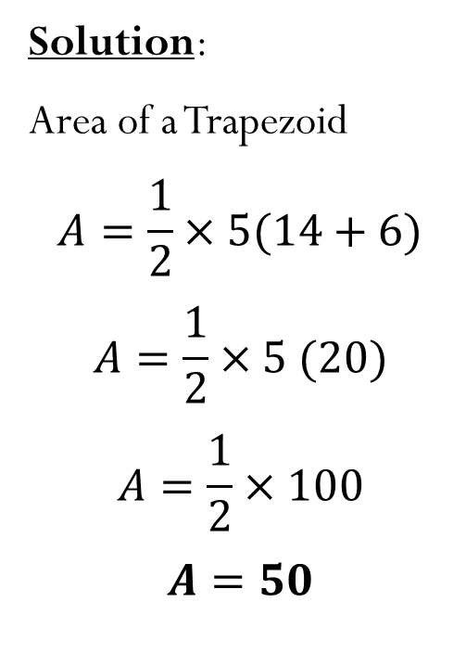
Group Practice
Find the area of each trapezoid in your groups.
5.)
Solution:
Area of a Trapezoid
$$A=\frac{1}{2}×5(14+6)$$
$$A=\frac{1}{2}×5 (20)$$
$$A=\frac{1}{2}×100$$
$$A=50$$
$$6$$
$$5$$
$$10$$
$$30°$$
$$14$$

Slide 19
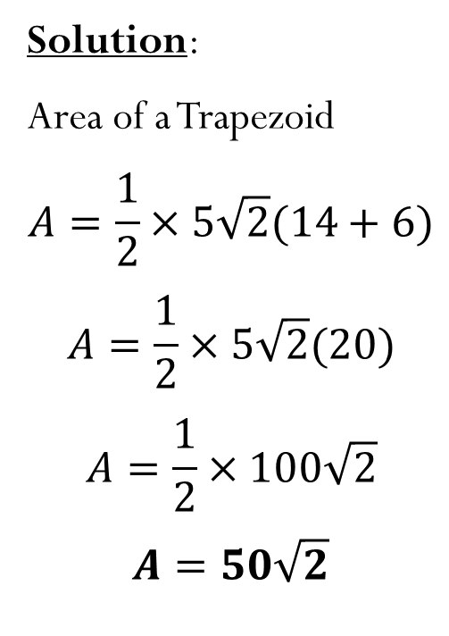
Group Practice
Find the area of each trapezoid in your groups.
6.)
Solution:
Area of a Trapezoid
$$A=\frac{1}{2}×5\sqrt{2}(14+6)$$
$$A=\frac{1}{2}×5\sqrt{2}(20)$$
$$A=\frac{1}{2}×100\sqrt{2}$$
$$A=50\sqrt{2}$$
$$6$$
$$5\sqrt{2}$$
$$10$$
$$45°$$
$$14$$

Slide 20
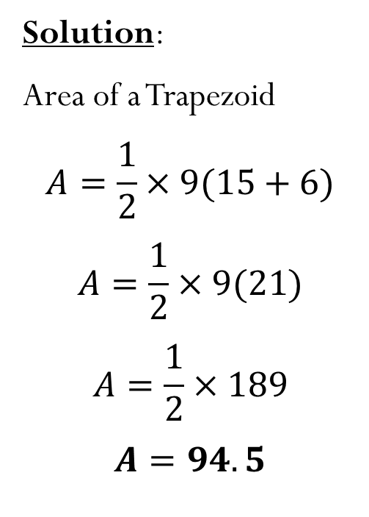
Group Practice
Find the area of each trapezoid in your groups.
7.)
Solution:
Area of a Trapezoid
$$A=\frac{1}{2}×9(15+6)$$
$$A=\frac{1}{2}×9(21)$$
$$A=\frac{1}{2}×189$$
$$A=94.5$$
$$45°$$
$$9\sqrt{2}$$
$$9$$
$$15$$
$$9$$
$$6$$

Slide 21
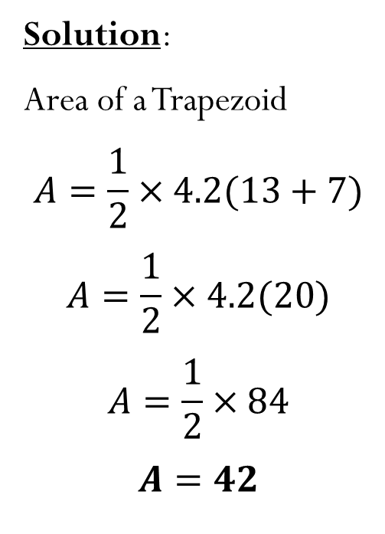
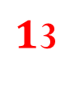
Group Practice
Find the area of each trapezoid in your groups.
8.)
Solution:
Area of a Trapezoid
$$A=\frac{1}{2}×4.2(13+7)$$
$$A=\frac{1}{2}×4.2(20)$$
$$A=\frac{1}{2}×84$$
$$A=42$$
$$7$$
$$4.2$$
$$35°$$
$1$3
$$6$$

Slide 22
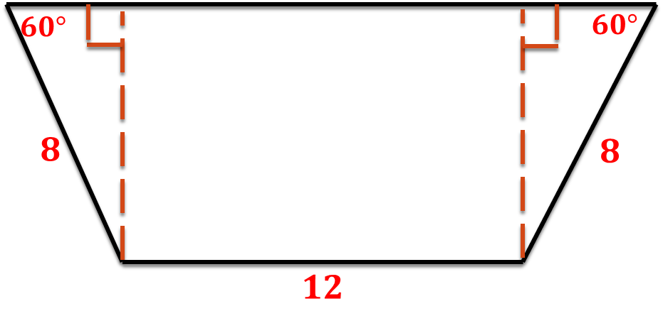
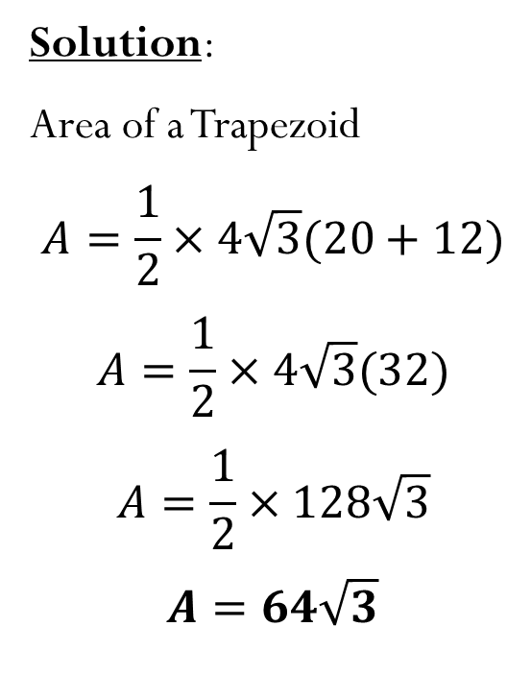
Group Practice
Find the area of each trapezoid in your groups.
9.)
Solution:
Area of a Trapezoid
$$A=\frac{1}{2}×4\sqrt{3}(20+12)$$
$$A=\frac{1}{2}×4\sqrt{3}(32)$$
$$A=\frac{1}{2}×128\sqrt{3}$$
$$A=64\sqrt{3}$$
$$20$$
$$4$$
$$12$$
$$4$$
$$4\sqrt{3}$$

