Slide 1
Geometry Unit 10
11-4: Areas of Regular Polygons

Slide 2
Areas of Regular Polygons
Content Objective: Students will be able to use theorems and equations to solve for the area of regular polygons.
Language Objective: Students will be able to identify various polygons, as well as find their area using equations.

Slide 3
Regular Polygons
Given any circle, you can inscribe in it a regular polygon of any number of sides.
Square – 4 Sides
Hexagon – 6 Sides
Decagon – 10 Sides

Slide 4
Regular Polygons - Vocabulary
The relationship between circles and polygons leads to the following terms:
The center of a regular polygon is the center of the circle.
The radius of the regular polygon is the radius of the circle.
A central angle of a regular polygon is an angle formed by two radii drawn at the center.
The apothem of a regular polygon is the perpendicular distance from the center of the polygon to a side.

Slide 5
Regular Polygons - Vocabulary
Example of each term (on an Octagon)
Radius
Center
Central Angle
Apothem

Slide 6
Regular Polygons
When a central angle is made using two radii that connect to vertices of the polygon, it splits the measure of a circle into as many parts as there are sides.
Square
Central Angle: $90°$
Hexagon
Central Angle: $60°$
Decagon
Central Angle: $90°$

Slide 7
Area of Regular Polygons
Theorem 11-6: The area of a regular polygon is equal to half the product of the apothem and the perimeter.
Equation: $A=\frac{1}{2}ap$
$$s$$
$$p=s×\#of sides$$
$$a$$

Slide 8
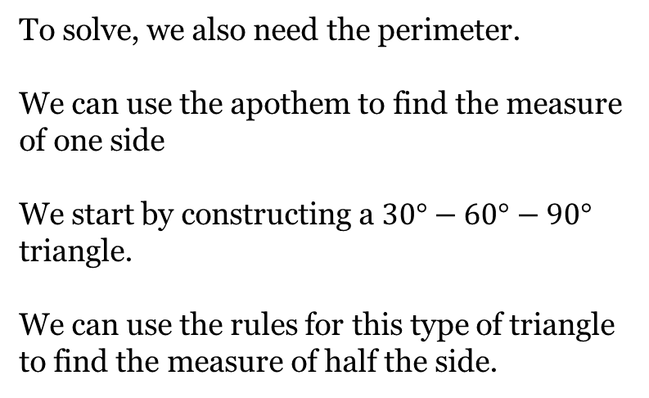
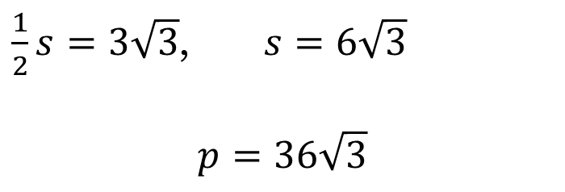
Practice
Find the area of the polygon
Regular Hexagon with Apothem 9
To solve, we also need the perimeter.
We can use the apothem to find the measure of one side
We start by constructing a $30°−60°−90°$ triangle.
We can use the rules for this type of triangle to find the measure of half the side.
$$30°$$
9
$$60°$$
$\frac{1}{2}s=3\sqrt{3}$, $s=6\sqrt{3}$
$$p=36\sqrt{3}$$
$$3\sqrt{3}$$

Slide 9
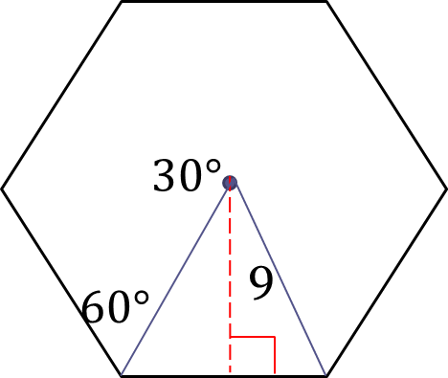
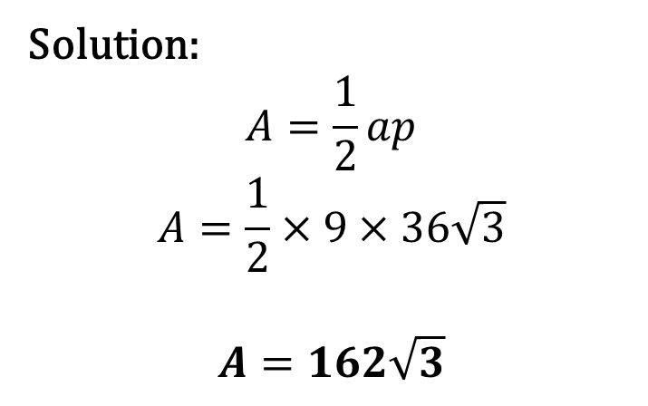
Practice
Find the area of the polygon
Regular Hexagon with Apothem 9
Solution:
$$A=\frac{1}{2}ap$$
$$A=\frac{1}{2}×9×36\sqrt{3}$$
$$A=162\sqrt{3}$$

Slide 10
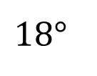
Practice
Find the area of the polygon
Regular decagon inscribed in a circle with radius 10
We will need to use trig to find the side and apothem.
Apothem: $\cos{18}=\frac{a}{10}$
$$a=10×\cos{18}=9.5106$$
Side: $\sin{18}=\frac{h}{10}$
$$h=10×\sin{18}=3.0902$$
$$s=h×2=6.1804$$
$$18°$$
10
Finding the area can now be done in one of two ways…

Slide 11
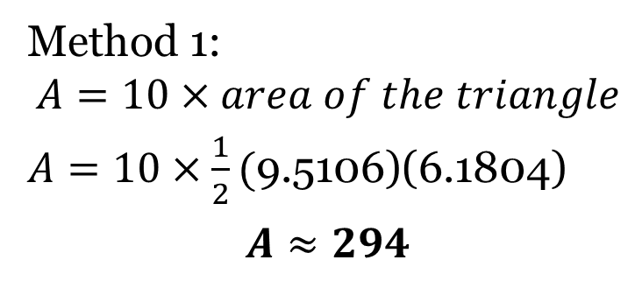
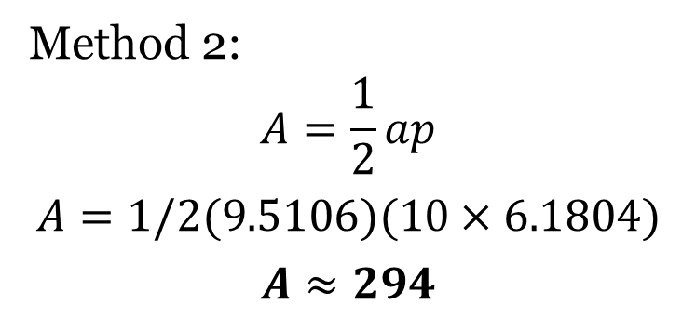
Practice
Find the area of the polygon
Regular decagon inscribed in a circle with radius 10
Method 1:
$$A=10×area of the triangle$$
$A=10×\frac{1}{2}($9.5106)(6.1804)
$$A≈294$$
$$18°$$
Method 2:
$$A=\frac{1}{2}ap$$
$$A=1/2(9.5106)(10×6.1804)$$
$$A≈294$$
10

Slide 12
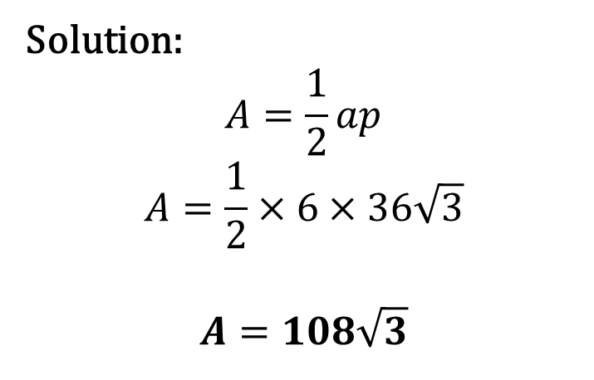
Group Practice
Find the area of the polygons in your groups
1.)
Solution:
$$A=\frac{1}{2}ap$$
$$A=\frac{1}{2}×6×36\sqrt{3}$$
$$A=108\sqrt{3}$$
12
$$60°$$
6
$$30°$$
$$6\sqrt{3}$$
$$12\sqrt{3}$$
$$p=12\sqrt{3}×3=36\sqrt{3}$$

Slide 13

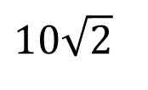
Group Practice
Find the area of the polygons in your groups
2.)
Solution:
$$A=\frac{1}{2}ap$$
$$A=\frac{1}{2}×5×40$$
$$A=100$$
$$10\sqrt{2}$$
$$45°$$
$$5$$
$$5$$
$$10$$
$$p=10×4=40$$

Slide 14
Group Practice
Find the area of the polygons in your groups
3.)
We will need to use trig to find the side and apothem.
Apothem: $\cos{36}=\frac{a}{15}$
$$a=15×\cos{36}=12.1353$$
Side: $\sin{36}=\frac{h}{15}$
$$h=15×\sin{36}=8.8168$$
$$s=h×2=17.6336$$
$$36°$$
15
Solution on next slide..

Slide 15
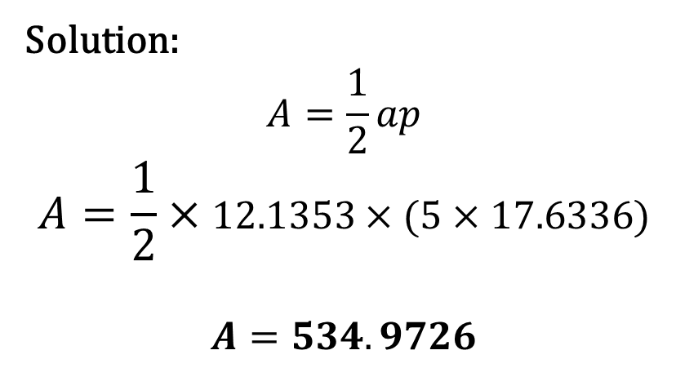
Group Practice
Find the area of the polygons in your groups
3.)
Solution:
$$A=\frac{1}{2}ap$$
$$A=\frac{1}{2}×12.1353×(5×17.6336)$$
$$A=534.9726$$
$$36°$$
15

Slide 16
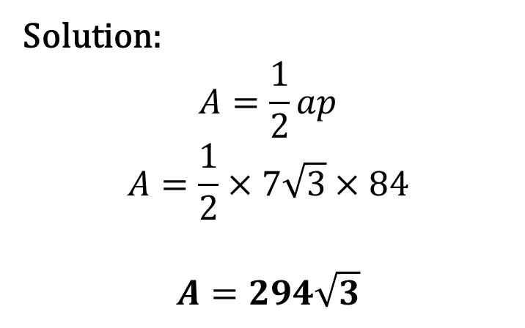
Group Practice
Find the area of the polygons in your groups
4.)
Solution:
$$A=\frac{1}{2}ap$$
$$A=\frac{1}{2}×7\sqrt{3}×84$$
$$A=294\sqrt{3}$$
$$30°$$
$$7\sqrt{3}$$
14
7
$$14$$
$$p=14×6=84$$

Slide 17
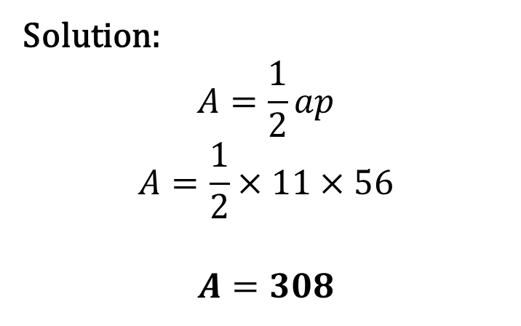
Group Practice
Find the area of the polygons in your groups
5.)
Solution:
$$A=\frac{1}{2}ap$$
$$A=\frac{1}{2}×11×56$$
$$A=308$$
8
11
$$p=8×7=56$$

Slide 18
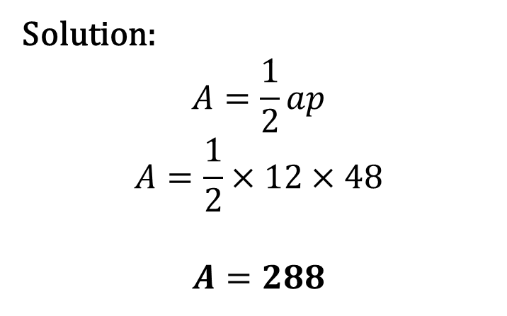
Group Practice
Find the area of the polygons in your groups
6.)
Solution:
$$A=\frac{1}{2}ap$$
$$A=\frac{1}{2}×12×48$$
$$A=288$$
6
12
$$p=6×8=48$$

Slide 19
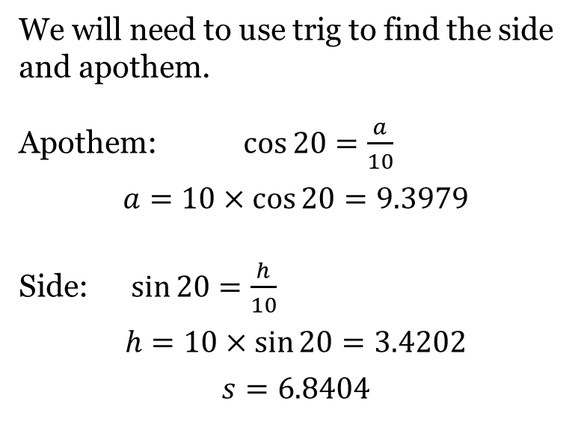
Group Practice
Find the area of the polygons in your groups
7.)
We will need to use trig to find the side and apothem.
Apothem: $\cos{20}=\frac{a}{10}$
$$a=10×\cos{20}=9.3979$$
Side: $\sin{20}=\frac{h}{10}$
$$h=10×\sin{20}=3.4202$$
$$s=6.8404$$
$$20°$$
10
Solution on next slide..

Slide 20
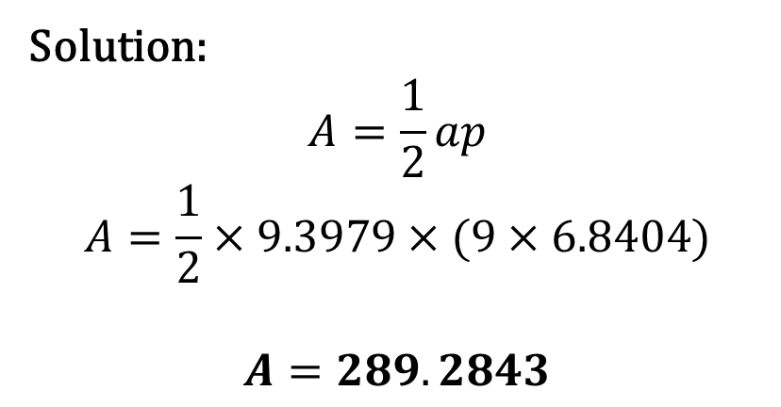
Group Practice
Find the area of the polygons in your groups
7.)
Solution:
$$A=\frac{1}{2}ap$$
$$A=\frac{1}{2}×9.3979×(9×6.8404)$$
$$A=289.2843$$
$$20°$$
10

Slide 21
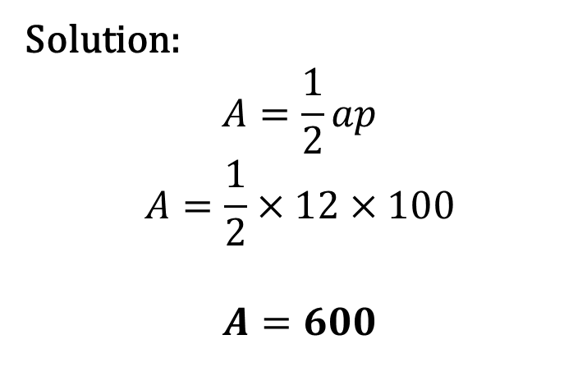
Group Practice
Find the area of the polygons in your groups
8.)
Solution:
$$A=\frac{1}{2}ap$$
$$A=\frac{1}{2}×12×100$$
$$A=600$$
12
13
5
$$10$$
$$p=10×10=100$$

Slide 22
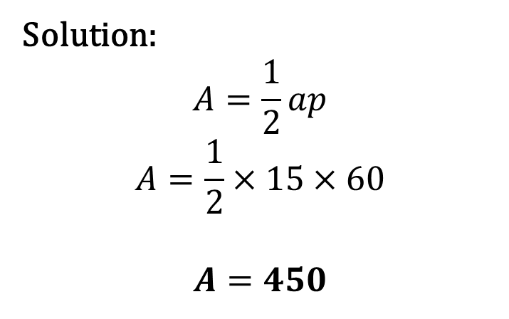
Group Practice
Find the area of the polygons in your groups
9.)
Solution:
$$A=\frac{1}{2}ap$$
$$A=\frac{1}{2}×15×60$$
$$A=450$$
5
15
$$p=5×12=60$$

