Slide 1
Geometry Unit 10
11-1: Circumferences and Areas of Circles

Slide 2
Warm-Up
On the whiteboards:
Give the Equations for the area of the following figures:
1.) Square:
2.) Parallelogram:
3.) Triangle:
4.) Rhombus:
5.) Trapezoid:
6.) Any Regular Polygon:
$$A=s^{2}$$
$$A=b×h$$
$$A=\frac{1}{2}(b×h)$$
$$A=\frac{1}{2}d_{1}d_{2}$$
$$A=\frac{1}{2}×h(b_{1}+b_{2})$$
$$A=\frac{1}{2}×a×p$$

Slide 3
Circumferences and Areas of Circles
Content Objective: Students will be able to use equations to solve for the circumference and area of circles.
Language Objective: Students will be able to identify the parts of a circle that are required to solve for its circumference and area.

Slide 4



Circles - Equations
Circumference:
With radius r :
With diameter d :
Area with radius r :
$$C=2πr$$
r
$$C=dπ$$
r
d
$$C=πr^{2}$$

Slide 5


Practice:
Find the area and circumference of a circle with the given radius or diameter.
1.)
$$C=2πr$$
$$C=2π×8=16π$$
8
$$A=πr^{2}$$
$$A=π×8^{2}=64π$$

Slide 6


Practice:
Find the area and circumference of a circle with the given radius or diameter.
2.)
$$C=2πr$$
$$C=2π×10=20π$$
20
10
$$A=πr^{2}$$
$$A=π×{10}^{2}=100π$$

Slide 7


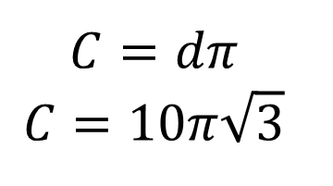
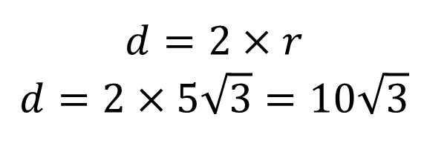
Practice:
3.) Given a circle with area of $75π$, find the
Radius:
Diameter:
Circumference:
$$75π=πr^{2}$$
$$75=r^{2}$$
$$r=5\sqrt{3}$$
$$d=2×r$$
$$d=2×5\sqrt{3}=10\sqrt{3}$$
$$C=dπ$$
$$C=10π\sqrt{3}$$

Slide 8

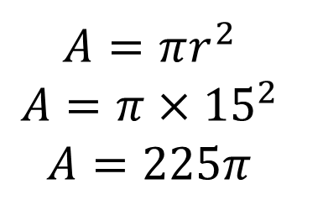
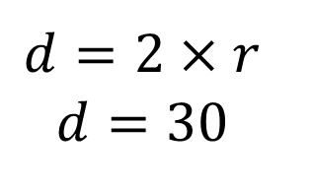
Practice:
Given a circle with a circumference of $30π$, find the
Radius:
Diameter:
Area:
$$30π=2πr$$
$$r=15$$
$$d=2×r$$
$$d=30$$
$$A=πr^{2}$$
$$A=π×{15}^{2}$$
$$A=225π$$

Slide 9
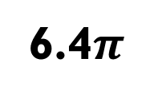
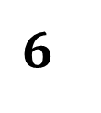
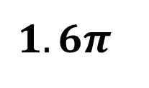
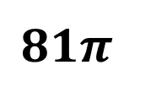

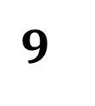
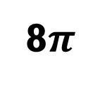

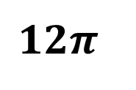
Practice:
Complete the table.
$$5$$
$$9$$
$$6$$
$$7$$
$$12$$
$$6π$$
8$π$
$$1.6π$$
$$12π$$
14$π$
24$π$
$$9π$$
16$π$
6.4$π$
25$π$
$$81π$$

Slide 10


Group Practice:
Find the area and circumference of a circle with the given radius or diameter.
1.)
$$C=2πr$$
$$C=2π×11=22π$$
11
$$A=πr^{2}$$
$$A=π×{11}^{2}=121π$$

Slide 11
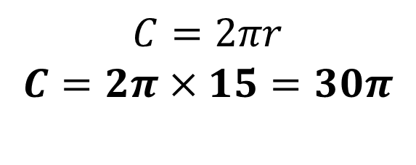
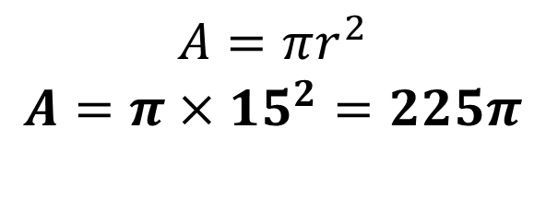
Group Practice:
Find the area and circumference of a circle with the given radius or diameter.
2.)
$$C=2πr$$
$$C=2π×15=30π$$
30
$$A=πr^{2}$$
$$A=π×{15}^{2}=225π$$
15

Slide 12
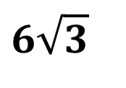


Group Practice:
Find the area and circumference of a circle with the given radius or diameter.
3.)
$$C=2πr$$
$$C=2π×6\sqrt{3}=12\sqrt{3}π$$
$$6\sqrt{3}$$
$$A=πr^{2}$$
$$A=π×{(6\sqrt{3})}^{2}$$
$$A=\left(36×3\right)π=108π$$

Slide 13



Group Practice:
4.) Given a circle with area of $36π$, find the
Radius:
Diameter:
Circumference:
$$36π=πr^{2}$$
$$36=r^{2}$$
$$r=6$$
$$d=2×r$$
$$d=2×6=12$$
$$C=dπ$$
$$C=12π$$

Slide 14



Practice:
5.) Given a circle with a circumference of $25π$, find the
Radius:
Diameter:
Area:
$$25π=2πr$$
$$r=12.5$$
$$d=2×r$$
$$d=25$$
$$A=πr^{2}$$
$$A=π×{12.5}^{2}$$
$$A=156.25π$$

Slide 15


Group Practice:
6.) Given a circle with area of $80π$, find the
Radius:
Diameter:
Circumference:
$$80π=πr^{2}$$
$$80=r^{2}$$
$$r=4\sqrt{5}$$
$$d=2×r$$
$$d=2×4\sqrt{5}=8\sqrt{5}$$
$$C=dπ$$
$$C=8π\sqrt{5}$$

Slide 16



Practice:
7.) Given a circle with a circumference of $40π$, find the
Radius:
Diameter:
Area:
$$40π=2πr$$
$$r=20$$
$$d=2×r$$
$$d=40$$
$$A=πr^{2}$$
$$A=π×{20}^{2}$$
$$A=400π$$

Slide 17

Group Practice:
Complete the table.
$$10$$
$$6$$
$$5$$
$$5\sqrt{2}$$
$$14π$$
$$240π$$
$$5π$$
$$12\sqrt{2}π$$
$$10π$$
$$10\sqrt{2}π$$
$$49π$$
$$\frac{25}{4}π$$
$$72π$$
$$100π$$
$$36π$$
$$14400π$$

