Slide 1
Geometry Unit 10
11-6: Arc Lengths and Areas of Sectors

Slide 2
Warm-up
Continue working where you left off on the group questions in the 11-5 notes.
10 minutes of work time, then we move on.

Slide 3
Arc Lengths and areas of sectors
Content Objective: Students will be able to use equations to solve for the lengths of arcs and area of sectors.
Language Objective: Students will be able to identify arcs and sectors of circle, being able to find the length of arcs and area of sectors.

Slide 4
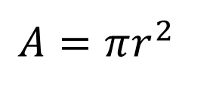
Review
An arc is A portion of the circle connecting two points from the circle.
Circumference of a circle:
Area of a circle:
$$C=2πr$$
$$A=πr^{2}$$
A
Minor Arc: $\hat{AB}$
r
O
B

Slide 5
Sectors
The inside portion of the circle that is bounded by the arc and the radii is called the
There are two sectors, each covered by a specific arc.
Sector.
A
Sector $2$
r
O
Sector $1$
B

Slide 6


Arc Length and Area of a Sector
Given the circle with minor arc $\hat{AB}$,
Arc Length:
Area of a Sector:
A
$$L=\frac{m \hat{AB}}{360}×2πr$$
r
O
$$A=\frac{m \hat{AB}}{360}×πr^{2}$$
B

Slide 7
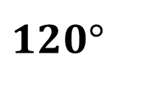
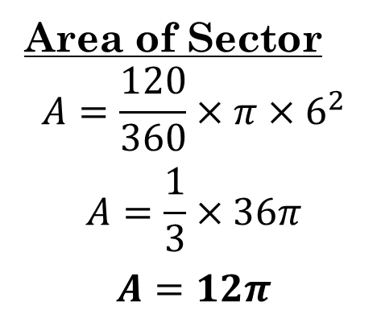
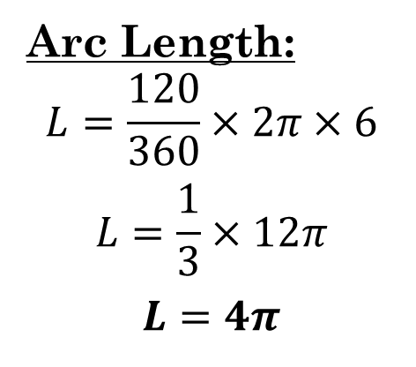
Practice
Find the arc length and area of each chosen sector.
1.)
Arc Length:
$$L=\frac{120}{360}×2π×6$$
$$L=\frac{1}{3}×12π$$
$$L=4π$$
$$120°$$
6
Sector
6
Area of Sector
$$A=\frac{120}{360}×π{×6}^{2}$$
$$A=\frac{1}{3}×36π$$
$$A=12π$$

Slide 8
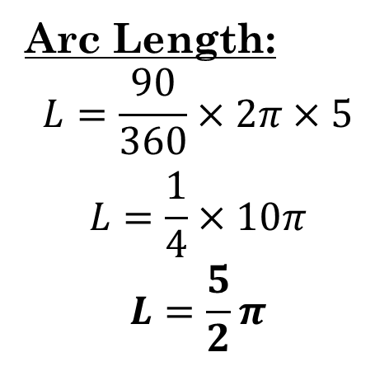
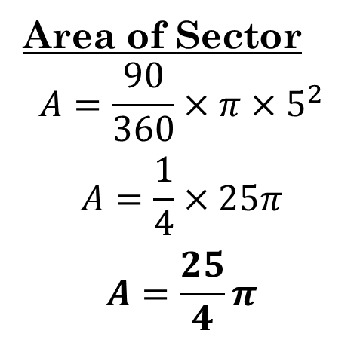
Practice
Find the arc length and area of each chosen sector.
2.)
Arc Length:
$$L=\frac{90}{360}×2π×5$$
$$L=\frac{1}{4}×10π$$
$$L=\frac{5}{2}π$$
5
Sector
5
Area of Sector
$$A=\frac{90}{360}×π{×5}^{2}$$
$$A=\frac{1}{4}×25π$$
$$A=\frac{25}{4}π$$

Slide 9
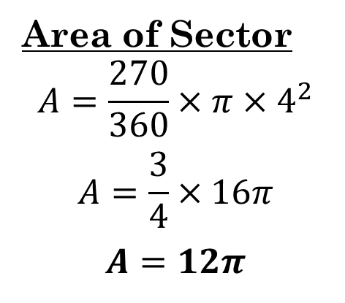
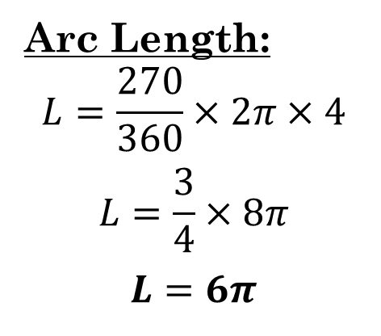
Practice
Find the arc length and area of each chosen sector.
3.)
Arc Length:
$$L=\frac{270}{360}×2π×4$$
$$L=\frac{3}{4}×8π$$
$$L=6π$$
4
Sector
4
Area of Sector
$$A=\frac{270}{360}×π{×4}^{2}$$
$$A=\frac{3}{4}×16π$$
$$A=12π$$
$$270°$$

Slide 10
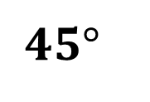
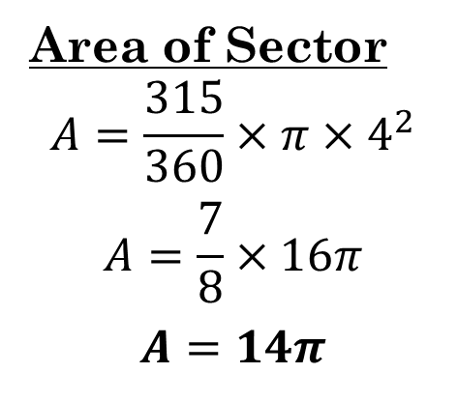
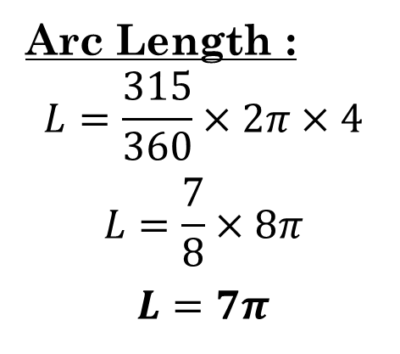
Group Practice:
Find the arc length and area of each sector of the circle.
1.)
Arc Length :
$$L=\frac{315}{360}×2π×4$$
$$L=\frac{7}{8}×8π$$
$$L=7π$$
$$315°$$
Sector
4
4
$$45°$$
Area of Sector
$$A=\frac{315}{360}×π{×4}^{2}$$
$$A=\frac{7}{8}×16π$$
$$A=14π$$

Slide 11
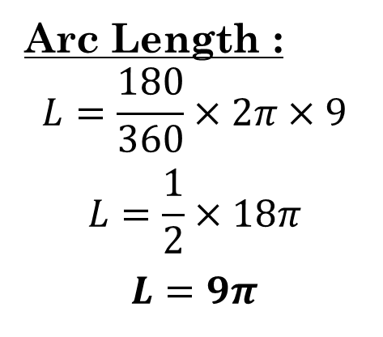
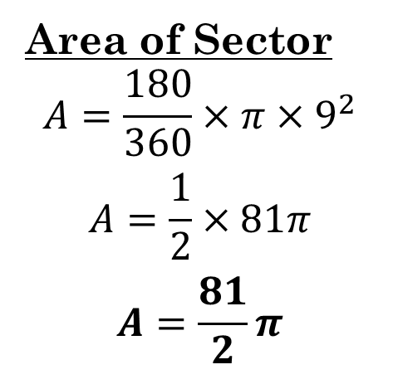
Group Practice:
Find the arc length and area of each sector of the circle.
2.)
Arc Length :
$$L=\frac{180}{360}×2π×9$$
$$L=\frac{1}{2}×18π$$
$$L=9π$$
9
Sector
Area of Sector
$$A=\frac{180}{360}×π{×9}^{2}$$
$$A=\frac{1}{2}×81π$$
$$A=\frac{81}{2}π$$

Slide 12
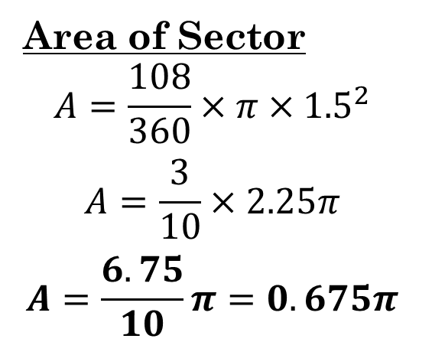
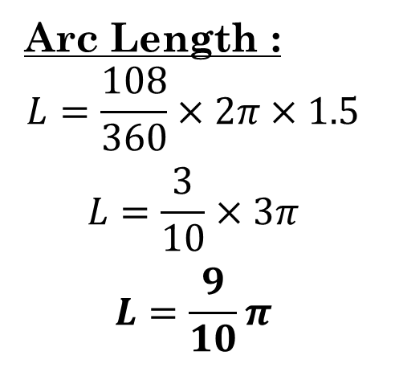
Group Practice:
Find the arc length and area of each sector of the circle.
3.)
Arc Length :
$$L=\frac{108}{360}×2π×1.5$$
$$L=\frac{3}{10}×3π$$
$$L=\frac{9}{10}π$$
$$108°$$
1.5
Sector
1.5
Area of Sector
$$A=\frac{108}{360}×π×{1.5}^{2}$$
$$A=\frac{3}{10}×2.25π$$
$$A=\frac{6.75}{10}π=0.675π$$

Slide 13
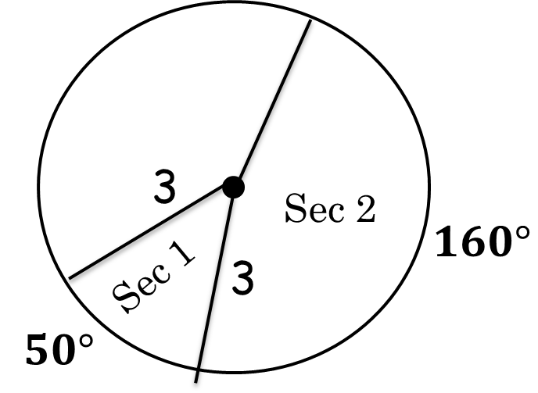
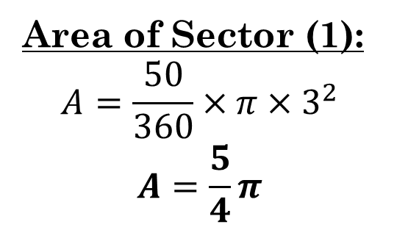
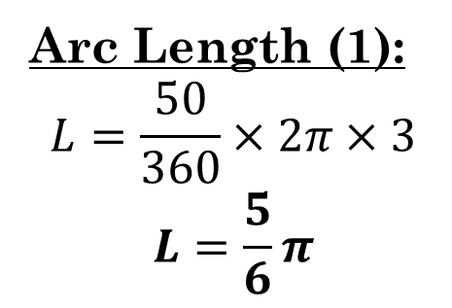
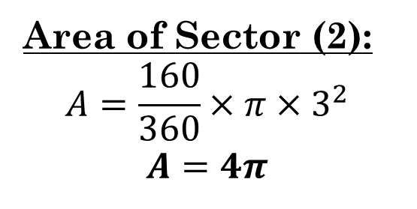
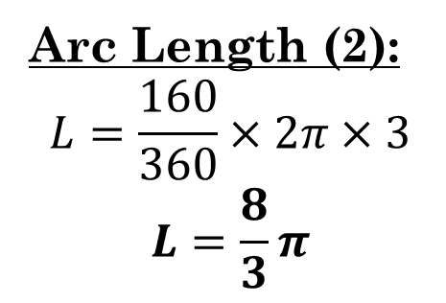
Group Practice:
Find the arc length and area of each chosen sector.
4.)
Arc Length (1):
$$L=\frac{50}{360}×2π×3$$
$$L=\frac{5}{6}π$$
Area of Sector (1):
$$A=\frac{50}{360}×π{×3}^{2}$$
$$A=\frac{5}{4}π$$
Arc Length (2):
$$L=\frac{160}{360}×2π×3$$
$$L=\frac{8}{3}π$$
Area of Sector (2):
$$A=\frac{160}{360}×π{×3}^{2}$$
$$A=4π$$

Slide 14
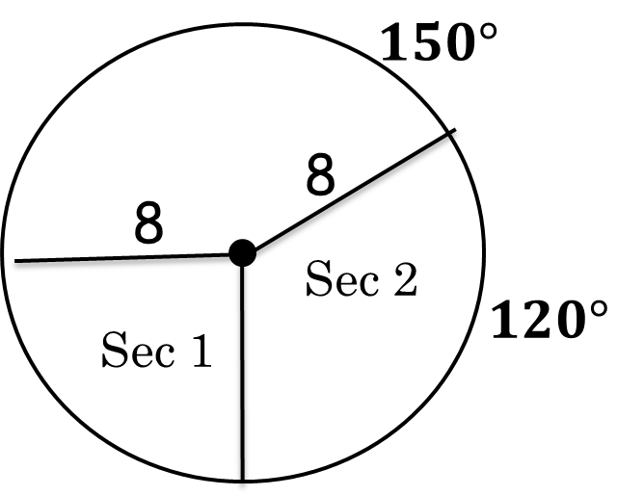
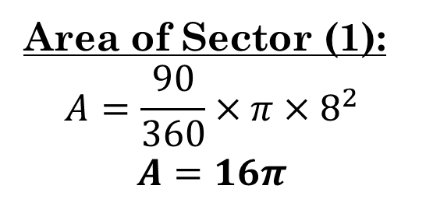
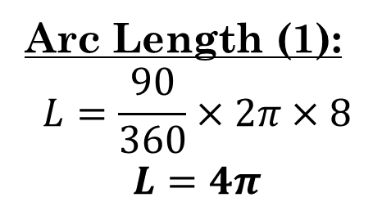
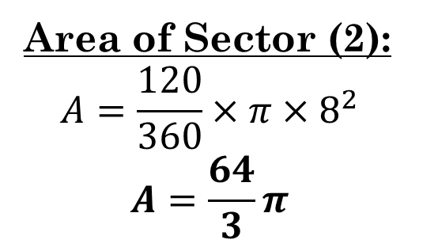
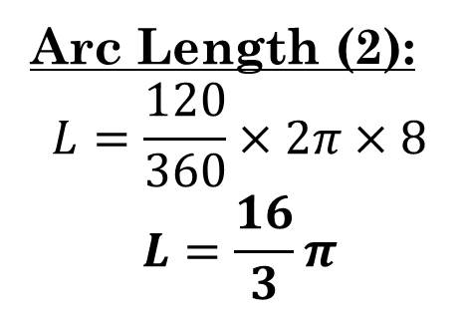
Group Practice:
Find the arc length and area of each chosen sector.
5.)
Arc Length (1):
$$L=\frac{90}{360}×2π×8$$
$$L=4π$$
Area of Sector (1):
$$A=\frac{90}{360}×π×8^{2}$$
$$A=16π$$
$$90°$$
Arc Length (2):
$$L=\frac{120}{360}×2π×8$$
$$L=\frac{16}{3}π$$
Area of Sector (2):
$$A=\frac{120}{360}×π×8^{2}$$
$$A=\frac{64}{3}π$$

Slide 15
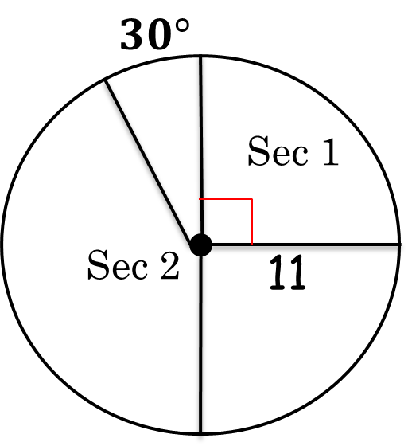
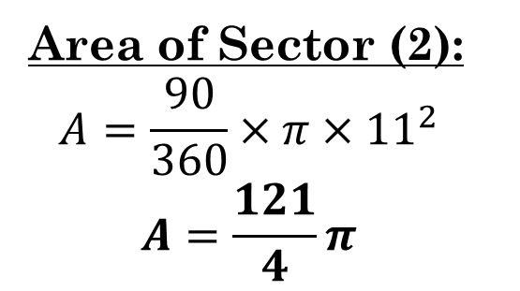
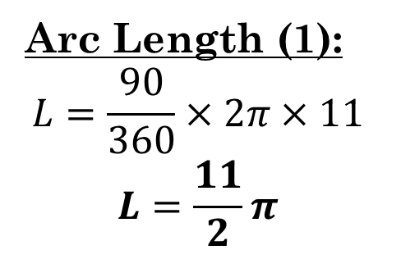
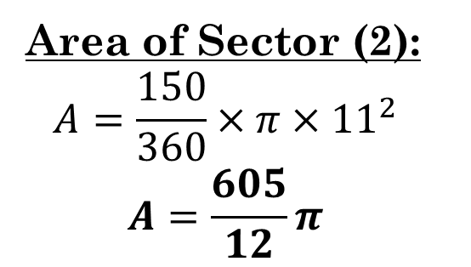
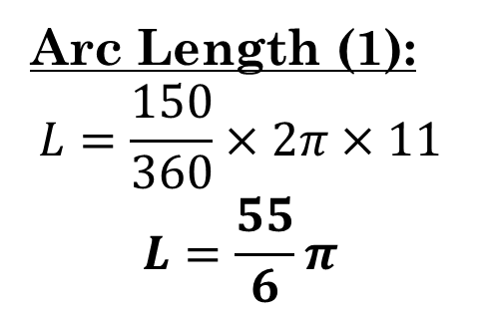
Group Practice:
Find the arc length and area of each chosen sector.
6.)
Arc Length (1):
$$L=\frac{90}{360}×2π×11$$
$$L=\frac{11}{2}π$$
Area of Sector (2):
$$A=\frac{90}{360}×π{×11}^{2}$$
$$A=\frac{121}{4}π$$
$$150°$$
Arc Length (1):
$$L=\frac{150}{360}×2π×11$$
$$L=\frac{55}{6}π$$
Area of Sector (2):
$$A=\frac{150}{360}×π{×11}^{2}$$
$$A=\frac{605}{12}π$$

Slide 16
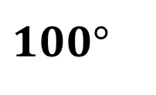
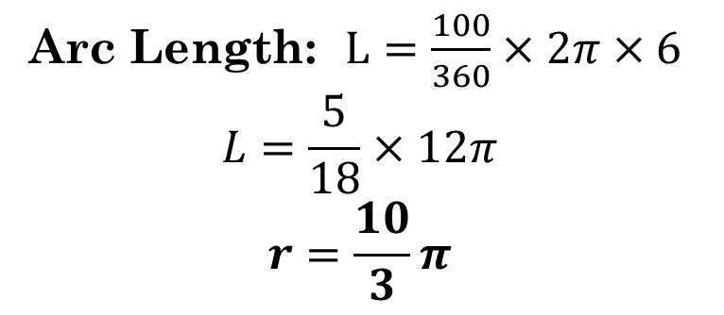
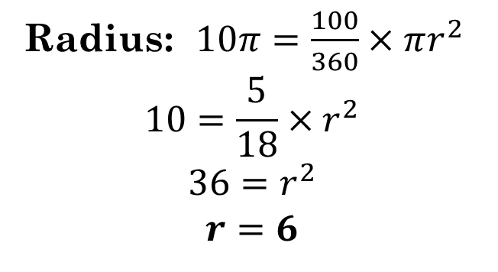
Group Practice:
If given the area of the sector, find the radius and the arc length. If given the arc length, find the radius and the area of the sector
7.)
Given Area of Sector: $10π$
Radius: $10π=\frac{100}{360}×πr^{2}$
$$10=\frac{5}{18}×r^{2}$$
$$36=r^{2}$$
$$r=6$$
Arc Length: $L=\frac{100}{360}×2π×6$
$$L=\frac{5}{18}×12π$$
$$r=\frac{10}{3}π$$
$$100°$$

Slide 17
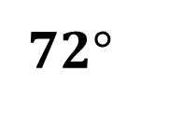
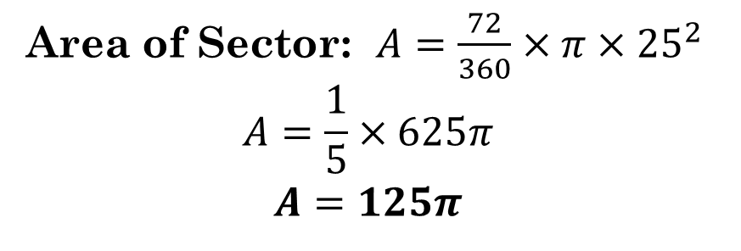
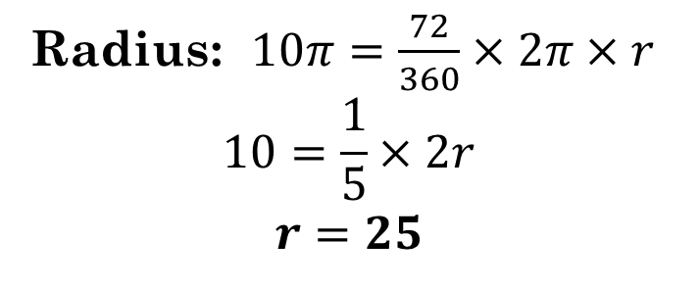
Group Practice:
If given the area of the sector, find the radius and the arc length. If given the arc length, find the radius and the area of the sector
8.)
Given Arc Length: $10π$
Radius: $10π=\frac{72}{360}×2π×r$
$$10=\frac{1}{5}×2r$$
$$r=25$$
Area of Sector: $A=\frac{72}{360}×π{×25}^{2}$
$$A=\frac{1}{5}×625π$$
$$A=125π$$
$$72°$$

Slide 18
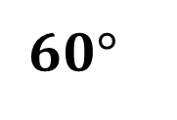
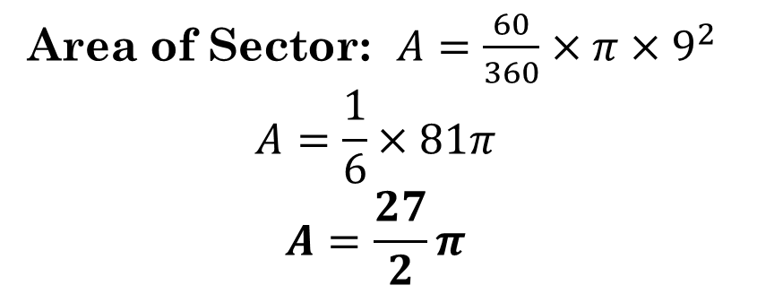
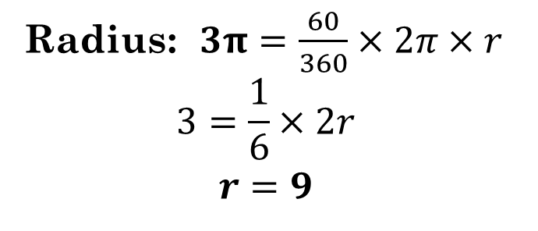
Group Practice:
If given the area of the sector, find the radius and the arc length. If given the arc length, find the radius and the area of the sector
9.)
Given Arc Length: 3$π$
Radius: $3π=\frac{60}{360}×2π×r$
$$3=\frac{1}{6}×2r$$
$$r=9$$
Area of Sector: $A=\frac{60}{360}×π×9^{2}$
$$A=\frac{1}{6}×81π$$
$$A=\frac{27}{2}π$$
$$60°$$

Slide 19
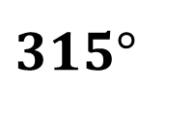
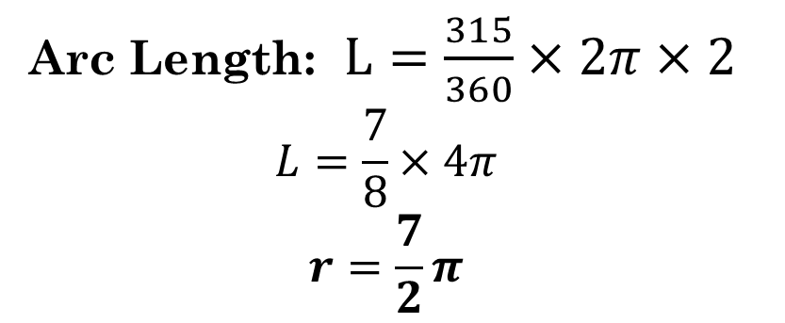
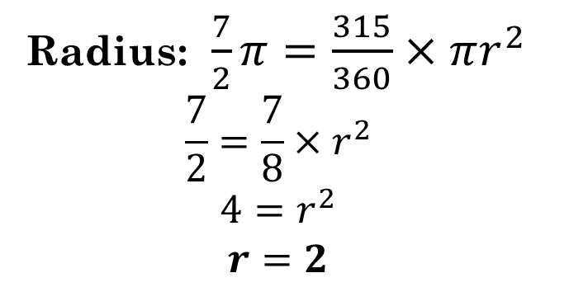
Group Practice:
If given the area of the sector, find the radius and the arc length. If given the arc length, find the radius and the area of the sector
10.)
Given Area of Sector: $\frac{7}{2}π$
Radius: $\frac{7}{2}π=\frac{315}{360}×πr^{2}$
$$\frac{7}{2}=\frac{7}{8}×r^{2}$$
$$4=r^{2}$$
$$r=2$$
$$315°$$
Arc Length: $L=\frac{315}{360}×2π×2$
$$L=\frac{7}{8}×4π$$
$$r=\frac{7}{2}π$$

