Slide 1
Geometry Unit 11
12-1: Area and Volume of Prisms

Slide 2
Area and Volume of Prisms
Content Objective: Students will be able to identify the different types of prisms, as well as the equations for their area and volume.
Language Objective: Students will be able to find the areas and volume of prisms.

Slide 3
Prisms
We will be examining 3 dimensional figures.
The first figure we will be looking at will be the Prisms.
The ends of a prism are called the bases.
These bases are congruent to each other and are parallel.
bases

Slide 4
Prisms
The faces of the prism that are not its bases are known as its lateral faces.
Adjacent lateral faces intersect in parallel segments called lateral edges.
Lateral Edge
Lateral Face

Slide 5
Prisms
An altitude of a prism is a segment joining the planes that contain the bases.
The length of the altitude is the height, h, of the prism.
Altitude
$$h$$

Slide 6
What we will be Calculating.
For prisms, we will be looking for the following values:
1.) Lateral Area: Sum of the areas of the lateral faces
2.) Total Area: The area of the entire prism
Equation: $T.A.=L.A. +2B$
where $B$ is the area of each base.
3.) Volume: The space that can be contained within the prism.

Slide 7
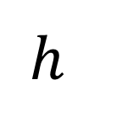
Area of a Prism
Theorem 12-1: The lateral area of a right prism equals
Equation: $A=ph$
the perimeter of a base times the height of the prism.
$$h$$
bases

Slide 8
Volume of a Prism
Theorem 12-2: The volume of a right prism equals
Equation: $V=Bh$
the area of a base times the height of the prism.
$$h$$
bases

Slide 9
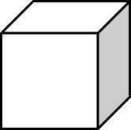
Cubes
A rectangular prism with square faces is known as a cube.
Since each face is a square, then all of its edges have equal length.
The lateral and total areas are found using the same formulas given.
The volume however can be simplified to:
$$V=e^{3}$$
where $e$ represents a single edge
$$e$$

Slide 10
Example
Given a right triangular prism, find the
a.) Lateral Area
b.) Total Area
c.) Volume
10.5
4
7
6.5
15

Slide 11
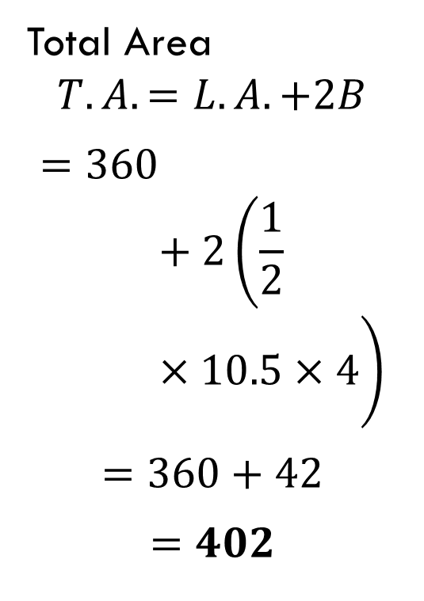
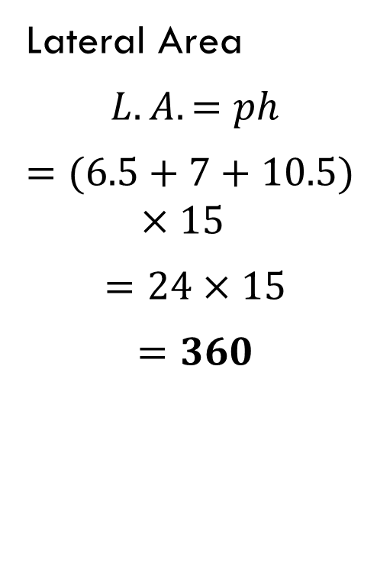
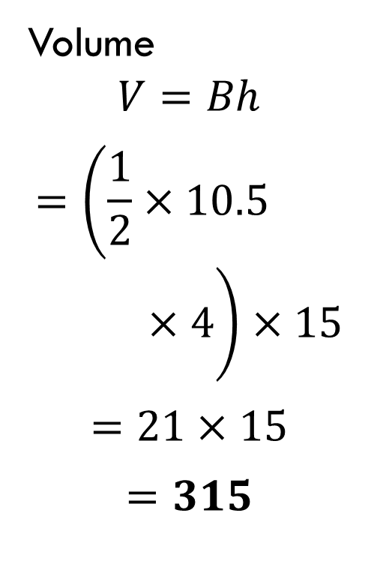
Example #1 Solution
Lateral Area
$$L.A.=ph$$
$$=(6.5+7+10.5)×15$$
$$=24×15$$
$$=360$$
Total Area
$$T.A.=L.A.+2B$$
$$=360+2\left(\frac{1}{2}×10.5×4\right)$$
$$=360+42$$
$$=402$$
Volume
$$V=Bh$$
$$=\left(\frac{1}{2}×10.5×4\right)×15$$
$$=21×15$$
$$=315$$

Slide 12
Example
Given a right trapezoidal prism, find the
a.) Lateral Area
b.) Total Area
c.) Volume
12
4
5
5
6
10

Slide 13
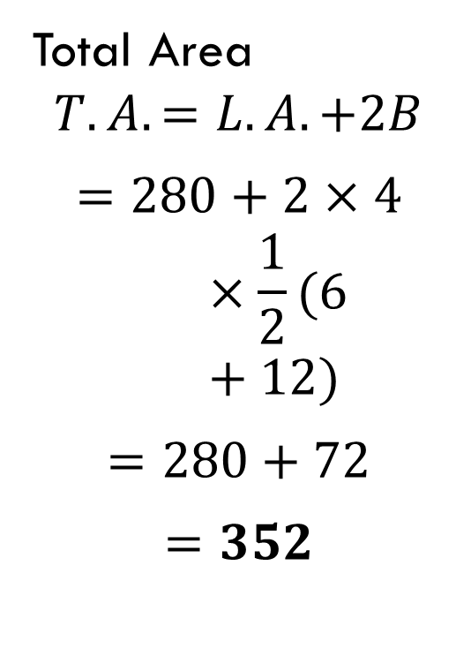
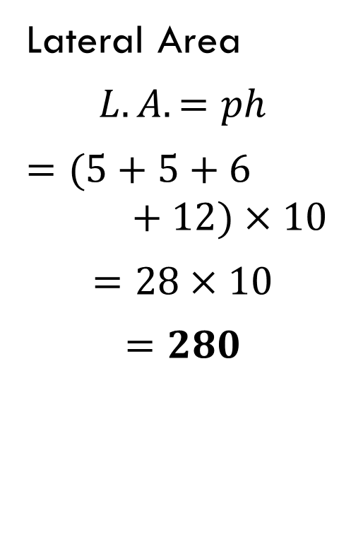
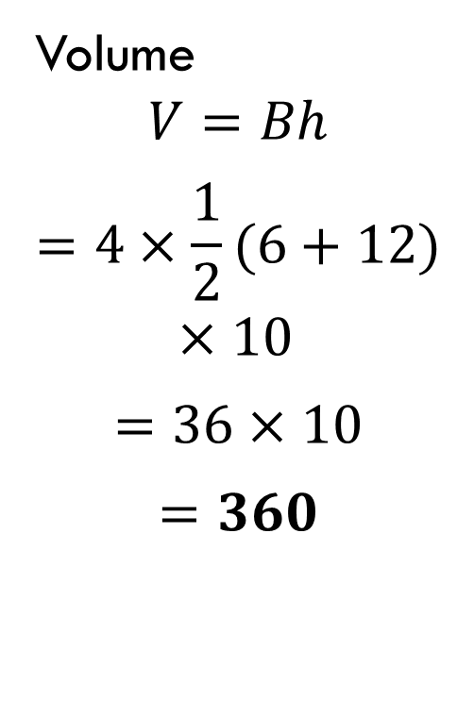
Example #2 Solution
Lateral Area
$$L.A.=ph$$
$$=(5+5+6+12)×10$$
$$=28×10$$
$$=280$$
Total Area
$$T.A.=L.A.+2B$$
$$=280+2×4×\frac{1}{2}(6+12)$$
$$=280+72$$
$$=352$$
Volume
$$V=Bh$$
$$=4×\frac{1}{2}(6+12)×10$$
$$=36×10$$
$$=360$$

Slide 14
Group Practice
For each of the following right prisms, find the
a.) Lateral Area 1.)
b.) Total Area
c.) Volume
16
6
10
10
15

Slide 15
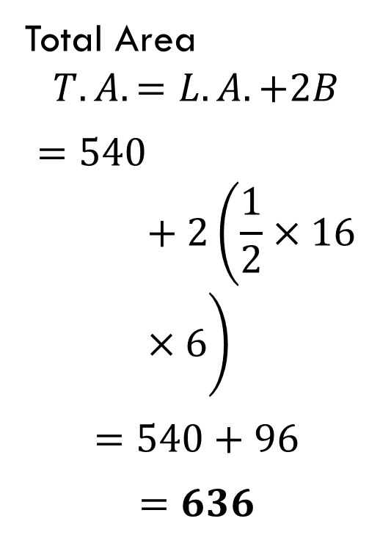
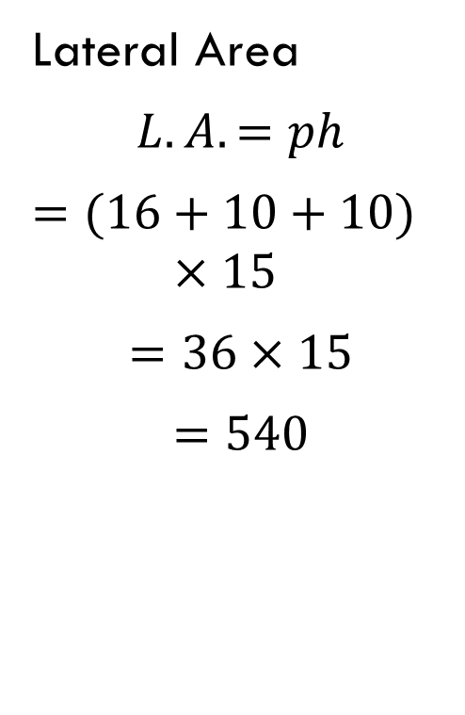
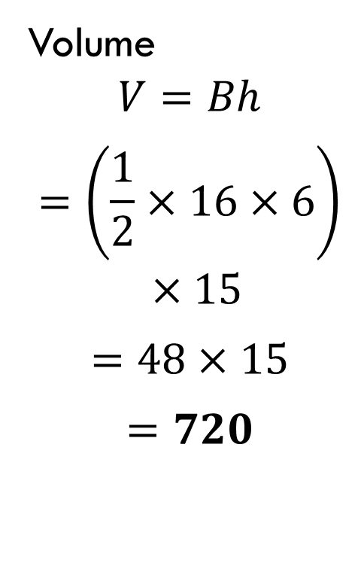
Group #1 Solution
Lateral Area
$$L.A.=ph$$
$$=(16+10+10)×15$$
$$=36×15$$
$$=540$$
Total Area
$$T.A.=L.A.+2B$$
$$=540+2\left(\frac{1}{2}×16×6\right)$$
$$=540+96$$
$$=636$$
Volume
$$V=Bh$$
$$=\left(\frac{1}{2}×16×6\right)×15$$
$$=48×15$$
$$=720$$

Slide 16
Group Practice
For each of the following right prisms, find the
a.) Lateral Area 2.)
b.) Total Area
c.) Volume
$$5$$

Slide 17
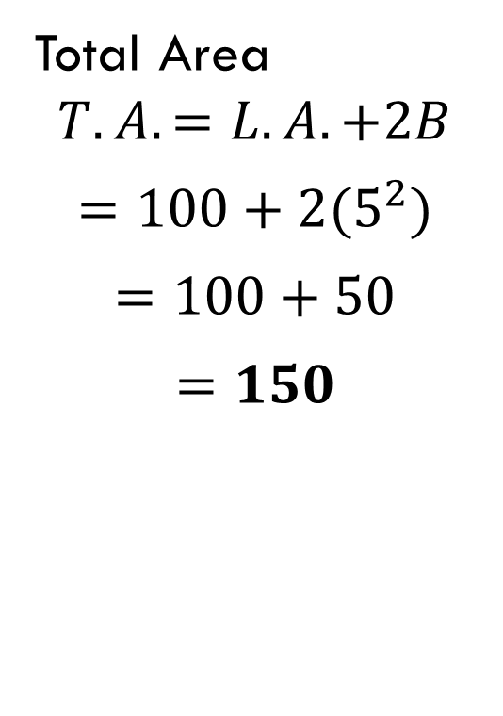
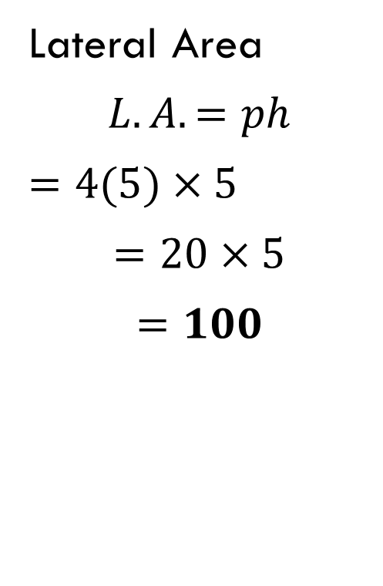

Group #2 Solution
Lateral Area
$$L.A.=ph$$
$$=4(5)×5$$
$$=20×5$$
$$=100$$
Total Area
$$T.A.=L.A.+2B$$
$$=100+2(5^{2})$$
$$=100+50$$
$$=150$$
Volume
$$V=Bh$$
$$=5^{2}×5$$
$$=25×5$$
$$=125$$

Slide 18
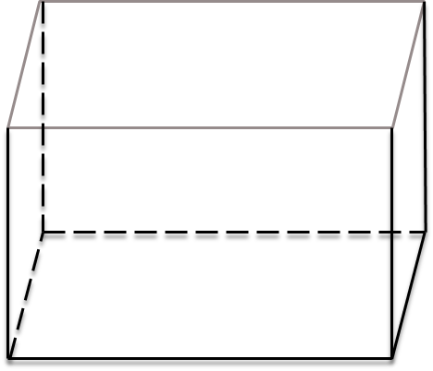
Group Practice
For each of the following right prisms, find the
a.) Lateral Area 3.)
b.) Total Area
c.) Volume
$$2$$
$$3$$
$$4$$
$$6$$

Slide 19
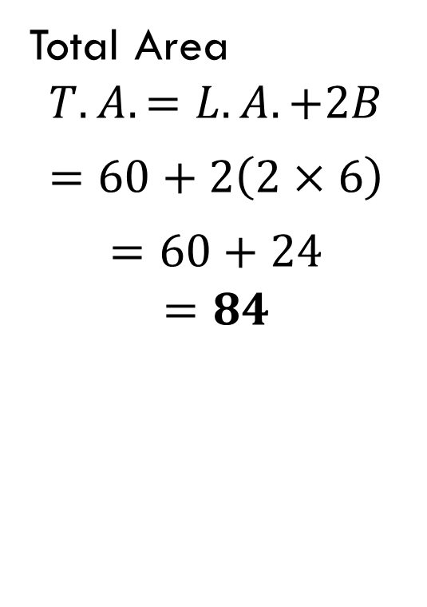
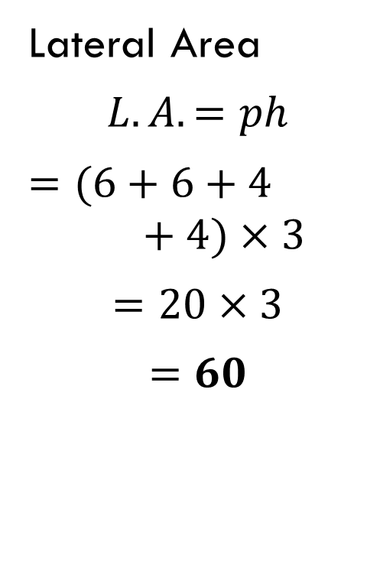
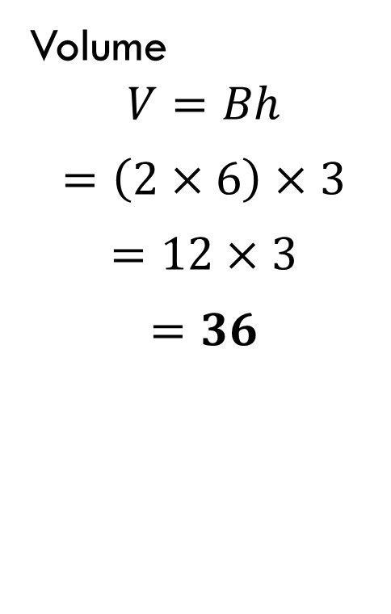
Group #3 Solution
Lateral Area
$$L.A.=ph$$
$$=(6+6+4+4)×3$$
$$=20×3$$
$$=60$$
Total Area
$$T.A.=L.A.+2B$$
$$=60+2\left(2×6\right)$$
$$=60+24$$
$$=84$$
Volume
$$V=Bh$$
$$=\left(2×6\right)×3$$
$$=12×3$$
$$=36$$

Slide 20
Group Practice
For each of the following right prisms, find the
a.) Lateral Area 4.)
b.) Total Area
c.) Volume
$$4$$
$$5$$
$$9$$

Slide 21
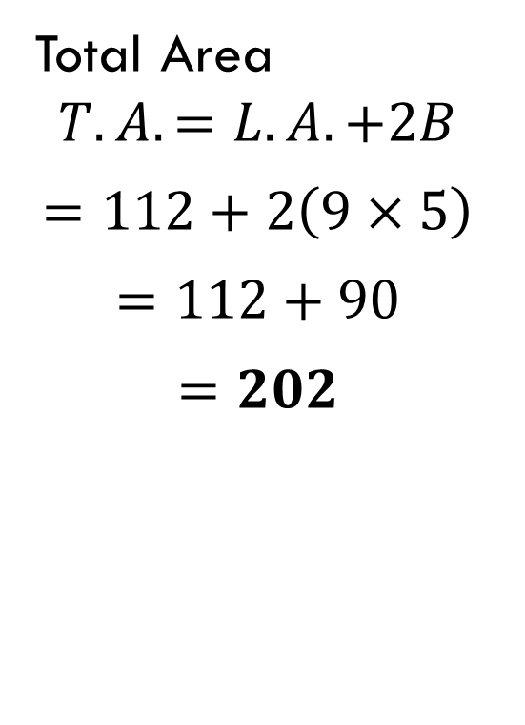
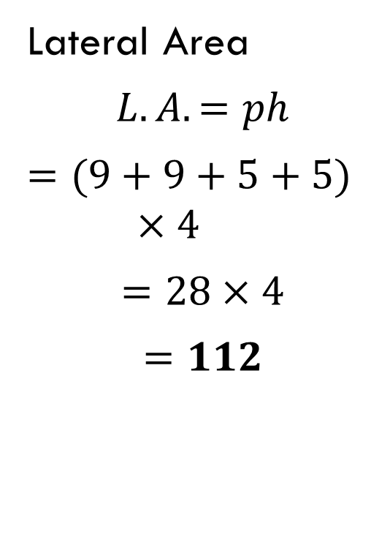
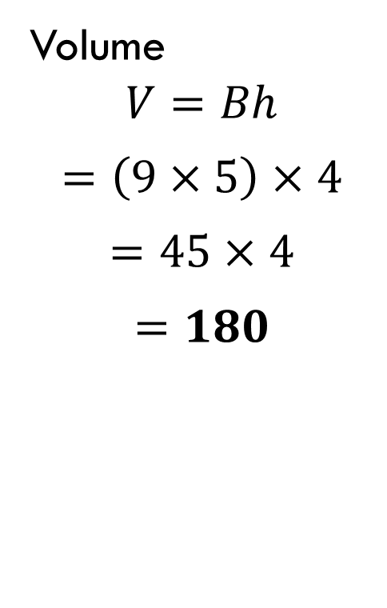
Group #4 Solution
Lateral Area
$$L.A.=ph$$
$$=(9+9+5+5)×4$$
$$=28×4$$
$$=112$$
Total Area
$$T.A.=L.A.+2B$$
$$=112+2\left(9×5\right)$$
$$=112+90$$
$$=202$$
Volume
$$V=Bh$$
$$=\left(9×5\right)×4$$
$$=45×4$$
$$=180$$

Slide 22
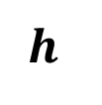
Group Practice
For the following right prisms, you are given lateral area or the volume. First find the height, then find the remaining values. 5.)
Given:
Volume: $V=330$
15
3
5
5
7
$$h$$

Slide 23
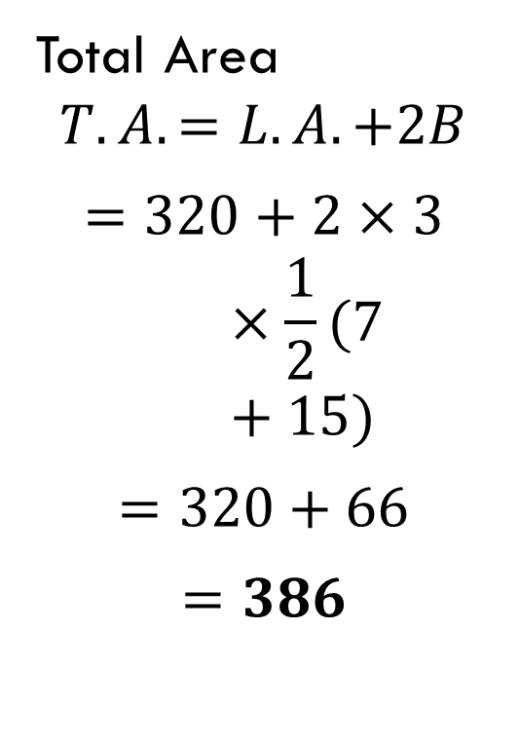
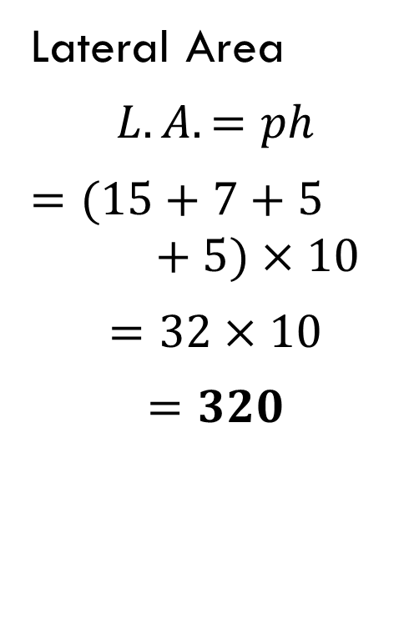
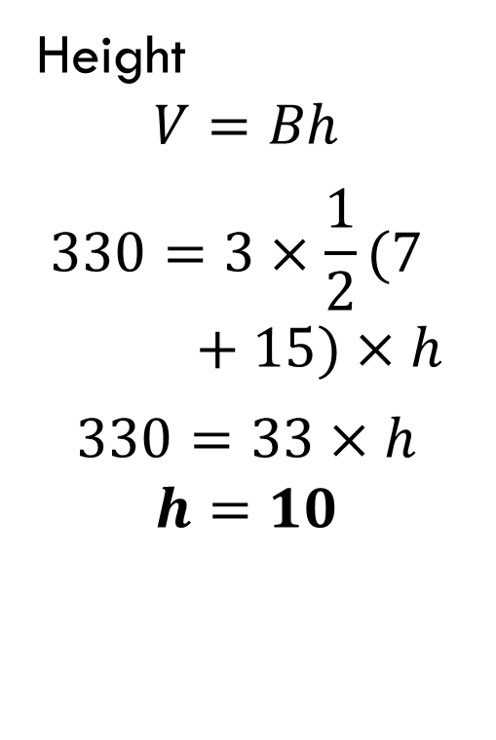
Group #5 Solution
Height
$$V=Bh$$
$$330=3×\frac{1}{2}(7+15)×h$$
$$330=33×h$$
$$h=10$$
Lateral Area
$$L.A.=ph$$
$$=(15+7+5+5)×10$$
$$=32×10$$
$$=320$$
Total Area
$$T.A.=L.A.+2B$$
$$=320+2×3×\frac{1}{2}(7+15)$$
$$=320+66$$
$$=386$$

Slide 24
Group Practice
For the following right prisms, you are given lateral area or the volume. First find the height, then find the remaining values. 6.)
Given:
Lateral Area: $L.A.=66$
$$h$$
$$2$$
$$9$$

Slide 25
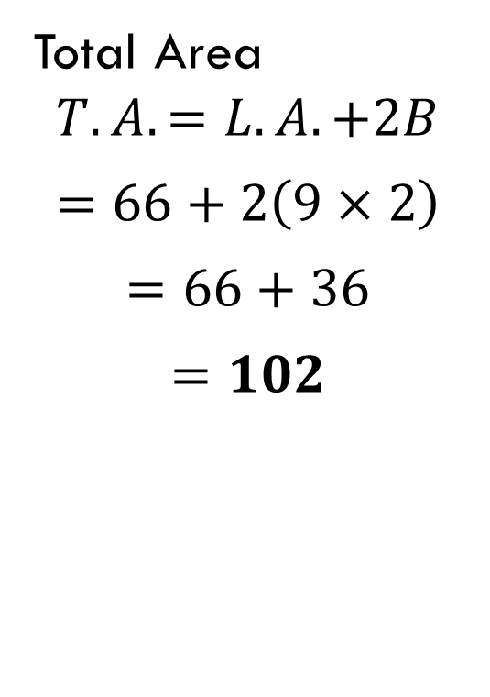
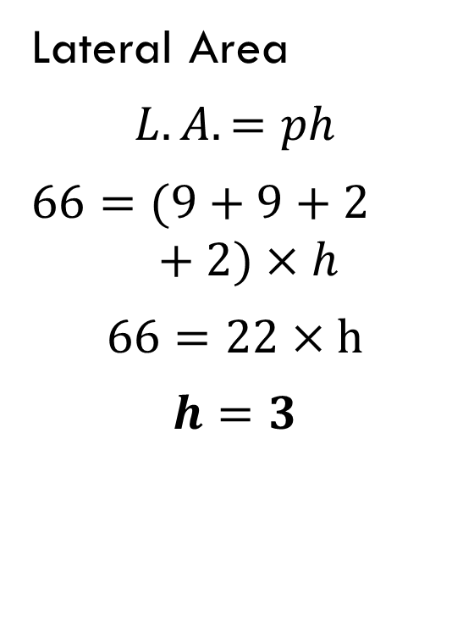
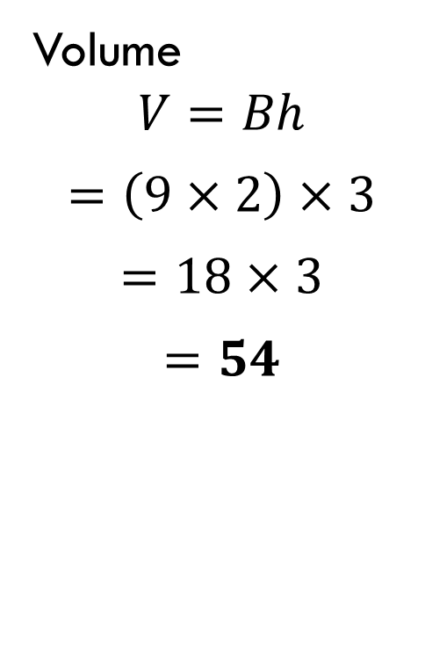
Group #6 Solution
Lateral Area
$$L.A.=ph$$
$$66=(9+9+2+2)×h$$
$$66=22×h$$
$$h=3$$
Total Area
$$T.A.=L.A.+2B$$
$$=66+2\left(9×2\right)$$
$$=66+36$$
$$=102$$
Volume
$$V=Bh$$
$$=\left(9×2\right)×3$$
$$=18×3$$
$$=54$$

