Slide 1
Geometry Unit 11
12-2: Area and Volume of Pyramids

Slide 2
Area and Volume of Pyramids
Content Objective: Students will be able to identify the parts required for finding the areas and volume of Regular Pyramids.
Language Objective: Students will be able to use equations to find the areas and volume of Regular Pyramids.

Slide 3
Pyramids
Our next figure is a Pyramid
It only has one base, but that base can be any polygon.
The lateral faces are all triangles.
It has a vertex (i.e. The point where all the lateral edges meet).

Slide 4
Pyramids
Refer to this example (a regular square Pyramid):
The base is a regular polygon.
*This means that all the sides of the base are congruent.
All lateral edges are congruent.
All lateral faces are congruent Isosceles Triangles.

Slide 5
Pyramids
Refer to this example (a regular square Pyramid):
The height of a lateral face is called the Slant Height.
*(Slant Height is denoted by the letter $l$)
The altitude (or height) meets the base at its center.
$$h$$
$$l$$

Slide 6
Area of a Pyramid
Theorem 12-3: The lateral area of a pyramid equals
Equation: $L.A.=\frac{1}{2}pl$
half the perimeter of the base times the slant height.
$$l$$

Slide 7

Volume of a Pyramid
Theorem 12-4: The volume of a pyramid equals
Equation: $V=\frac{1}{3}Bh$
one third the area of the base times the height of the pyramid.
$$h$$

Slide 8
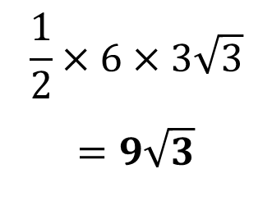

Practice
For the following regular pyramids, First find the values listed, then find the
a.) Lateral Area 1.)
b.) Total Area
c.) Volume
$$p=$$
$$l=$$
$$h=$$
$$B=$$
18
9
8
9
8
$$\frac{1}{2}×6×3\sqrt{3}$$
$$=9\sqrt{3}$$
6

Slide 9

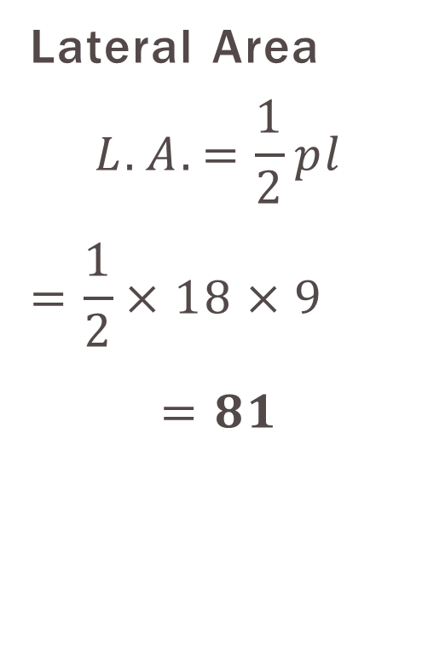
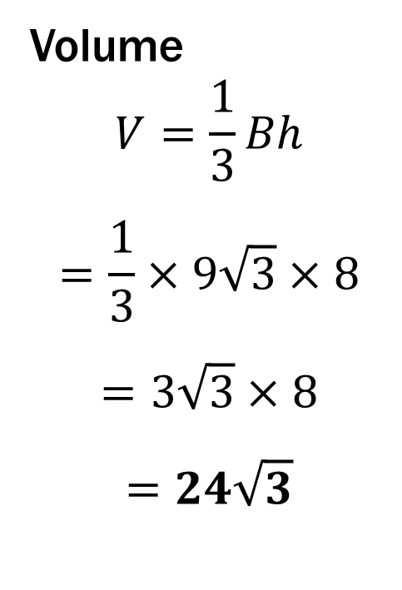
Example #1 Solution
Lateral Area
$$L.A.=\frac{1}{2}pl$$
$$=\frac{1}{2}×18×9$$
$$=81$$
Total Area
$$T.A.=L.A.+B$$
$$=81+9\sqrt{3}$$
$$≈96.59$$
Volume
$$V=\frac{1}{3}Bh$$
$$=\frac{1}{3}×9\sqrt{3}×8$$
$$=3\sqrt{3}×8$$
$$=24\sqrt{3}$$

Slide 10
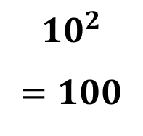

Practice
For the following regular pyramids, First find the values listed, then find the
a.) Lateral Area 2.)
b.) Total Area
c.) Volume
$$p=$$
$$l=$$
$$h=$$
$$B=$$
40
15
15
9
$${10}^{2}$$
$$=100$$
9
10

Slide 11

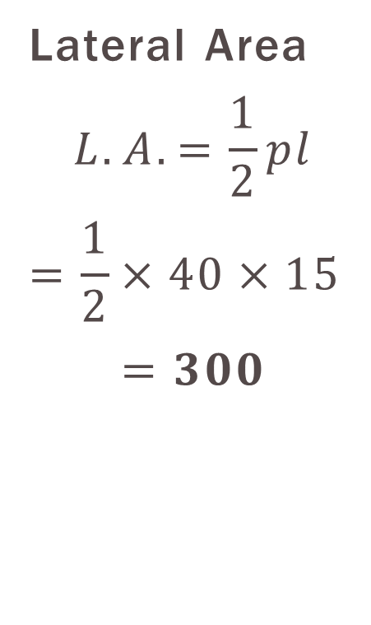
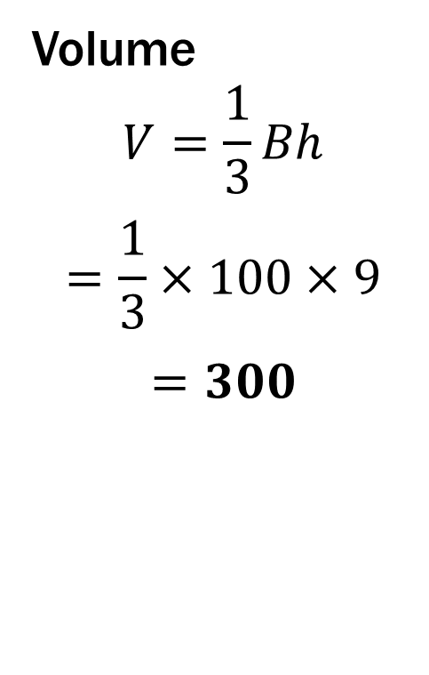
Example #2 Solution
Lateral Area
$$L.A.=\frac{1}{2}pl$$
$$=\frac{1}{2}×40×15$$
$$=300$$
Total Area
$$T.A.=L.A.+B$$
$$=300+100$$
$$=400$$
Volume
$$V=\frac{1}{3}Bh$$
$$=\frac{1}{3}×100×9$$
$$=300$$

Slide 12
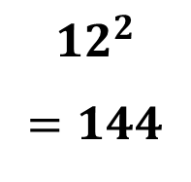
Group Practice
For the following regular pyramids, First find the values listed, then find the
a.) Lateral Area 1.)
b.) Total Area
c.) Volume
$$p=$$
$$l=$$
$$h=$$
$$B=$$
48
13.3
13.3
9.5
9.5
$${12}^{2}$$
$$=144$$
12

Slide 13

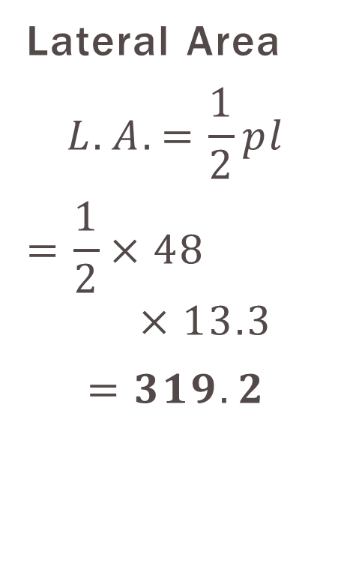
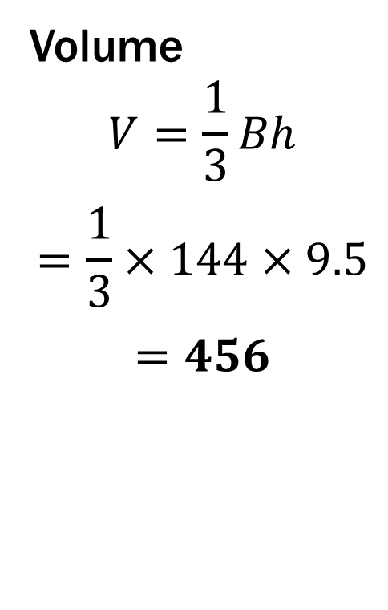
Group #1 Solution
Lateral Area
$$L.A.=\frac{1}{2}pl$$
$$=\frac{1}{2}×48×13.3$$
$$=319.2$$
Total Area
$$T.A.=L.A.+B$$
$$=319.2+144$$
$$=463.2$$
Volume
$$V=\frac{1}{3}Bh$$
$$=\frac{1}{3}×144×9.5$$
$$=456$$

Slide 14
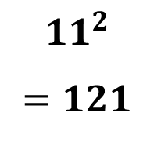
Group Practice
For the following regular pyramids, First find the values listed, then find the
a.) Lateral Area 2.)
b.) Total Area
c.) Volume
$$p=$$
$$l=$$
$$h=$$
$$B=$$
44
9
7.5
7.5
9
$${11}^{2}$$
$$=121$$
11

Slide 15

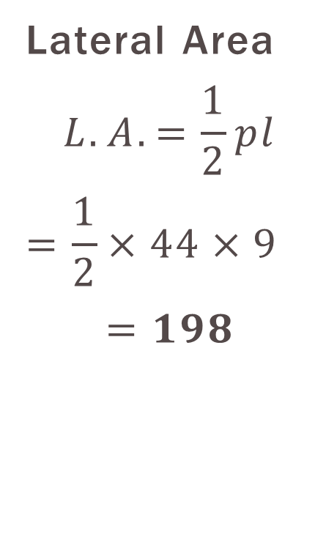
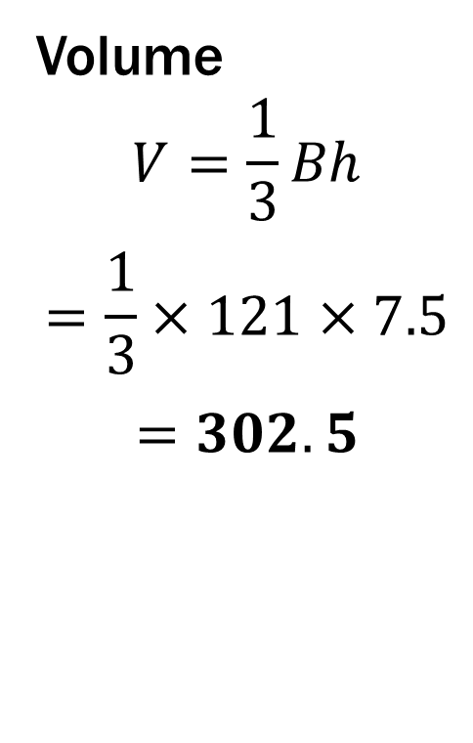
Group #2 Solution
Lateral Area
$$L.A.=\frac{1}{2}pl$$
$$=\frac{1}{2}×44×9$$
$$=198$$
Total Area
$$T.A.=L.A.+B$$
$$=198+121$$
$$=319$$
Volume
$$V=\frac{1}{3}Bh$$
$$=\frac{1}{3}×121×7.5$$
$$=302.5$$

Slide 16
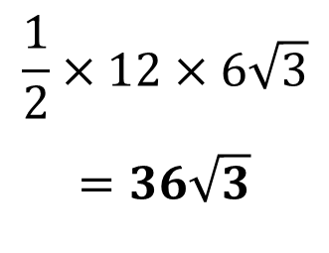

Group Practice
For the following regular pyramids, First find the values listed, then find the
a.) Lateral Area 3.)
b.) Total Area
c.) Volume
$$p=$$
$$l=$$
$$h=$$
$$B=$$
36
8
6
8
6
$$\frac{1}{2}×12×6\sqrt{3}$$
$$=36\sqrt{3}$$
12

Slide 17

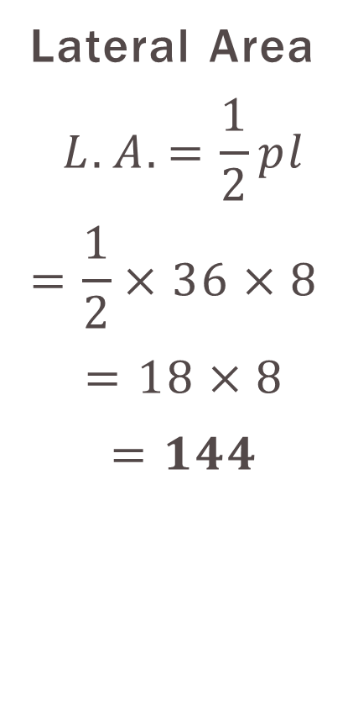
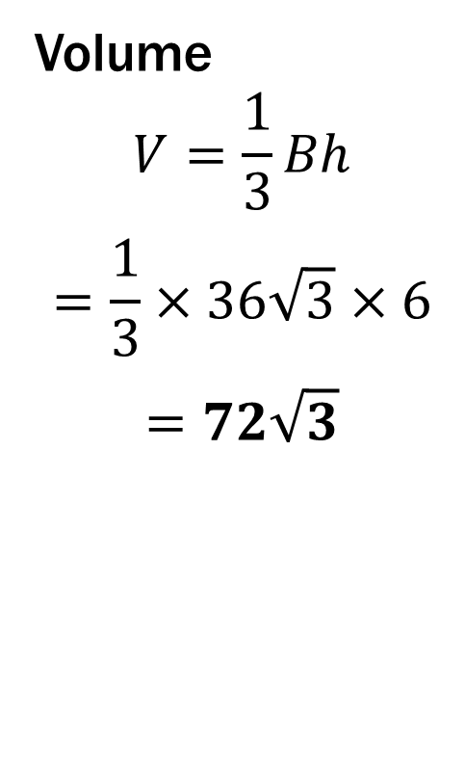
Group #3 Solution
Lateral Area
$$L.A.=\frac{1}{2}pl$$
$$=\frac{1}{2}×36×8$$
$$=18×8$$
$$=144$$
Total Area
$$T.A.=L.A.+B$$
$$=144+36\sqrt{3}$$
$$≈206.35$$
Volume
$$V=\frac{1}{3}Bh$$
$$=\frac{1}{3}×36\sqrt{3}×6$$
$$=72\sqrt{3}$$

Slide 18

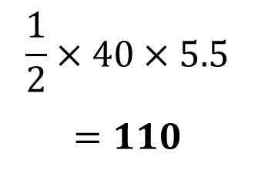
Group Practice
For the following regular pyramids, First find the values listed, then find the
a.) Lateral Area 4.)
b.) Total Area
c.) Volume
$$p=$$
$$l=$$
$$h=$$
$$B=$$
40
10.6
7
$$\frac{1}{2}×40×5.5$$
$$=110$$
7 ft

Slide 19

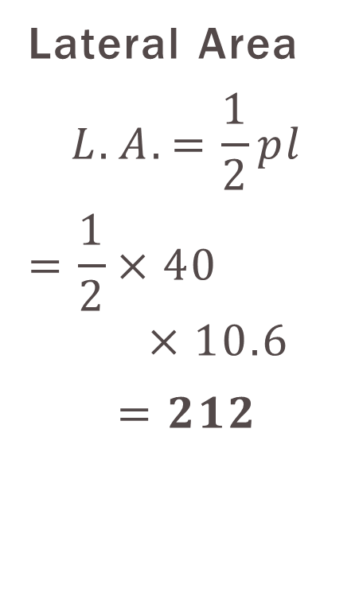
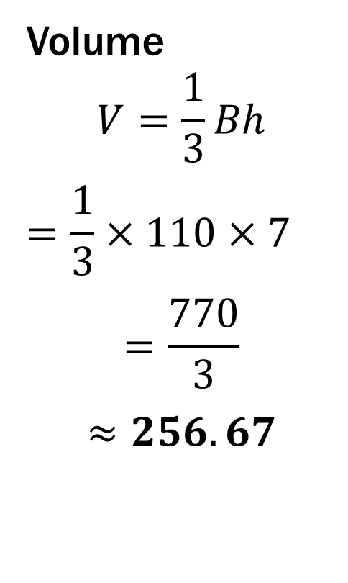
Group #4 Solution
Lateral Area
$$L.A.=\frac{1}{2}pl$$
$$=\frac{1}{2}×40×10.6$$
$$=212$$
Total Area
$$T.A.=L.A.+B$$
$$=212+110$$
$$=322$$
Volume
$$V=\frac{1}{3}Bh$$
$$=\frac{1}{3}×110×7$$
$$=\frac{770}{3}$$
$$≈256.67$$

Slide 20

Group Practice
For the following regular pyramids, First find the values listed, then find the
a.) Lateral Area 5.)
b.) Total Area
c.) Volume
$$p=$$
$$l=$$
$$h=$$
$$B=$$
72
15
15
12
324
18

Slide 21

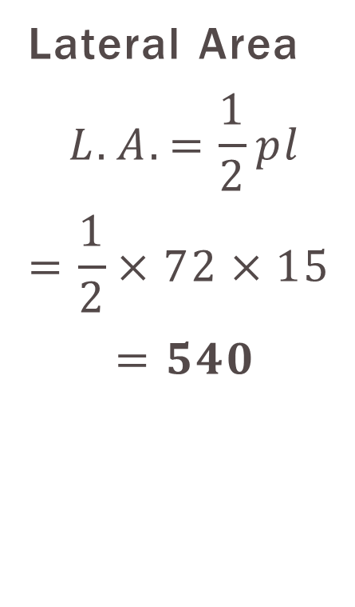
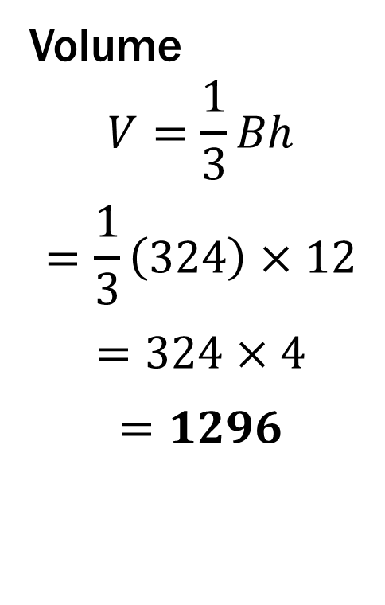
Group #5 Solution
Lateral Area
$$L.A.=\frac{1}{2}pl$$
$$=\frac{1}{2}×72×15$$
$$=540$$
Total Area
$$T.A.=L.A.+B$$
$$=540+324$$
$$=864$$
Volume
$$V=\frac{1}{3}Bh$$
$$=\frac{1}{3}\left(324\right)×12$$
$$=324×4$$
$$=1296$$

Slide 22

Group Practice
For the following regular pyramids, First find the values listed, then find the
a.) Lateral Area 6.)
b.) Total Area
c.) Volume
$$p=$$
$$l=$$
$$h=$$
$$B=$$
100
20
16
16
600
20
12

Slide 23
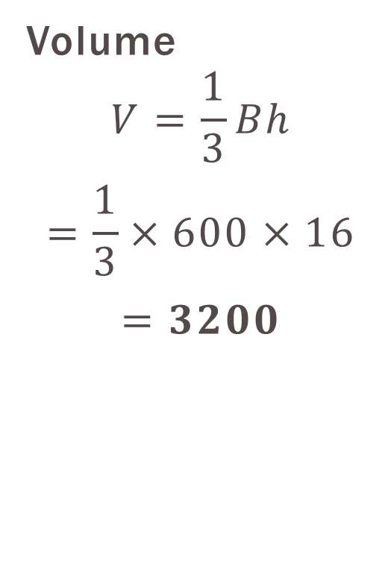
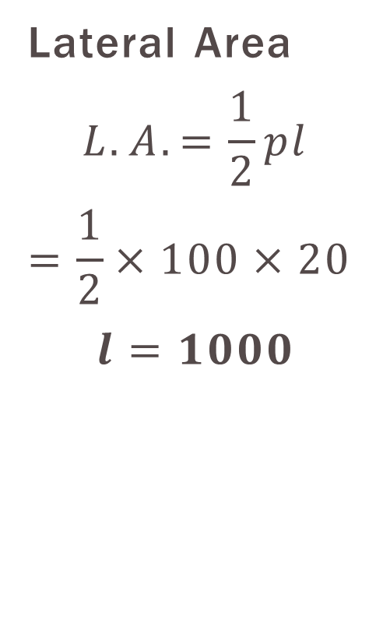

Group #6 Solution
Lateral Area
$$L.A.=\frac{1}{2}pl$$
$$=\frac{1}{2}×100×20$$
$$l=1000$$
Total Area
$$T.A.=L.A.+B$$
$$=1000+600$$
$$=1600$$
Volume
$$V=\frac{1}{3}Bh$$
$$=\frac{1}{3}×600×16$$
$$=3200$$

