Slide 1
Geometry Unit 11
12-3: Area and Volume of Cylinders and Cones

Slide 2
12.1 – 12.2 Warm -up
Complete the worksheet provided
*Keep the backside for your notes.

Slide 3
Cylinders and Cones
Content Objective: Students will be able to compare and contrast cylinders and cones to prisms and pyramids to determine their area and volume equations.
Language Objective: Students will be able to use equations to solve for the areas and volume of cylinders and cones.

Slide 4
Cylinders – A Introduction
For the following diagrams, compare and contrast a Right Prism to a Cylinder.
Discuss your thoughts in your group, and take notes of your thoughts in the space provided.
For the discussion, focus on these questions:
What do you notice about each the cylinder?
How do its parts compare to that of the prism? How do they differ?
$$h$$
bases
Right Prism
Cylinder

Slide 5
Cylinders
A Cylinder shares similar properties to the right prism.
It has two bases, and these bases are always circles.
The line segment joining the bases is the height, h.
The radius of the base is also the radius of the cylinder.
*How would the lateral area and volume of a cylinder be similar to those of Prisms?
$$h$$
bases
$$h$$
bases
$$r$$
Right Prism
Cylinder

Slide 6
Cylinders – Lateral Area
Theorem 12-5: The lateral area of a cylinder equals the
circumference of a base time the height of the cylinder.
Equation: $L.A. =2πrh$
$$h$$
*Total Area: $T.A. =L.A. + 2B$
$$r$$

Slide 7
Cylinders – Volume
Theorem 12-6: The volume of a cylinder equals the
area of a base time the height of the cylinder.
Equation: $V=πr^{2}h$
$$h$$
$$r$$

Slide 8
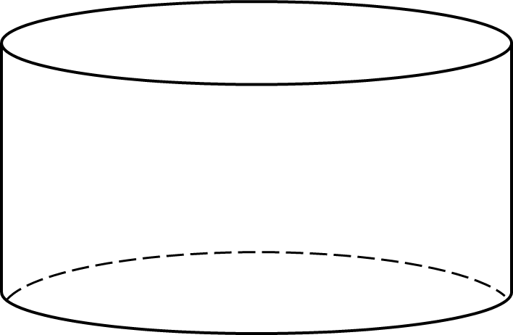
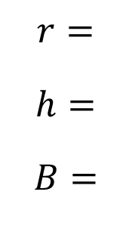
Cylinders – Examples
For the following Cylinders, find the
a.) Lateral Area 1.)
b.) Total Area
c.) Volume
$$r=$$
$$h=$$
$$B=$$
8
7
$$7$$
$$π\left(8^{2}\right)=64π$$
$$8$$

Slide 9
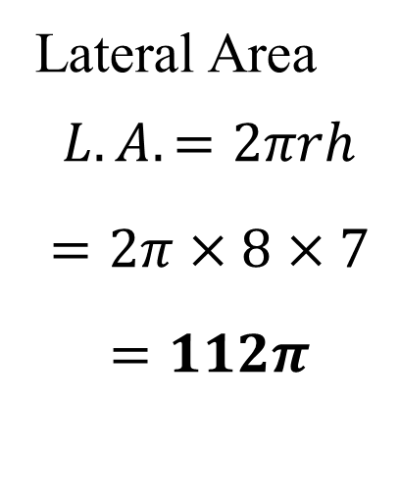

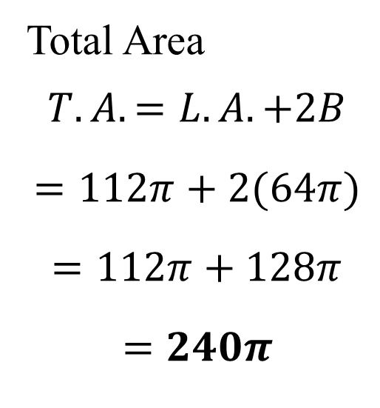
Cylinder Example #1 Solution
Lateral Area
$$L.A. =2πrh$$
$$=2π×8×7$$
$$=112π$$
Total Area
$$T.A.=L.A. +2B$$
$$=112π+2(64π)$$
$$=112π+128π$$
$$=240π$$
Volume
$$V=πr^{2}h$$
$$=64π×7$$
$$=448π$$

Slide 10
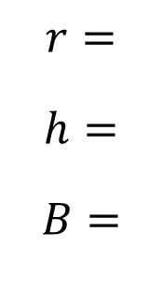
Cylinders – Examples
For the following Cylinders, find the
a.) Lateral Area 2.)
b.) Total Area
c.) Volume
$$r=$$
$$h=$$
$$B=$$
6
15
$$π\left(6^{2}\right)=36π$$
$$15$$
$$12$$

Slide 11
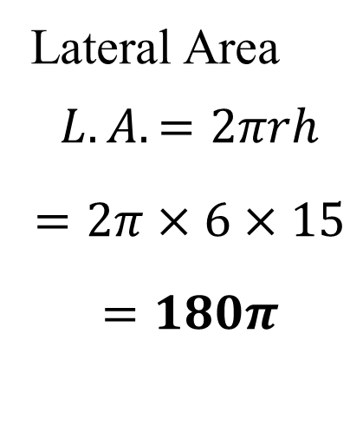

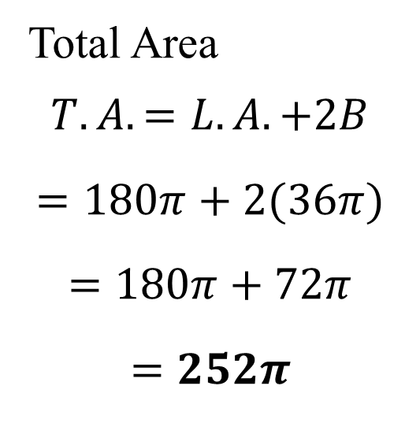
Cylinder Example #2 Solution
Lateral Area
$$L.A. =2πrh$$
$$=2π×6×15$$
$$=180π$$
Total Area
$$T.A.=L.A. +2B$$
$$=180π+2(36π)$$
$$=180π+72π$$
$$=252π$$
Volume
$$V=πr^{2}h$$
$$=36π×15$$
$$=540π$$

Slide 12
Cones
For the following diagrams, compare and contrast a Regular Pyramid to a Cone.
Discuss your thoughts in your group, and take notes of your thoughts in the space provided.
For the discussion, focus on these questions:
What do you notice about each the cone?
How do its parts compare to that of the pyramid? How do they differ?
Regular Pyramid
Cone
$$h$$
$$l$$

Slide 13
Cones
A Cone shares similar properties to the regular pyramid.
It has a single bases, and that base will always be a circle.
The line segment joining the vertex to the base is the height, $h$.
The segment joining the vertex to an end of the diameter of the base is the slant height, $l$.
The radius of the base is also the radius of the cylinder.
*How would the lateral area and volume of a cone be similar to those of pyramids?
Regular Pyramid
Cone
$$l$$
$$h$$
$$h$$
$$l$$
$$r$$

Slide 14
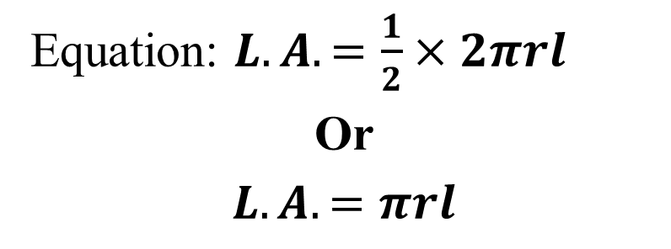
Cones – Lateral Area
Theorem 12-7: The lateral area of a cone equals
half the circumference of the base time the slant height.
Equation: $L.A. =\frac{1}{2}×2πrl$
Or
$$L.A.=πrl$$
$$l$$
*Total Area: $T.A. =L.A. + B$
$$r$$

Slide 15
Cones – Volume
Theorem 12-8: The volume of a cones equals
one third the area of the base times the height of the cone.
Equation: $V=\frac{1}{3}πr^{2}h$
$$h$$
$$r$$

Slide 16
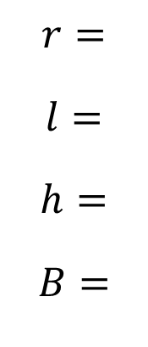
Cones – Examples
For the following Cones, find the
a.) Lateral Area 1.)
b.) Total Area
c.) Volume
$$r=$$
$$l=$$
$$h=$$
$$B=$$
3
$$14$$
14
$$10$$
10
$$π\left(3^{2}\right)=9π$$
$$6$$

Slide 17
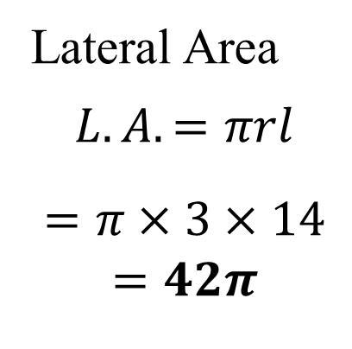
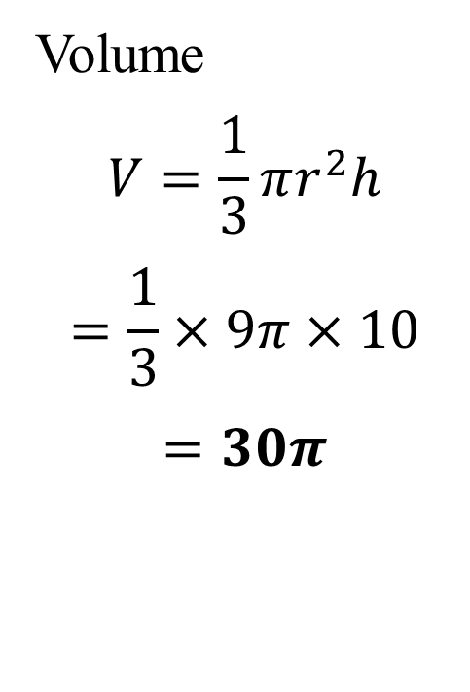
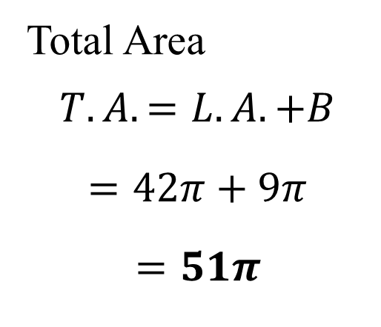
Cone Example #1 Solution
Lateral Area
$$L.A.=πrl$$
$$=π×3×14$$
$$=42π$$
Total Area
$$T.A.=L.A. +B$$
$$=42π+9π$$
$$=51π$$
Volume
$$V=\frac{1}{3}πr^{2}h$$
$$=\frac{1}{3}×9π×10$$
$$=30π$$

Slide 18
Cones – Examples
For the following Cones, find the
a.) Lateral Area 2.)
b.) Total Area
c.) Volume
$$r=$$
$$l=$$
$$h=$$
$$B=$$
5
$$l$$
13
$$12$$
12
$$π\left(5^{2}\right)=25π$$
$$5$$

Slide 19
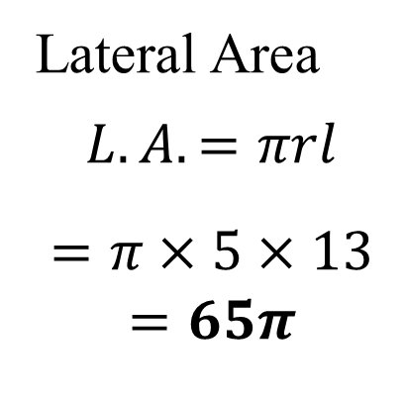
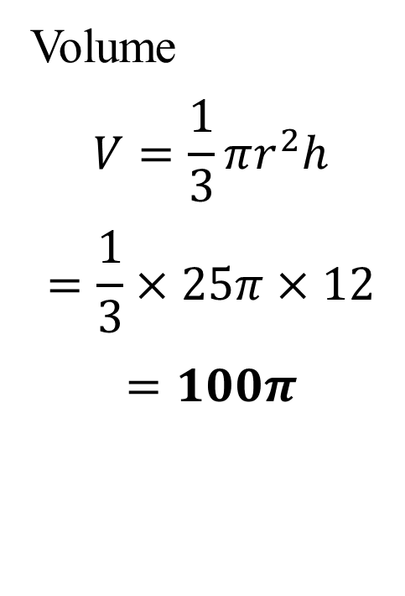
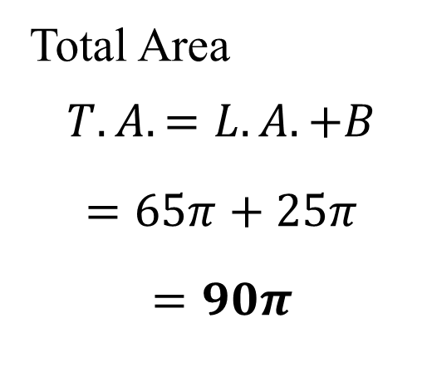
Cone Example #1 Solution
Lateral Area
$$L.A.=πrl$$
$$=π×5×13$$
$$=65π$$
Total Area
$$T.A.=L.A. +B$$
$$=65π+25π$$
$$=90π$$
Volume
$$V=\frac{1}{3}πr^{2}h$$
$$=\frac{1}{3}×25π×12$$
$$=100π$$

