Slide 1
Geometry Unit 11
12-4: Area and volume of Spheres

Slide 2
Warm-up
Each group will be given an example of the object that we will be working with today…
A Sphere
Make some observations about these spheres and discuss them with your group.
Focus your discussion on these questions:
What do you notice about the sphere?
How is it similar to the other shapes we have looked at in this chapter? How is it different?

Slide 3
Area and Volume of Spheres
Content Objective: Students will be able to identify the similarities between spheres and circles.
Language Objective: Students will be able to use equations to solve for the area and volume of spheres.

Slide 4
Spheres
A sphere with O and r is the set of all points in a space at a distance from point .
Many of the terms used with spheres are the same as those used with circles.
center
radius
$$r$$
$$O$$
$$r$$
O

Slide 5

Spheres
Radii
$\overline{OA}$, $\overline{OB}$, and $\overline{OD}$ are
$\overline{BD}$ is a
$\overline{BC}$ is a
$\overset{⃡}{BC}$ is a
$\overset{⃡}{AT}$ is a
$\overline{AT}$ is a
Diameter
A
D
Chord
T
Secant
O
Tangent
Tangent Segment
C
B

Slide 6
Spheres
Why?
Spheres have no lateral faces.
Thus we do not have a lateral area to calculate.
For Spheres, we only calculate the Total Area, or just Area, and the Volume.
$$r$$
O

Slide 7
Spheres - Area
Theorem 12-9: The area of a sphere equals
Equations: $A=4πr^{2}$
$4π$ times the square of the radius.
$$r$$
O

Slide 8
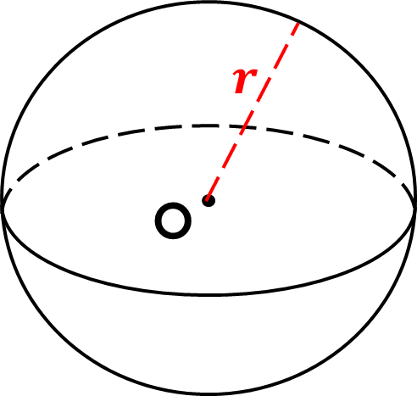
Spheres - Volume
Theorem 12-10: The volume of a sphere equals
Equations: $V=\frac{4}{3}πr^{3}$
$\frac{4}{3}π$ times the cube of the radius.

Slide 9

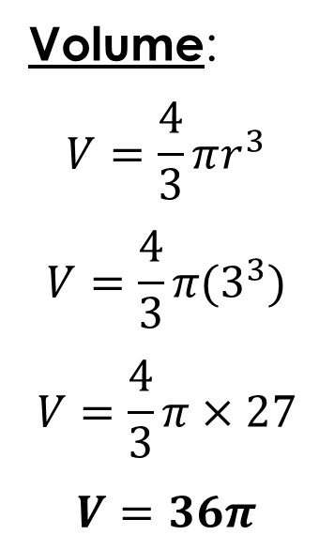
Practice
Find the Area and Volume of the following Spheres.
1.)
Area:
$$A=4πr^{2}$$
$$A=4π{(3}^{2})$$
$A=36π$
Volume:
$$V=\frac{4}{3}πr^{3}$$
$$V=\frac{4}{3}π{(3}^{3})$$
$$V=\frac{4}{3}π×27$$
$V=36π$
$$3$$

Slide 10
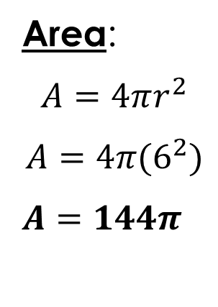

Practice
Find the Area and Volume of the following Spheres.
2.)
Area:
$$A=4πr^{2}$$
$$A=4π{(6}^{2})$$
$A=144π$
Volume:
$$V=\frac{4}{3}πr^{3}$$
$$V=\frac{4}{3}π{(6}^{3})$$
$$V=\frac{4}{3}π×216$$
$V=288π$
$$12$$

Slide 11

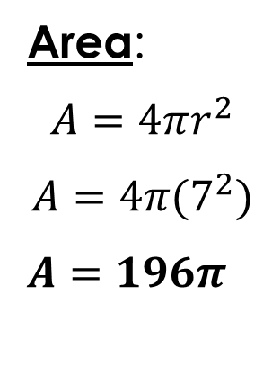
Group Practice
Find the Area and Volume of the following Spheres in your groups.
1.)
Area:
$$A=4πr^{2}$$
$$A=4π{(7}^{2})$$
$A=196π$
Volume:
$$V=\frac{4}{3}πr^{3}$$
$$V=\frac{4}{3}π{(7}^{3})$$
$$V=\frac{4}{3}π×343$$
$V=\frac{1372}{3}π$
$$7$$

Slide 12

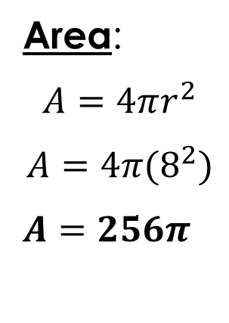
Group Practice
Find the Area and Volume of the following Spheres in your groups.
2.)
Area:
$$A=4πr^{2}$$
$$A=4π{(8}^{2})$$
$A=256π$
Volume:
$$V=\frac{4}{3}πr^{3}$$
$$V=\frac{4}{3}π{(8}^{3})$$
$$V=\frac{4}{3}π×512$$
$V=\frac{2048}{3}π$
$$8$$

Slide 13


Group Practice
Find the Area and Volume of the following Spheres in your groups.
3.)
Area:
$$A=4πr^{2}$$
$$A=4π{(10}^{2})$$
$A=400π$
Volume:
$$V=\frac{4}{3}πr^{3}$$
$$V=\frac{4}{3}π{(10}^{3})$$
$$V=\frac{4}{3}π×1000$$
$V=\frac{4000}{3}π$
$$10$$

Slide 14


Group Practice
Find the Area and Volume of the following Spheres in your groups.
4.)
Area:
$$A=4πr^{2}$$
$$A=4π{(9}^{2})$$
$A=324π$
Volume:
$$V=\frac{4}{3}πr^{3}$$
$$V=\frac{4}{3}π{(9}^{3})$$
$$V=\frac{4}{3}π×729$$
$V=972π$
$$18$$

Slide 15


Group Practice
Find the Area and Volume of the following Spheres in your groups.
5.)
Area:
$$A=4πr^{2}$$
$$A=4π{(12}^{2})$$
$A=576π$
Volume:
$$V=\frac{4}{3}πr^{3}$$
$$V=\frac{4}{3}π{(12}^{3})$$
$$V=\frac{4}{3}π×1728$$
$V=2304π$
$$24$$

Slide 16


Group Practice
Find the Area and Volume of the following Spheres in your groups.
6.)
Area:
$$A=4πr^{2}$$
$$A=4π{(6.2}^{2})$$
$A=153.76π$
Volume:
$$V=\frac{4}{3}πr^{3}$$
$$V=\frac{4}{3}π{(6.2}^{3})$$
$$V=\frac{4}{3}π×238.328$$
$V=317.77π$
$$6.2$$

Slide 17


Group Practice
7.) A sphere with diameter of 15.6. Find the area and volume.
Area:
$$A=4πr^{2}$$
$$A=4π{(7.8}^{2})$$
$A=243.36π$
Volume:
$$V=\frac{4}{3}πr^{3}$$
$$V=\frac{4}{3}π{(7.8}^{3})$$
$$V=\frac{4}{3}π×474.552$$
$V=632.736π$
$$r=7.8$$

Slide 18


Group Practice
8.) A sphere has a volume of $\frac{1372π}{3}$. Find the radius and the area.
Radius:
$$V=\frac{4}{3}πr^{3}$$
$$\frac{1372π}{3}=\frac{4}{3}πr^{3}$$
$$1372=4r^{3}$$
$$343=r^{3}$$
$$r=7$$
Area:
$$A=4πr^{2}$$
$$A=4π{(7}^{2})$$
$A=196π$

Slide 19


Group Practice
9.) A sphere has an area of $144π$. Find the radius and volume.
Radius:
$$A=4πr^{2}$$
$$144π=4πr^{2}$$
$$36=r^{2}$$
$r=6$
Volume:
$$V=\frac{4}{3}πr^{3}$$
$$V=\frac{4}{3}π(6^{3})$$
$$V=\frac{4}{3}π×216$$
$$V=288π$$

