Slide 1
Geometry Unit 11
12-5: Area and Volumes of Similar Solids

Slide 2
Warm-up
Look at the following shapes and answer the following questions:
What do you notice about the shapes?
How are they alike?
How are they different?
What is the key word that links these shapes together.
It is that they are _______________.
Similar
15
5

Slide 3
Area and Volumes of Similar Solids
Content Objective: Students will be able to identify ratios between the values of similar solids.
Language Objective: Students will be able to find missing values using proportions between similar solids.

Slide 4
Recall: Similar Polygons
Two polygons are similar if their vertices can be paired so that:
1.) Corresponding angles are congruent.
2.) Corresponding sides are in proportion.
(i.e. Their side lengths have the same ratio.)
Ex:

Slide 5
Similar Solids
Similar Solids are solids that have the same shape but not necessarily the same size.
To determine if two solids are similar, you must check
That their bases are similar
That corresponding lengths are proportional
If the solids are similar, we will be able to identify a ratio between their corresponding parts, known as the Scale Factor.

Slide 6
Checking for Similarity
Examine the following Cylinders:
The bases are similar (all circles are similar).
As for the lengths, they are proportional, because
$$\frac{6}{4}=\frac{12}{8}$$
$$\frac{3}{2}=\frac{3}{2}$$
4
6
12
8
Therefore, the two cylinders are similar with a scale factor of $\frac{3}{2}$

Slide 7
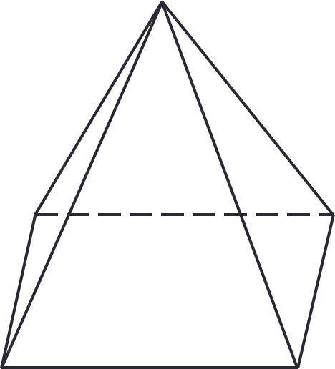
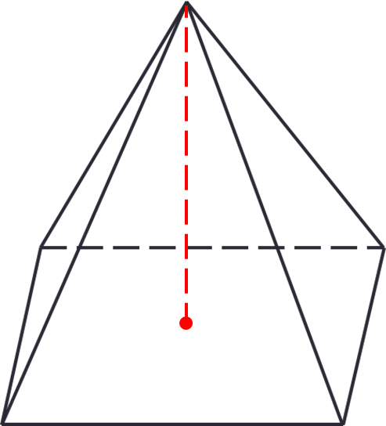
Examples of Similar Solids
The bases are similar (why?).
As for the lengths, they are proportional, because
$$\frac{8}{4}=\frac{12}{6}=\frac{10}{5}$$
$$2=2=2$$
Examine the following Cylinders:
10
8
5
4
12
6
Therefore, the two Pyramids are similar with a scale factor of $2$

Slide 8
Examining Similarity
Depending on what values we are comparing the scale factor between similar solids may change.
Find the scale factor between the values given in each of the first two columns. Identify how these scale factors relate to the original scale factor given.
Pyramid I Pyramid II
Scale Factor:
Base Perimeter:
Lateral Area:
Volume:
$$2/1$$
$$12$$
$$6$$
$$240$$
$$60$$
$$384$$
$$48$$

Slide 9
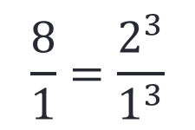
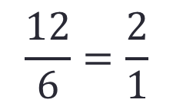
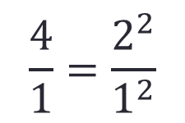
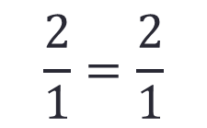
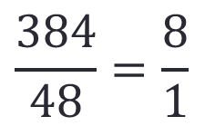
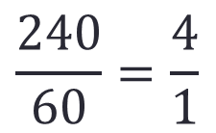
Comparing the Scale Factors
Now, determine the scale factor between the values given from each shape, then compare them to the original scale factor between the shapes.
Base Perimeter
Lateral Area
Volume
$$\frac{I}{II}$$
$$\frac{12}{6}=\frac{2}{1}$$
$$\frac{240}{60}=\frac{4}{1}$$
$$\frac{384}{48}=\frac{8}{1}$$
Compared to Scale Factor:
$$\frac{2}{1}=\frac{2}{1}$$
$$\frac{4}{1}=\frac{2^{2}}{1^{2}}$$
$$\frac{8}{1}=\frac{2^{3}}{1^{3}}$$
Can you see the relationship between the original scale factor and the scale factors for the base perimeter, lateral area, and volume?

Slide 10
Examining Similarity
Now we are going to see how this relationship affects the area and volume of similar solids.
Find the scale factor between the values given in each of the first two columns. Identify how these scale factors relate to the original scale factor given.
Cylinder I Cylinder II
Scale Factor:
Base Circumference:
Lateral Area:
Volume:
$$3/2$$
$$12π$$
$$8π$$
$$144π$$
$$64π$$
$$1728π$$
$$512π$$

Slide 11
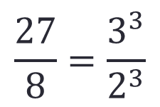
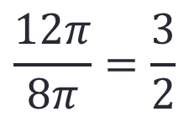
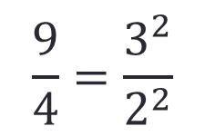
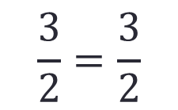
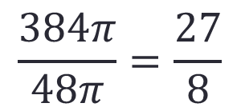
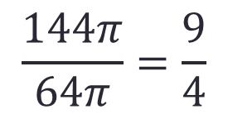
Comparing the Scale Factors
Now, determine the scale factor between the values given from each shape, then compare them to the original scale factor between the shapes.
Base Circumference
Lateral Area
Volume
$$\frac{I}{II}$$
$$\frac{12π}{8π}=\frac{3}{2}$$
$$\frac{144π}{64π}=\frac{9}{4}$$
$$\frac{384π}{48π}=\frac{27}{8}$$
Compared to Scale Factor:
$$\frac{3}{2}=\frac{3}{2}$$
$$\frac{9}{4}=\frac{3^{2}}{2^{2}}$$
$$\frac{27}{8}=\frac{3^{3}}{2^{3}}$$
Can you see the relationship between the original scale factor and the scale factors for the base circumference, lateral area, and volume?

Slide 12
Theorem for Similar Solids
Theorem 12-11: If the scale factor of two similar solids is $a:b$, then
(1) The ratio of corresponding perimeters is
(2) The ratio of the base areas, of the lateral area, and of the total areas is
(3) The ratio of the volumes is
$$a:b$$
$$a^{2}:b^{2}$$
$$a^{3}:b^{3}$$

Slide 13

Practice
1.) Given the following measurements for similar solids, identify the reduced ratio for each of the following.
Given height 2 and height 5
(a.) Scale Factor __________
(b.) Total Area _______________
$$2/5$$
$${2^{2}}/{5^{2}}=4/{25}$$

Slide 14
Practice
2.) Given the following measurements for similar solids, identify the reduced ratio for each of the following.
Given areas 4$π$ and 12$π$.
(a.) Scale Factor _______________
(b.) Volume _______________
$${4π}/{12π}=1/3$$
$${1^{3}}/{3^{3}}=1/{27}$$

Slide 15

Practice
3.) The following solids are similar. Use the given information to solve for the value:
The scale factor of solid A : solid B is 3:4.
If solid A has a circumference of 18, calculate the circumference of solid B.
Solution:
From the Theorem, we have
$$\frac{Circ. A}{Circ. B}=\frac{A}{B}$$
$$\frac{18}{x}=\frac{3}{4}$$
$$3x=72$$
$$x=24$$

Slide 16
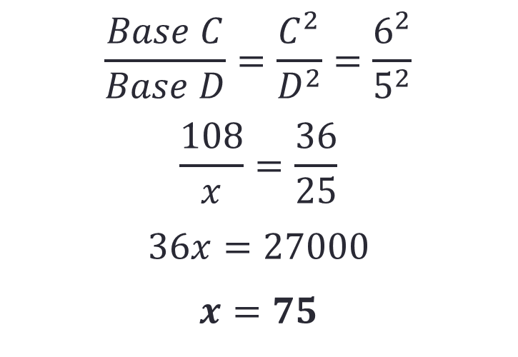
Practice
4.) The following solids are similar. Use the given information to solve for the value:
The scale factor of solid C : solid D is 6:5.
If solid C has a base area of 108, calculate the base area of solid D.
Solution:
From the Theorem, we have
$$\frac{Base C}{Base D}=\frac{C^{2}}{D^{2}}=\frac{6^{2}}{5^{2}}$$
$$\frac{108}{x}=\frac{36}{25}$$
$$36x=27000$$
$$x=75$$

Slide 17

Group Practice
1.) Given the following measurements for similar solids, identify the reduced ratio for each of the following.
Given height 4 and height 7
(a.) Scale Factor __________
(b.) Total Area _______________
$$4/7$$
$${4^{2}}/{7^{2}}={16}/{49}$$

Slide 18
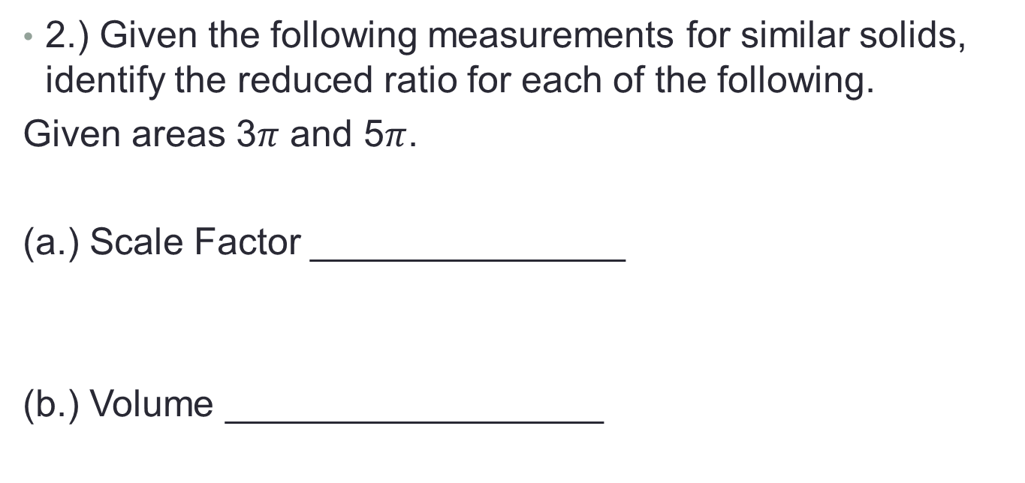
Group Practice
2.) Given the following measurements for similar solids, identify the reduced ratio for each of the following.
Given areas 3$π$ and 5$π$.
(a.) Scale Factor _______________
(b.) Volume __________________
$${3π}/{5π}=3/5$$
$${3^{3}}/{5^{3}}={27}/{125}$$

Slide 19
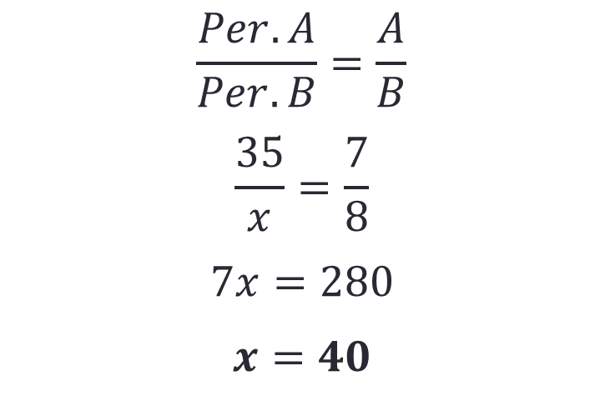
Group Practice
3.) The following solids are similar. Use the given information to solve for the value:
The scale factor of solid A : solid B is 7:8.
If solid A has a perimeter of 18, calculate the perimeter of solid B.
Solution:
From the Thm 12-11, we have
$$\frac{Per. A}{Per. B}=\frac{A}{B}$$
$$\frac{35}{x}=\frac{7}{8}$$
$$7x=280$$
$$x=40$$

Slide 20
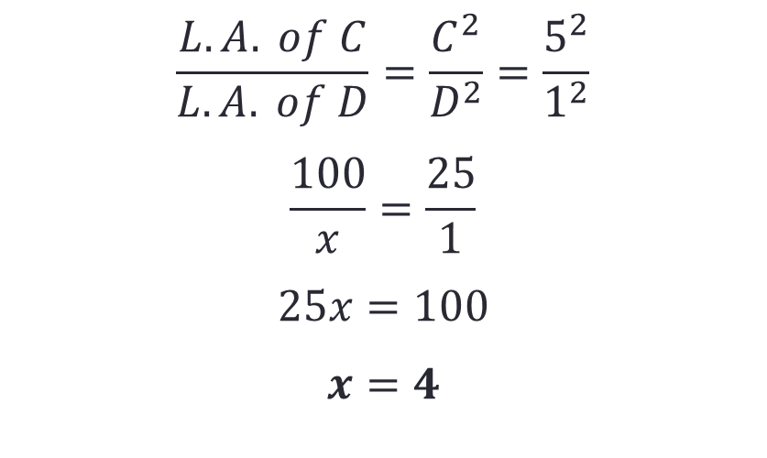
Group Practice
4.) The following solids are similar. Use the given information to solve for the value:
The scale factor of solid C : solid D is 5:1.
If solid C has a lateral area of 108, calculate the lateral area of solid D.
Solution:
From the Thm 12-11, we have
$$\frac{L.A. of C}{L.A. of D}=\frac{C^{2}}{D^{2}}=\frac{5^{2}}{1^{2}}$$
$$\frac{100}{x}=\frac{25}{1}$$
$$25x=100$$
$$x=4$$

