Slide 1
Geometry Unit 6
Proving Quadrilaterals are parallelograms

Slide 2
Proving that a Quadrilateral is a Parallelogram
Content Objective: Students will be able to prove that a Quadrilateral is a Parallelogram by using special properties in theorems.
Language Objective: Students will be able to explain what properties and theorems allow a Quadrilateral to be a Parallelogram.

Slide 3
5 Ways to prove that a Quadrilateral is a Parallelogram
1.) Show that both pairs of opposite sides are parallel
2.) Show that both pairs of opposite sides are congruent.
3.) Show that one pair of opposite sides are both parallel and congruent.
4.) Show that both pairs of opposite angles are congruent.
5.) Show that the diagonals bisect each other.

Slide 4
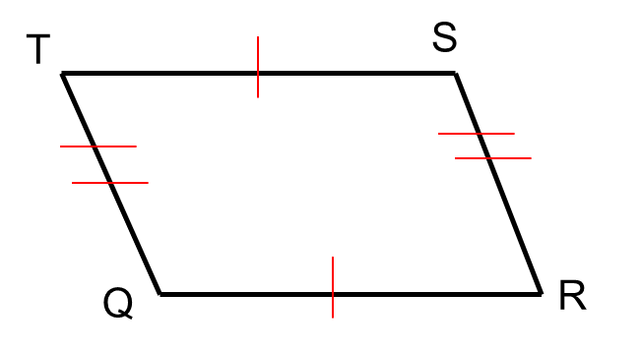
Theorem 5-4
Theorem 5-4: If both pairs of opposite sides of a quadrilateral are congruent, then the quadrilateral is a parallelogram.
Given: $\overline{TS}≅\overline{QR}; \overline{TQ}≅\overline{SR}$
Prove: Quad. QRST is a .

Slide 5
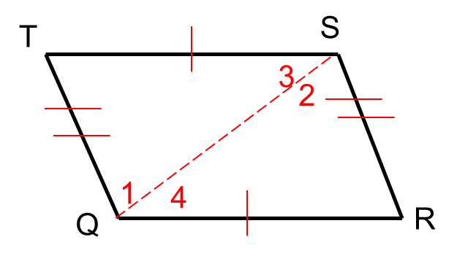
Theorem 5-4 – Proof
Given: $\overline{TS}≅\overline{QR}; \overline{TQ}≅\overline{SR}$
Prove: Quad. QRST is a .
Statements ________ _______Reasons
1. $\overline{TS}≅\overline{QR}; \overline{TQ}≅\overline{SR}$
1. Given
2. Draw $\overline{QS}$
2. Between any 2 pts., there exists exactly 1 line.
3. $\overline{QS}≅\overline{QS}$
3. Reflexive Property
4. $∆TSQ≅∆RQS$
4. SSS Postulate
5. $<1≅ <2;<3≅ <4$
5. CPCTC
6. $\overline{TS} // \overline{QR}$ ; $\overline{QT} // \overline{RS}$
6. If 2 lines ACBAT and alt. int. <‘s are $≅$, then the lines are //.
7. Quad QRST is a
7. Def. of a Parallelogram

Slide 6
Theorem 5-5
Theorem 5-5: If one pair of opposite sides or a quadrilateral are both congruent and parallel, then the quadrilateral is a parallelogram.
Given: $\overline{AB}≅\overline{CD}$; $\overline{AB} // \overline{CD}$
Prove: Quad ABCD is a .
D
C
A
B

Slide 7
Theorem 5-6
Theorem 5-6: If both pairs of opposite angles of a quadrilateral are congruent, then the quadrilateral is a parallelogram.
Given: $<E≅ <G$; $<H≅ <F$
Prove: Quad EFGH is a .
H
G
E
F

Slide 8
Theorem 5-7
Theorem 5-7: If the diagonals of a quadrilateral bisect each other, then the quadrilateral is a parallelogram.
Given: $\overline{HF} and \overline{EG}$ bisect each other at point J.
Prove: Quad EFGH is a .
H
G
J
E
F

Slide 9
Identifying Parallelograms
Study the markings on each figure and decide whether the given quadrilateral is a parallelogram. If it is, state the definition or theorem that proves it.
Yes; One pair of opposite sides are both parallel and congruent.

Slide 10
Identifying Parallelograms
Study the markings on each figure and decide whether the given quadrilateral is a parallelogram. If it is, state the definition or theorem that proves it.
Yes; The diagonals bisect each other.

Slide 11
Identifying Parallelograms
Study the markings on each figure and decide whether the given quadrilateral is a parallelogram. If it is, state the definition or theorem that proves it.
Yes; Both pairs of opposite sides are congruent.

Slide 12
Identifying Parallelograms
Study the markings on each figure and decide whether the given quadrilateral is a parallelogram. If it is, state the definition or theorem that proves it.
No; The pairs of parallel and congruent sides are not the same.

Slide 13
Identifying Parallelograms
Study the markings on each figure and decide whether the given quadrilateral is a parallelogram. If it is, state the definition or theorem that proves it.
Yes; Both pairs of opposite angles are congruent.

Slide 14
Identifying Parallelograms
Study the markings on each figure and decide whether the given quadrilateral is a parallelogram. If it is, state the definition or theorem that proves it.
Based off the markings…NO
If you work some things out…YES

Slide 15
Theorem 5-5 – Proof
D
C
Given: $\overline{AB}≅\overline{CD}$; $\overline{AB} // \overline{CD}$
Prove: Quad ABCD is a .
A
B
Statements ________ _______Reasons
1. $\overline{AB}≅\overline{CD}$; $\overline{AB} // \overline{CD}$
1. $Given$
2. $Draw \overline{AC}$
2. Between any 2 pts., there exists exactly 1 line.
3. $<1≅ <2$
3. If 2 // lines ACBAT, then alt. int. <‘s are $≅$.
4. $\overline{AC}≅\overline{AC}$
4. Reflexive Property
5. $∆ABC≅∆CDA$
5. SAS Postulate
6. $<3≅ <4$
6. CPCTC
7. $\overline{AD} // \overline{BC}$
7. If 2 lines ACBAT and alt. int. <‘s are $≅$, then the lines are //.
8. Quad ABCD is a
8. Def. of a Parallelogram

