Slide 1
Geometry Unit 6
5.4

Slide 2
Special Parallelograms
Content Objective: Students will be able to apply the definitions and identify the properties of a rectangle, a rhombus, and a square.
Language Objective: Students will be able to state the similarities and differences between the types of Parallelograms.

Slide 3
Rectangle
A Rectangle is a quadrilateral with
Why would a Rectangle also be considered a Parallelogram?
4 Right Angles.
Rectangle

Slide 4
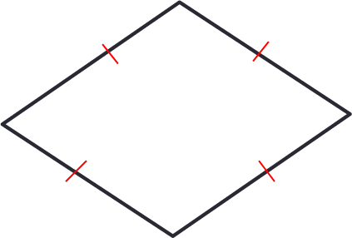
Rhombus
A Rhombus is a quadrilateral with
Why would a Rhombus also be considered a Parallelogram?
4 Congruent Sides.
Rhombus

Slide 5
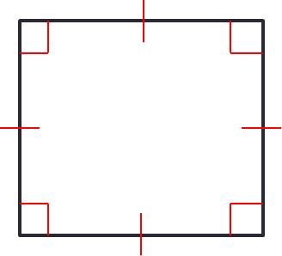
Square
4 Right Angles
A Square is a quadrilateral with and
Why would a Square also be considered a parallelogram?
4 Congruent Sides.
Square

Slide 6
Shared and Unique Properties
Since rectangles, rhombuses, and squares are all considered as parallelograms, they have all the properties of parallelograms.
However, they each posses their own, individual properties as well, as seen in the following theorems.

Slide 7
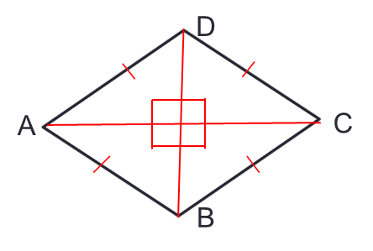
Diagonals Properties
Theorem 5-12: The diagonals of a rectangle are _________.
Theorem 5-13: The diagonals of a rhombus are _____________.
Congruent
D
C
In Rectangle ABCD,
$$\overline{AC}≅ \overline{DB}$$
A
B
Perpendicular
In Rhombus ABCD,
$$\overline{AC} \overline{DB}$$

Slide 8
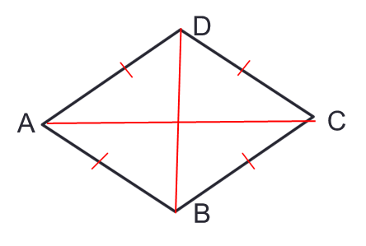
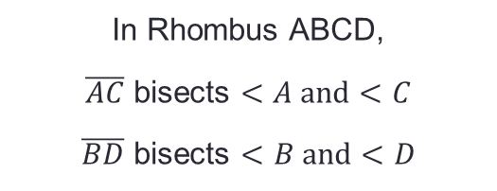
Diagonals Properties
Theorem 5-14: Each diagonal of a rhombus _______ two angles of the rhombus.
bisects
In Rhombus ABCD,
$\overline{AC}$ bisects $<A and<C$
$\overline{BD}$ bisects $<B and<D$

Slide 9
Properties Linked To Parallelograms
Theorem 5-16: If an angle of a parallelogram is a right angle, then the parallelogram is a _________.
Given: Parallelogram ABCD;
Prove: ABCD is a Rectangle
Rectangle
$$<A is a right angle$$
D
C
A
B

Slide 10
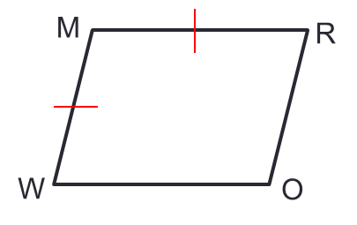
Properties Linked To Parallelograms
Theorem 5-17: If two consecutive sides of a parallelogram are congruent, then the parallelogram is a _________.
Given: Parallelogram WORM;
Prove: WORM is a Rhombus
Rhombus
$$\overline{WM}≅\overline{MR}$$

Slide 11
Using the Properties
Use the properties of special parallelograms to solve for the value of the variable.
Solution:
$$3x=90$$
$$x=30$$

Slide 12
Using the Properties
Use the properties of special parallelograms to solve for the value of the variable.
Solution:
$$5x−13=2x+17$$
$$3x=30$$
$$x=10$$

Slide 13
Using the Properties
Use the properties of special parallelograms to solve for the value of the variable.
Solution:
$$2x−14=x+15$$
$$x=29$$

Slide 14
Using the Properties
Use the properties of special parallelograms to solve for the value of the variable.
Solution:
$$4x−5=2x+17$$
$$2x=22$$
$$x=11$$
D. ABCD is a Rhombus

Slide 15
Using the Properties
Use the properties of special parallelograms to solve for the value of the variable.
Solution:
$$3x+15=90$$
$$3x=75$$
$$x=25$$
E. ABCD is a Square

Slide 16
Using the Properties
Use the properties of special parallelograms to solve for the value of variable.
Solution:
$$15y+10=18y−2$$
$$−3y=−12$$
$$y=4$$
F. ABCD is a Square

Slide 17
Exit Ticket

