Slide 1
Geometry Unit 7
7-1 and 7-2: Ratio and Proportion Properties.

Slide 2
DO NOT MESS WITH THE DESKS!!!
LEAVE THEM AS THEY ARE

Slide 3
Warm-up
Discussing Winter break
New Seating Chart

Slide 4
Ratio and Proportion Properties
Content Objective: Students will be able to identify and use the properties of ratios and proportions.
Language Objective: Students will be able to use the properties of proportions to write equations.

Slide 5

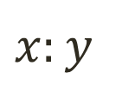
Ratios
The Ratio of one number to another is the quotient when the first number is divided by the second.
This quotient is expressed in simplest form
Ex:
The ratio of 8 to 12 is $\frac{8}{12}$, or
If $y≠0$, then the ratio of x to y is $\frac{x}{y}$
*For any ratio $\frac{x}{y}$, you may assume $y≠0$, even if it is not given.
*A ratio can also be expressed using “:”
Ex: $\frac{x}{y} →$
$$\frac{2}{3}$$
$$x:y$$

Slide 6
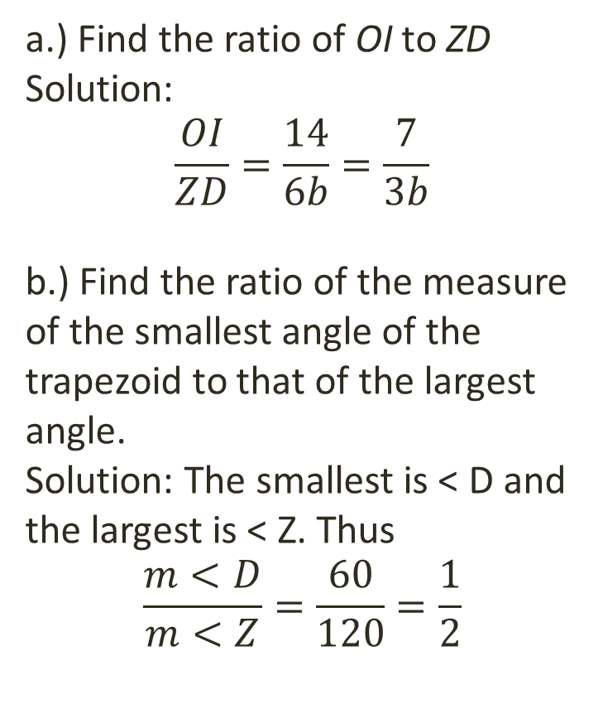
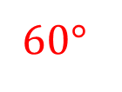
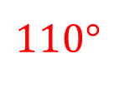
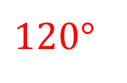
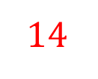
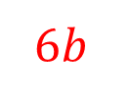
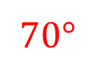
Ratios with Shapes
Use trapezoid ZOID and the given measures to solve the examples.
a.) Find the ratio of OI to ZD
Solution:
$$\frac{OI}{ZD}=\frac{14}{6b}=\frac{7}{3b}$$
b.) Find the ratio of the measure of the smallest angle of the trapezoid to that of the largest angle.
Solution: The smallest is < D and the largest is < Z. Thus
$$\frac{m<D}{m<Z}=\frac{60}{120}=\frac{1}{2}$$
Z
O
$$120°$$
$$110°$$
$$6b$$
$$14$$
$$60°$$
$$70°$$
D
I

Slide 7
Proportions
A Proportion is an equation stating that two ratios are equal.
Ex:
$\frac{a}{b}=\frac{c}{d}$ which also means $a:b=c:d$
The first and last terms (a and d) are called the extremes.
The middle terms (b and c) are called the means.

Slide 8
Properties of Proportions
All proportions have this property, known as the means-extremes property:
$\frac{a}{b}=\frac{c}{d}$ is equivalent to $ad=bc$
Ex: In the proportion $6:9=2:3$,
The extremes are 6 and 3, and
The means are 9 and 2
Thus, by the means-extremes property, $6 ∙3=9∙2$
It is often necessary, and helpful, to replace one proportion by an equivalent proportion.

Slide 9
Properties of Proportions
The following properties are commonly used as equivalent replacements $\frac{a}{b}=\frac{c}{d}$
$ad=bc$
$\frac{a}{c}=\frac{b}{d}$
$\frac{b}{a}=\frac{d}{c}$
$\frac{a+b}{b}=\frac{c+d}{d}$
Additional property: in the case of 3 or more ratios in a proportion,
If $\frac{a}{b}=\frac{c}{d}=\frac{e}{f}=…$, then $\frac{a}{b}=…=\frac{a+c+e+…}{b+d+f+…}$

Slide 10




Using the properties
Use the properties, along with the proportion $x:y=5:2$ to complete each statement.
$5y=$
$\frac{x+y}{y}=$
$\frac{2}{5}=$
$\frac{x}{5}=$
$$2x$$
$$\frac{7}{2}$$
$$\frac{y}{x}$$
$$\frac{y}{2}$$

Slide 11
Ratios in Real Life
Use ratios to solve the problem: A poster is 1 m long and 52 cm wide. Find the ratio of width to length using
A.) Centimeters
Solution: First note that $1 m=100 cm$
Then $\frac{Width}{Length}=\frac{52}{100}=\frac{13}{25}$
B.) Meters
Solution: Note that $52 cm=0.52 m$ (Why?)
Then $\frac{Width}{Length}=\frac{0.52}{1}=\frac{52}{100}=\frac{13}{25}$

