Slide 1
Geometry Unit 7
7-3 Similar Polygons

Slide 2
Similar Triangles
Content Objective: Students will be able to solve for missing side lengths and angle measures in similar polygons.
Language Objective: Students will be able to state and write equations using corresponding parts of similar polygons.

Slide 3
Similar Polygons
Two polygons are similar if their vertices can be paired so that:
1.) Corresponding angles are congruent.
2.) Corresponding sides are in proportion.
(i.e. Their side lengths have the same ratio.)
Ex:
Y
S
Z
T
R
X
P
20
Q
V
32
W

Slide 4
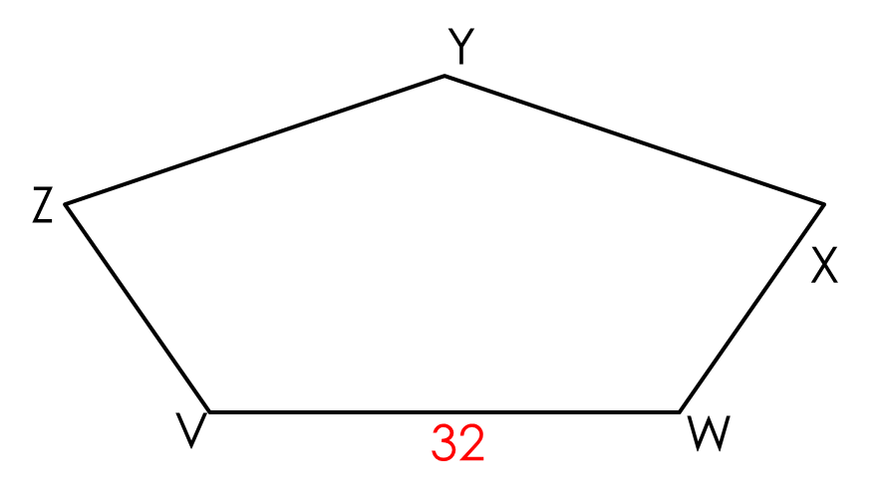
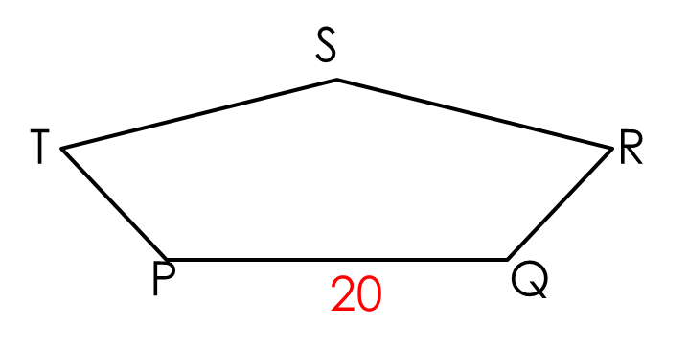
Similar Polygons
Ex Cont.: I give you that polygon PQRST is similar to polygon VWXYZ, written as
$$polygon PQRST \sim polygon VWXYZ$$
Thus, by the definition of similar polygons, we know that
(1)
(2) $\frac{PQ}{VW}=\frac{QR}{WX}=\frac{RS}{XY}=\frac{ST}{YZ}=\frac{TP}{ZV}$
$$<P≅ <V$$
$$<Q≅ <W$$
$$<R≅ <X$$
$$<S≅ <Y$$
$$<T≅ <Z$$

Slide 5

Similar Polygons
If two polygons are similar, then the ratio of the lengths of the corresponding sides is called the
Ex: The Scale Factor from PQRST to VWXYZ is $\frac{PQ}{VW}=$
*Note: This ratio should be exactly the same between all sets of corresponding sides
scale factor.
$$\frac{20}{32}=\frac{5}{8}$$

Slide 6
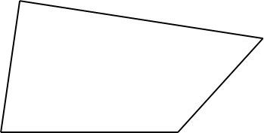
Similar Polygons
Example:
$Quad ABCD \sim Quad A^{′}B^{′}C^{′}D′$. Find:
a.) Their Scale Factor
b.) the values of x, y, and z
c.) the perimeters of the two quadrilaterals
d.) the ratio of the perimeters
D’
30
D
20
C’
C
z
10
8
y
A
x
B
A’
21
B’

Slide 7





Similar Polygons
Solutions:
a.) Scale Factor:
b.)
$$\frac{DC}{D^{′}C^{′}}$$
$$=\frac{20}{30}=\frac{2}{3}$$
$$\frac{DC}{D^{′}C′}=\frac{AB}{A^{′}B^{′}}$$
$$\frac{2}{3}=\frac{x}{21}$$
$$3x=42$$
$$x=14$$
$$\frac{DC}{D^{′}C′}=\frac{BC}{B^{′}C^{′}}$$
$$\frac{2}{3}=\frac{8}{y}$$
$$2y=24$$
$$y=12$$
$$\frac{DC}{D^{′}C′}=\frac{AD}{A^{′}D^{′}}$$
$$\frac{2}{3}=\frac{10}{z}$$
$$2z=30$$
$$z=15$$

Slide 8
Similar Polygons
Solutions:
c.) the perimeters of the two quadrilaterals
Perimeter of Quad. ABCD is
Perimeter of Quad A’B’C’D’ is
d.) the ratio of the perimeters
The ratio of the perimeters is
$$\frac{ABCD}{A^{′}B^{′}C^{′}D′}=\frac{52}{78}=\frac{2}{3}$$
$$10+20+8+14=52$$
$$15+30+12+21=78$$

Slide 9

Similar Polygon examples
Two similar polygons are shown. Find the values of x, y, and z.
$$12$$
$$39$$
$$5$$
$$x$$
$$60°$$
$$y$$
$$z°$$
$$36$$
To Find x and y, we first need the scale factor between the two triangles.
Using the pair of known corresponding sides, we get
Scale Factor:
$$\frac{12}{36}=\frac{1}{3}$$

Slide 10



Similar Polygon examples
Two similar polygons are shown. Find the values of x, y, and z.
$$12$$
$$60°$$
$$39$$
$$5$$
$$x$$
$$60°$$
$$y$$
$$z°$$
$$36$$
Using this scale factor, we can make proportions to solve for x and y.
To Find z, first match the corresponding angles.
For x:
$$\frac{1}{3}=\frac{5}{x}$$
$$x=15$$
For y:
$$\frac{1}{3}=\frac{y}{39}$$
$$3y=39$$
$$y=13$$
For z:
$$z+60+90=180$$
$$z+150=180$$
$$z=30$$

Slide 11

Similar Polygon examples
Two similar polygons are shown. Find the values of x, y, and z.
$$16$$
$$12$$
$$15$$
$$y$$
$$x$$
$$z$$
$$z°$$
$$10$$
$$14$$
To Find x, y and z, we first need the scale factor between the two polygons.
Using the pair of known corresponding sides, we get
Scale Factor:
$$\frac{10}{24}=\frac{5}{12}$$

Slide 12



Similar Polygon examples
Two similar polygons are shown. Find the values of a, b, and c.
$$16$$
$$12$$
$$15$$
$$y$$
$$x$$
$$z$$
$$10$$
$$14$$
$$z°$$
Using this scale factor, we can make proportions to solve for x, y and z.
For x:
$$\frac{5}{12}=\frac{x}{15}$$
$$12x=75$$
$$x=\frac{75}{12}=\frac{25}{4}$$
For y:
$$\frac{5}{12}=\frac{y}{16}$$
$$12y=80$$
$$y=\frac{80}{12}=\frac{20}{3}$$
For z:
$$\frac{5}{12}=\frac{z}{12}$$
$$12z=60$$
$$z=5$$

