Slide 1
Geometry Unit 7
7-4 and 7-5: Postulates and Theorems for Similar Triangles.

Slide 2
Warm-up
F. A. Unit 7

Slide 3
Postulates and Theorems for Similar Triangles
Content Objective: Students will be able to prove that two triangles are similar using postulates and theorems.
Language Objective: Students will be able to write similarity statements using the AA postulate, as well as the SSS and SAS theorems.

Slide 4
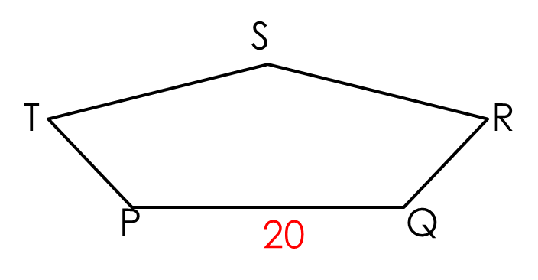
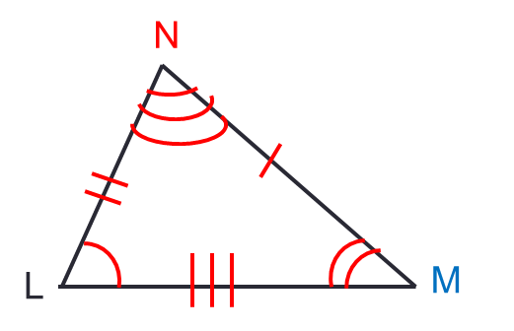
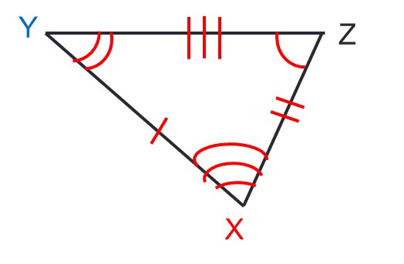
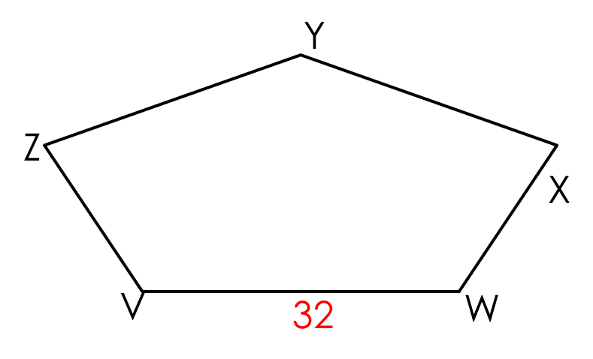
Postulates and Theorems for Similar Triangles
Congruent
Corresponding Angles are
Corresponding Sides are
Same Shape and Size
Similarity
Corresponding Angles are
Corresponding Sides are
Same Shape…but not necessarily same
$$≅$$
$$≅$$
$$≅$$
Proportional
Size
In short, all Congruent figures are always Similar…
But Similar figures are not always Congruent.

Slide 5
Much like Congruence, Similarity between two triangles must also be proven…
And we do it using the following postulate and theorems.

Slide 6
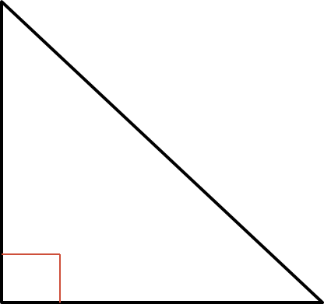
A Postulate for Similar Triangles
AA Similarity Postulate: If two angles of one triangle are congruent to two angles of another triangle, then the triangles are similar.
Example:
$<$ ___ $≅ <$ ___ (Why?)
$<$ _____ $≅ <$ _____ (Why?)
Thus
H
F
K
HOK
FOG
H
O
$∆HOK\sim ∆FOG$
by the AA Similarity Postulate
F
G

Slide 7
Theorems for Similar Triangles
Theorem 7-1 SAS Similarity Theorem: If an angle of one triangle is congruent to an angle of another triangle and the sides including those angles are in proportion, then the triangles are similar.
Given: $<A≅ <D$
$\frac{AB}{DE}=$
Then:
D
A
$$\frac{AC}{DF}$$
B
C
$$∆ABC\sim ∆DEF$$
E
F

Slide 8

Theorems for Similar Triangles
Theorem 7-2 SSS Similarity Theorem: If the sides of two triangles are in proportion, then the triangles are similar.
Given: $\frac{AB}{DE}=$
Then:
D
$$\frac{BC}{EF}=\frac{AC}{DF}$$
A
$$∆ABC\sim ∆DEF$$
B
C
E
F

Slide 9
Practice using the Postulates and Theorems
Can the two triangles given be proven similar? If so, state the similarity and tell which similarity postulate or theorem you would use.
These triangles are congruent by the _____ _________ ________ because
9
10.5
6
7
12
8
SSS
Similarity
Theorem
The sides of the triangles are in proportion.

Slide 10
Practice using the Postulates and Theorems
Can the two triangles given be proven similar? If so, state the similarity and tell which similarity postulate or theorem you would use.
The triangles are NOT similar because
16
24
10
20
16
32
The sides of the triangles are NOT in proportion.

Slide 11
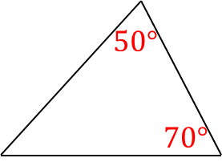
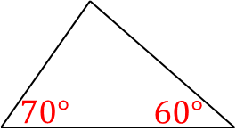
Practice using the Postulates and Theorems
Can the two triangles given be proven similar? If so, state the similarity and tell which similarity postulate or theorem you would use.
These triangles are congruent by the _____ _________ ________ because
AA
Similarity
Postulate
2 Angles of the 1st triangle are congruent to 2 Angles of the 2nd triangle.

Slide 12
Practice using the Postulates and Theorems
Can the two triangles given be proven similar? If so, state the similarity and tell which similarity postulate or theorem you would use.
These triangles are congruent by the _____ _________ ________ because
12
6
9
8
SAS
Similarity
Theorem
The proportional sides are between the congruent angles.

Slide 13
Practice using the Postulates and Theorems
Can the two triangles given be proven similar? If so, state the similarity and tell which similarity postulate or theorem you would use.
The triangles are NOT similar because
12
6
8
9
The proportional sides are not between the congruent angles.

Slide 14
Practice using the Postulates and Theorems
Can the two triangles given be proven similar? If so, state the similarity and tell which similarity postulate or theorem you would use.
These triangles are congruent by the _____ _________ ________ because
20
24
30
16
36
SSS
Similarity
Theorem
The sides of the triangles are in proportion.

