Slide 1
Geometry Unit 8
The Pythagorean Theorem

Slide 2
The Pythagorean Theorem
Content Objective: Students will be able to find missing side lengths of Right Triangles using the Pythagorean Theorem.
Language Objective: Students will be to state and write equations using the Pythagorean Theorem, as well as identify Pythagorean Triples.

Slide 3
Right Triangles
The sides of a right triangle named as such:
The side opposite the right angle is known as the Hypotenuse.
The other two sides are known as the Legs.
Hypotenuse
Leg
Leg

Slide 4
The Pythagorean Theorem
Theorem 8-2 – The Pythagorean Theorem: In a right triangle, the square of the hypotenuse is equal to the sum of the squares of the legs.
Given: $∆ABC;<ACB$
is a right angle
Prove:
B
c
a
C
b
A
$$c^{2}=a^{2}+b^{2}$$

Slide 5
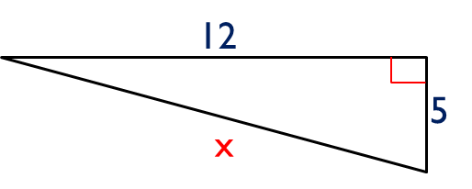

Pythagorean Theorem Examples
Use the Pythagorean Theorem to find the value of x.
Then
$$a=5$$
$$b=12$$
$$c=x$$
$$x^{2}=5^{2}+{12}^{2}$$
$$x^{2}=25+144$$
$$x^{2}=169$$
$$x=\sqrt{169}=13$$

Slide 6
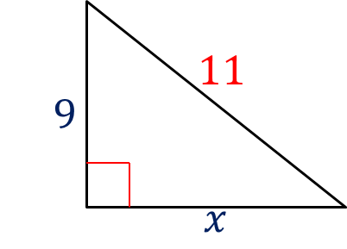

Pythagorean Theorem Examples
Use the Pythagorean Theorem to find the value of x.
Then
$$a=x$$
$$b=9$$
$$c=11$$
$${11}^{2}=x^{2}+9^{2}$$
$$121=x^{2}+81$$
$$x^{2}=40$$
$$x=\sqrt{40}=2\sqrt{10}$$

Slide 7
Pythagorean Triples
When a right triangle has side lengths that are all whole numbers, we call those a
Here is a list of (a few) Pythagorean Triples
Pythagorean Triple
3 – 4 – 5
5 – 12 – 13
8 – 15 – 17
7 – 24 – 25
6 – 8 – 10
10 – 24 – 26
16 – 30 – 34
14 – 48 – 50
9 – 12 – 15
12 – 16 – 20
15 – 20 – 25

Slide 8

More Pythagorean Theorem Examples
Find the value of x.
1.) $3^{2}+4^{2}=x^{2}$
$9+16=x^{2}$
$25=x^{2}$
$$x=\sqrt{25}=5$$
2.) $6^{2}+x^{2}={10}^{2}$
$36+x^{2}=100$
$x^{2}=64$
$$x=\sqrt{64}=8$$
x
3
4
x
6
10

Slide 9
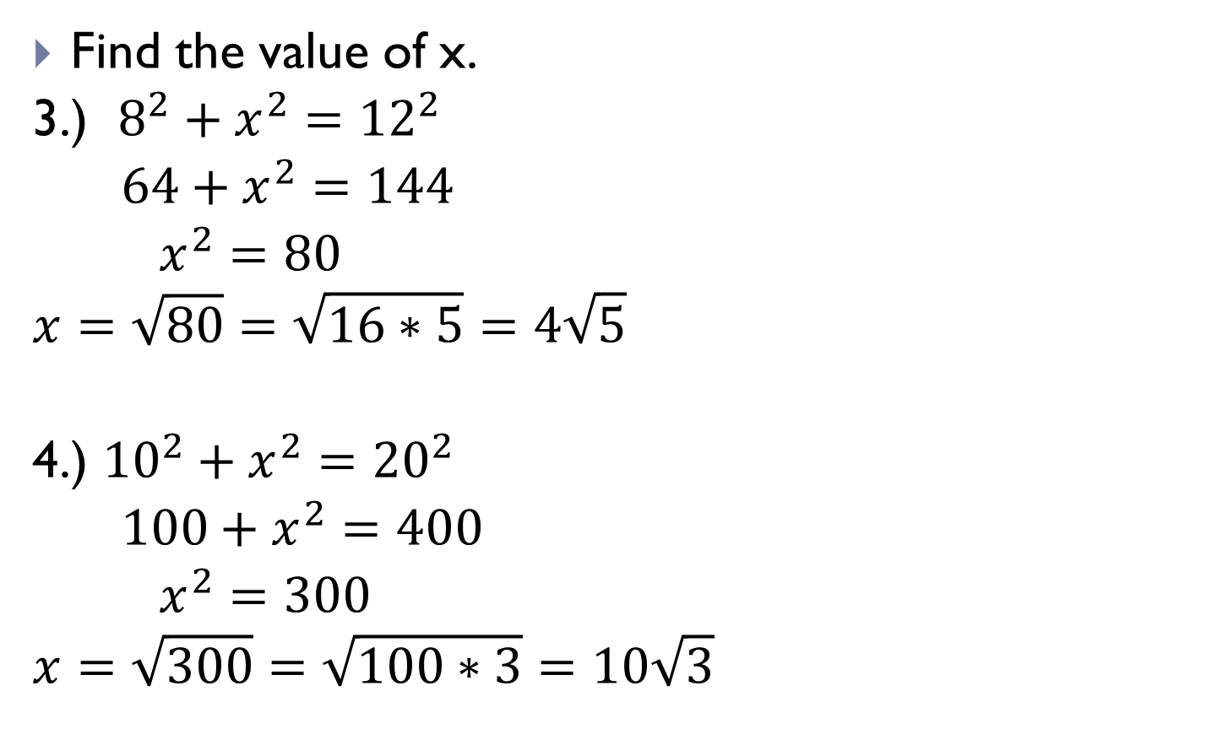
More Pythagorean Theorem Examples
Find the value of x.
3.) $8^{2}+x^{2}={12}^{2}$
$64+x^{2}=144$
$x^{2}=80$
$$x=\sqrt{80}=\sqrt{16∗5}=4\sqrt{5}$$
4.) ${10}^{2}+x^{2}={20}^{2}$
$100+x^{2}=400$
$x^{2}=300$
$$x=\sqrt{300}=\sqrt{100∗3}=10\sqrt{3}$$
12
8
x
x
10
20

Slide 10
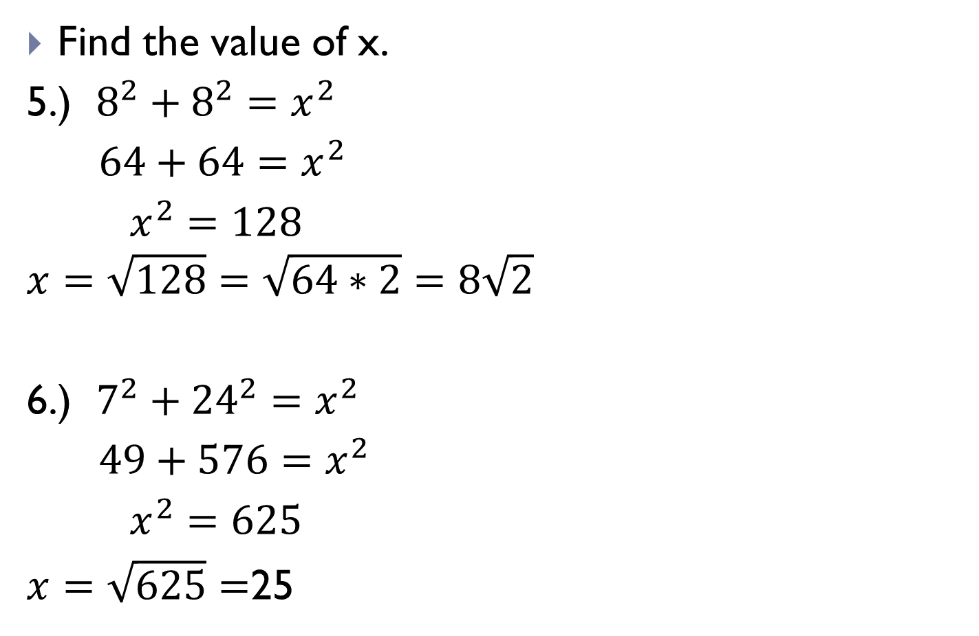
More Pythagorean Theorem Examples
Find the value of x.
5.) $8^{2}+8^{2}=x^{2}$
$64+64=x^{2}$
$x^{2}=128$
$$x=\sqrt{128}=\sqrt{64∗2}=8\sqrt{2}$$
6.) $7^{2}+{24}^{2}=x^{2}$
$49+576=x^{2}$
$x^{2}=625$
$x=\sqrt{625}=$25
8
8
x
8
8
24
x
7
7

