Slide 1
Geometry Unit 8
8-4: Special Right Triangles

Slide 2
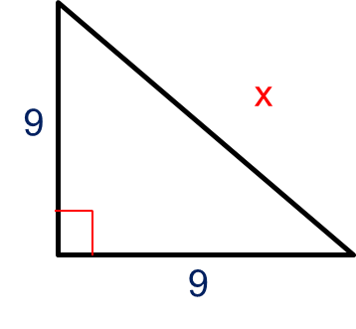
Warm-up
Find the value of x in these right triangles.
1.) 2.)
3.)
x
16
x
8
20
15

Slide 3
Special Right Triangles
Content Objective: Students will be able to solve for missing side lengths in special right triangles.
Language Objective: Students will be able to name the special right triangles, as well as label their specific parts.

Slide 4
$45°−45°−90°$ Theorem
Theorem 8-6: In a $45°−45°−90°$ right triangle, the hypotenuse is $\sqrt{2}$ times as long as a leg.
Hypotenuse
$$45°$$
Hypotenuse
Leg
c
$c=a\sqrt{2}$ or $c=b\sqrt{2}$
a
$$45°$$
b
Leg

Slide 5
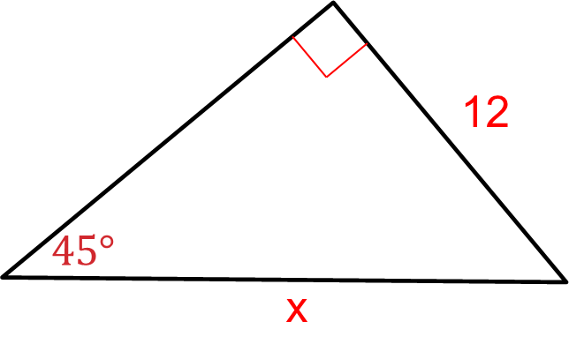
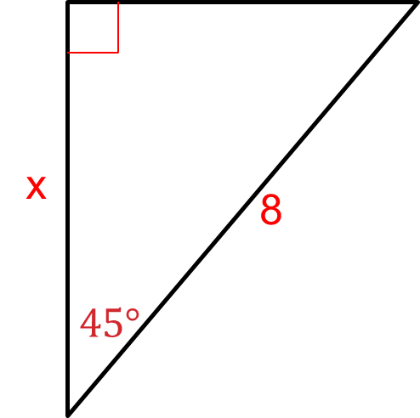


$45°−45°−90°$ Examples
Find the value of x.
1.) 2.)
Leg
Leg
Hypotenuse
Hypotenuse
Solution:
$$8=x\sqrt{2}$$
$$x=\frac{8}{\sqrt{2}}$$
$$x=\frac{8}{\sqrt{2}}∗\frac{\sqrt{2}}{\sqrt{2}}=\frac{8\sqrt{2}}{2}$$
$$x=4\sqrt{2}$$
Solution:
$$x=12∗\sqrt{2}$$
$$x=12\sqrt{2}$$

Slide 6
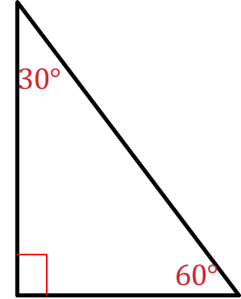
$30°−60°−90°$ Theorem
Theorem 8-7: In a $30°−60°−90°$ right triangle, the hypotenuse is twice as long as the shorter leg, and the longer leg is $\sqrt{3}$ times as long as a shorter leg.
Hypotenuse
$$c=2a$$
Hypotenuse
Hypotenuse
Longer Leg
c
b
Longer Leg
$$b=a\sqrt{3}$$
a
Shorter Leg

Slide 7
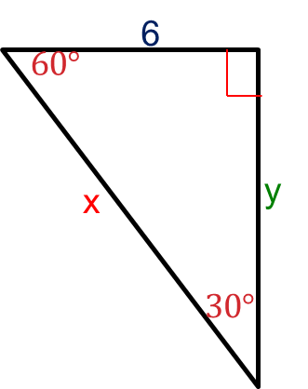


$30°−60°−90°$ Examples
3.) Find the values of x and y
For x:
$$x=6∗2$$
$$x=12$$
Shorter Leg
For y:
$$y=6∗\sqrt{3}$$
$$y=6\sqrt{3}$$
Longer Leg
Hypotenuse

Slide 8
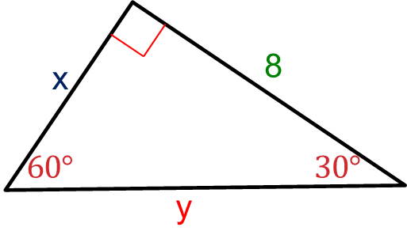


$30°−60°−90°$ Examples
4.) Find the values of x and y
For x:
$$8=x\sqrt{3}$$
$$x=\frac{8}{\sqrt{3}}$$
$$x=\frac{8}{\sqrt{3}}∗\frac{\sqrt{3}}{\sqrt{3}}=\frac{8\sqrt{3}}{3}$$
Longer Leg
Shorter Leg
Hypotenuse
For y:
$$y=x∗2$$
$$y=2∗\frac{8\sqrt{3}}{3}$$
$$y=\frac{16\sqrt{3}}{3}$$

Slide 9
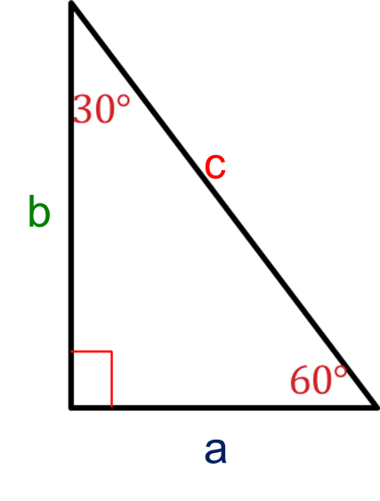
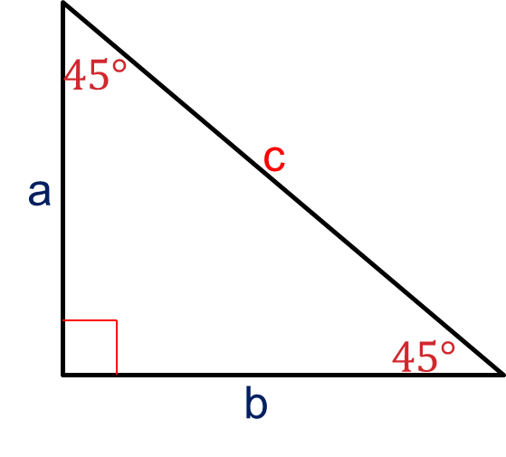
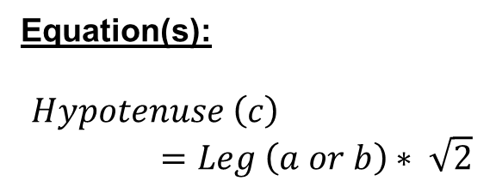
Warm-up: Reviewing the Triangles
Label the parts of each triangle, then give the equations associated with them.
$$30°−60°−90°$$
$$45°−45°−90°$$
Hypotenuse
Hypotenuse
Leg
Longer Leg
Leg
Shorter Leg
Equation(s):
$$Hypotenuse \left(c\right)=Leg \left(a or b\right)∗ \sqrt{2}$$
Equation(s):
$$Hypotenuse \left(c\right)=Shorter Leg \left(a\right)∗2$$
$$Longer Leg \left(b\right)=Shorter leg \left(a\right)∗\sqrt{3}$$

Slide 10
Ratio of sides
In Closing, the sides of each of the special right triangles can be put into this form
$$45°−45°−90°$$
$$30°−60°−90°$$
Side Ratio:
$$a:b:c→1:1:\sqrt{2}$$
Side Ratio:
$$a:b:c→1:\sqrt{3}:2$$

Slide 11

Examples – Both Triangles
Find the missing side lengths. Leave answers as simplified radicals (if necessary).
1.
For u:
$u=2∗2$
$$u=4$$
Hypotenuse
Shorter Leg
For v:
$$v=\sqrt{3}∗2$$
$$v=2\sqrt{3}$$
Longer Leg

Slide 12
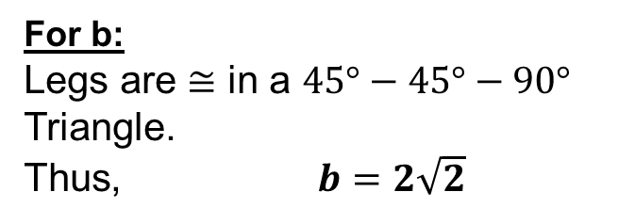

Examples – Both Triangles
Find the missing side lengths. Leave answers as simplified radicals (if necessary).
2.
For b:
Legs are $≅$ in a $45°−45°−90°$ Triangle.
Thus, $b=2\sqrt{2}$
Leg
Leg
For a:
$$a=\sqrt{2}∗2\sqrt{2}$$
$$a=2∗\sqrt{2}∗\sqrt{2}$$
$$a=2∗2=4$$
Hypotenuse

Slide 13


Examples – Both Triangles
Find the missing side lengths. Leave answers as simplified radicals (if necessary).
3.
For v:
$$8\sqrt{2}=\sqrt{2}∗v$$
$$v=\frac{8\sqrt{2}}{\sqrt{2}}$$
$$v=8$$
Leg
Leg
For u:
Legs are $≅$ in a $45°−45°−90°$ Triangle.
Thus, $u=8$
Hypotenuse

Slide 14


Examples – Both Triangles
Find the missing side lengths. Leave answers as simplified radicals (if necessary).
4.
For b:
$$11\sqrt{3}=\sqrt{3}∗b$$
$$b=\frac{11\sqrt{3}}{\sqrt{3}}$$
$$v=11$$
Longer Leg
Shorter Leg
For a:
$$a=2∗11$$
$$a=22$$
Hypotenuse

Slide 15


Examples – Both Triangles
Find the missing side lengths. Leave answers as simplified radicals (if necessary).
5.
For y:
$$8\sqrt{5}=2∗y$$
$$y=\frac{8\sqrt{5}}{2}$$
$$y=4\sqrt{5}$$
Hypotenuse
Shorter Leg
Longer Leg
For x:
$$x=\sqrt{3}∗4\sqrt{5}$$
$$x=4\sqrt{3∗5}$$
$$x=4\sqrt{15}$$

Slide 16


Examples – Both Triangles
Find the missing side lengths. Leave answers as simplified radicals (if necessary).
6.
For x:
$$2\sqrt{6}=\sqrt{2}∗x$$
$$x=\frac{2\sqrt{6}}{\sqrt{2}}$$
$$x=2\sqrt{\frac{6}{2}}$$
$$x=2\sqrt{3}$$
Hypotenuse
Leg
Leg
For y:
Legs are $≅$ in a $45°−45°−90°$ Triangle.
Thus, $y=2\sqrt{3}$

