Slide 1
Geometry Unit
8-5: The Tangent Ratio

Slide 2
Trigonometry
The word Trigonometry comes from the Greek words meaning “Triangle Measure.”
This material can be applied to any kind of triangle…
But we will only be using this for right triangles.

Slide 3
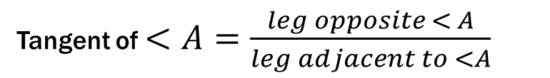

Tangent
From the same triangle, only one acute angle ($<A$) is marked.
The leg across from the angle is known as the Opposite Leg and the leg attached to the angle is known as the Adjacent Leg.
The first of our 3 ratios is known as the Tangent Ratio.
Tangent of $<A=\frac{leg opposite < A}{leg adjacent to <A}$
Hypotenuse
Opposite Leg
A
Adjacent Leg

Slide 4


Tangent Examples
From the given triangle, find tan X and tan Y.
Tangent of $<X=\frac{leg opposite < X}{leg adjacent to < X}$
$$\frac{12}{5}$$
Y
13
12
Tangent of $<Y=\frac{leg opposite < Y}{leg adjacent to < Y}$
$$\frac{5}{12}$$
Z
5
X

Slide 5
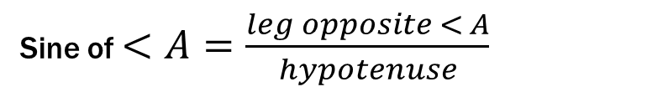

Sine
From the same triangle, only one acute angle ($<A$) is marked.
Our next two ratios involve one of the legs, as well as the hypotenuse.
This next ratio is known as the Sine Ratio.
Sine of $<A=\frac{leg opposite < A}{hypotenuse}$
Hypotenuse
Opposite Leg
A
Adjacent Leg

Slide 6


Sine Examples
From the given triangle, find sin X and sin Y.
sin$X=\frac{leg opposite < X}{hypotenuse}$
$$\frac{8}{17}$$
Y
17
8
sin$Y=\frac{leg opposite < Y}{hypotenuse}$
$$\frac{15}{17}$$
Z
X
15

Slide 7
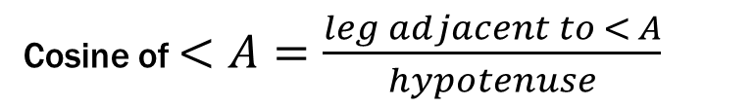

Cosine
From the same triangle, only one acute angle ($<A$) is marked.
The last ratio is known as the Cosine Ratio.
Cosine of $<A=\frac{leg adjacent to < A}{hypotenuse}$
Hypotenuse
Opposite Leg
A
Adjacent Leg

Slide 8


Cosine Examples
From the given triangle, find cos X and cos Y.
Y
cos$X=\frac{leg adjacent to < X}{hypotenuse}$
$$\frac{15}{17}$$
17
8
cos$Y=\frac{leg adjacent to < Y}{hypotenuse}$
$$\frac{8}{17}$$
Z
X
15

Slide 9
Trig Ratios
Content Objective: Students will be able to solve for angles and sides of right triangles using the trig ratios of Sine, Cosine, and Tangent
Language Objective: Students will be able to write trigonometric ratios using sides and angles of right triangles.

Slide 10



Warm-up
Find Sin X, Cos Y, Tan X, and Tan Y
Solution:
$\sin{X=\frac{5}{23}}$
$\cos{Y=\frac{5}{23}}$
$\tan{X=\frac{5}{7\sqrt{7}}}=\frac{5\sqrt{7}}{49}$
$\tan{Y=\frac{7\sqrt{7}}{5}}$
Y
$$23$$
5
Z
$$7\sqrt{7}$$
X

Slide 11
Putting it all together
In trigonometry, there is a saying that helps with memorizing how to set up the ratios of Sine, Cosine and Tangent.
See if you can get it from this:

Slide 12
Putting it all together
Sine:Opposite:Hypotenuse
Cosine:Adjacent:Hypotenuse
Tangent:Opposite:Adjacent
SOH
CAH
TOA

Slide 13
Putting it all together
All together, we have…
S
H
-
C
A
H
-
O
T
O
A

Slide 14
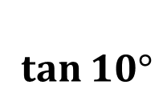
Trig With Angles
Trig Ratios can also be used to find the values of specific angles.
For example, you can write to represent the tangent of any angle of degree measure 10.
You can find these values by using either a calculator, or a table of values.
(i.e. there is a table of trig values on page 311 of your textbook).
$\tan{10°}$

Slide 16







Trig With Angles
Examples:
1.) $\tan{10°}≈$ 5.) $\sin{45°}≈$
2.) $\sin{25°}≈$ 6.) $\cos{30°}≈$
3.) $\cos{44°}≈$
4.) $\tan{60°}≈$
$$0.1763$$
$$0.7071$$
$$0.4226$$
$$0.8660$$
$$0.7193$$
$$1.7321$$

Slide 17




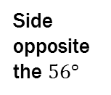
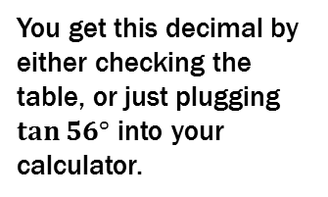
Trig With Angles
Using the trig values of specific angles is helpful for finding missing sides of a triangle.
Example: Find the value of x.
You get this decimal by either checking the table, or just plugging $\tan{56°}$ into your calculator.
Solution:
$$\tan{56°}=\frac{x}{32}$$
$$x=32∗\tan{56°}$$
$$x=32 ∗1.4826$$
$y=47.4432$ or $y≈47.4$
Side opposite the $56°$
Marked angle: $56°$
x
$$56°$$
32
Side adjacent to the $56°$

Slide 18



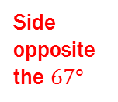

Trig With Angles
Now you try
Example: Find the values of x and y.
Solution (For x):
$$\sin{67°}=\frac{x}{120}$$
$$x=120∗\sin{67°}$$
$$x=120 ∗0.9205$$
$x=110.46$ or $x≈110$
Side opposite the $67°$
Hypotenuse
120
x
Marked angle: $67°$
$$67°$$
y
Side adjacent to the $67°$

Slide 19

Trig With Angles
Now you try
Example: Find the values of x and y.
Solution (For y):
$$\cos{67°}=\frac{y}{120}$$
$$y=120∗\cos{67°}$$
$$y=120 ∗0.3907$$
$y=46.884$ or $y≈47$
Side opposite the $67°$
Hypotenuse
120
x
Marked angle: $67°$
$$67°$$
y
Side adjacent to the $67°$

Slide 20



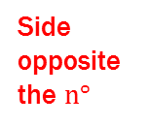

What if I Don’t Give you the Angle?
Find the measure of n to the nearest integer.
Solution:
$$\sin{n°}=\frac{22}{40}$$
$$\sin{n°}=0.5500$$
Hypotenuse
Side opposite the $n°$
From here, you have a choice:
Either look for 0.5500 (or the closest value to it) on the table…
Or let your calculator do it the following way:
1.) Go to the button that reads “2nd”
2.) Hit the “sin” button. If it went well, then “$\sin^{−1}{( }$” should appear on the screen.
3.) Put the decimal value (0.5500) in the and press “enter”
4.) Round your answer to the nearest integer, and there you go.
40
22
Marked angle: $n°$
$$n°$$

Slide 21


What if I Don’t Give you the Angle?
If all went well, you should have
$\sin^{−1}{(0.5500)}=33.3670≈33$
Hypotenuse
Side opposite the $n°$
40
22
Marked angle: $n°$
$$n°$$

Slide 22
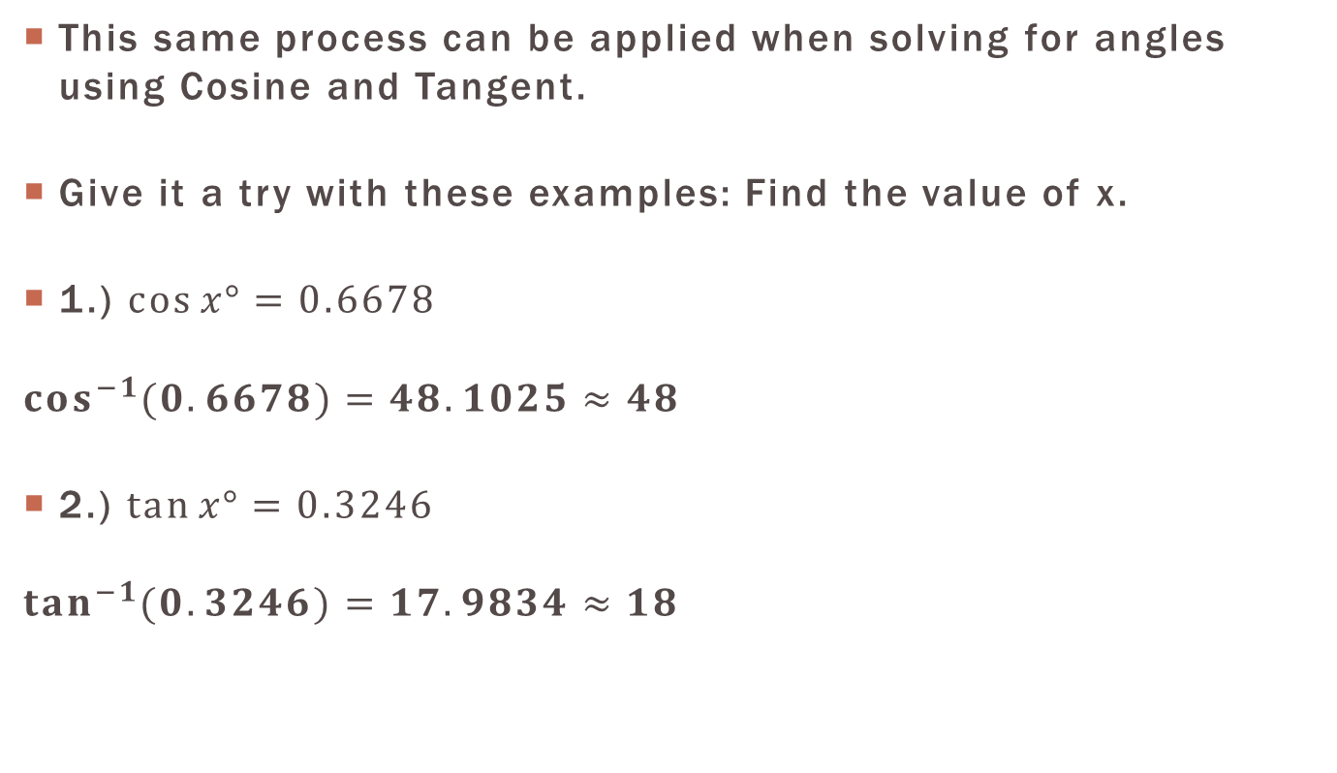
Finding Angles
This same process can be applied when solving for angles using Cosine and Tangent.
Give it a try with these examples: Find the value of x.
1.) $\cos{x°}=0.6678$
$$\cos^{−1}{(0.6678)}=48.1025≈48$$
2.) $\tan{x°}=0.3246$
$$\tan^{−1}{(0.3246)}=17.9834≈18$$
Note: When you have to divide to get the decimal, it is best to round to 4 decimal places.

Slide 23
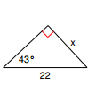

Final Check
Solve the value of x using trig ratios.
1.)
Solution:
$$\sin{43°}=\frac{x}{22}$$
$$x=22×\sin{43°}$$
$$x≈15.004$$

Slide 24
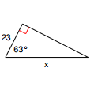

Final Check
Solve the value of x using trig ratios.
2.)
Solution:
$$\cos{63°}=\frac{23}{x}$$
$$x=\frac{23}{\cos{63°}}$$
$$x≈50.6619$$

Slide 25


Final Check
Solve the value of x using trig ratios.
3.)
Solution:
$$\tan{38°}=\frac{20}{x}$$
$$x=\frac{20}{\tan{38°}}$$
$$x≈25.5988$$

Slide 26


Final Check
Solve the value of x using trig ratios.
4.)
*Just pretend “?” is x.
Solution:
$$\tan{x°}=\frac{8}{20}$$
$$\tan{x°}=0.4$$
$$x=\tan^{−1}{(0.4)}=21.8014≈22$$

