Slide 1
Geometry Unit 8
8-7 Word Problems with Trigonometry

Slide 2
Warm-Up
Work on the problems from the last section of the 8-5/8-6 Notes.
Answer with your groups then come up and fill in the answers on the board.

Slide 3
Applications of Right Triangle Trig
Content Objective: Students will be able to solve for missing side lengths and angle measures in right triangles through word problems.
Language Objective: Students will be able to draw and label diagrams for right triangle word problems.

Slide 4
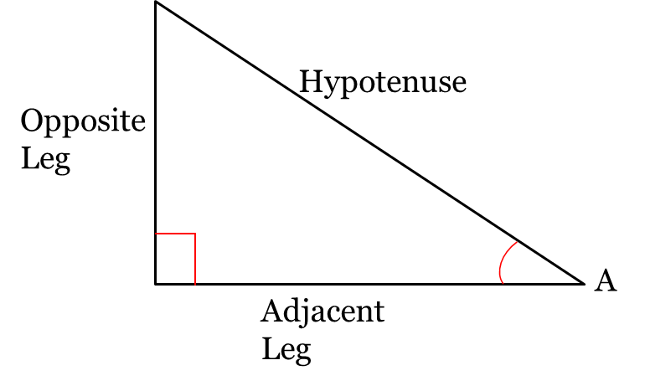
Quick Review of the Trig ratios
Given a right triangle, with $<A$ marked, we have the following ratios:
$$\sin{A}=$$
$$\cos{A=}$$
$$tan A=$$
$$\frac{leg opposite < A}{hypotenuse}$$
$$\frac{leg adjacent to< A}{hypotenuse}$$
$$\frac{leg opposite < A}{leg adjacent to <A}$$

Slide 5
Trigonometry’s Place in the World
Trigonometry can be used on a daily basis in the workplace.
Since trigonometry means "triangle measure", any profession that deals with measurement deals with trigonometry as well.
Carpenters, construction workers and engineers, for example, must possess a thorough understanding of trigonometry.

Slide 6
Looking Up: Angle of Elevation
The angle of elevation of an object as seen by an observer is the angle between the horizontal and the line from the object to the observer's eye (the line of sight).
The angle of elevation is always measured from the ground up. It is always INSIDE the triangle.

Slide 7
Looking Down: Angle of Depression
When an object is below the level of the observer, the angle between the horizontal and the observer's line of sight is called the angle of depression.
It is always OUTSIDE the triangle. It is never inside the triangle.
x

Slide 8
Example: Word Problem with Elevation
The length of a wire supporting a radio tower is 157 feet. The angle of elevation from the top of the radio tower to the foot of the wire is $56°$. How tall is the radio tower?
Each of these problems can be solved with the following steps:
Step 1: Draw a diagram of the problem
Tower
Wire

Slide 9
Example: Word Problem with Elevation
Step 2: Label the diagram
Step 3: Identify and setup the trig ratio required from the information given.
157
x
$$56°$$
This will require the Sine ratio
157
$$\sin{56°=\frac{x}{157}}$$
x
$$56°$$

Slide 10
Example: Word Problem with Elevation
Step 4: Solve the Problem
$$\sin{56°}=\frac{x}{157}$$
$$x=157×sin{56°}$$
$$x=157×0.8290$$
$x≈130.16$ or $x≈130$
157
x
$$56°$$

Slide 11
Example: Word Problem with Depression
From the top of a vertical cliff 40 m high, the angle of depression of an object that is level with the base of the cliff is 34º. How far is the object from the base of the cliff?
Follow the same steps as before to solve this
Step 1: Draw a diagram of the problem
Top (Line of sight)
Cliff
Base To Object

Slide 12
Example: Word Problem with Elevation
$$34°$$
Step 2: Label the diagram
Step 3: Identify and setup the trig ratio required from the information given.
40
$$34°$$
x
$$34°$$
This will require the Tangent ratio
40
$$\tan{34°=\frac{40}{x}}$$
$$34°$$
x

Slide 13

Example: Word Problem with Elevation
Step 4: Solve the Problem
$$\tan{34°}=\frac{40}{x}$$
$$x=\frac{40}{\tan{34°}}$$
$x≈59.3024$ or $x≈59$
$$34°$$
40
$$34°$$
x

Slide 14

Example: Finding the Angle
When the sun is at a certain angle of elevation, a 32 m tall building casts a shadow 21 m long. What is the angle of elevation that causes this shadow with the building?
If you follow the steps, you should have this diagram
With this ratio:
$$\tan{x°=}\frac{32}{21}$$
Solution:
$$x=\tan^{−1}{\frac{32}{21}}$$
$$x≈57°$$
Building
Angle of Elevation
32
$$x°$$
21
Shadow

Slide 15

Final Checks
Use the steps given to solve the following problems:
1.) A guy wire is attached to the top of a 75 foot tower and meets the ground at a $65°$ angle. How long is the wire?
If you follow the steps, you should have this diagram
With this ratio:
$$\sin{65°=}\frac{75}{x}$$
Solution:
$$x=\frac{75}{\sin{65}}$$
$$x≈83$$
Wire
Tower
x
Angle of Elevation
75
$$65°$$

Slide 16

Final Checks
2.) An observer in an airplane at a height of 500 meters sees a car at an angle of depression of $31°$ . If the plane is over a barn, how far is the car from the barn?
If you follow the steps, you should have this diagram
With this ratio:
$$\tan{31°=}\frac{500}{x}$$
Solution:
$$x=\frac{500}{\tan{31}}$$
$$x≈832$$
$$31°$$
Angle of Depression
Height
500
$$31°$$
x
Car to Barn

