Slide 1
Geometry Unit 9
9-1: Circle Basics
And
9-2: Tangent Properties

Slide 2
Circles
Content Objective: Students will be able to solve for missing lengths in circles.
Language Objective: Students will be able to identify the types of lines in circles through their notation and their properties.

Slide 3
Circles – Basic Terms
Circle: A set of points in a plane that are all equidistant (the same given distance) from a given point in that plane.
Center: The point in the plane that all points of the circle are equidistant to.
Center

Slide 4
Lines inside the Circle
Radius: The line that represents the distance from any given point on the circle to the center.
Chord: A segment whose endpoints lie on a circle.
Diameter: A chord that goes through the center of the circle.
A
Radius: $\overline{OA}$
Chord: $\overline{DE}$
B
C
Diameter: $\overline{BC}$
O
D
E

Slide 5
Lines Through the Circle
Secant: A line that goes through a circle, crossing at two points.
Tangent: A line in the plane of a circle that intersects the circle in exactly on point, called the point of tangency.
Point of Tangency
Tangent
A
Secant

Slide 6
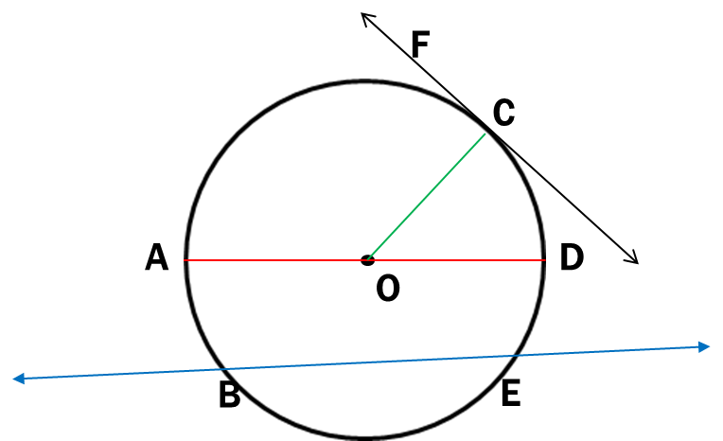
Lines Practice
Identify the type of line based off the picture and the notation given.
1.) $\overline{AD}$
2.) $\overline{BE}$
3.) $\overset{⃡}{BE}$
4.) $\overset{⃡}{FC}$
5.) $\overline{OC}$
Diameter
Chord
Secant
Tangent
Radius

Slide 7
Common Tangents
A Line that is tangent to each of two coplanar circles is called a common tangent.
Between two coplanar circles, there can be no common tangents, or as many as 4…
It all depends on how the circles are placed.
Examine the chart on the following slide to gain an understanding.

Slide 8
Common Tangents – Chart

Slide 9
Theorems with Tangents
Theorem 9-1: If a line is tangent to a circle, then the line is perpendicular to the radius drawn to the point of tangency.
If: $\overset{⃡}{AB}$ is a tangent
$D$ is the point of tangency
Then: $\overset{⃡}{AB}$ $\overline{OD}$
A
D
B
O

Slide 10
Theorems with Tangents
Theorem 9-2: If a line in the plane of a circle is perpendicular to a radius at its other endpoint, then the line is tangent to the circle.
If: $\overset{⃡}{AB}$ radius $\overline{OD}$ at point D.
Then: $\overset{⃡}{AB}$ is tangent to the circle
A
D
B
O

Slide 11
Corollary with Tangents
Corollary: Tangents to a circle from a point are congruent
If: $\overline{PA}$ and $\overline{PB}$ are tangent to the circle at
points A and B, respectively.
Then: $\overline{PA}≅\overline{PB}$
A
P
B

Slide 12
Where will you see these Theorems used
Since these theorems tell us about properties related to tangent, we can use them to confirm the existence of tangent lines…
Or find the measures of lines when given tangents.

Slide 13
Identifying Tangent Lines
Determine if the line AB is tangent to the circle
From the theorems, we can determine that we should have a right triangle in order for $\overline{AB}$ to be a Tangent.
So we must check if this is a right triangle…
Which we can do by using the Pythagorean Theorem
20
12
You should discover that this is a Pythagorean Triple (12-16-20), so this is a right triangle.
Thus, $\overline{AB}$ is a tangent line.

Slide 14
Identifying Tangent Lines
Determine if the line AB is tangent to the circle
Just like the previous problem, you must check to see if this a right triangle using the Pythagorean Theorem.
You should have
$${11}^{2}+{6.6}^{2}={13}^{2}$$
$$121+43.56=169$$
$$164.56≠169$$
Thus, $\overline{AB}$ is NOT a tangent line

Slide 15
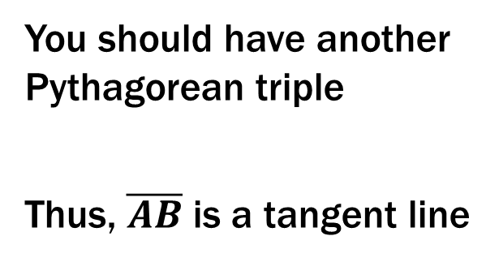
Identifying Tangent Lines – Try these in your Group
Determine if the line AB is tangent to the circle
You should have another Pythagorean triple
Thus, $\overline{AB}$ is a tangent line

Slide 16
Identifying Tangent Lines
Determine if the line AB is tangent to the circle
You will need the Pythagorean Theorem.
You should have
$${11.4}^{2}+{15.2}^{2}={19}^{2}$$
$$129.96+231.04=361$$
$$361=361$$
Thus, $\overline{AB}$ is a tangent line

Slide 17
Using tangents to find lengths
Find the segment length indicated (pretend the question mark is an “x”). You may use rounded decimals in your answers.
Since we have a tangent line, then we have a right triangle. Thus, we can use the Pythagorean theorem to find the missing side:
$$x^{2}+4^{2}={8.5}^{2}$$
$$x^{2}+16=72.25$$
$$x^{2}=56.25$$
$$x=\sqrt{56.25}=7.5$$

Slide 18
Using tangents to find lengths – Try the Rest in your groups
Find the segment length indicated (pretend the question mark is an “x”). You may use rounded decimals in your answers.
First get all the sides in order, then use the Pythagorean Theorem:
$$x^{2}+{1.5}^{2}={2.5}^{2}$$
$$x^{2}+2.25=6.25$$
$$x^{2}=4$$
$$x=\sqrt{4}=2$$
1.5
2.5

Slide 19
Using tangents to find lengths
Find the segment length indicated (pretend the question mark is an “x”). You may use rounded decimals in your answers.
You have seen this a few times already:
This a Pythagorean Triple, with 12 and 16 as the legs.
Thus,
$$x=20$$

Slide 20
Using tangents to find lengths
Find the segment length indicated (pretend the question mark is an “x”). You may use rounded decimals in your answers.
Use the Pythagorean Theorem:
$${12}^{2}+{6.4}^{2}=x^{2}$$
$$144+40.96=x^{2}$$
$${184.96=x}^{2}$$
$$x=\sqrt{184.96}=13.6$$
12

Slide 21
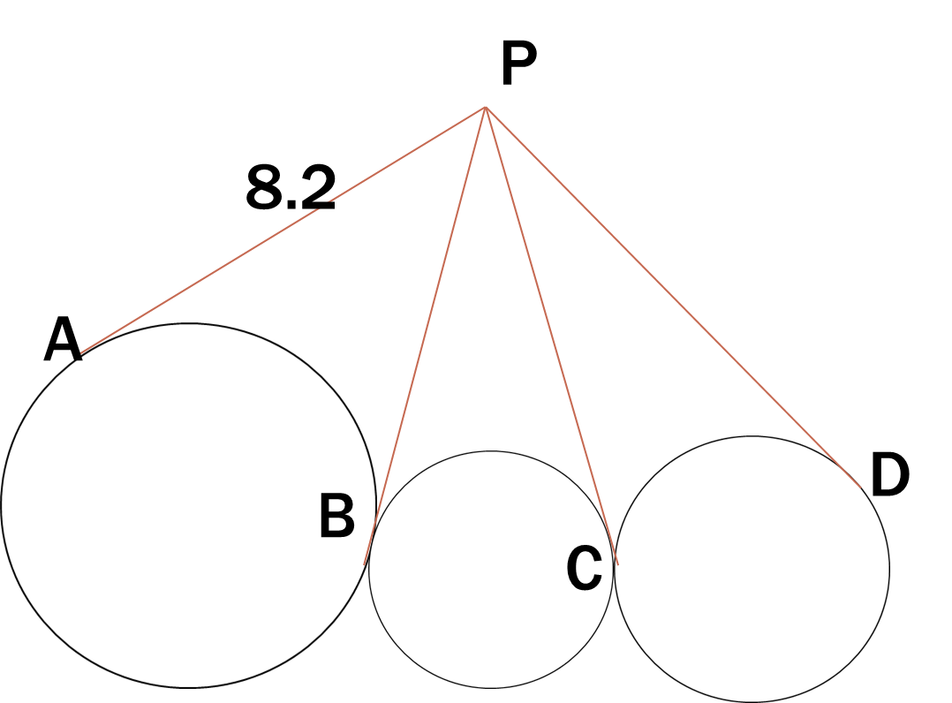

Warm-up: Tangents practice
The diagram below shows tangent lines and circles. Find PD.
Using the corollary, since all the lines are coming from the point P, then they are all congruent to each other.
Thus,
$$PD=8.2$$

Slide 22
Common Tangents – Chart

Slide 23
Common Tangents Practice
From each of the given circles, how many common tangents be made?
4 Common Tangents

Slide 24
Common Tangents Practice
From each of the given circles, how many common tangents be made?
1 Common Tangent

Slide 25
Common Tangents Practice
From each of the given circles, how many common tangents be made?
3 Common Tangents

Slide 26
Common Tangents Practice
From each of the given circles, how many common tangents be made?
2 Common Tangents

Slide 27
Common Tangents Practice
From each of the given circles, how many common tangents be made?
No Common Tangents

Slide 28
Common Tangents Practice
From each of the given circles, how many common tangents be made?
2 Common Tangents

