Slide 1
Geometry Unit 9
9-3: Arcs and Central Angles

Slide 2
Angles in Circles
Content Objective: Students will be able to find the measures of arcs and central angles in circles.
Language Objective: Students will be able to name arcs and angles in circles based off notation and placement on the circle.

Slide 3
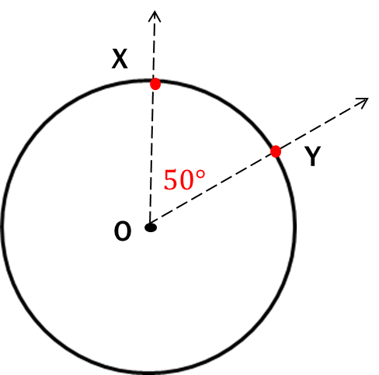
Angle in the Circle
Central Angle: An angle with its vertex at the center of the circle, created by two radii.
$$m<YOX=50°$$

Slide 4
Arcs
Arc: A portion of the circle connecting two points from the circle.
Minor Arc: The shortest arc connecting two points.
Semicircle: An arc that connects two points on opposite sides of the circle (i.e. the points of the diameter).
Major Arc: The longest arc connecting two points.

Slide 5
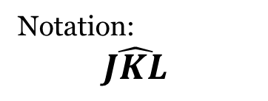
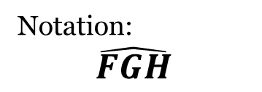
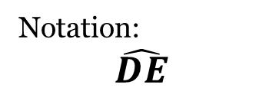
The Measures of the Arcs
Minor Arc
Semicircle
Major Arc
Notation:
$$\hat{DE}$$
Notation:
$$\hat{FGH}$$
Notation:
$$\hat{JKL}$$
Note: Minor arcs are named using two points, while semicircles and major arcs require three points.

Slide 6

Arc Practice
Identify the type of arc based off the picture and the notation.
1.) $\hat{ABD}$
2.) $\hat{AC}$
3.) $\hat{ADB}$
4.) $\hat{AFC}$
A
Semicircle
Minor Arc
B
O
Major Arc
C
F
Major Arc
D

Slide 7
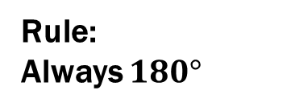
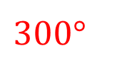
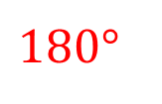
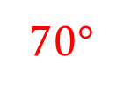
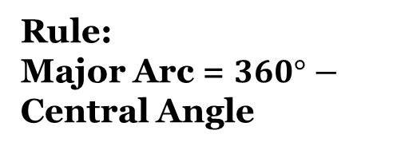
Use the measures given to find a rule for how to find the measure of each type of arc.
Minor Arc
Semicircle
Major Arc
$$180°$$
$$300°$$
$$70°$$
$$m\hat{DE}=70°$$
$$m\hat{FGH}=180°$$
$$m\hat{JKL}=300°$$
Rule:
Minor Arc = Central Angle
Rule:
Always $180°$
Rule:
Major Arc = $360°−$ Central Angle

Slide 8
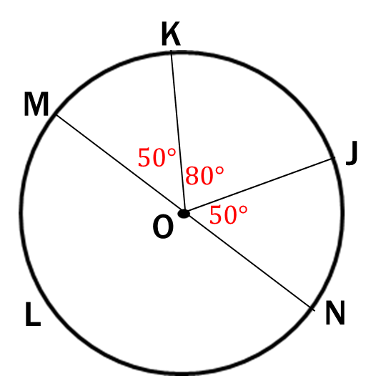

Arc Practice – With Measures
Based on the given information, find the measure of the arc or of the angle.
1.) $m<KOJ$ 5.) $m\hat{MLJ}$
2.) $m\hat{MJ}$
3.) $m\hat{MKN}$
4.) $m\hat{MLK}$
$$Minor Arc=Central Angle=80°$$
$$m\hat{MLJ}=360° −130°=230°$$
$$80°$$
$$m\hat{MJ}=50°+80°=130°$$
$$m\hat{MKN}=180°$$
$$m\hat{MLK}=360° −50°=310°$$

Slide 9
Practice With Names
Name the arc made by the given angle.
The arc is made by the part of the circle connecting the two radii.
Thus, we have the minor arc
$\hat{FE}$
Or, we could also say we have the major arc
$$\hat{FDE}$$

Slide 10

Practice With Names
Name the arc made by the given angle.
Similar to the last problem
We have the minor arc
$\hat{HI}$
Or, we could also say we have the major arc
$$\hat{HJI}$$

Slide 11

Practice With Names
Name the central angle of the given arc
The central angle is covering the arc.
Thus, we have the central angle
$$<1$$
Note: I had to use a number because it was there, but also because I did not three letters.

Slide 12

Practice With Names
Name the central angle of the given arc
The central angle is covering the arc.
Thus, we have the central angle
$$<MQL$$

Slide 13

Practice With Names – Interchanging
If an angle is given, name the arc it makes. If an arc is given, name its central angle.
You were given an arc…
So find the central angle.
Central Angle
$$<RQS$$

Slide 14

Practice With Names – Interchanging
If an angle is given, name the arc it makes. If an arc is given, name its central angle.
You were given an angle…
And specifically asked to find the major arc.
Major Arc
$$\hat{ACB}$$

Slide 15

Practice With Names – Interchanging
If an angle is given, name the arc it makes. If an arc is given, name its central angle.
You were given a central angle…
So find the arc(s) it makes.
Arc:
Minor: $\hat{KL}$
Or
Major: $\hat{KIL}$

Slide 16

Practice With Names – Interchanging
If an angle is given, name the arc it makes. If an arc is given, name its central angle.
You were given an arc, specifically a major arc…
So find the central angle.
Central Angle
$$<SQT$$

Slide 17

Finding Arcs and Angles
Find the measure of the arc or central angle indicated.
G
$$60°$$
9.) $<GQF$ 10.) $<EQF$
11.) $\hat{EHF}$ 12.) $\hat{GE}$
13.) $<GQE$ 14.) $\hat{GHE}$
F
$$60°$$
$$50°$$
$$50°$$
Q
E
H
$$310°$$
$$110°$$
$$110°$$
$$250°$$

