Slide 1
Geometry Unit 9
9-4: Arcs and Chords

Slide 2
Arcs and Chords
Content Objective: Students will be able to find the measures of arcs and chords in circles.
Language Objective: Students will be able to identify properties of arcs and chords from theorems and examples.

Slide 3
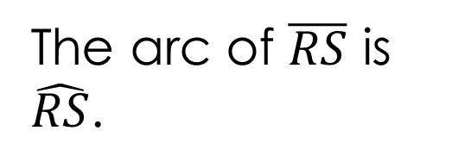
Arcs and chords
In $ʘO$, $\overline{RS}$ cuts off two arcs, minor arc $\hat{RS}$, and major arc $\hat{RTS}$.
From the two arcs, we say that the minor arc, $\hat{RS}$, is called the arc of $\overline{RS}$.
R
T
The arc of $\overline{RS}$ is $\hat{RS}$.
O
S

Slide 4
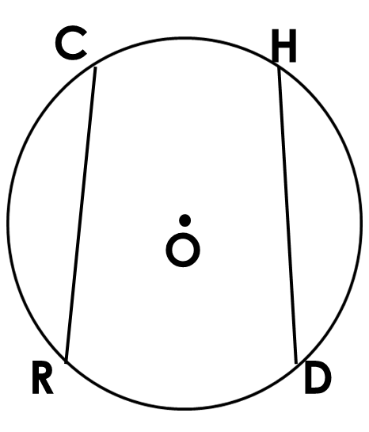
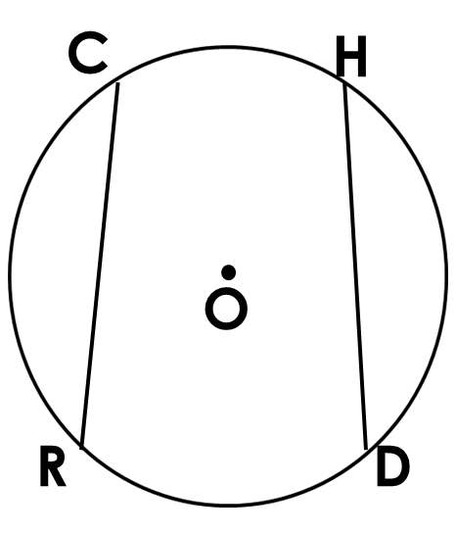
Arcs and Chords
Theorem 9-4: In the same circle, or in congruent circles:
Congruent arcs have congruent chords;
Congruent chords have congruent arcs.
For ʘ O, we have the two conditions:
If: $m \hat{CR}≅m \hat{HD}$
Then: $\overline{CR} ≅ \overline{HD}$
(2) If: $\overline{CR} ≅ \overline{HD}$
Then: $m \hat{CR}≅m \hat{HD}$

Slide 5
Arcs and Chords
Theorem 9-5: A diameter that is perpendicular to a chord
the chord and its arc.
Given: ʘ O; $\overline{BE}⊥ \overline{AC}$
Then: $\overline{AR}≅\overline{RC}$; $\hat{AE}≅\hat{CE}$
bisects
B
O
R
A
C
E

Slide 6

Arcs and Chords
Theorem 9-6: In the same circle, or in congruent circles:
Chords equally distant from the center are congruent;
Congruent chords are equally distant from the center.
S
With $\overline{AV}$ and $\overline{UV}$ as the respective distances between $\overline{BT}$ and $\overline{SP}$;
(1) If $AV=UV$
Then $\overline{BT} ≅ \overline{SP}$
(2) If $\overline{BT} ≅ \overline{SP}$
Then $AV=UV$
U
V
P
B
A
T

Slide 7
Practice Using the Theorems
Find the measures of x and y.
1.)
Diameter $\overline{CD}$ bisects chord $\overline{AB}$, thus
$x=5$
By theorem 9-5
$\overline{AB}≅\overline{EF}$, so $m \hat{AB}=86$
By theorem 9-4
Diameter $\overline{CD}$ bisects chord $\overline{AB}$, so
$$y=43$$
By theorem 9-5
$$86°$$
F
A
E
10
5
O
D
C
$$x$$
$$y°$$
B

Slide 8
Practice using The theorems
2.) Find the length of chord $\overline{AB}$
Using a Pythagorean triple, we can show that
$$AP=4$$
Also, $\overline{OP}$ bisects $\overline{AB}$, thus
$$AB=8$$
By theorem 9-5
O
5
3
A
B
P

Slide 9

Practice the Rules
Find the value of x.
S
$\overline{AU}$ bisects $\overline{SP}$, thus
$$SP=6$$
By theorem 9-5
This makes $\overline{SP}≅\overline{BT}$
Thus
$$x=4$$
By theorem 9-6
3
U
x
A
P
4
B
6
T

Slide 10
Final Practice
Find the measure(s) given.
Find $OP$ if $AB=24$
Since $AB=24$, then
$$PB=12$$
By Theorem 9-5
You can use the Pythagorean Theorem, or a triple, which will result in
$$OP=5$$
O
13
A
P
B

Slide 11
Final Practice
Find the measure(s) given.
B
Find $m \hat{CD}$
Since $\overline{BC}≅\overline{CD}$, then their arcs must also be $≅$, by theorem 9-4.
Since $m\hat{ BD}=90$, then
$$m \hat{CD}=\frac{1}{2}×90$$
$=45$
C
A
D
O

Slide 12


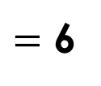
Final Practice – Challenge Problem
Find the measure(s) given.
E
If $OM=ON=7$ and $CM=6$, find
$DM$
$EF$
$DO$
$EO$
D
$=$ 6
$=$ 12
N
M
$$=\sqrt{85}$$
O
$$=\sqrt{85}$$
F
C

