Slide 1
Geometry Unit 9
9-5 Inscribed Angles in Circles

Slide 2
Inscribed Angles in Circles
Content Objective: Students will be able to identify inscribed angles and their intercepted arcs in circles.
Language Objective: Students will be able to solve for the missing measures of inscribed angles and their intercepted arcs in a variety of problems.

Slide 3
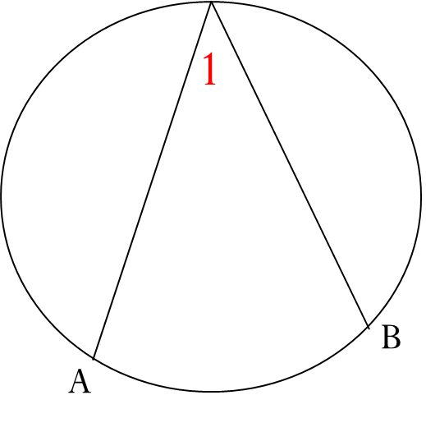
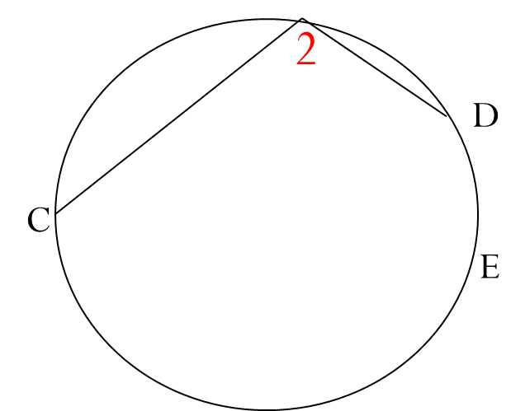
Inscribed Angles in a Circle
An Inscribed Angle is an angle whose vertex is on a circle and whose sides are chords of the circle.
The arc created by the chords is known as the Intercepted Arc.
Intercepted Arc
Intercepted Arc
$<1$ is the Inscribed Angle
$\hat{AB}$ is the Intercepted Arc
$<2$ is the Inscribed Angle
$\hat{CED}$ is the Intercepted Arc

Slide 4
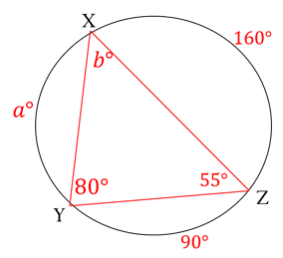

Warm-up: 9-5 Practice
1.) Name each Inscribed Angle, along with its intercepted arc?
Angle Intercepted Arc
$<X$
$\hat{XZ}$
$$<Z$$
$$\hat{YZ}$$
$$<Y$$
$$\hat{XY}$$
2.) What do you notice about the measure of $<Y$ and the measure of its Intercepted Arc?

Slide 5
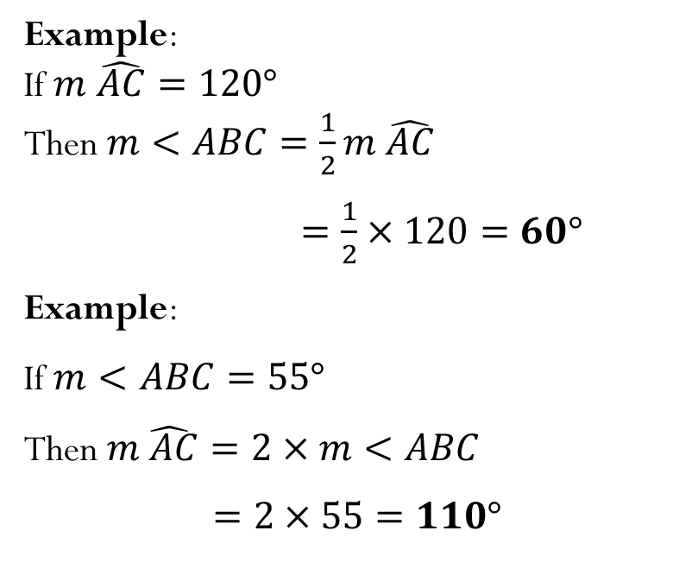
Theorems For Inscribed Angles
Theorem 9-7: The measure of an inscribed angle is equal to
half the measure of its intercepted arc.
B
Equation:
$$Inscribed Angle=\frac{1}{2}×Intercepted Arc$$
Example:
If $m \hat{AC}=120°$
Then $m<ABC=\frac{1}{2}m \hat{AC}$
$=\frac{1}{2}×120=60°$
Example:
If $m<ABC=55°$
Then $m\hat{ AC}=2×m<ABC$
$=2×55=110°$
O
A
C
Intercepted Arc

Slide 6


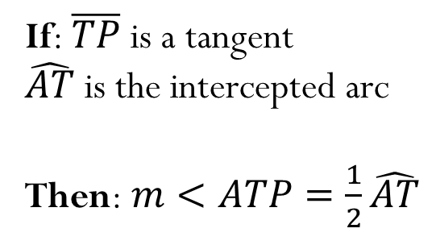
Theorems For Inscribed Angles
Theorem 9-8: The measure of an angle formed by a chord and a tangent is equal to
half the measure of the intercepted arc.
If: $\overline{TP}$ is a tangent
$\hat{AT}$ is the intercepted arc
Then: $m<ATP=\frac{1}{2}\hat{AT}$
A
Intercepted Arc:
$140°$
Example:
If $m\hat{ AT}=140°$
$$m<ATP=\frac{1}{2}\hat{AT}$$
$$=\frac{1}{2}×140$$
$$=70°$$
P
T

Slide 7
Corollaries For Inscribed Angles
Corollary 1: If two inscribed angles intercept the same arc, then the angles are
congruent.
$$<1≅ <2$$
1
2
Intercepted Arc

Slide 8
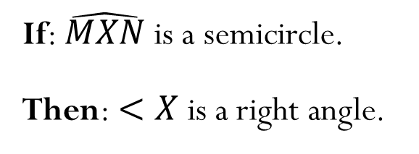
Corollaries For Inscribed Angles
Corollary 2: An angle inscribed in a semicircle is a
right angle.
X
If: $\hat{MXN}$ is a semicircle.
Then: $<X$ is a right angle.
M
N

Slide 9
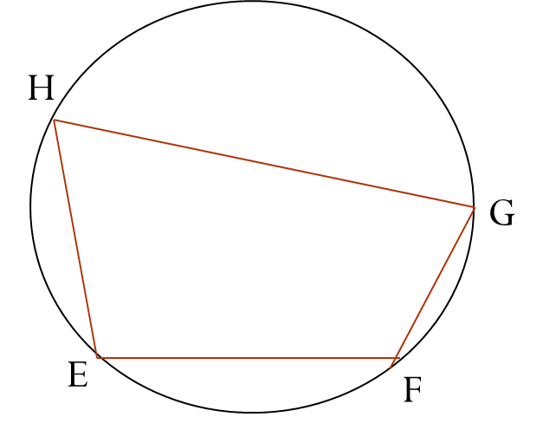
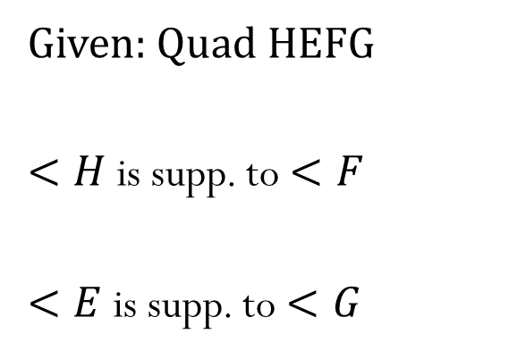
Corollaries For Inscribed Angles
Corollary 3: If a quadrilateral is inscribed in a circle, then its opposite angles are
supplementary.
Given: Quad HEFG
$<H$ is supp. to $<F$
$<E$ is supp. to $<G$

Slide 10



Final Practice
Use the theorems and corollaries given to solve for the variables given.
For x:
$$x=\frac{1}{2}×100$$
$$=50°$$
$$100°$$
$$z°$$
$$y°$$
For y:
$$y=\frac{1}{2}×120$$
$$=60°$$
$$70°$$
$$x°$$
$$120°$$
For z:
$$70=\frac{1}{2}×z$$
$$z=70×2$$
$=140°$

Slide 11


Final Practice
Use the theorems and corollaries given to solve for the variables given.
For x:
$$x=\frac{1}{2}×76$$
$$=38°$$
This will use Corollary 1
$$76°$$
$$38°$$
For y:
$$y=\frac{1}{2}×76$$
$$=38°$$
$$y°$$
$$x°$$

Slide 12


Final Practice
Use the theorems and corollaries given to solve for the variables given.
This will use Corollary 3
For x:
$$110+x=180$$
$x=70°$
$$y°$$
$$x°$$
For y:
$$85+y=180$$
$$y=95°$$
$$110°$$
$$85°$$

Slide 13
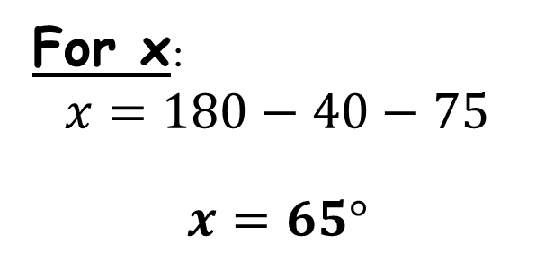
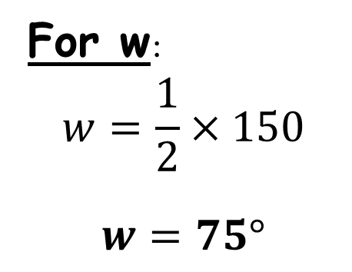
Final Practice
Use the theorems and corollaries given to solve for the variables given.
For w:
$$w=\frac{1}{2}×150$$
$w=75°$
$$y°$$
$$40°$$
$$150°$$
$$w°$$
$$x°$$
For x:
$$x=180−40−75$$
$x=65°$
$$z°$$

Slide 14
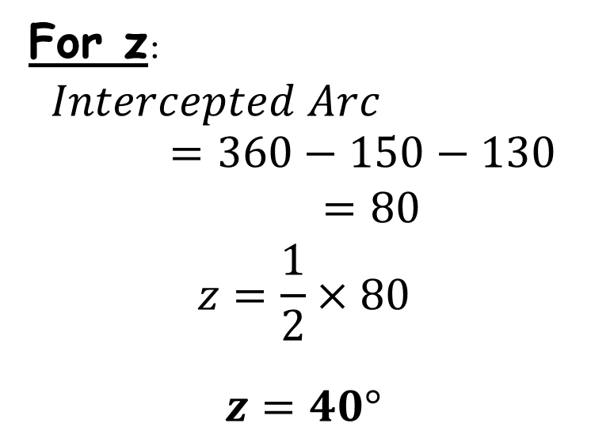
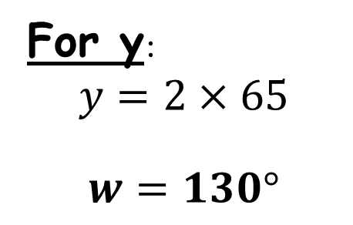
Final Practice
Use the theorems and corollaries given to solve for the variables given.
For y:
$$y=2×65$$
$w=130°$
$$y°$$
$$40°$$
$$150°$$
For z:
$$Intercepted Arc=360−150−130$$
$=80$
$$z=\frac{1}{2}×80$$
$z=40°$
$$w°$$
$$x°$$
$$z°$$

