Slide 1
Geometry Unit 9
9-6: Other Angles of Circles

Slide 2
Other Angles of Circles
Content Objective: Students will be able to identify interior and exterior angles created by chords, secant, and tangent lines in circles.
Language Objective: Students will be able to write equations and solve for the measures of interior and exterior angles in circles.

Slide 3

Interior Angles
Theorem 9-9:The measure of an angle formed by two chords that intersect inside a circle is equal to
Equation:
$m<1=\frac{1}{2}(m \hat{AC}+m\hat{ BD})$
half the sum of the measures of the intercepted arcs.
A
D
1
B
C

Slide 4

Interior Angles Practice
Find the measure of x.
1.)
$$x=\frac{1}{2}\left(40+30\right)$$
$$x=\frac{1}{2}×70$$
$$x=35$$
$$30°$$
$$40°$$
$$x°$$

Slide 5

Interior Angles Practice
Find the measure of x.
2.)
$$140°$$
$$x=\frac{1}{2}\left(140+135\right)$$
$$x=\frac{1}{2}×275$$
$$x=137.5$$
$$x°$$
$$135°$$

Slide 6

Interior Angles Practice
Find the measure of x.
3.)
$$x°$$
$$75=\frac{1}{2}\left(x+100\right)$$
$$150=x+100$$
$$x=50$$
$$75°$$
$$100°$$

Slide 7
Exterior Angles
Theorem 9-10: The measure of an angle formed by two secants, two tangents, or a secant and a tangent drawn from a point outside the circle is equal to
half the difference of the measures of the intercepted arcs.

Slide 8
Exterior Angles
Theorem 9-10: Case 1: Two Secants
$$m<1=\frac{1}{2}(m \hat{AC}−m \hat{BD})$$
A
D
1
B
C

Slide 9
Exterior Angles
Theorem 9-10: Case 2: Two Tangents
$$m<2=\frac{1}{2}(m \hat{ACB}−m \hat{AB})$$
A
C
2
B

Slide 10
Exterior Angles
Theorem 9-10: Case 3: A secant and a Tangent
A
$$m<3=\frac{1}{2}(m \hat{AC}−m \hat{BC})$$
B
3
C

Slide 11

Exterior Angles Practice
Find the measure of x.
1.)
$$x=\frac{1}{2}\left(120−40\right)$$
$$x=\frac{1}{2}×80$$
$$x=40$$
$$120°$$
$$40°$$
$$x°$$

Slide 12

Exterior Angles Practice
Find the measure of x.
3.)
$$30=\frac{1}{2}\left(x−70\right)$$
$$60=x−70$$
$$x=130$$
$$30°$$
$$70°$$
$$x°$$

Slide 13

Exterior Angles Practice
Find the measure of x.
2.)
$$x=\frac{1}{2}\left(260−100\right)$$
$$x=\frac{1}{2}×160$$
$$x=80$$
$$260°$$
$$x°$$
$$100°$$

Slide 14
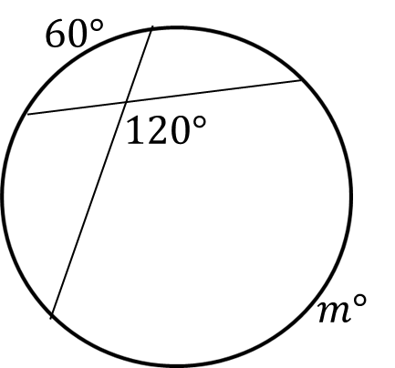

Mixed Practice
Solve for the missing value(s).
$$120=\frac{1}{2}\left(60+m\right)$$
$$240=60+m$$
$$m=180$$

Slide 15

Mixed Practice
Solve for the missing value(s).
$$p=\frac{1}{2}\left(129−63\right)$$
$$p=\frac{1}{2}(66)$$
$$p=33$$
$$p°$$
$$61°$$
$$129°$$

Slide 16

Mixed Practice
Solve for the missing value(s).
$$58=\frac{1}{2}\left(360−a−a\right)$$
$$58=\frac{1}{2}(360−2a)$$
$$58=180−a$$
$$a=180−58$$
$$a=122$$
$$58°$$
$$a°$$
$$360°−a°$$

Slide 17


Mixed Practice
Solve for the missing value(s).
For c:
$$c=\frac{1}{2}(175+53)$$
$$c=\frac{1}{2}(228)$$
$$c=114$$
$$53°$$
$$c°$$
$$d°$$
$$175°$$
For d:
$$d=180−114$$
$d=66$

Slide 18


Mixed Practice
Solve for the missing value(s).
For x:
$$x=\frac{1}{2}(70+50)$$
$$x=\frac{1}{2}(120)$$
$$x=60$$
$$50°$$
$$x°$$
$$70°$$
$$26°$$
$$y°$$
For y:
$$y=\frac{1}{2}(70−26)$$
$$y=\frac{1}{2}×44$$
$$y=22$$

Slide 19


Mixed Practice
Solve for the missing value(s).
For x:
$$100=\frac{1}{2}(x+66)$$
$$200=x+66$$
$$x=134$$
$$40°$$
$$y°$$
$$66°$$
$$x°$$
$$100°$$
For y:
$$40=\frac{1}{2}(134−y)$$
$$80=134−y$$
$$y=134−80$$
$$y=54$$

