Slide 1
Geometry Unit 9
9-7: Lengths of Segments in Circles

Slide 2
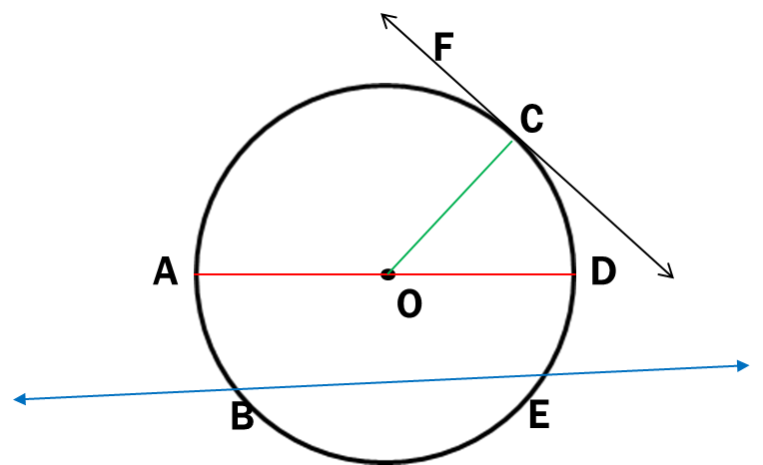
Warm-up
Identify the type of line, arc or angle that is made based off the picture and the notation given.
1.) $\overline{AD}$ 8.) $\hat{CDA}$
2.) $\overline{BE}$ 9.) $\overset{⃡}{FC}$
3.) $\overset{⃡}{BE}$ 10.) $<DAG$
4.) $\hat{BE}$
5.) $\overline{OC}$
6.) $<COD$
7.) $\hat{DCA}$
Major Arc
Diameter
Chord
Tangent
G
Secant
Inscribed Angle
Minor Arc
Radius
Central Angle
Semicircle

Slide 3
Segment Lengths in Circles
Content Objective: Students will be able to identify segments created by chords, secants, and tangents inside and outside of circles.
Language Objective: Students will be able to solve for the measures of segments created by chords, secants, and tangents by using equations.

Slide 4
Segment Lengths in Circles
In the figure below, you see that $\overline{AB}$ and $\overline{CD}$ intersect at P in the circle.
We call $\overline{AP}$ and $\overline{PB}$ the segments of chord $\overline{AB}$.
Similarly, we would call $\overline{CP}$ and $\overline{PD}$the segments of chord $\overline{CD}$.
D
A
P
C
B

Slide 5
Segment Lengths in Circles
Theorem 9-11: When two chords intersect inside a circle, the of
the segments of one chord equals the of the segments of the other chord.
product
product
D
Given: $\overline{AB}$ and $\overline{CD}$ intersect at P
Then: $f ×h=m×n$
A
$$n$$
$$f$$
P
$$m$$
$$h$$
C
B

Slide 6
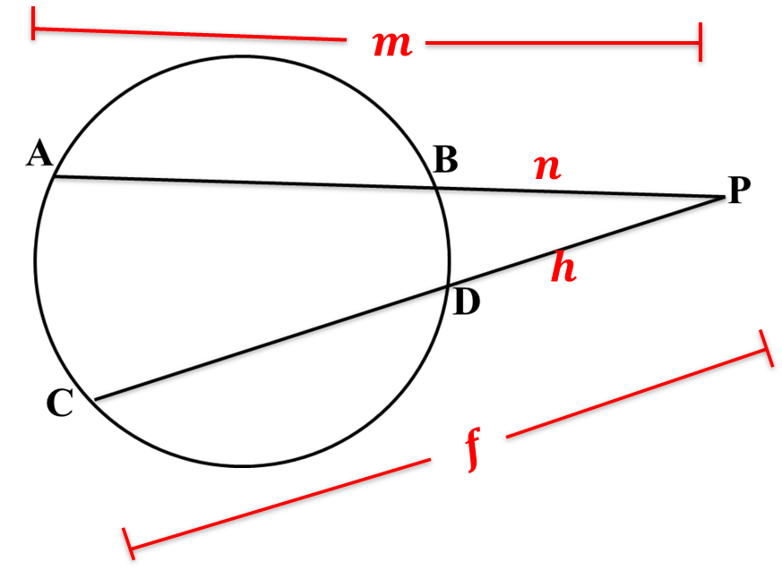
Segment Lengths in Circles
Theorem 9-12: When two secant segments are drawn to a circle from an external point,
the product of one secant segment and its external segment equals
the product of the other secant segment and its external segment.
Given: $\overline{PA}$ and $\overline{PC}$ drawn from P
Then: $f ×h=m×n$

Slide 7
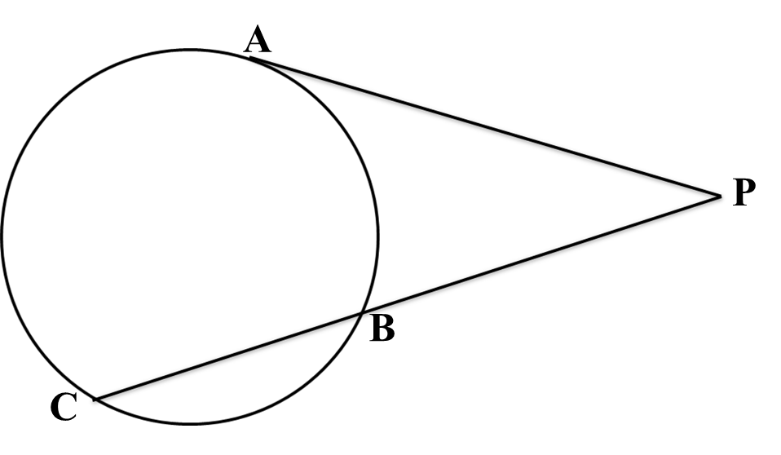
Segment Lengths in Circles
Theorem 9-13: When a secant segment and a tangent are drawn to a circle from an external point,
the product of the secant segment and its external segment is equal to
the square of the tangent segment.
Given: $\overline{PA}$ and $\overline{PC}$ drawn from P
Then: $f ×h=m^{2}$
$$m$$
$$h$$
$$f$$

Slide 8
Examples
Chords, Secants, and Tangents are shown. Find the value of x.
1.)
Using Theorem 9-1, we have
$$x×3x=6×8$$
$${3x}^{2}=48$$
$$x^{2}=16$$
$$x=4$$
6
$$x$$
$$3x$$
8

Slide 9
Examples
Chords, Secants, and Tangents are shown. Find the value of x.
2.)
Using Theorem 9-2, we have
$$x×8=12×4$$
$$8x=48$$
$$x=6$$
$$8$$
$$x$$
4
$$12$$

Slide 10
Examples
Chords, Secants, and Tangents are shown. Find the value of x.
3.)
Using Theorem 9-3, we have
$$x^{2}=4×9$$
$$x^{2}=36$$
$$x=6$$
$$9$$
$$5$$
$$4$$
$$x$$

Slide 11
Group Practice
Chords, Secants, and Tangents are shown. Find the value of x.
1.)
Solution
$$x×4=5×8$$
$$4x=40$$
$$x=10$$
5
4
$$x$$
8

Slide 12
Group Practice
Chords, Secants, and Tangents are shown. Find the value of x.
2.)
9
Solution
$$x×x=9×16$$
$$x^{2}=144$$
$$x=12$$
$$x$$
$$x$$
16

Slide 13
Group Practice
Chords, Secants, and Tangents are shown. Find the value of x.
3.)
Solution
$$x^{2}=7×3$$
$$x^{2}=21$$
$$x=\sqrt{21}$$
$$7$$
4
3
$$x$$

Slide 14
Group Practice
Chords, Secants, and Tangents are shown. Find the value of x.
4.)
Solution
$$3x×2x=8×3$$
$$6x^{2}=24$$
$$x^{2}=4$$
$$x=2$$
$$8$$
5
3
$$2x$$
$$3x$$
$$x$$

Slide 15
Group Practice
Chords, Secants, and Tangents are shown. Find the value of x.
5.)
Solution
$$(x+4)×4=8×5$$
$$4x+16=40$$
$$4x=24$$
$$x=6$$
$$x$$
$$x+4$$
4
3
5
$$8$$

Slide 16
Group Practice
Chords, Secants, and Tangents are shown. Find the value of x.
6.)
Solution
$$x×x=9×3$$
$$x^{2}=27$$
$$x=3\sqrt{3}$$
O
$$9$$
3
$$x$$
$$x$$
3

Slide 17
Group Practice
Chords, Secants, and Tangents are shown. Find the value of x.
7.)
Solution
$$x×5=10×4$$
$$5x=40$$
$$x=8$$
$$x$$
6
5
$$10$$
4

Slide 18
Group Practice
Chords, Secants, and Tangents are shown. Find the value of x.
8.)
Solution
$$x×6=8×3$$
$$6x=24$$
$$x=4$$
x
$$3$$
8
$$11$$
$$6$$

Slide 19
Group Practice
Chords, Secants, and Tangents are shown. Find the value of x.
9.)
Solution
$$4x×x=100$$
$${4x}^{2}=100$$
$$x^{2}=25$$
$$x=5$$
10
$$3x$$
$$x$$
$$4x$$

