Slide 1
Geometry Unit 5
Ways to Prove Triangles Are Congruent

Slide 2
Other Ways to Prove Triangles Congruent
Content Objective: Students will be able to use postulates and theorems to prove that triangles are congruent.
Language Objective: Students will be able to write congruence statements using the AAS and HL Theorems.

Slide 3
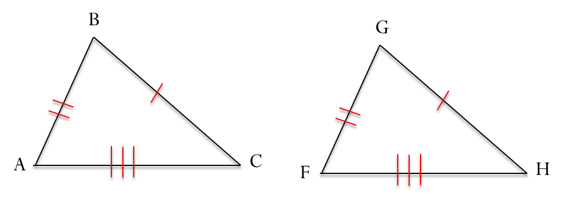
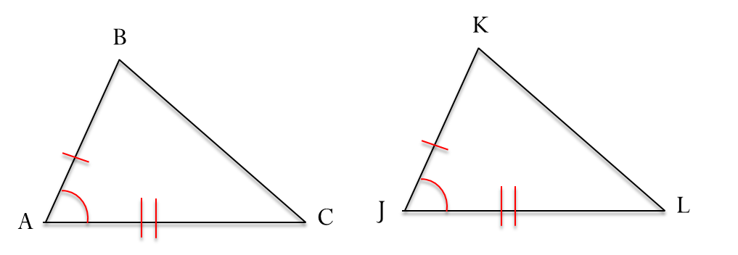
We started with 3 Ways to prove Triangles Congruent
SSS
SAS
ASA
Today, we learn 2 more…

Slide 4
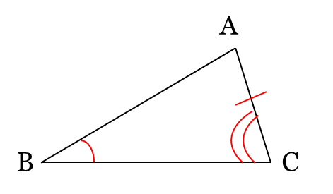
AAS Theorem
Theorem 4-3: AAS Theorem
If two angles and a non-included side of one triangle are congruent to the corresponding parts of another triangle, then the triangles are congruent.
Given: $<B≅ <E;$
$<C≅ <F; \overline{AC}≅\overline{DF}$
Prove: $∆ABC≅∆DEF$
Plan for Proof:
You can use the _____ Postulate by showing that $<$___$≅ <$___
You can do that by using the following fact: two ______ of $∆ABC$ are congruent to two ______ of $∆DEF$.
ASA
A
D
Angles
Angles

Slide 5

AAS Theorem – The Proof
Given: $<B≅ <E;$
$<C≅ <F; \overline{AC}≅\overline{DF}$
Prove: $∆ABC≅∆DEF$
1.) 1.)
2.) 2.)
3.) 3.)
Statements ________ _______ _______Reasons
$<B≅ <E;<C≅ <F; \overline{AC}≅\overline{DF}$
Given
$<A≅ <D$
If 2 <‘s of 1 $∆$ are $≅$ to 2 <‘s of another $∆$, then the 3rd <‘s are $≅$.
$∆ABC≅∆DEF$
ASA Postulate

Slide 6
Overlapping Triangles
Suppose you have the following problem:
Given: $\overline{GJ}≅ \overline{GK};$
$<H≅ <I$
Prove: $∆GHJ≅∆GIK$
How would you solve this?
…Separate the Triangles!
G
K
J
H
I

Slide 7
Overlapping Triangles
Separating the two different triangles, we now have $∆GHJ$ and $∆GIK$ as such:
You can also label $<G≅ <G$ because it is the exact the same angle from the combined diagram.
Therefore, $∆GHJ≅∆GIK$ by the ____ _________.
G
G
J
K
H
I
AAS
Theorem

Slide 8
Right Triangles
The sides of a right triangle named as such:
The side opposite the right angle is known as the Hypotenuse
The other two sides are known as the Legs
Hypotenuse
Leg
Leg

Slide 9
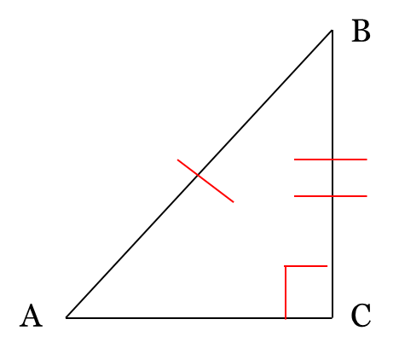
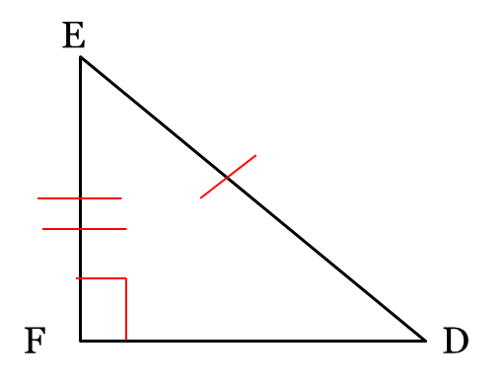
HL Theorem
Theorem 4-4: HL Theorem
If the hypotenuse and a leg of one right triangle are congruent to the corresponding parts of another right triangle, then the triangles are congruent.
Given: $<C and<F are right<^{′}s;$
$\overline{AB}≅\overline{DE} (Hypotenuse);$
$\overline{BC}≅\overline{EF}$ (Leg)
Prove: $∆ABC≅∆DEF$
We will not be proving this one

Slide 10
Proving Triangles Congruent
State which postulate, or theorem, you can use to prove that these triangles are congruent. Explain using the sentence provided.
These triangles are congruent by the _____ _________ because
HL
Theorem
Between the two right triangles, we have the corresponding hypotenuse and legs congruent to one another.

Slide 11
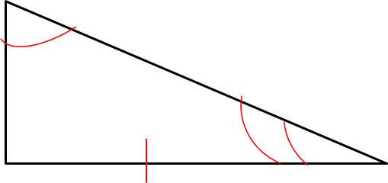
Proving Triangles Congruent
State which postulate, or theorem, you can use to prove that these triangles are congruent. Explain using the sentence provided.
These triangles are congruent by the _____ _________ because
AAS
Theorem
Between the two triangles, we have two angles and their included sides congruent to one another.

Slide 12
Proving Triangles Congruent
State which postulate, or theorem, you can use to prove that these triangles are congruent. Explain using the sentence provided.
These triangles are congruent by the _____ _________ because
ASA
Postulate
Between the two triangles, we have two angles and their included sides congruent to one another.

Slide 13
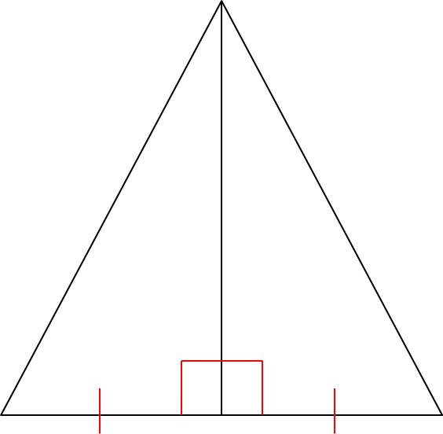
Proving Triangles Congruent
State which postulate, or theorem, you can use to prove that these triangles are congruent. Explain using the sentence provided.
These triangles are congruent by the _____ _________ because
SAS
Postulate
Between the two triangles, we have two angles and their included sides congruent to one another.

Slide 14
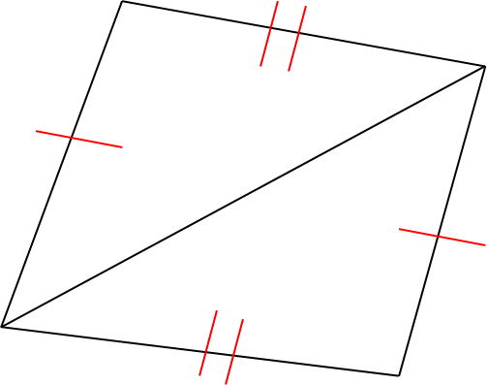
Proving Triangles Congruent
State which postulate, or theorem, you can use to prove that these triangles are congruent. Explain using the sentence provided.
These triangles are congruent by the _____ _________ because
SSS
Postulate
Between the two triangles, we have two angles and their included sides congruent to one another.

Slide 15
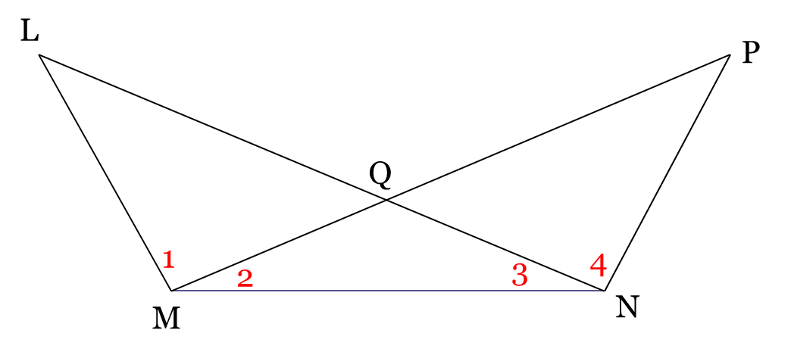
Proving Triangles Congruent
State which postulate, or theorem, you can use to prove that these triangles are congruent. Explain using the sentence provided.
Given: $<2≅ <3$;
$<1≅ <4$
These triangles are congruent by the _____ _________
AAS
Theorem

