Slide 1
Geometry: Unit 2
Angles

Slide 2
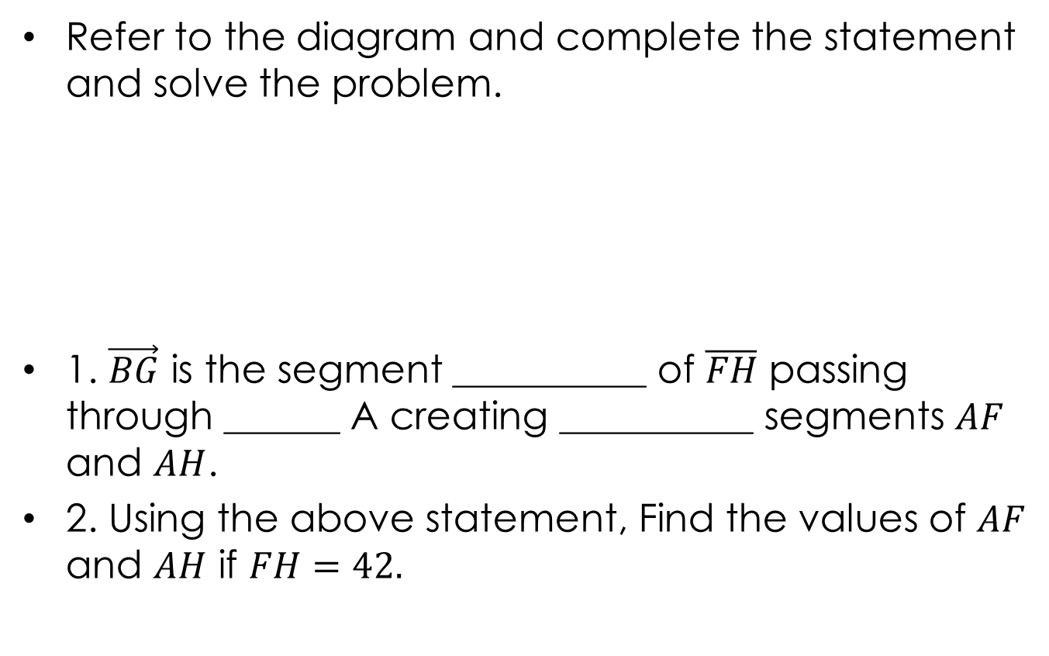
Warmup – Segment Review
Refer to the diagram and complete the statement and solve the problem.
1. $\vec{BG}$ is the segment __________ of $\overline{FH}$ passing through ______ A creating __________ segments $AF$ and $AH$.
2. Using the above statement, Find the values of $AF$ and $AH$ if $FH=42.$
E
B
F
H
A
G

Slide 3
Angles
Content Objective: Students will be able to complete statements and answer problems related to angles using the Angle Addition Postulate.
Language Objective: Students will be able to state and use the Angle Addition Postulate to solve problems.

Slide 4
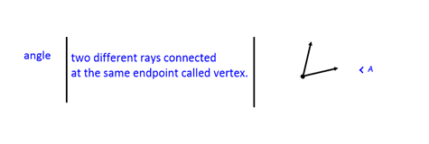
Angle Reminder
Here is a reminder of the definitions, along with visual examples, of an angle, discussed in the previous lecture.
Additional information: The two rays that make the angle are known as the sides.

Slide 5
Different Types of Angles
Angles are classified according to their measures (in degrees for us).
Acute Angle: Measures less than $90°$
Right Angle: Measure of exactly $90°$
Obtuse Angle: Measures larger then $90°$, but less than $180°$
Straight Angle: Measure of exactly 1$80°$

Slide 6
Angle Congruence
Congruent Angles are angles that have equal measures. In the diagram below you can see that both $<A$ and $<B$ have angle measures of $40°$. So we can write
$m<A=m<B$ or $<A= <B$
Thus, we can write that the angles are congruent:
$<A≅ <B$
B
$$40°$$
$$40°$$
A

Slide 7
Adjacent Angles
Adjacent Angles are two angles in a plane that have a common vertex and an common side. Here are some examples:
$<1$ and $<2$ are adjacent angles.
$<3$ and $<4$ are not adjacent angles.
1
2
1
4
2
3
4
3

Slide 8
Angle Bisector
The bisector of an angle is the ray that divides the angle into two congruent, adjacent angles.
In the given diagram,
$m<XYW=m<WYZ$,
$$<XYW≅ <WYZ,$$
$\vec{YW}$bisects $<XYZ$.
X
W
$$30°$$
$$30°$$
Y
Z

Slide 9
Using Diagrams to Identify
What can you conclude from the diagram shown below.
All points shown are coplanar
$\overset{⃡}{AB}$, $\vec{BD}$, and $\vec{BE}$ intersect at $B$
A, B, and C are Collinear.
B is between A and C.
$<ABC$ is a straight angle.
D is in the interior of $<ABE$
$<ABD$ and $<DBE$ are adjacent angles
A
D
B
E
C

Slide 10
Angle Addition Postulate
Angle Addition Postulate:
If point $B$ lies in the interior of $<AOC$, then
$m<AOB+m<BOC=m<AOC$.
2. If $AOC$ is a straight angle and B is any point not on $\overset{⃡}{AC}$, then $m<AOB+m<BOC=180$.
C
B
A
O
B
A
O
C

Slide 11
Angle Addition Example
Use the diagram: $m<MNK=75°$, $m<MNL=3x+15$, and $m<LNK=4x−10$. Find the values of x, $m<MNL$ and $m<LNK$.
Using the Angle Addition Postulate, we can write
$m<MNL+m<LNK=m<MNK$
$\left(3x+15\right)+\left(4x−10\right)=75$
$7x+5=75$
$7x=70$
$x=10$
K
L
M
N

Slide 12
Angle Addition Example Cont.
We can now use the value of $x$ we just found (10) to solve for $m<MNL$ and $m<LNK$:
$m<MNL=3x+15$
$=3\left(10\right)+15$
$=30+15$
$=45$
and
$m<LNK=4x−10$
$=4\left(10\right)−10$
$=40−10$
$=30$
K
L
M
N

Slide 13
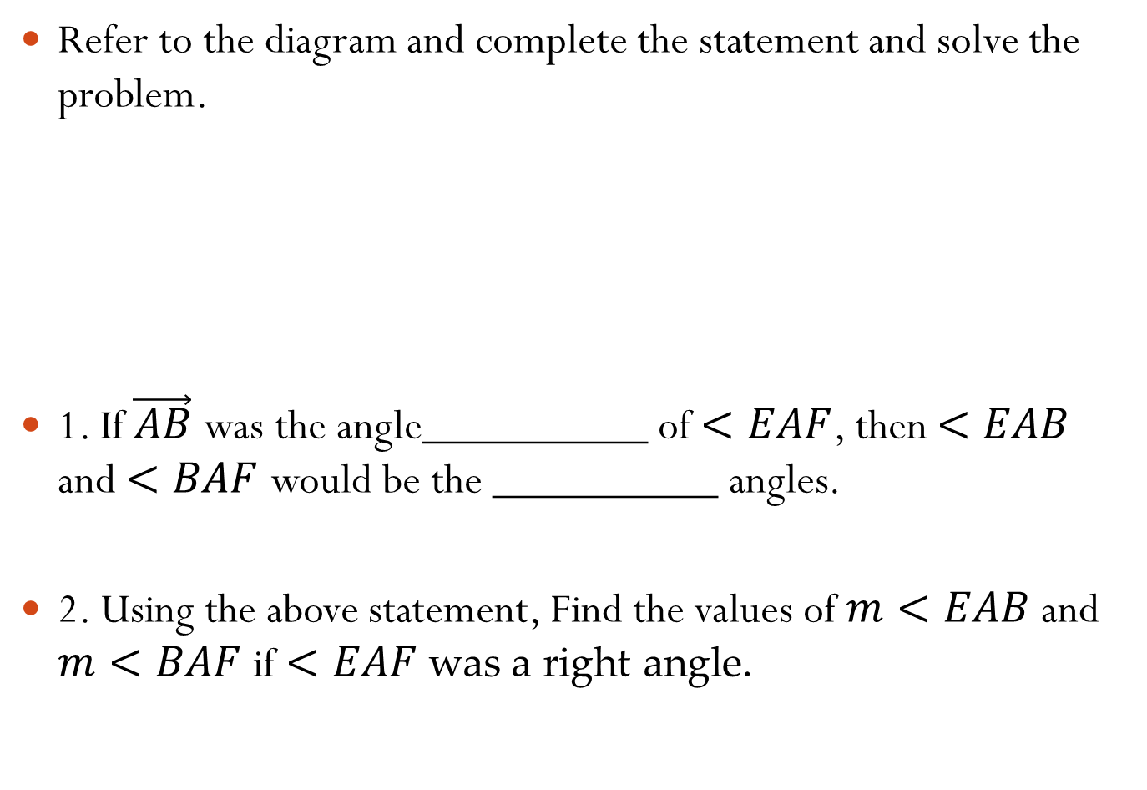
Exit Ticket
Refer to the diagram and complete the statement and solve the problem.
1. If $\vec{AB}$ was the angle__________ of $<EAF$, then $<EAB$ and $<BAF$ would be the __________ angles.
2. Using the above statement, Find the values of $m<EAB$ and $m<BAF$if $<EAF$ was a right angle.
E
B
F
H
A
G

