Slide 1
Coordinate System: the basics
Algebra Review
Objective: Students will be able to demonstrate their ability to plot points on the Cartesian coordinate system

Slide 2
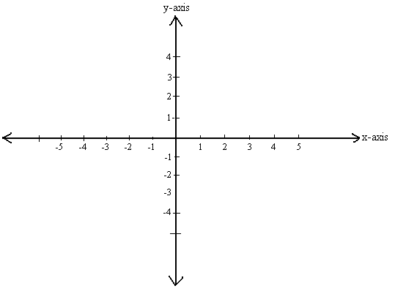
The (x,y) Coordinate System
A Cartesian coordinate system, also known as rectangular coordinate system, can be used to plot points and graph lines.
The following is an example of rectangular coordinate system.

Slide 3
The (x,y) Coordinate System
Four Quadrants
In Quadrant I, both x and y are positive
In Quadrant II, x is negative and y is positive
In Quadrant III, both x and y are negative
In Quadrant IV, x is positive and y is negative

Slide 4
How to Plot a Point
A point is represented by a pair of numbers (x,y).
When given a point to plot, do the following:
Locate where each number is on the x and y-axis respectively.
For the x-axis number, draw (or imagine) a vertical line going through it.
For the y-axis, draw (or imagine) a horizontal line going through it.
The point occurs where the lines meet.

Slide 5
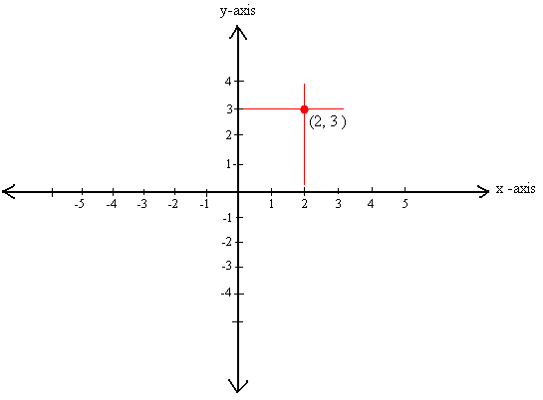
Try it: Plot (2,3)
Note that this means that 2 is the x value and 3 is the y value.
Now, locate 2 on the x-axis and 3 on the y-axis.
Draw (or imagine) a vertical line through x = 2 and a horizontal line through y = 3. Where the lines meet is your point.
End result:

Slide 6
Plotting Points Activity

