Slide 1
Geometry Unit 12
Distance and Circles

Slide 2
Distance and Circles
Content Objective: Students will be able to identify distances between points, using them to make the equations of circles.
Language Objective: Students will be able to graph circles whose equation was given or discovered by calculating distances between points.

Slide 3
Distance
As a reminder, the distance between two points is the measure of line segment that connects them.
Ex: If $A=x_{1}$ and $B=x_{2}$, then the distance (d) between points A and B can be found by
$$d=\left|x_{2}−x_{1}\right|$$
Key Question: Could this idea also be used to find the midpoint of two points on the (x, y) – coordinate plane?
A
B

Slide 4
Distance
Ex: Find the distance between the set of points given (label all points and segments connecting each pair of points on the same graph)
1.) A: $(−1, 4)$ and B: $(3, 4)$
$$A$$
$$B$$
$$d=4$$
$$why?$$
2.) B: $(3, 4)$ and C: $(3, 1)$
$$C$$
$$d=3$$
$$why?$$
3.) A: $(−1, 4)$ and C: $(3, 1)$
$$d=5$$
$$why?$$

Slide 5
The Distance Formula
Theorem 13-1: The distance d between points ($x_{1}, y_{1})$ and ($x_{2}, y_{2})$ is given by
$$d=\sqrt{{(x_{2}−x_{1})}^{2}+{(y_{2}−y_{1})}^{2}}$$
This equation works best if the segment made by the points is a diagonal line.
If the segment between the points is vertical or horizontal, you can find the distance by taking the absolute value of:
For vertical: the y-values
For Horizontal: the x-values

Slide 6
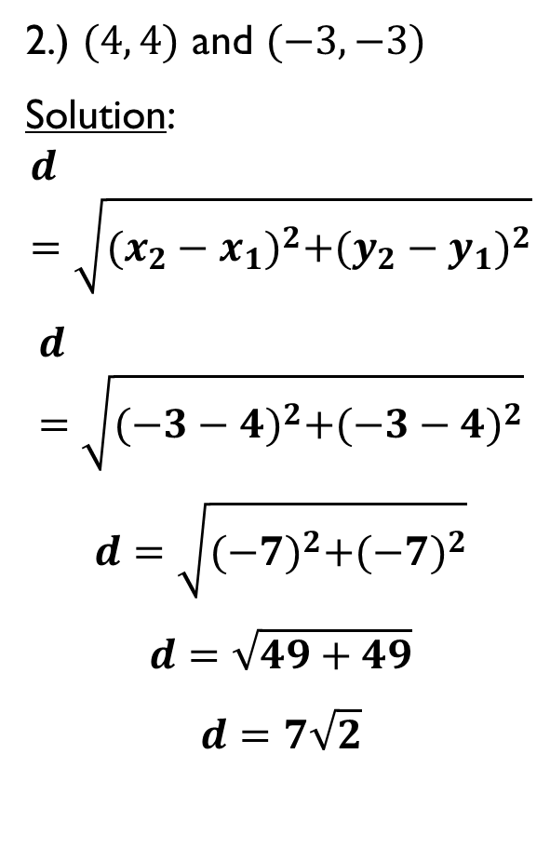
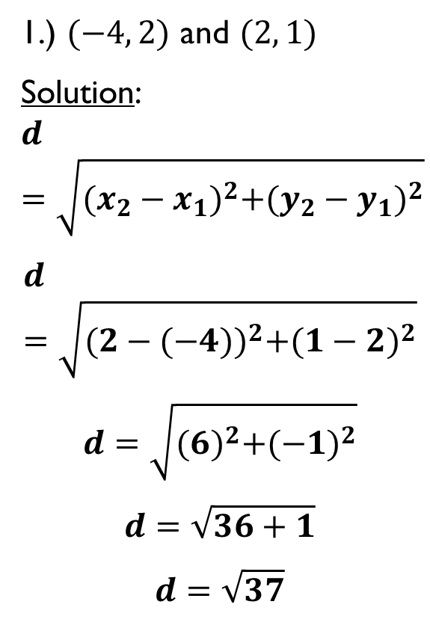
Practice – Distance
Find the distance between the given points
1.) $(−4, 2)$ and $(2, 1)$
Solution:
$$d=\sqrt{{(x_{2}−x_{1})}^{2}+{(y_{2}−y_{1})}^{2}}$$
$$d=\sqrt{{(2−(−4))}^{2}+{(1−2)}^{2}}$$
$$d=\sqrt{{(6)}^{2}+{(−1)}^{2}}$$
$$d=\sqrt{36+1}$$
$$d=\sqrt{37}$$
2.) $(4, 4)$ and $(−3, −3)$
Solution:
$$d=\sqrt{{(x_{2}−x_{1})}^{2}+{(y_{2}−y_{1})}^{2}}$$
$$d=\sqrt{{(−3−4)}^{2}+{(−3−4)}^{2}}$$
$$d=\sqrt{{(−7)}^{2}+{(−7)}^{2}}$$
$$d=\sqrt{49+49}$$
$$d=7\sqrt{2}$$

Slide 7
Distance Examples
Find the distance between the given points
3.) $(3, −2)$ and $(−5, −2)$
Solution:
These points make a horizontal line (Why?)
Thus, the distance can be found with
$$d=\left|−5−3\right|$$
$$d=\left|−8\right|$$
$$d=8$$
4.) $(5, 3)$ and $(5, 10)$
Solution:
These points make a vertical line (Why?)
Thus, the distance can be found with
$$d=\left|3−10\right|$$
$$d=\left|−7\right|$$
$$d=7$$

Slide 8
Circles – Review
Recall that for a circle…
Center: The point in the plane that all points of the circle are equidistant to.
Radius: The line that represents the distance from any given point on the circle to the center.
Since the radius can be expressed as the distance between the center and all points around it, we can use the distance formula to make an equation for the circle…
Center
$$r$$

Slide 9
Equation of a Circle
Theorem 13-2: An equation of a circle with center $(a, b)$ and radius r is
$${(x−a)}^{2}+{(y−b)}^{2}=r^{2}$$
Ex: Write the equation of a circle with the given center and radius
C: $\left(2, 5\right)$; $r=3$
Solution: ${(x−a)}^{2}+{(y−b)}^{2}=r^{2}$
$${(x−2)}^{2}+{(y−5)}^{2}=3^{2}$$
$${(x−2)}^{2}+{(y−5)}^{2}=9$$

Slide 10
Finding Center and Radius
Find the center and radius of the circle with the given equation. Sketch the graph.
$${(x−1)}^{2}+{(y+2)}^{2}=9$$
Center: Radius:
$$(1, −2)$$
$$r=\sqrt{9}=3$$

Slide 11
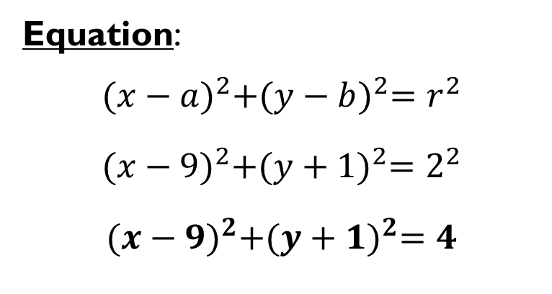
Practice - Circles
Write the equation of a circle with the given information
1.) Center: $(9, −1)$ Diameter: $4$
Radius: $r=2$
Equation:
$${(x−a)}^{2}+{(y−b)}^{2}=r^{2}$$
$${(x−9)}^{2}+{(y+1)}^{2}=2^{2}$$
$${(x−9)}^{2}+{(y+1)}^{2}=4$$

Slide 12
Practice - Circles
Write the equation of a circle with the given information
2.) Diameter with endpoints $\left(0, 2\right)$ and $\left(8, 8\right)$
To solve this problem, you must use:
Midpoint: The center would be the midpoint of the given points:
Distance: The distance from the center to either of these points would be the radius

Slide 13
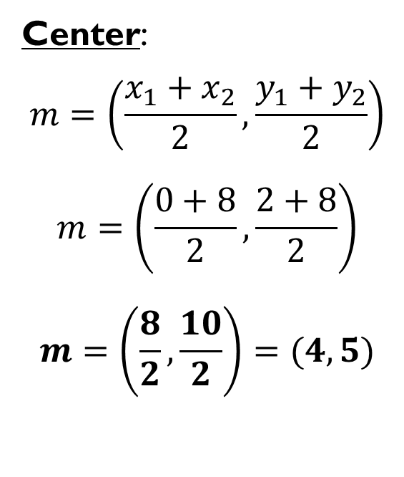
Practice - Circles
Write the equation of a circle with the given information
2.) Diameter with endpoints $\left(0, 2\right)$ and $\left(8, 8\right)$
Center:
$$m=\left(\frac{x_{1}+x_{2}}{2}, \frac{y_{1}+y_{2}}{2}\right)$$
$$m=\left(\frac{0+8}{2}, \frac{2+8}{2}\right)$$
$$m=\left(\frac{8}{2}, \frac{10}{2}\right)=(4,5)$$
Radius: use distance formula with (4, 5) and one of your given endpoints:
$$r=\sqrt{{(x_{2}−x_{1})}^{2}+{(y_{2}−y_{1})}^{2}}$$
$$r=\sqrt{{(4−0)}^{2}+{(5−2)}^{2}}$$
$$r=\sqrt{{(4)}^{2}+{(3)}^{2}}$$
$$r=\sqrt{16+9}=\sqrt{25}=5$$

Slide 14
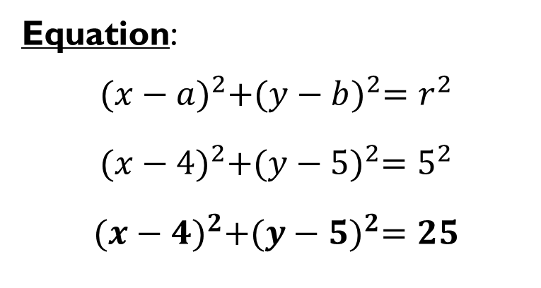
Practice - Circles
Write the equation of a circle with the given information
2.) Diameter with endpoints $\left(0, 2\right)$ and $\left(8, 8\right)$
Center: $(4,5)$
Radius: $r=5$
Equation:
$${(x−a)}^{2}+{(y−b)}^{2}=r^{2}$$
$${(x−4)}^{2}+{(y−5)}^{2}=5^{2}$$
$${(x−4)}^{2}+{(y−5)}^{2}=25$$

Slide 15
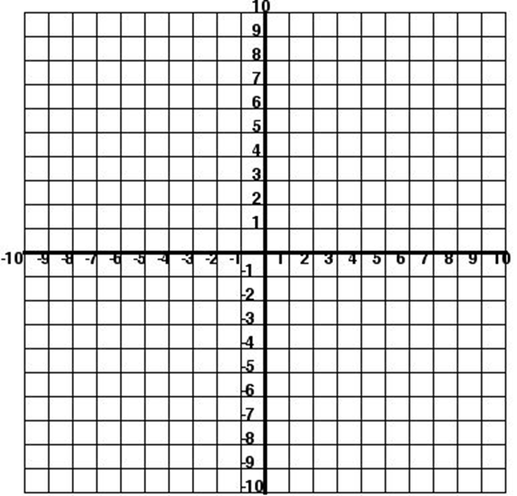

Practice - Circles
Find the center and radius of the circle with the given equation. Sketch the graph.
3.) ${(x+3)}^{2}+{(y−2)}^{2}=25$
Center: $(−3, 2)$
Radius: $r=5$

Slide 16

Practice - Circles
Find the center and radius of the circle with the given equation. Sketch the graph.
4.) $x^{2}+{(y+5)}^{2}=17$
Center: $(0, −5)$
Radius: $r=\sqrt{17}$
$$r≈4.1231$$

