Slide 1
Geometry Unit 12
Equation of a Line

Slide 2
Equation of a Line
Content Objective: Students will be able to identify parts of linear equations in Standard and Slope-Intercept Form.
Language Objective: Students will be able to graph linear equations in Standard and Slope-Intercept Form.

Slide 3
Linear Equations
A linear Equation is an equation whose graph is a line.
$$y$$
A line on a graph has the following properties:
Slope (m): ratio of change from y to change in x
x – intercept: the part of the line that intersects the x-axis. Written as the point (x,0)
y – intercept: the part of the line that intersects the y-axis. Written as the point (0,y)
(0,y)
(x,0)
$$x$$

Slide 4
Forms of a Linear Equation
A linear equation can be written in the following forms:
Standard Form:
The equation of a line can be written in the form
$$Ax+By=C$$
where A and B are not both zero
Slope – Intercept From:
A line with slope m and y-intercept b has the equation
$$y=mx+b$$

Slide 5
Graphing a Line
To graph a linear equation, you need at least two points.
Linear equations, in either form, can be used to find points that can help you graph the line.
Standard Form can give you both the x – intercept and the y – intercept.
Slope-Intercept Form can give you both the y-intercept and the slope
The slope can then be used to get a second point by applying it to the y-intercept.

Slide 6
Example – Standard Form
Graph the line $2x−3y=12$
Solution: Since the equation is in standard form, we can use it to find intercepts.
To find the x-intercept, we let $y=0$ and solve for x:
$$2x−3\left(0\right)=12$$
$$2x=12$$
$$x=6$$
Thus, the x-intercept is the point (6,0)

Slide 7
Examples – Standard Form
Next, to find the y-intercept, we let $x=0$ and solve for y:
$$2(0)−3y=12$$
$$−3y=12$$
$$y=−4$$
Thus, the y-intercept is the point (0,-4)

Slide 8
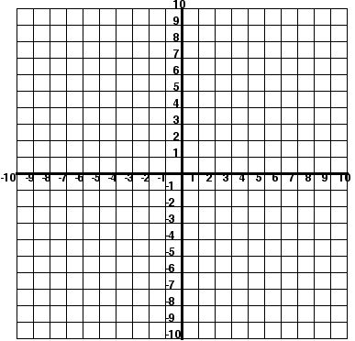
Examples – Standard Form
Finally, you plot both points, then connect them to make the line.

Slide 9
Examples – Slope-Intercept Form
Graph the line $y=−\frac{3}{4}x+6$
Solution: Since the equation is in slope-intercept form, we can quickly identify the slope and y-intercept, and then use the slope to find a second point:
y-intercept: $b=6$
slope: $m={−3}/4$
(0,6)

Slide 10
Examples – Slope-Intercept Form
To graph the line, follow these steps:
1.) Plot the y-intercept you found.
2.) Use the motion of the slope to find another point going from y-intercept.
3.) Where the slope landed you will be your second point
4.) You can use the slope to get even more points, but two is enough to get your line.
5.) Finally, connect the points to make your line.

Slide 11
Group Practice
On a separate piece of paper (that I will provide), graph the following lines given their equation.
For equations in Standard Form, give the intercepts
For equations in Slope-Intercept Form, give the slope and y-intercept

Slide 12
Group Practice
1.) $3x−5y=15$
x-intercept: (5,0)
y-intercept: (0,-3)

Slide 13
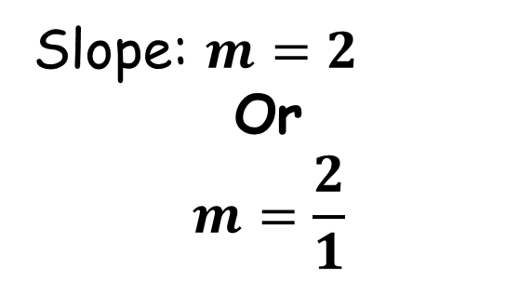
Group Practice
2.) $y=2x+5$
y-intercept: (0,5)
Slope: $m=2$
Or
$$m=\frac{2}{1}$$

Slide 14
Group Practice
3.) $−4x+3y=24$
x-intercept: (-6,0)
y-intercept: (0,8)

Slide 15
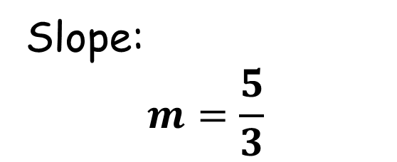
Group Practice
4.) $y=\frac{5}{3}x−2$
y-intercept: (0,-2)
Slope:
$$m=\frac{5}{3}$$

Slide 16
Group Practice
5.) $4x+6y=36$
x-intercept: (9,0)
y-intercept: (0,6)

Slide 17
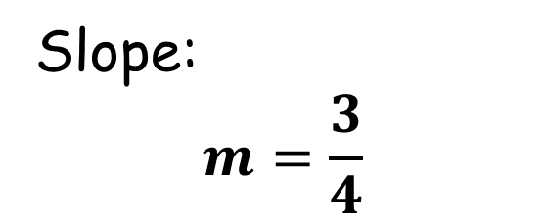
Group Practice
6.) $y=\frac{3}{4}x+1$
y-intercept: (0,1)
Slope:
$$m=\frac{3}{4}$$

