Slide 1
Algebra Review: Factoring By Grouping

Slide 2
Warmup
Go to Kahoot.it
Work in your group.
Enter the Game pin that appears on the screen and choose your team nickname.

Slide 3
Factoring Polynomials
Objective: Students will be able to solve quadratic functions by factoring using the grouping method.
* Question: What is a Quadratic Function?

Slide 4
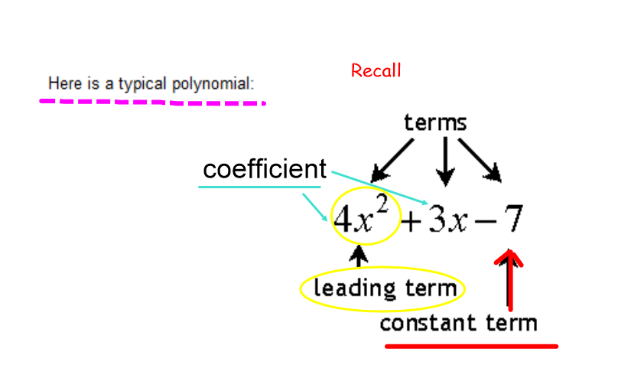
What’s a Polynomial?

Slide 5
What’s a Quadratic
A quadratic is a polynomial that is written in the form “$ax^{2}+bx+c$“ where a, b, and c are all numbers.
Note that $b,c=0$, but $a≠0$. Can you tell me why?

Slide 6
How to Factor A Quadratic by Grouping
Remember the standard form for a Quadratic: $ax^{2}+bx+c$
First, find the product $a∙c$ (or $ac$). Also, take note of the value of $b$ (including the sign).
Next, find two numbers that multiply to get $ac$ and add into $b$ or have a difference of $b$. It would be best to create a list of factors for $ac$.

Slide 7
How to Factor A Quadratic by Grouping
Once you have identified the appropriate factors, you will replace “$bx$” with a sum/difference of those factors, also multiplied by “$x$”
Next, factor completely by grouping (as we will see).

Slide 8

Practice Factoring: When $a=1$
Factor the following polynomial:
$$x^{2}+5x+6$$
$a=1$, $b=5$, $c=6$
Thus, the factors of $ac$ that adds up to 5 are 2 and 3.
List of factors of $ac$:
1,6 $1+6=$
2,3 $2+3=$

Slide 9
Example 1 Continued
This mean
$$x^{2}+2x+3x+6$$
Group the first two and the second two terms
$$x^{2}+2x+3x+6$$
From the groups, factor out their GCF
$x\left(x+2\right)+3(x+2)$
Notice that each group has a common term: “$x+2$”
Factor that out from the group, and finally you have
$$(x+2)(x+3)$$

Slide 10
Example
Factor the following polynomial:
$x^{2}−6x+8$ Factors of $ac=8$
$a=1$,$b=−6$ ,$c=8$
The factors of 8 that add to make -6 are -2 and -4.
Thus $x^{2}−2x−4x+8$
Next $x\left(x−2\right)−4(x−2)$
Finally $(x−2)(x−4)$

Slide 11
Critical Question
How do we know if the factors of $ac$ have to add up to $b$ or must have a difference of $b.$
How to remember the rules:
Add to $b$:
$ax^{2}+bx+c$
$ax^{2}−bx+c$
Difference of $b$:
$ax^{2}+bx−c$
$ax^{2}−bx−c$

Slide 12
Example
Factor the Polynomial completely:
$$x^{2}+3x−18$$
Add to $b$ or Difference of $b$
Factors of $ac=$
Then
$$x^{2}−3x+6x−18$$
$$x\left(x−3\right)+6(x−3)$$
$$(x−3)(x+6)$$

Slide 13
Day 2: Warmup
Factor the Following Polynomials
$x^{2}+9x+18$
$x^{2}−12x+35$
$x^{2}+5x−24$

Slide 14
Day 2: What about when $a>1$?
The rules are the same, just a little more work.
Example:
$$2x^{2}+7x+6$$
Factors of $ac=12$ that add to make $b=7$ are
Next $2x^{2}+4x+3x+6$
$2x\left(x+2\right)+3(x+2)$
$$(2x+3)(x+2)$$
$ac$ $b$

Slide 15
Example
Factor the Polynomial Completely
$$5x^{2}+13x−6$$
Factors of $ac=−30$ that have a difference of $b=13$ are
$$5x^{2}+15x−2x−6$$
$$5x\left(x+3\right)−2\left(x+3\right)$$
$$(x+3)(5x−2)$$
$ac$ $b$

Slide 16
Exit Ticket
Factor the Following Polynomials
${3x}^{2}+8x+5$
$2x^{2}−15x−8$

