Slide 1
Geometry Unit 1: Transformations
Quiz/Test Review

Slide 2
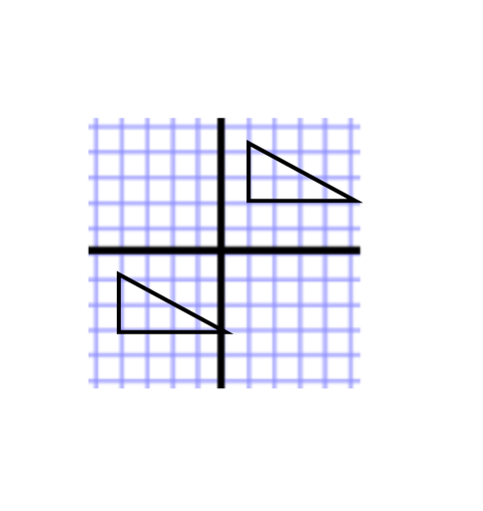
Identify Transformations by Image
Identify and state the Transformation being demonstrated be the following shapes
Transformation: Translation

Slide 3
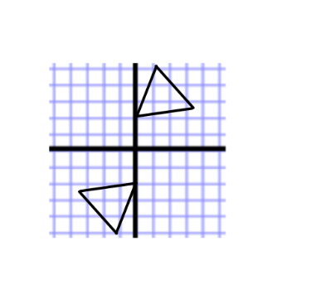
Identify Transformations by Image.
Identify and state the Transformation being demonstrated be the following shapes.
Transformation: Rotation

Slide 4
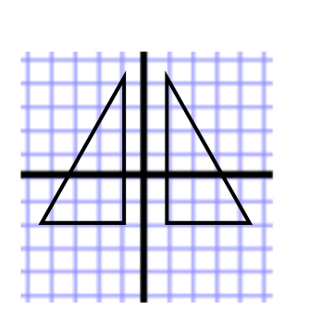
Identify Transformations by Image.
Identify and state the Transformation being demonstrated be the following shapes.
Transformation: Reflection

Slide 5
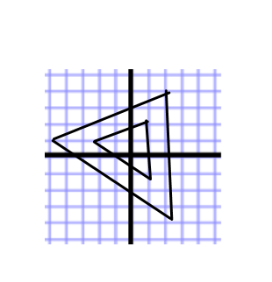
Identify Transformations by Image…and write in notation
Identify and state the Transformation being demonstrated be the following shapes.
Transformation: Dilation

Slide 6
Explain Transformations in Words
For each Transformation, describe how each point should move.
1. T:(x, y) → (x + a, y + b):
Every point moves a units (left if a is negative/right if a is positive) and b units (down if b is negative and up if b is positive.
2. $R_{m}:$
Every point maps to its image, forming a line that is perpendicular to the line “m” (you would put the specific line for your problem in place of “m”), with both image and pre-image being equidistant (same distance) from the line “m”.

Slide 7
Explain Transformations in Words
For each Transformation, describe how each point should move.
3. $R_{O,90°}$:
Every point moves $90°$ clockwise about the origin.
4. $H_{O}:$
Every point moves $180°$ about the origin (in either direction).

Slide 8
Explain Transformations in Words
For each Transformation, describe how each point should move.
5. $D_{O,k}$:
Every point moves to a point “k” times the distance from the center O.

Slide 9
Translation: From Pre-Image to Image, and Vice versa
You are Given a translation that moves the point $(1,−5)$ to the point $(4, −7)$
Complete the translation that describes the movement above. $T:(x,y)→(x_______,y_________)$,
Use the above translation you found to answer the next problem:
Find the image of (-4,-4)
Since you are finding the image, you simply apply the above notation to the point (-4,-4): $T:(−4,−4)→(−4+3,−4−2)$
$$(x+3,y−2)$$
Image: (-1,-6)

Slide 10
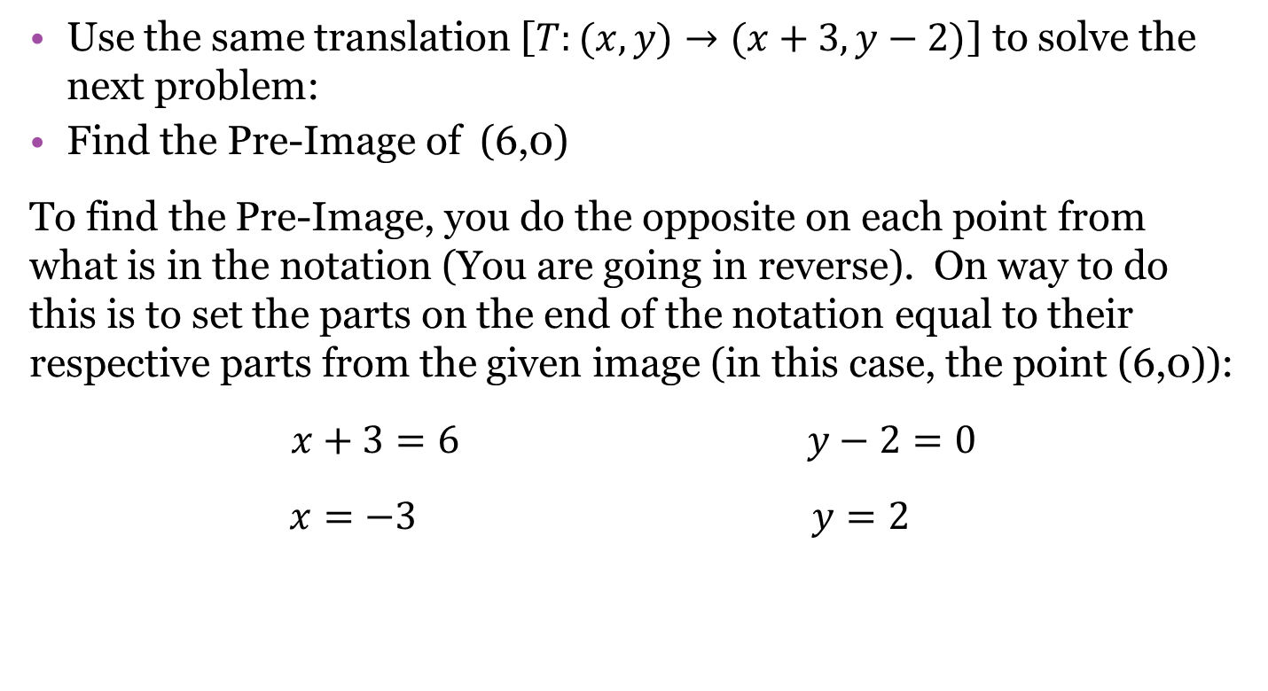
Translation: From Pre-Image to Image, and Vice versa
Use the same translation [$T:(x,y)→(x+3,y−2)$] to solve the next problem:
Find the Pre-Image of (6,0)
To find the Pre-Image, you do the opposite on each point from what is in the notation (You are going in reverse). On way to do this is to set the parts on the end of the notation equal to their respective parts from the given image (in this case, the point (6,0)):
$x+3=6$ $y−2=0$
$x=−3$ $y=2$
Pre-Image: (-3,2)

Slide 11
Rules For the Transformations
Reflections:
Reflect across y-axis: change the sign on the x-coordinate. [$R_{y}:(x,y)→(−x,y)]$
Reflect across the x-axis: change the sign on the y-coordinate. [$R_{x}:(x,y)→(x,−y)]$
Reflect across the line $y=x$: switch the x and y values.
[$R_{y=x}:\left(x,y\right)→(y,x)$]
For other Reflections: It is best to use a graph to visualize the change.

Slide 12
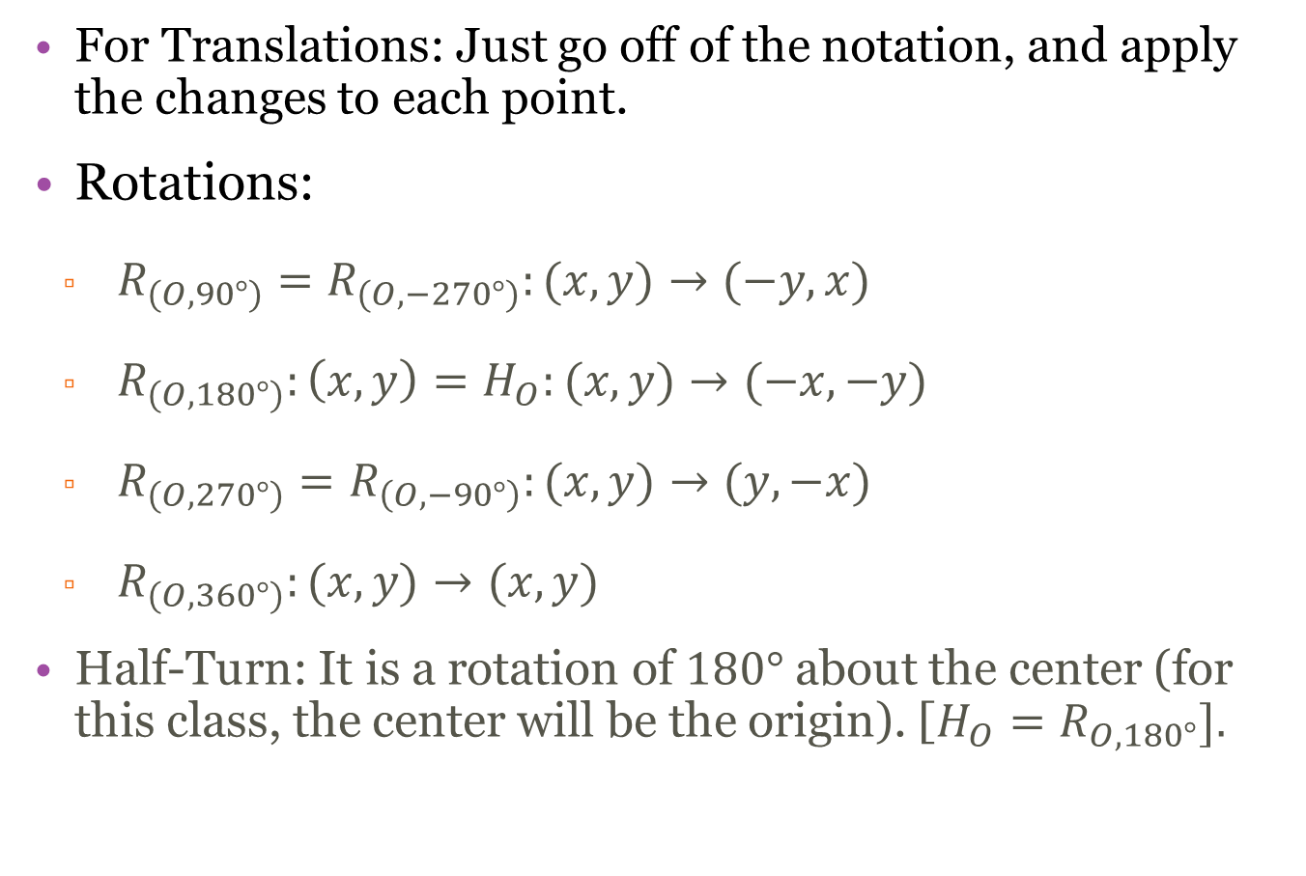
Rules For the Transformations
For Translations: Just go off of the notation, and apply the changes to each point.
Rotations:
$R_{(O,90°)}=R_{(O,−270°)}:(x,y)→(−y,x)$
$R_{(O,180°)}:\left(x,y\right)=H_{O}:(x,y)→(−x,−y)$
$R_{(O,270°)}=R_{\left(O,−90°\right)}:(x,y)→(y,−x)$
$R_{(O,360°)}:(x,y)→(x,y)$
Half-Turn: It is a rotation of $180°$ about the center (for this class, the center will be the origin). [$H_{O}=R_{O,180°}].$

Slide 13
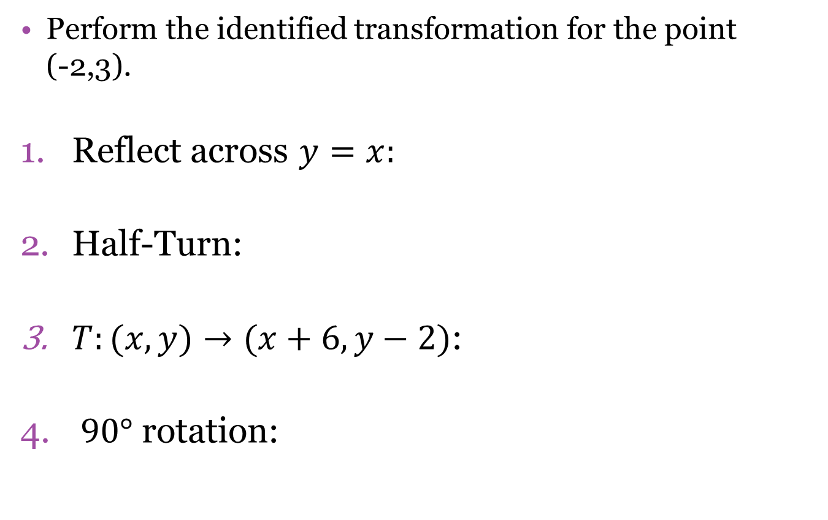
Practice Using the Rules
Perform the identified transformation for the point (-2,3).
Reflect across $y=x:$
Half-Turn:
$T:(x,y)→(x+6, y−2)$:
$90°$ rotation:
(3,-2)
(2,-3)
(4,1)
(-3,-2)

Slide 14

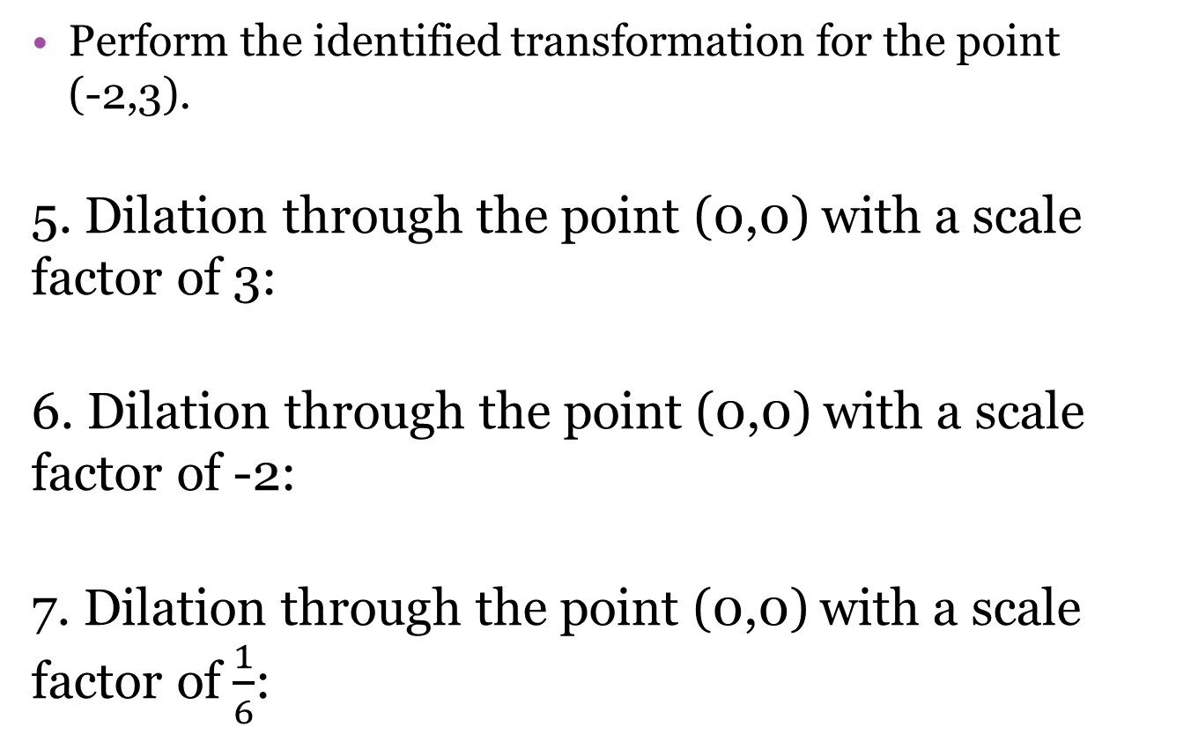
Practice Using the Rules
Perform the identified transformation for the point (-2,3).
5. Dilation through the point (0,0) with a scale factor of 3:
6. Dilation through the point (0,0) with a scale factor of -2:
7. Dilation through the point (0,0) with a scale factor of $\frac{1}{6}$:
(-6,9)
(4,-6)
$$\left(\frac{−1}{3},\frac{1}{2}\right)$$

Slide 15
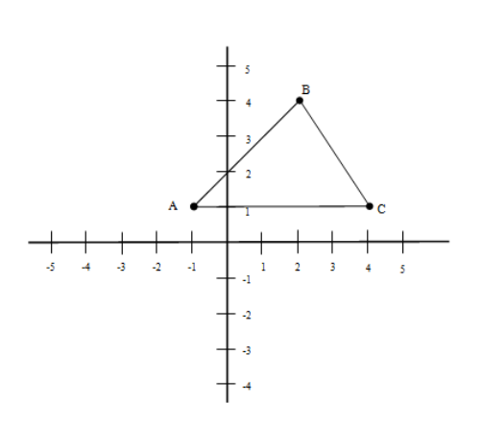
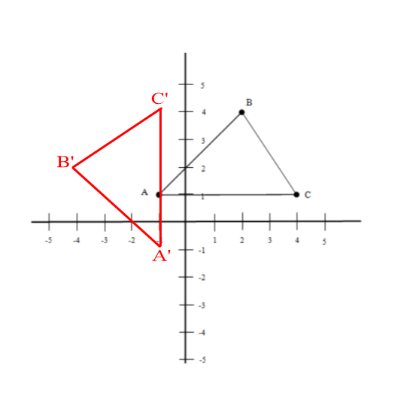
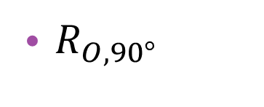
Using a given shape, graph its image under the given transformation.
$R_{O,90°}$
Image

Slide 16
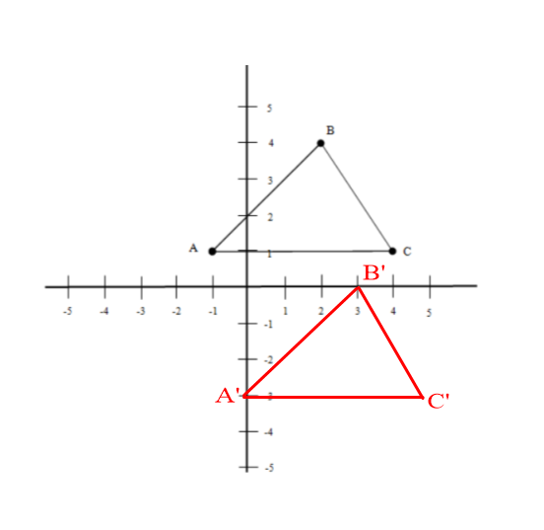
Using a given shape, graph its image under the given transformation.
$T:(x,y)→(x+1,y−4)$
Image

Slide 17
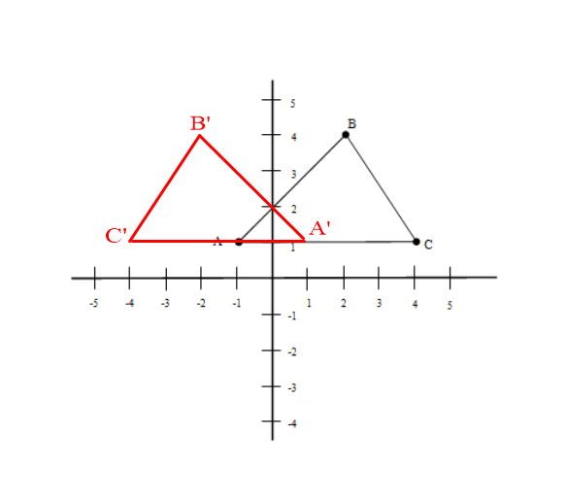
Using a given shape, graph its image under the given transformation.
$R_{y−axis}$
Image

Slide 18
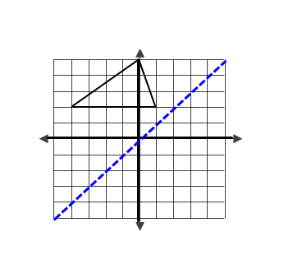
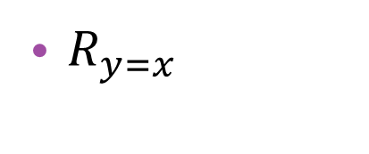
Using a given shape, graph its image under the given transformation.
$R_{y=x}$
To start here is the pre-image, along with the line you are reflecting across ($y=x)$

Slide 19
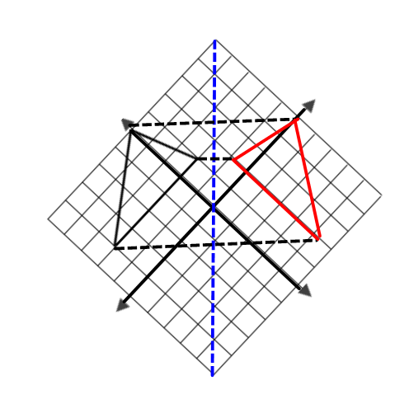
Reflecting Across $y=x$ continued
Now, in order to accurately measure across $y=x$, I suggest you rotate the graph (i.e. the paper) as shown below, then to and across the line, as we have done in the past.

Slide 20
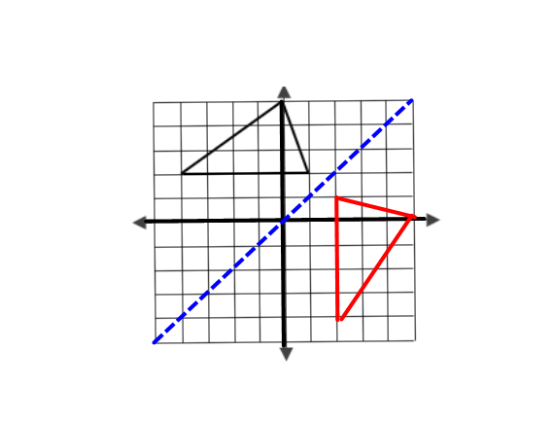
Reflecting Across $y=x$ continued
Thus, without the dashes lines, our image looks like this (in red).
Image

Slide 21
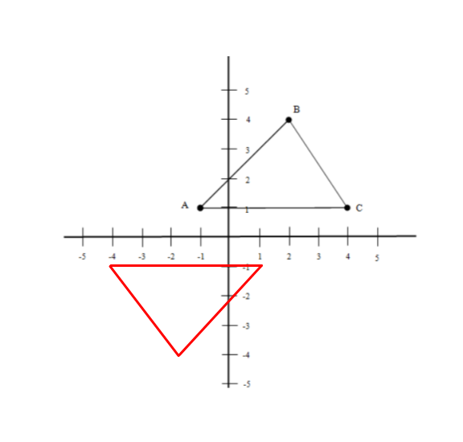
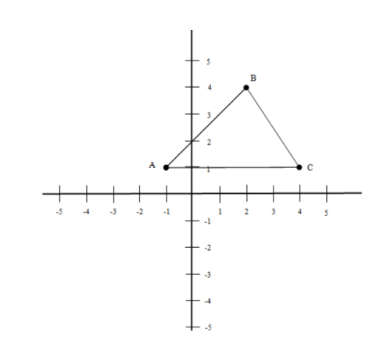
Using a given shape, graph its image under the given transformation.
$D_{O,−1}$ When the center is the origin, you can easily find the image by multiplying the points on the pre-image by the scale factor.
Image

Slide 22
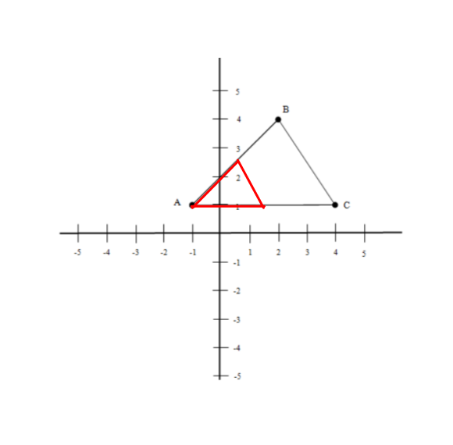
Using a given shape, graph its image under the given transformation.
$D_{A,\frac{1}{2}}$ When the center is not the origin, you must measure distances and multiply them by the scale factor to find the correct image (Remember that the center is its own image.)
Image

