Slide 1
Algebra Review!
Warm-up
Take about 5-10 minutes to complete the coordinates worksheet from yesterday.

Slide 2
Order of Operations
Objective: Students will be able to simplify expressions using order of operations.
*Question: Do you know what the saying is for order of operations.

Slide 3
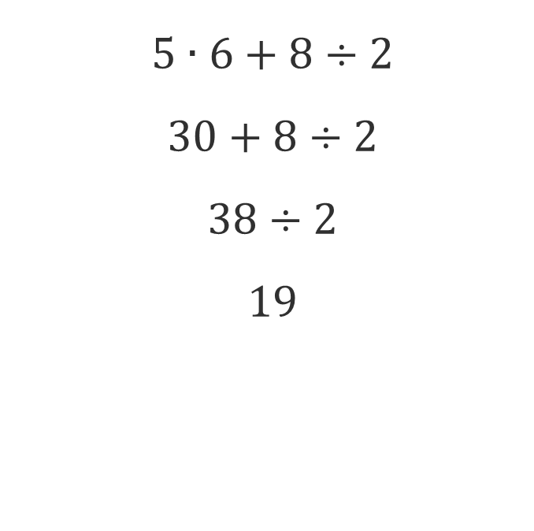

Example: Simplify the expression on your own $$5∙6+8÷2$$ There are two different ways we could solve this problem. Which one is the correct way?
Way #1
Way #2
$$5∙6+8÷2$$
$$30+8÷2$$
$$38÷2$$
$$19$$
$$5∙6+8÷2$$
$$30+8÷2$$
$$30+4$$
$$34$$

Slide 4

Now try this
$$(3∙4−9)∙7$$
$$\left(12−9\right)∙7$$
$$\left(3\right)∙7$$
$$21$$

Slide 5
PEMDAS
Parenthesis
Exponent
Multiplication
Division
Addition
Subtraction
More accurately read as
Parenthesis
Exponent
Multiplication Division
Addition Subtraction

Slide 6

Example
Simplify the expression using order of operations.
$$3^{2}+8÷4$$
$$9+8÷4$$
$$9+2$$
11

Slide 7

Example
Simplify the expression using order of operations
$$\frac{(5+7)}{(1+5)}$$
$$\frac{12}{6}$$
$$2$$

Slide 8
Working with Variables
Simplify the Expression using order of operations
$$−(4x−6x+7−9)$$
$$−\left(−2x−2\right)$$
$$2x+2$$

Slide 9
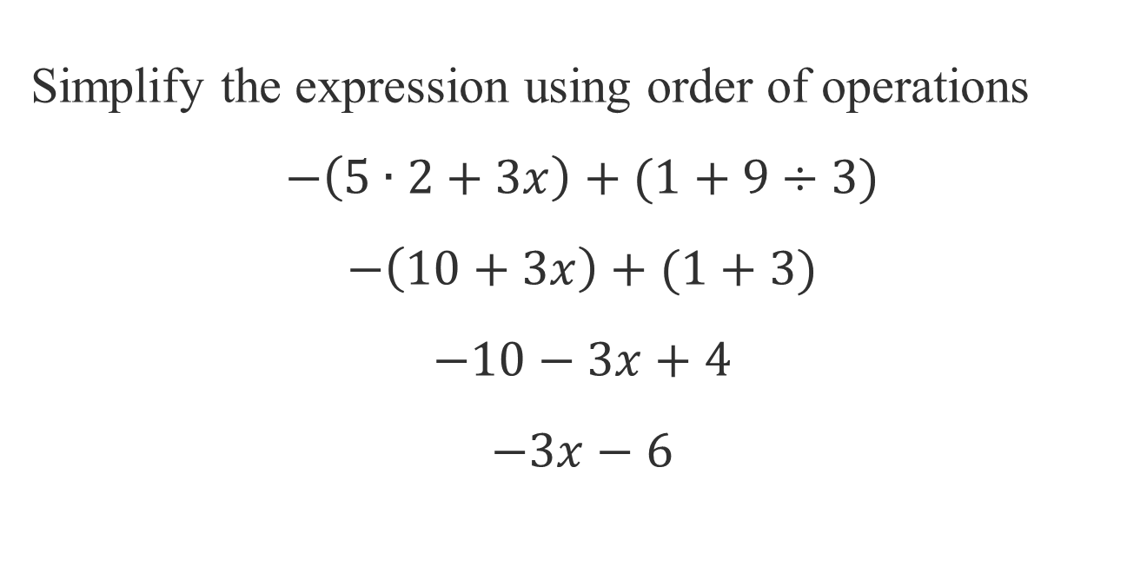
More with Variables
Simplify the expression using order of operations
$$−\left(5∙2+3x\right)+(1+9÷3)$$
$$−\left(10+3x\right)+(1+3)$$
$$−10−3x+4$$
$$−3x−6$$

Slide 10
Worksheet: Order of Operations Practice
Work with your group.
Whatever you do not finish in class is homework.

