Slide 1
Geometry – Unit 2
Postulates
And
Theorems

Slide 2
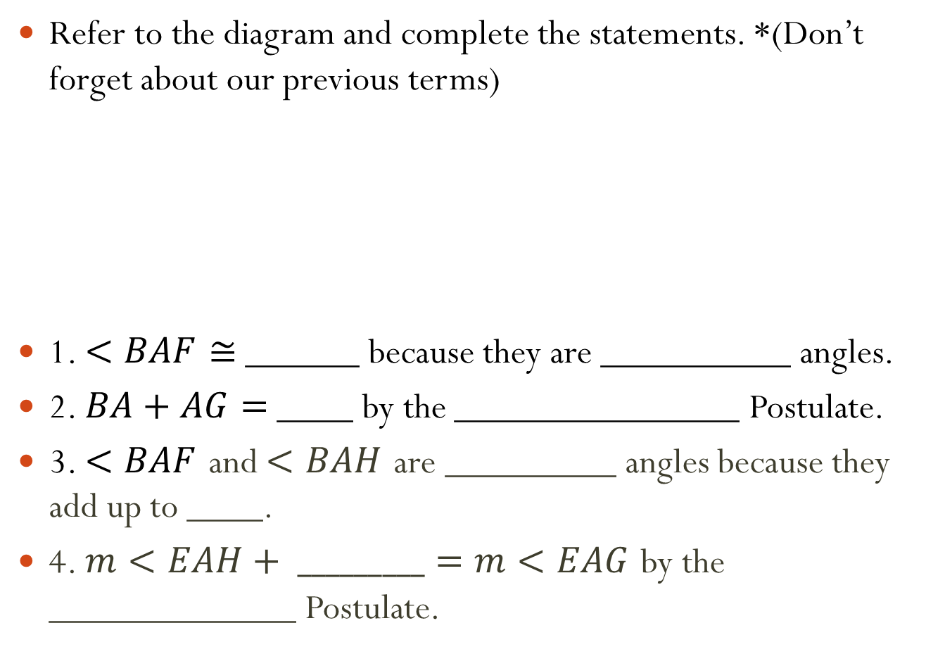
Warmup
Refer to the diagram and complete the statements. *(Don’t forget about our previous terms)
1. $<BAF≅$ ______ because they are __________ angles.
2. $BA+AG=$ ____ by the _______________ Postulate.
3. $<BAF$ and $<BAH$ are _________ angles because they add up to ____.
4. $m<EAH+ _________=m<EAG$ by the _____________ Postulate.
E
B
F
H
A
G

Slide 3
Postulates and Theorems
Content Objective: Students will be able to know and use postulates and theorems related to points, lines and planes.
Language Objective: Students will be able to use postulates and theorems to determine whether a given statement is true or false.

Slide 4
Basic Terms
Postulate: A basic assumption that is accepted without proof.
Theorem: A statement that can be proved using postulates, definitions, and previously used theorems.
Exists: There is at least one.
Unique: There is no more than one.
One and only one: There is exactly one.
Determine: To decline or specify.

Slide 5
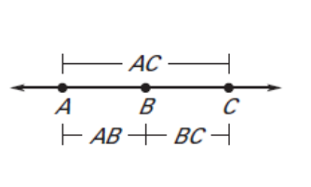
Previous Postulates
Segment Addition Postulate:
If B is between A and C, then $AB+BC=AC$.
Angle Addition Postulate:
If point $B$ lies in the interior of $<AOC$, then
$m<AOB+m<BOC=m<AOC$.
C
B
A
O

Slide 6
New Postulates – Pg 23 (Textbook)
Postulate #5:
A line contains at least 2 points.
A plane contains at least 3 non-collinear points.
A space contains at least 4 non-coplanar points.

Slide 7
New Postulates – Pg 23 (Textbook)
Postulate #6:
Through any two points, there is exactly 1 line.
Postulate #7:
Through any three points there is at least 1 plane.
Through any three non-collinear points there is exactly one plane.

Slide 8
New Postulates – Pg 23 (Textbook)
Postulate #8:
If two points are in a plane, then the line that contains the points is also in the plane.
M
B
A

Slide 9
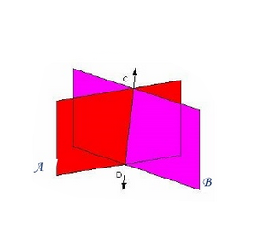
New Postulates – Pg 23 (Textbook)
Postulate #9:
If two planes intersect, then their intersection is a line.
In the diagram, $\overset{⃡}{DC}$ is the intersection of Plane A and Plane B.

Slide 10
Theorems
Theorem 1-1: Intersection of Lines
If two lines intersect, then they intersect in exactly one point.
What postulate could you use to prove this theorem?
Postulate 6

Slide 11
Theorems
Theorem 1-2:
Through a line and a point not in the line, there is exactly one plane.
What postulate could you use to prove this theorem?
C
B
A
Postulate 7

Slide 12
Theorems
Theorem 1-3: Intersection of Lines
If two lines intersect, then exactly one plane contains the lines.
What postulate could you use to prove this theorem?
Postulate 5…and 7

Slide 13
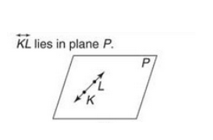
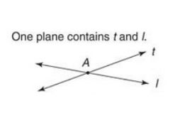
Practice Worksheet
State the Theorem or Postulate you would use to justify the statement made about each figure.
1.) 2.)
Postulate 8
Theorem 1-3

Slide 14
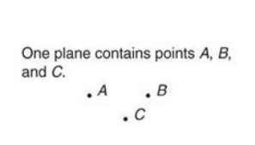
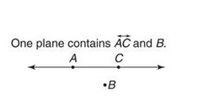
Practice Worksheet
State the Theorem or Postulate you would use to justify the statement made about each figure.
3.) 4.)
Postulate 7
Theorem 1-2

Slide 15
Practice Worksheet
Each of the following statements is FALSE. Use a complete sentence to explain why.
9.) A plain is made up of exactly 3 points.
10.) If two lines intersect, then at least one plane contains the lines.
A
B
A plane is made up of AT LEAST 3 points (There could be more)
D
C
Exactly one plane contains the lines (Theorem 1-3).

