Slide 1
Geometry Unit 3: Proofs
Proof Building ft.
Properties from Algebra

Slide 2
WArmup
Give the hypothesis and conclusion of the following statements:
1. If two segments have equal measure, then they are congruent.
2. $If a=b and b=c, then a=c$
3. $If<D≅ <E, then<E≅ <D$

Slide 3
Proof building – Properties
Content Objective: Students will be able to fill in algebraic and geometric proofs using properties of equality and congruence.
Language Objective: Students will be able to state properties from Algebra, using them to construct two-column proofs.

Slide 4
Properties of Equality
$$If a=b and c=d, then a+c=b+d$$
Addition Property:
Subtraction Property:
Multiplication Property:
Division Property:
Distributive Property:
Substitution Property:
$$If a=b and c=d, then a−c=b−d$$
$$If a=b, then ca=cb$$
$$If a=b, and c≠0, then \frac{a}{c}=\frac{b}{c}$$
$$a\left(b+c\right)=ab+ac$$
$$If a=b, then either a or b may be written$$
$$in placed of the other in an equation$$

Slide 5

Properties of Equality (cont.)
Reflexive Property:
Symmetric Property:
Transitive Property:
$$a=a$$
$$If a=b, then b=a$$
$$If a=b and b=c, then a=c$$

Slide 6
Properties of Congruence
Reflexive Property:
Symmetric Property:
Or
Transitive Property:
Or
$\overline{DE}≅\overline{ED}$ $<XYZ≅ <ZYX$
$$If \overline{DE}≅\overline{FG}, then \overline{FG}≅\overline{DE}$$
$$If<D≅ <E, then<E≅ <D$$
$$If \overline{DE}≅\overline{FG} and \overline{FG}≅\overline{JK}, then \overline{DE}≅\overline{Jk}$$
$If<X≅ <Y and<Y≅ <Z, then<X≅ <Z$

Slide 7

Solving Equations
Solve $2x=10−3x$, and justify each step.
Steps Reasons
$2x=10−3x$
$5x=10$
$x=2$
1. Given Equation
2. Addition Property
3. Division Property

Slide 8
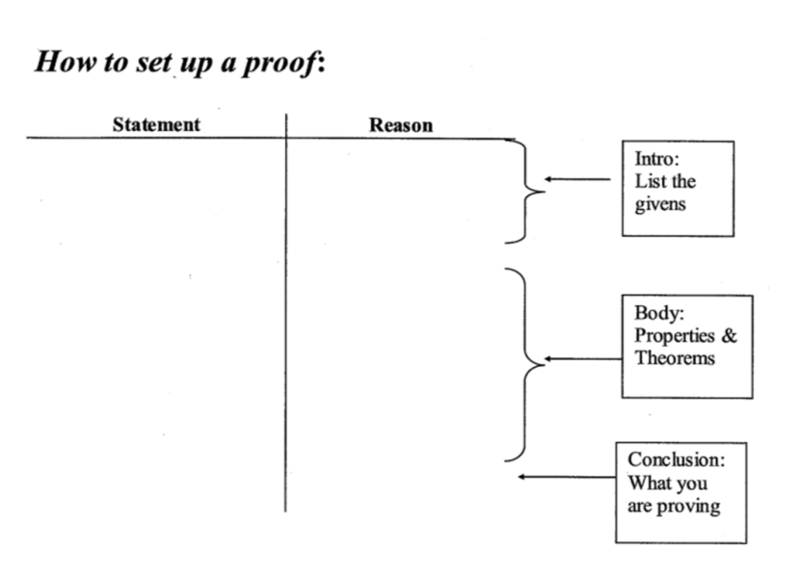
Two-Colum Proofs
Begin with what you are ______.
End with what you are trying to ______.
Make logical _____________ in between.
Justify each statement with a _______.
Given
Prove
statements
Reason

Slide 9
Using a Two-Column Proof
R
P
Given: $\overline{RT}$ and $\overline{PQ}$ intersecting at S so that
$RS=PS$ and $ST=SQ$
Prove: $RT=PQ$
Proof:
Statements Reasons
S
Q
T
1. $RS=PS;ST=SQ$
1. Given
2. $RS+ST=PS+SQ$
2. Addition Property
3. $RS+ST=RT;PS+SQ=PQ$
3. Segment Addition Post.
4. $RT=PQ$
4. Substitution Property

Slide 10

Using a Two-Column Proof
Given: $m<AOC=m<BOD$
Prove: $m<1=m<3$
Proof:
Statements Reasons
B
C
A
D
1
2
3
O
1. $m<AOC=m<BOD$
1. Given
2. $m<AOC=m<1+m<2;$
$$m<BOD=m<2+m<3$$
2. Angle Addition Post.
3. $m<1+m<2=m<2+m<3$
3. Substitution Property
4. $m<2=m<2$
4. Reflexive Property
5. $m<1=m<3$
5. Subtraction Property

Slide 11
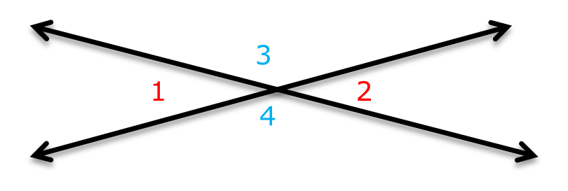
Final Word
Substitution
You can always use ___________ instead of ___________.
You cannot always use ___________ instead of ___________.
Safer to stick with ___________.
Transitivity
Transitivity
Substitution
Substitution

