Slide 1
Geometry Unit 4
Properties of Parallel Lines

Slide 2
Properties of Parallel Lines
Content Objective: Students will be able to use the properties of parallel lines to prove theorems and solve for variables.
Language Objective: Students will be able to identify the properties of parallel lines from labeled diagrams.

Slide 3
Corresponding Angles
Postulate 10: If two parallel lines are cut by a transversal, then the corresponding angles are congruent.
This postulate is essential for proving the next three theorems.

Slide 4
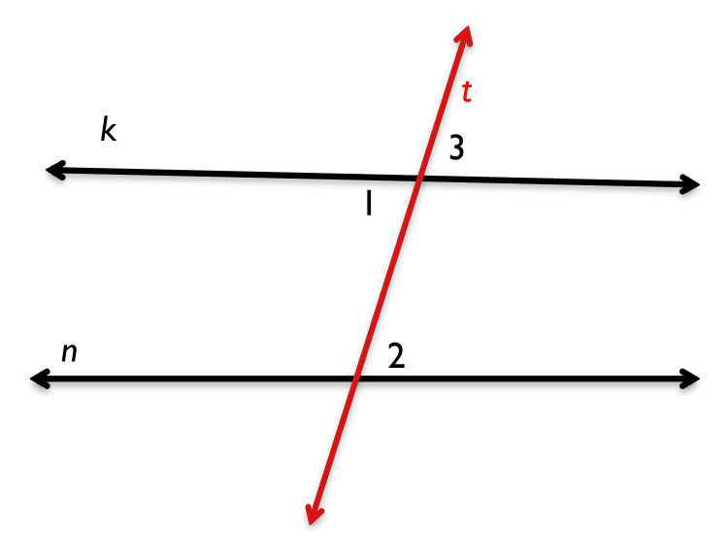
Theorem 3-2
Theorem 3-2: If two parallel lines are cut by a transversal, then alternate interior angles are congruent.
Given: k ll n; transversal t cuts k and n.
Prove: $<1≅ <2$
Statements ________ _______Reasons
k ll n
1. Given
2. $<1≅ <3$
2. Vertical Angle Theorem
3. $<3≅ <2$
3. If two parallel lines are cut by a transversal, then corr. <‘s are $≅$
4. $<1≅ <2$
4. Transitive/Substitution Property

Slide 5
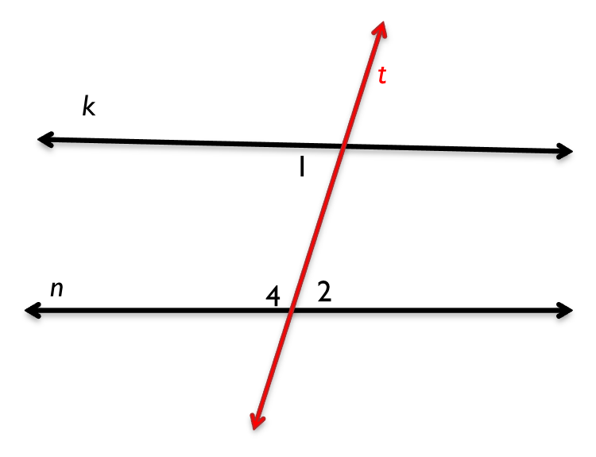
Theorem 3-3
Theorem 3-3: If two parallel lines are cut by a transversal, then same-side interior angles are supplementary.
Given: k ll n; transversal t cuts k and n.
Prove: $<1$ is supplementary
to $<4$.
Statements ________ _______Reasons
k ll n
1. Given
2. $m<2+m<4=180$
2. Angle Addition Postulate
3. $<1≅ <2 or m<1=m<2$
3. If two parallel lines are cut by a transversal, then alt. int. <‘s are $≅$
4. $m<1+m<4=180$
4. Substitution Property
5. $<1$ is supplementary to $<4$.
5. Def. of Supp. <‘s

Slide 6
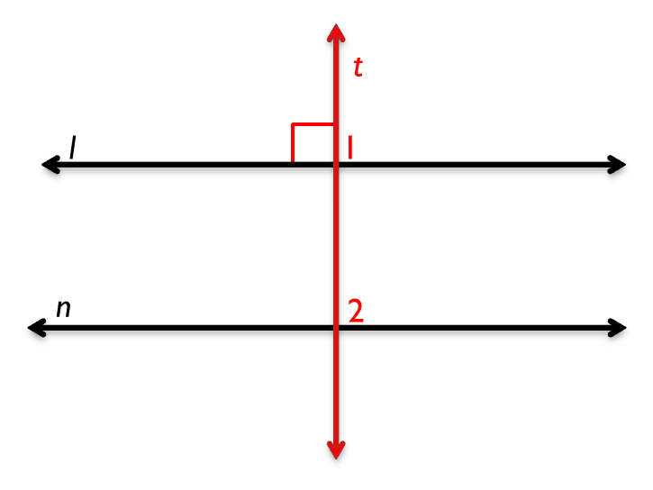
Theorem 3-4
Theorem 3-4: If a transversal is perpendicular one of two parallel lines, then it is perpendicular to the other line also.
Given: transversal t cuts l and n;
t l; l ll n
Prove: t n
Statements ________ _______Reasons
$t l$
1. Given
2. $m<1=90$
2. Def. of perpendicular lines
3. l ll n
3. Given
4. $<2≅ <1 or m<2=m<1$
4. If two parallel lines are cut by a transversal, then corr. <‘s are $≅$
5. $m<2=90$
5. Substitution Property
6. t n
6. Def. of perpendicular lines

Slide 7
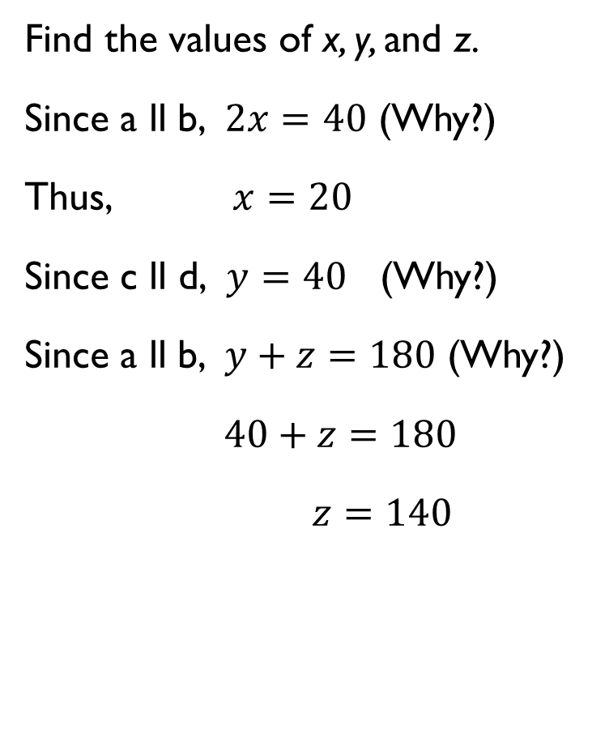
Using the Properties
Find the values of x, y, and z.
Since a ll b, $2x=40$ (Why?)
Thus, $x=20$
Since c ll d, $y=40$ (Why?)
Since a ll b, $y+z=180$ (Why?)
$40+z=180$
$z=140$
a
b
c
$$y°$$
z$°$
$$2x°$$
d
$$40°$$

