Slide 1
Geometry Unit 4
Proving Lines Parallel

Slide 2
Proving Lines Parallel
Content Objective: Students will be able to use angle and line relationships to prove that lines are parallel.
Language Objective: Students will be able to name parallel lines by reading a labeled diagram.

Slide 3
Key Postulates
Postulate 10: If two parallel lines are cut by a transversal, then the corresponding angles are congruent.
Postulate 11: If two lines are cut by a transversal and the corresponding angles are congruent, then the lines are parallel.
Postulate 11 will be essential for the proofs of this section.

Slide 4
Proving Theorem 3-5
Theorem 3-5: If two lines are cut by a transversal and the alternate interior angles are congruent, then the lines are parallel.
Given: transversal t cuts k and n;
$<1≅ <2$
Prove: k ll n
t
k
3
2
n
1
Statements ________ _______Reasons
$<1≅ <2$
1. Given
2. $<2≅ <3$
2. Vertical Angle Theorem
3. $<1≅ <3$
3. Transitive/Substitution Property
4. k ll n
4. If 2 line ACBAT and corr. <‘s are $≅$, then the lines are ll.

Slide 5
Proving theorem 3-6
Theorem 3-6: If two lines are cut by a transversal and same-side interior angles are supplementary, then the lines are parallel.
Given: transversal t cuts k and n;
$<1$ is supplementary to $<2$.
Prove: k ll n
t
k
1
n
2
3
Statements ________ _______Reasons
$<1$is supplementary to $<2$
1. Given
2. $m<1+m<2=180$
2. Def. of Supp. <‘s
3.$m<2+m<3=180$
3. Angle Addition Postulate
4. $m<1+m<2=m<2+m<3$
4. Substitution Property
5. $m<2=m<2$
5. Reflexive Property
6. $m<1=m<3$ or $<1≅ <3$
6. Subtraction Property
7. k ll n
7. If 2 lines ACBAT and alt. int. <‘s are $≅$, then the lines are ll.

Slide 6
Proving theorem 3-7
Theorem 3-7: In a plane, two lines perpendicular to the same lines are parallel.
Given: k t; n t
Prove: k ll n
$$t$$
$$k$$
$$1$$
$$n$$
$$2$$
Statements ________ _______Reasons
k$t$; n t
1. Given
2. $m<1=90$; $m<2=90$
2. Def. of perpendicular lines
3. $<2≅ <1 or m<2=m<1$
3. Substitution Property
4. k ll n
4. If 2 line ACBAT and corr. <‘s are $≅$, then the lines are ll.

Slide 7
More Theorems… No proofs required!
The following theorems can be proving using the previous postulates and theorems. You do not need to prove them, but you may use them in future work:
Theorem 3-8: Through a point outside a line, there is exactly one line parallel to the given line.
Theorem 3-9: Through a point outside a line, there is exactly one line perpendicular to the given line.
Theorem 3-10: Two lines parallel to a third line are parallel to each other.

Slide 8
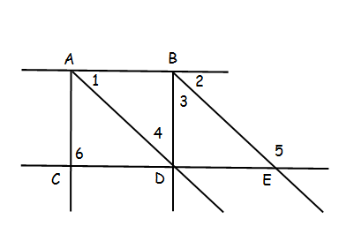
Finding Parallel Lines
Use the given information to name a pair of segments that must be parallel. If no such segments exist, write none.
$m<1+m<4=180$
$m<5=m<6$
$m<3=m<4$
$\overline{AC}$ ll $\overline{BD}$
None
$\overline{AD}$ ll $\overline{BE}$

