Slide 1
Geometry Unit 3
Proving Theorems

Slide 2
Proving Theorems
Content Objective: Students will be able to prove theorems using definitions, properties and postulates.
Language Objective: Students will be able to write two-column proofs to prove theorems.

Slide 3
Theorems
Statements are proved using:
Given Information
Definitions
Postulates
Properties
Proven Theorems

Slide 4
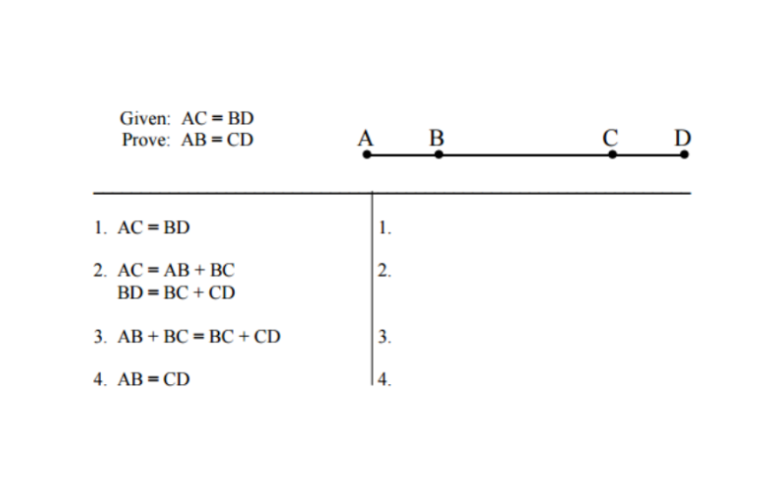
Warmup
Prove the Following statement:
Given
Segment Addition Postulate
Transitive Property
Subtraction Property

Slide 5
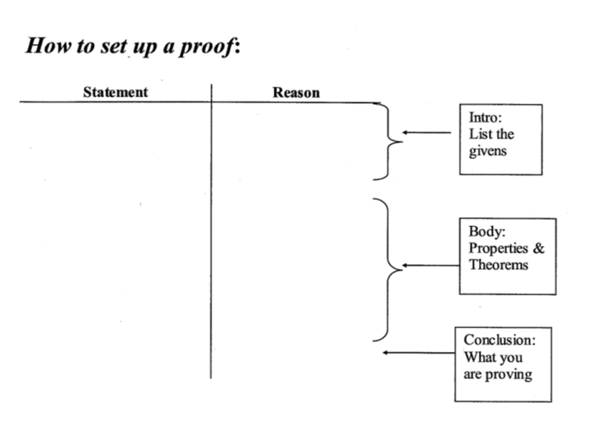
Two-Column Proofs

Slide 6
Proving Midpoint Theorem
Theorem 2-1: If M is the midpoint of $\overline{AB}$, then $AM=\frac{1}{2}AB$and $MB=\frac{1}{2}AB$
Given: M is the midpoint of $\overline{AB}$
Prove: $AM=\frac{1}{2}AB;MB=\frac{1}{2}AB$
A
M
B
Statements ________ Reasons
1. M is the midpoint of $\overline{AB}$
1. Given
2. $AM=MB$
2. Definition of Midpoint
3. $AM+MB=AB$
3. Segment Addition Postulate
4. $AM+AM=AB$;
$2AM=AB$
4. Substitution Property
5. $AM=\frac{1}{2}AB$
5. Division Property
6. $MB=\frac{1}{2}AB$
6. Substitution Property

Slide 7
Deductive Reasoning
Proving with facts
In deductive reasoning you are definite, you use definitions.

Slide 8
Proving Angle Bisector Theorem
Theorem 2-2: If $\vec{BX}$ is the angle bisector of $<ABC$, then $m<ABX=\frac{1}{2}m<ABC$ and $m<XBC=\frac{1}{2}m<ABC$
Given: $\vec{BX}$ is the angle bisector of $<ABC$
Prove: $m<ABX=\frac{1}{2}m<ABC$ and
$$m<XBC=\frac{1}{2}m<ABC$$
A
B
X
Statements ________ Reasons
C
1. $\vec{BX}$ is the angle bisector of $<ABC$
1. Given
2. $m<ABX=m<XBC$
2. Definition of Angle Bisector
3. $m<ABX+m<XBC=m<ABC$
3. Angle Addition Postulate
4. $m<ABX+m<ABX=m<ABC$;
$$2\left(m<ABX\right)=m<ABC$$
4. Substitution Property
5. $m<ABX=\frac{1}{2}m<ABC$
5. Division Property
6. $m<XBC=\frac{1}{2}m<ABC$
6. Substitution Property

Slide 9
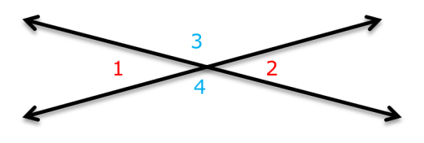
Proving Vertical Angle Theorem
Theorem 2-3: Vertical Angles are congruent.
Given: < 1 and < 2 are vertical angles
Prove: $<1≅ <2$
Statements ________ Reasons
1. <1 and <2 are Vertical Angles
1. Given
2. $m<1+m<3=180$;
$m<2+m<3=180$
2. Angle Addition Postulate
3. $m<1+m<3=m<2+m<3$
3. Substitution Property
4. $m<1=m<2$
4. Subtraction Property

