Slide 1
Geometry Unit 5
Ways to Prove Triangles Congruent

Slide 2
Warm-up
Mark the angles and sides of each pair of triangles to indicate that they are congruent.
1.)
2.)
V
U
L
M
$$∆LMN≅∆WUV$$
N
W
A
E
$$∆ABC≅∆EDC$$
B
D
C
C

Slide 3
Proving Triangles Congruent
Content Objective: Students will be able to identify and use postulates to prove that triangles are congruent.
Language Objective: Students will be able to read diagrams of congruent triangles and explain, in writing, the postulates that prove it.

Slide 4
How the Parts Relate
It is helpful to describe the parts of a triangle in terms of their relative positions.
$\overline{AB}$ is opposite $<$ .
$\overline{AB}$ is included between $<$ and $<$
$<A$ is opposite
$<A$ is included between and .
C
A
B
BC
AB
AC
B
A
C

Slide 5
Proving Triangles Congruent
Reminder of the Definition of Congruent Triangles:
Two triangles are congruent if and only if their vertices can be matched up so that the corresponding parts (angles and sides) of the triangles are congruent.
In order to use this definition, we would have to show that all 6 corresponding parts are congruent…
…Or instead, lets use the following Postulates

Slide 6
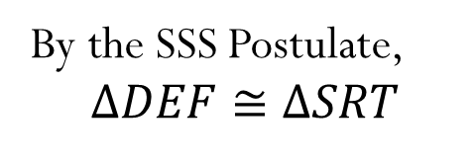
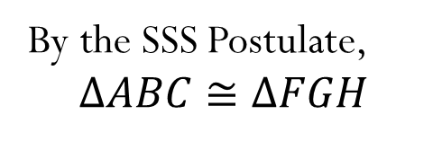
Postulate 12 – SSS Postulate
SSS Postulate: If three sides of a triangle are congruent to three sides of another triangle, then the triangles are congruent.
B
G
By the SSS Postulate,
$$∆ABC≅∆FGH$$
A
C
F
H
4
T
By the SSS Postulate,
$$∆DEF≅∆SRT$$
D
E
5
3
3
5
F
R
S
4

Slide 7
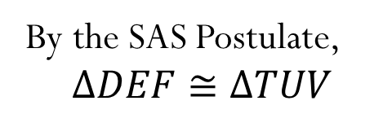
Postulate 13 – SAS Postulate
SAS Postulate: If two sides and the included angle of one triangle are congruent to two sides and the included angle of another triangle, then the triangles are congruent.
B
K
By the SAS Postulate,
$$∆ABC≅∆JKL$$
C
J
L
A
By the SAS Postulate,
$$∆DEF≅∆TUV$$
D
U
$$60°$$
9
3
3
F
$$60°$$
T
E
V
9

Slide 8
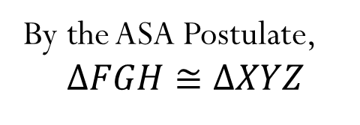
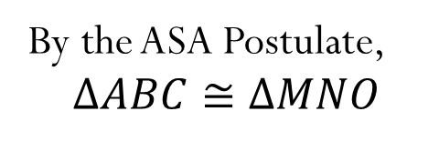
Postulate 14 – ASA Postulate
ASA Postulate: If two angles and the included side of one triangle are congruent to two angles and the included side of another triangle, then the triangles are congruent.
B
N
By the ASA Postulate,
$$∆ABC≅∆MNO$$
A
C
M
O
G
Z
By the ASA Postulate,
$$∆FGH≅∆XYZ$$
4
$$55°$$
4
F
$$55°$$
H
X
Y

Slide 9
Using the Postulates
State which postulate you can use to prove that these triangles are congruent. Explain using the sentence frame provided.
These triangles are congruent by the _____ postulate because
SAS
Between the two triangles, we have two sides and their included angles congruent to one another.

Slide 10
Using the Postulates
State which postulate you can use to prove that these triangles are congruent. Explain using the sentence provided.
These triangles are congruent by the _____ postulate because
ASA
Between the two triangles, we have two angles and their included sides congruent to one another.

Slide 11
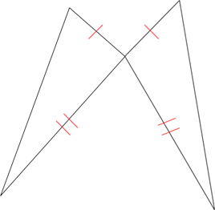
Using the Postulates
State which postulate you can use to prove that these triangles are congruent. Explain using the sentence frame provided
These triangles are congruent by the _____ postulate because
SAS
Between the two triangles, we have two sides and their included angles congruent to one another.

Slide 12
Using the Postulates
State which postulate you can use to prove that these triangles are congruent. Explain using the sentence frame provided.
These triangles are congruent by the _____ postulate because
SSS
Between the two triangles, we have the three sides each triangle congruent to one another.

Slide 13
Exit Ticket
Can the two triangles be proved congruent? If so, what postulate can be used to prove it? Use the following sentence frame to explain:
These triangles are congruent by the _____ postulate because _________________________________________.
1.) 2.)

Slide 14
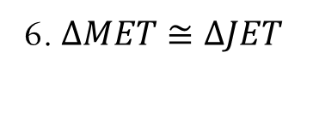
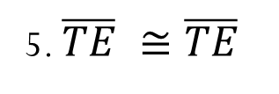

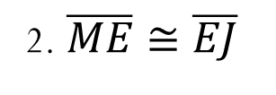
Using the Postulates
Supply the missing statements and reasons in the following proof.
Given: $E$ is the midpoint of $\overline{MJ}$
$\overline{TE} \overline{MJ}$
Prove: $∆MET≅∆JET$
T
E
J
M
Statements ________ _______Reasons
$E$ is the midpoint of $\overline{MJ}$
1. Given
2. $\overline{ME}≅\overline{EJ}$
2. Def. of Midpoint
3. $\overline{TE} \overline{MJ}$
3. Given
4. $<MET≅ <JET$
4. Def. of Perp. Lines
5. $\overline{TE} ≅\overline{TE}$
5. Reflexive
6. $∆MET≅∆JET$
6. SAS Postulate

