Slide 1
Geometry: Unit 1: Transformations
Reflections

Slide 2
Warmup
Watch the Following Video:
http://www.pbslearningmedia.org/resource/muen-math-g-reflection/reflection/

Slide 3
reflections
Objective: Students will be able to do the following, regarding geometric transformations.
Write Transformations Symbolically and justify their choice.
Explain the movement of points for a given transformation.
Draw an image under each transformation.

Slide 4
Isometry: A Reminder
An Isometric Transformation has the following properties are preserved:
Distance (All lengths stay the same)
Angle measure (All angles stay the same)
Parallelism (All lines that are parallel stay parallel)
Collinearity (All points on a line remain on a line)
In short, the transformed figure (Image) is the same shape and size as the original figure (Pre-Image).

Slide 5
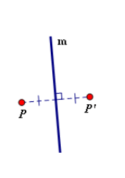
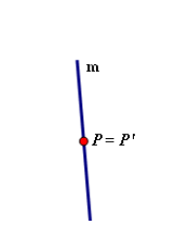
Reflections
A reflection in a line m is an isometric transformation that maps a point P on the plane to a point P’, so that the following properties are true:
1. If P is not on the line m, then the line m is a perpendicular bisector of $\overline{PP′}$.
2. If P is on the line m, then $P=P′$.

Slide 6
Reflections: Notation
To abbreviate a reflection in the line m, we write $R_{m}$. To abbreviate the statement $R_{m}$ maps P to P’, we write $R_{m}:P→P′$ or $R_{m}\left(P\right)=P′$.

Slide 7
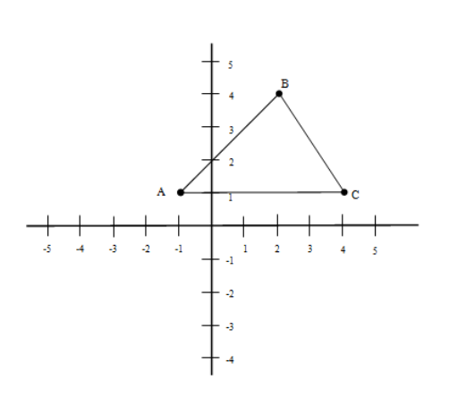
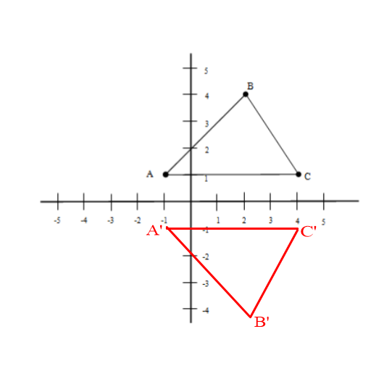
Reflecting Points
Given $∆ABC$ with A(-1,1), B(2,4), C(4,1), reflect $∆ABC$ through the x-axis.
Image

Slide 8
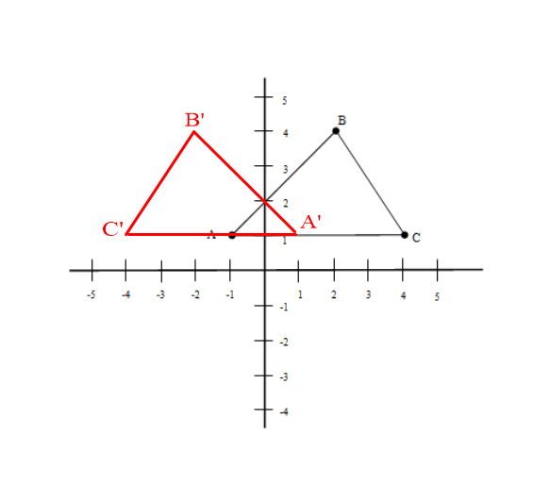
Reflecting Points Once more
Given $∆ABC$ with A(-1,1), B(2,4), C(4,1), reflect $∆ABC$ through the y-axis.
Image

Slide 9
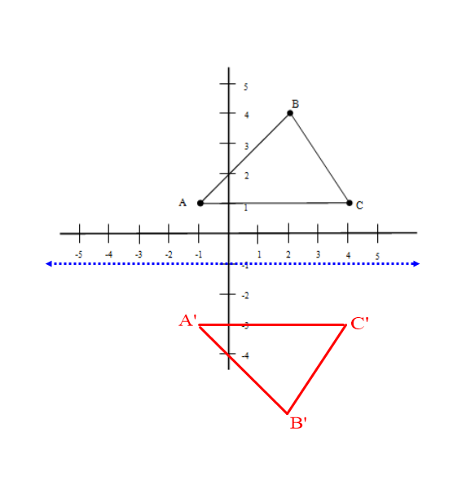
Reflecting Points from A Line not on an axis
Given $∆ABC$ with A(-1,1), B(2,4), C(4,1), reflect $∆ABC$ through the line $y=−1$.
Image

Slide 10
Classroom Activity
Go to page 579 of your textbook.
Work through problems 1-14 of the “Classroom Exercises” section with your group.
When you are done, explain in your own words what a reflection does to a point. Be brief, but not lazy (i.e. Don’t say “It Reflects it”).

