Slide 1
Geometry: Unit 1:Transformations
Rotations

Slide 2
Warmup
In words, describe how these transformations (given in their notations) would move each point.
$T:(x,y)→(x−3,y+5)$ Every Point…
$R_{x}$ Every Point…
$R_{y}$ Every Point…

Slide 3
Rotations
Objective: Students will be able to do the following, regarding geometric transformations.
Write Transformations Symbolically and justify their choice.
Explain the movement of points for a given transformation.
Draw an image under each transformation.
http://www.pbslearningmedia.org/resource/muen-math-g-rotation/rotation/

Slide 4
Isometry: A Reminder
An Isometric Transformation has the following properties preserved:
Distance (All lengths stay the same)
Angle measure (All angles stay the same)
Parallelism (All lines that are parallel stay parallel)
Collinearity (All points on a line remain on a line)
In short, the transformed figure (Image) is the same shape and size as the original figure (Pre-Image).

Slide 5
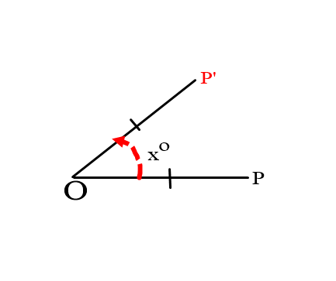
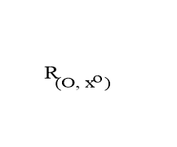
Rotations
A rotation is an isometric transformation that turns a point around a circle along a fixed point called the center of rotation. Rays drawn from the center of rotation to a point and its image form an angle called the angle of rotation.
For a counterclockwise rotation about a point O through $x°$, we write $R_{(O,x)}$. A counterclockwise rotation is considered positive, and a clockwise rotation is considered negative.

Slide 6
Rotations
An object and its rotation are the same shape and size, but the figures may be turned in different directions.

Slide 7
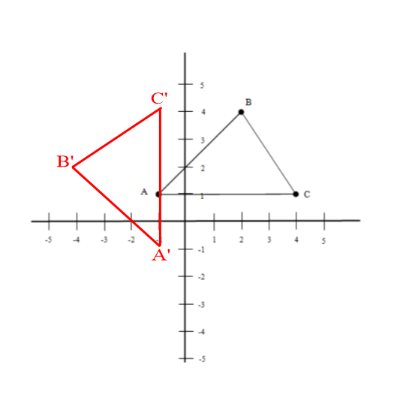
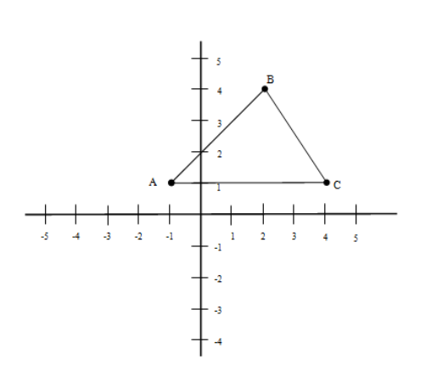
Rotations Example
Given $∆ABC$ with A(-1,1), B(2,4), C(4,1), rotate $∆ABC$ $90°$ about the origin.
Image

Slide 8
Rules for Rotation
There are four main rotations: $90°$, $180°$, $270°$, and $360°$. Rotations of degrees beyond $360°$ are simply repeats of the ones before it. Here are some rules for you to remember how points are changed when they are reflected by those four specific measures.
$$R_{O,90°}:(x,y)→(−y,x)$$
$$R_{O,180°}:\left(x,y\right)=H_{O}:\left(x,y\right)→\left(−x,−y\right)$$
$$R_{O,270°}:(x,y)→(y,−x)$$
$$R_{O,360°}:(x,y)→(x,y)$$
*This is also $R_{O,−270°}$
*This is also $R_{O,−90°}$

Slide 9
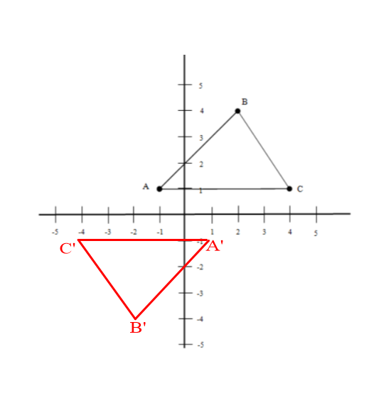
Half-Turn
A rotation about point O through $180°$ is called a half-turn about O and is usually denoted by $H_{O}$.
This is a general notation depicting the effect a half-turn has on any given point: $H_{0}:\left(x,y\right)→\left(−x,−y\right).$
This is an application of a half-turn on $∆ABC$ from the previous example.
Image

Slide 10
Exit Ticket
In words, describe how these transformations (given in their notations) would move each point.
$R_{O,−90°}$ Every point…
$R_{O,90°}$ Every point…
$H_{O}$ Every point…

Slide 11
Classroom Activity
Go to page 589 of your textbook.
Work through problems 1-8, 12-15 of the “Classroom Exercises” section with your group. For 15, don’t read aloud, write down what each expression is saying.
When you are done, explain in your own words what a rotation does to a point. Be brief, but not lazy (i.e. Don’t say “It Rotates it”).

