Slide 1
Geometry: Unit 2
Segments, Rays, and Distance

Slide 2
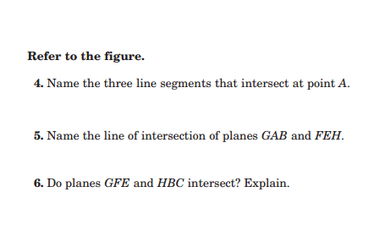
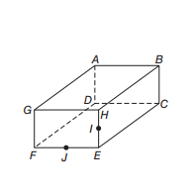
Warm-up

Slide 3
Segments, Rays, and Distance
Content Objective: Students will be able to complete statements and answer problems related to line segments using the Segment Addition Postulate.
Language Objective: Students will be able to state and use the Segment Addition Postulate to solve problems.

Slide 4
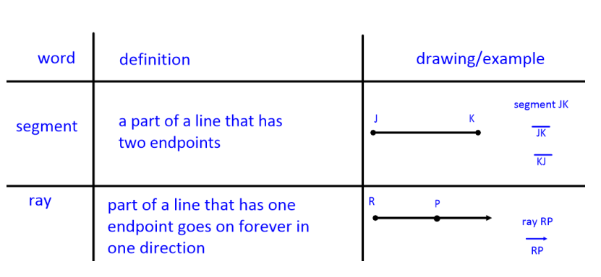
Segments and Rays
Here is a reminder of the definitions, along with visual examples, of segments and rays, discussed in the previous lecture.
Note: Since Segments have a fixed distance, then we can give a measure to it.

Slide 5
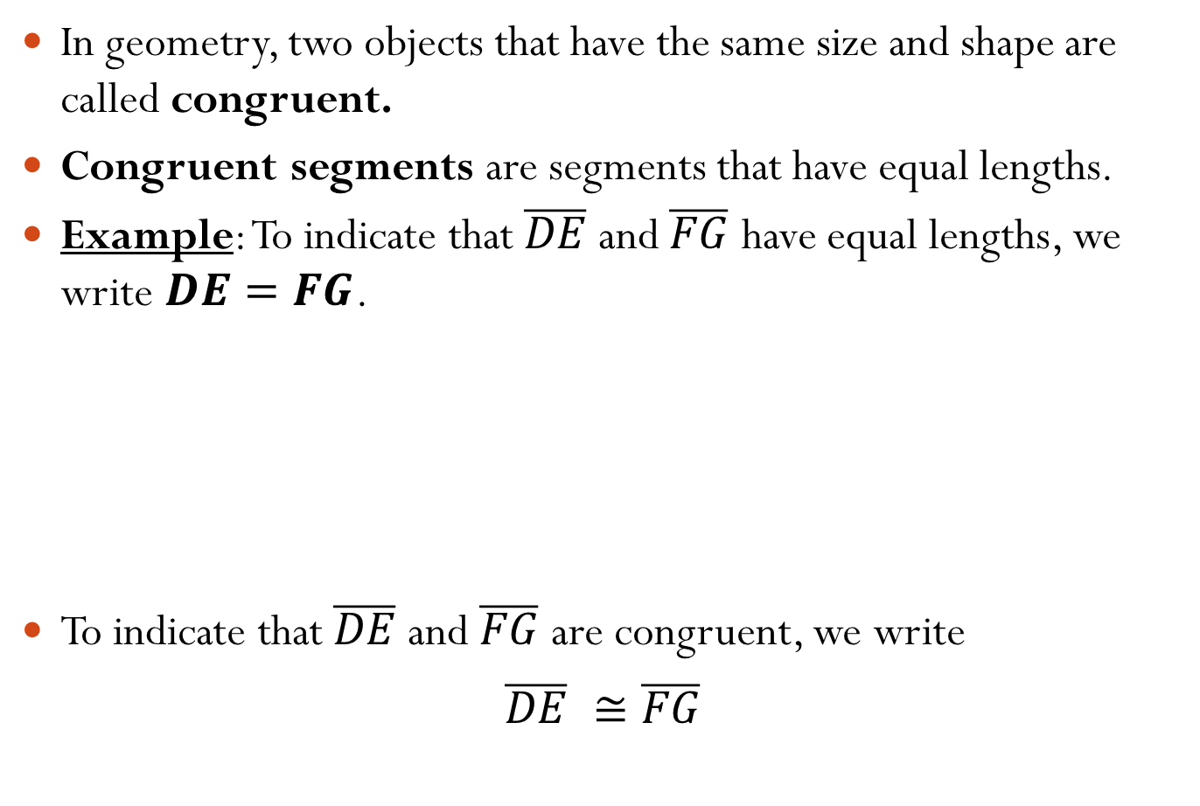
Congruence
In geometry, two objects that have the same size and shape are called congruent.
Congruent segments are segments that have equal lengths.
Example: To indicate that $\overline{DE}$ and $\overline{FG}$ have equal lengths, we write $DE=FG$.
To indicate that $\overline{DE}$ and $\overline{FG}$ are congruent, we write
$$\overline{DE} ≅\overline{FG}$$
E
5 in
D
F
5 in
G

Slide 6
Midpoint and Bisector
The midpoint of a segment is the point that divides the segment into two congruent segments.
From the diagram, we see that:
$$AP=PB$$
So $\overline{AP} ≅\overline{PB}$
Thus, $P$is the midpoint of $\overline{AB}$

Slide 7
Segment Bisector
A bisector of a segment is a line, segment, ray, or plane that intersects the segment at its midpoint.
From the diagram, you can see that Line l is the bisector of $\overline{AB}$. $\overline{PQ}$ and plane X also bisect $\overline{AB}$.
O
A
B
P
X

Slide 8
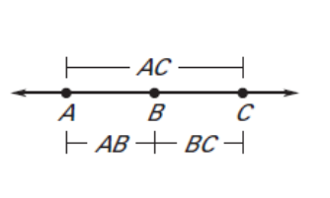

Segment Addition
Segment Addition Postulate:
If B is between A and C, then $AB+BC=AC$.

Slide 9
Example Using Segment Addition
B is between A and C, with $AB=x,$ $BC=x+6$, and $AC=24$. Find:
24
a) the value of $x$.
By the Segment Addition Postulate, we can write
$$AB+BC=AC$$
$$x+\left(x+6\right)=24$$
$$2x+6=24$$
$$2x=18$$
$$x=9$$
A
B
C
x
X+6
b) $BC$
With the value of $x$we got in part (a), we can plug it in to find the value of $BC$
$$BC=x+6$$
$$=9+6$$
$=15$

Slide 10
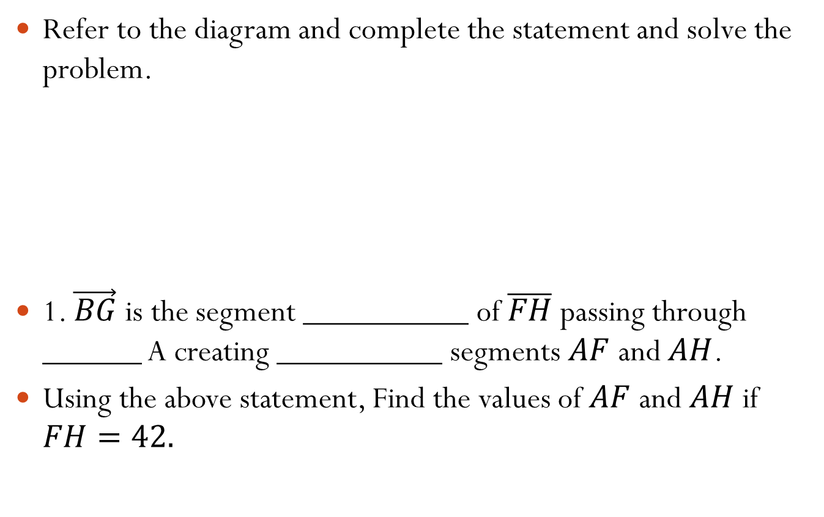
Exit Ticket
Refer to the diagram and complete the statement and solve the problem.
1. $\vec{BG}$ is the segment __________ of $\overline{FH}$ passing through ______ A creating __________ segments $AF$ and $AH$.
Using the above statement, Find the values of $AF$ and $AH$ if $FH=42.$
E
B
F
H
A
G

