Slide 1
Semester One: Final Test Review

Slide 2
Unit 1 Transformations
For each Transformation, describe how each point should move.
1. T:(x, y) → (x + a, y + b):
Every point moves a units (left if a is negative/right if a is positive) and b units (down if b is negative and up if b is positive.
2. $R_{m}:$
Every point maps to its image, forming a line that is perpendicular to the line “m” (you would put the specific line for your problem in place of “m”), with both image and pre-image being equidistant (same distance) from the line “m”.

Slide 3
Unit 1: Transformations
For each Transformation, describe how each point should move.
3. $R_{O,90°}$:
Every point moves $90°$ counterclockwise about the origin.
4. $H_{O}:$
Every point moves $180°$ about the origin (in either direction).

Slide 4
Unit 1: Transformations
For each Transformation, describe how each point should move.
5. $D_{O,k}$:
Every point moves to a point “k” times the distance from the center O.

Slide 5
Unit 1: Transformations
Translation
$$(−2,3)$$
-74
Reflection
$$(4,−7)$$
5 3
Rotation
$$(3,−5)$$
2 4
Dilation
$$(−4,−8)$$
-6-8
Dilation
$$(−3,−4)$$

Slide 6
Unit 2: Geometric Vocabulary
Recall some of the key terms from this section:
Point Line Plane
Collinear Coplanar Intersect
Contains Opposite Adjacent
Segment Addition Angle Addition Midpoint
Angle Bisector Supplementary Complementary
Vertical Congruent

Slide 7
Unit 2: Geometric Vocabulary
E
Use these terms to fill in blanks:
$FA+AH=$________ by _______________ Postulate.
$<BAF≅$ ______ because they are _______ angles.
$<FAB and<BAE$ are _____________ angles because they add up to ____.
B
F
H
A
$$FH$$
Segment Addition
G
$$<HAG$$
Vertical
Complementary
$$90°$$

Slide 8
Unit 2: Geometric Vocabulary
Be ready to solve equations using segment and angle addition:
3.) $m<FOE=3x−1$, $m<EOD=72°$, and $m<FOD=6x+11$
$3x−1+72=6x+11$
$3x+71=6x+11$
$3x=60$
$x=20$
4.) $EB=6x−8$, $OB=12$, and $OE=4x−2$
$4x−2+12=6x−8$
$4x+10=6x−8$
$2x=18$
$x=9$

Slide 9
Unit 3: Proofs
Be ready for another round of proofs:
Given
$$NP=NP$$
$$MN NP$$
Segment Addition Postulate
$$PN PQ$$
$$MN+NP=NP+PQ$$
Substitution
$$MN=PQ$$
Subtraction

Slide 10
Unit 4: Parallel Lines
Use the properties of parallel lines to find angle measures. Remember the big three that we focused on in this unit:
Corresponding Angles are Congruent
$Corr. <^{′}s are ≅$
Alternate Interior Angles (Alt. Int.) are Congruent $Alt. Int. <^{′}s are ≅$
Same-Side Interior Angles (S-S Int.) are Supplementary
$S−S Int. <^{′}s are supp.$

Slide 11
Unit 4: Parallel Lines
Use those properties to make equations and find angle measures using a diagram (you may also be asked to explain your answers):
$$115°$$
$$c d$$
Corr.
$$≅$$
$$70°$$
$$a b$$
Alt. Int.
$$≅$$
$$60°$$
$$c d$$
S-S Int.
$$supp.$$

Slide 12
Unit 4: Parallel Lines
Use those properties to make equations and find angle measures using a diagram (you may also be asked to explain your answers):
Ex: $m<8=4x+12$ and $m<2=6x−4$
$4x+12=6x−4$
$16=2x$
$8=x$

Slide 13
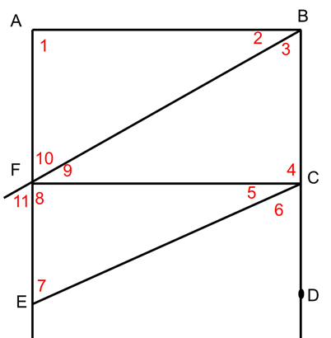
Unit 4: Parallel Lines
You can also use those properties to identify the existence of parallel lines in a diagram
1. $<2≅ <9$
$\overline{AB}$ ll $\overline{FC}$
2. $m<2=m<5$
None
3. $<6≅ <7$
$\overline{EF}$ ll $\overline{CD}$

Slide 14
Unit 4: Parallel Lines
You can also use those properties to identify the existence of parallel lines in a diagram
Yes; $\overline{AB} // \overline{EF}$
Because when lines ACBAT and Corr. <‘s are $≅$, then lines are //.

Slide 15
Unit 5: Triangles
Remember the 5 Postulates/Theorems we use for Proving That Triangles are congruent:
Side-Side-Side SSS
Side-Angle-Side SAS
Angle-Side-Angle ASA
Angle-Angle-Side AAS
Hypotenuse-Leg HL
Oh, and Let’s not forget about…
CPCTC

Slide 16
Unit 5: Triangles
Use these postulates/theorems to label diagrams and name the appropriate congruent statements:
S
$$\overline{FI}$$
$$\overline{HI}$$
A
$$<EIF$$
$$<GIH$$
S
$$\overline{EI}$$
$$\overline{GI}$$
$$GHI$$

Slide 17
Unit 5: Triangles
Use these postulates/theorems to label diagrams and name the missing parts to satisfy them:
AAS Theorem

Slide 18
Unit 5: Triangles
Use these postulates/theorems to label diagrams and name the missing parts to satisfy them:
SSS Postulate

Slide 19
Unit 5: Triangles
Use these postulates/theorems to label diagrams and name the appropriate congruent statements:
$$CDA$$
$$SSS$$

Slide 20
Unit 5: Triangles
Use these postulates/theorems to label diagrams and name the appropriate congruent statements:
$$EDC$$
$$AAS$$

Slide 21
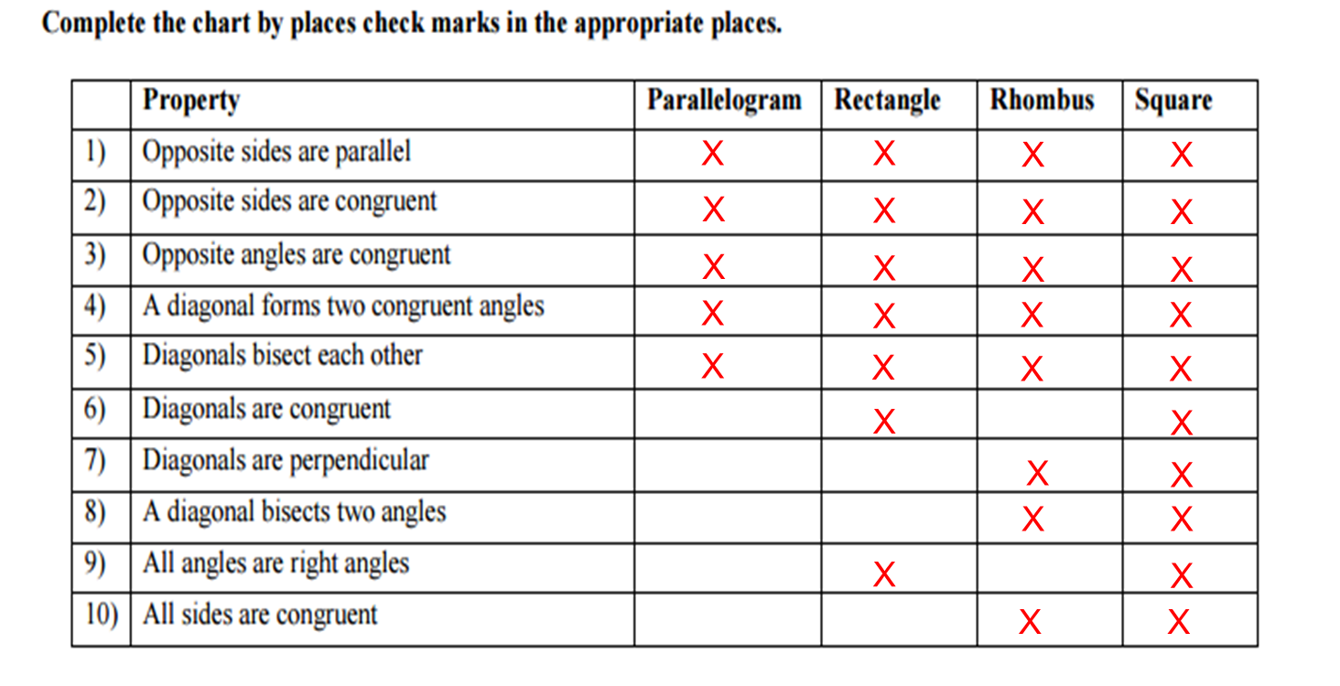
Unit 6: Quadrilaterals
Remember the properties of the Quadrilaterals, and how to use them to make equations.

Slide 22
Unit 6: Quadrilaterals
Remember the properties of the Quadrilaterals, and how to select the most best one from a given property.
A
A
A
C
B
B
D
A
C
E

Slide 23
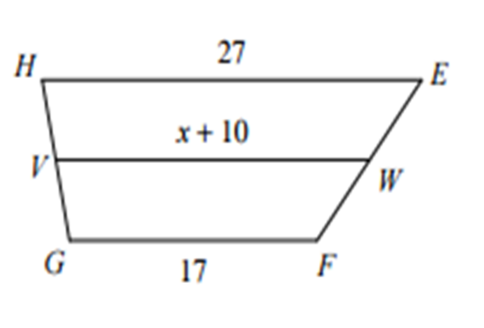
Unit 6: Quadrilaterals
And remember the Trapezoid…
It is NOT a Parallelogram! It has its own Properties.
Ex: Find the value of x in the figure.
$x+10=\frac{1}{2}(27+17)$ (Why?)
$$x+10=\frac{1}{2}(44)$$
$$x+10=22$$
$$x=12$$

