Slide 1
Geometry Unit 12
Slope and Midpoint

Slide 2




Warm-Up
Find the Slope of the line through the following pairs of points.
1. $(7,2)$ and $(2,7)$ 2. $(0,0)$ and $(5,1)$
3. $(1,6)$ and $(4,6)$ 4. $(3,3)$ and $(3,7)$
$$m=\frac{y_{2}−y_{1}}{x_{2}−x_{1}}=\frac{7−2}{2−7}$$
$$m=\frac{y_{2}−y_{1}}{x_{2}−x_{1}}=\frac{1−0}{5−0}$$
$$=−\frac{5}{5}=−1$$
$$=\frac{1}{5}$$
$$m=\frac{y_{2}−y_{1}}{x_{2}−x_{1}}=\frac{6−6}{4−1}$$
$$m=\frac{y_{2}−y_{1}}{x_{2}−x_{1}}=\frac{7−3}{3−3}$$
$$=\frac{0}{3}=0$$
$$=\frac{4}{0}= ?$$
Slope is undefined

Slide 3
Slope and Midpoint
Content Objective: Students will be able to identify the slopes and midpoints of lines.
Language Objective: Students will be able to calculate the slope and midpoint of a line given two points.

Slide 4
Slope: Recap
The Slope of a line is the ratio of change in y
to the change in x
Parallel Lines have slopes that are
Perpendicular Lines have slopes that
Positive slopes(#2 on the warm-up) rise to the right.
Negative slopes (#1 on the warm-up) fall to the right.
(vertical change, or rise)
(horizontal change, or run).
Equal
have a product of $−1$

Slide 5
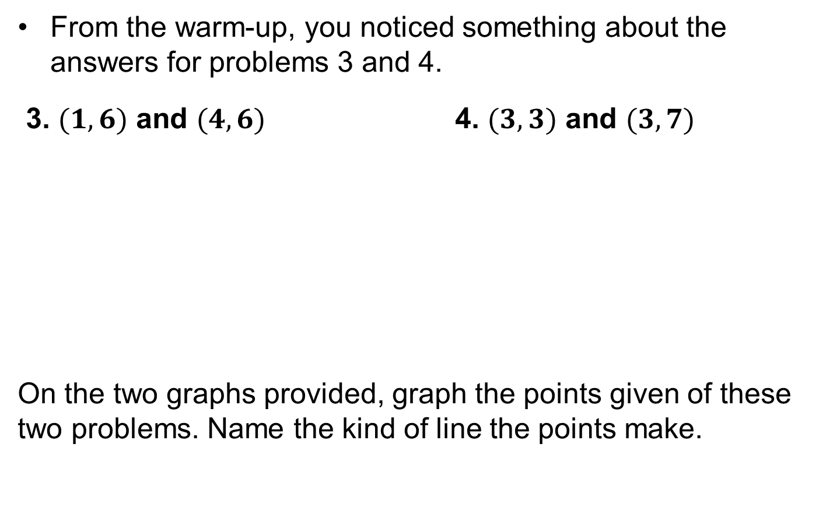
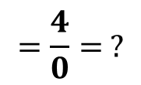

Slope: Continued
From the warm-up, you noticed something about the answers for problems 3 and 4.
3. $(1,6)$ and $(4,6)$ 4. $(3,3)$ and $(3,7)$
On the two graphs provided, graph the points given of these two problems. Name the kind of line the points make.
$$m=\frac{y_{2}−y_{1}}{x_{2}−x_{1}}=\frac{6−6}{4−1}$$
$$m=\frac{y_{2}−y_{1}}{x_{2}−x_{1}}=\frac{7−3}{3−3}$$
$$=\frac{0}{3}=0$$
$$=\frac{4}{0}= ?$$
Slope is undefined

Slide 6
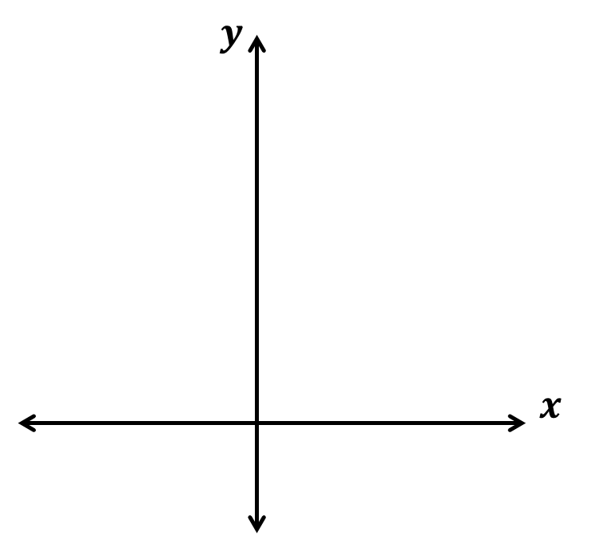
Slope: Continued
3.) $(1,6)$ and $(4,6)$
4.) $(3,3)$ and $(3,7)$
Horizontal
$$0$$
Conclusion: ____________ lines have a slope of ____ and _____________ lines have an _____________ slope.
Vertical
undefined

Slide 7
Midpoint
As a reminder, the Midpoint of a line segment is
We can calculate the value of this midpoint if we have the values of the endpoints.
Ex: If $A=x_{1}$ and $B=x_{2}$, then the value of M will be
$$M=\frac{x_{1}+x_{2}}{2}$$
The average of the values of A and B
Key Question: Could this idea also be used to find the midpoint of two points on the (x,y) – coordinate plane?
a point M such that $AM=MB$
A
M
B

Slide 8
The Midpoint Formula
Theorem 13-5: The midpoint of the segment that joins points ($x_{1},y_{1}$) and ($x_{2},y_{2}$) is the point
$$M=\left(\frac{x_{1}+x_{2}}{2}, \frac{y_{1}+y_{2}}{2}\right)$$
Example 1: Find the midpoint of the segment that joins $(−11,3)$ and $(8,−7)$.
Solution: $M=$ $\left(\frac{x_{1}+x_{2}}{2}, \frac{y_{1}+y_{2}}{2}\right)$
$$M=\left(\frac{−11+8}{2}, \frac{3+(−7)}{2}\right)$$
$$M=\left(\frac{−3}{2}, \frac{−4}{2}\right)=\left(\frac{−3}{2}, −2\right)$$

Slide 9
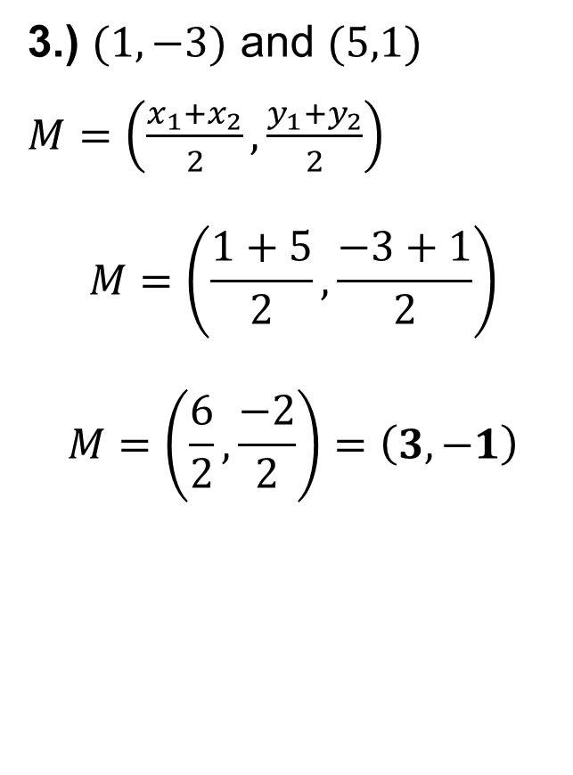
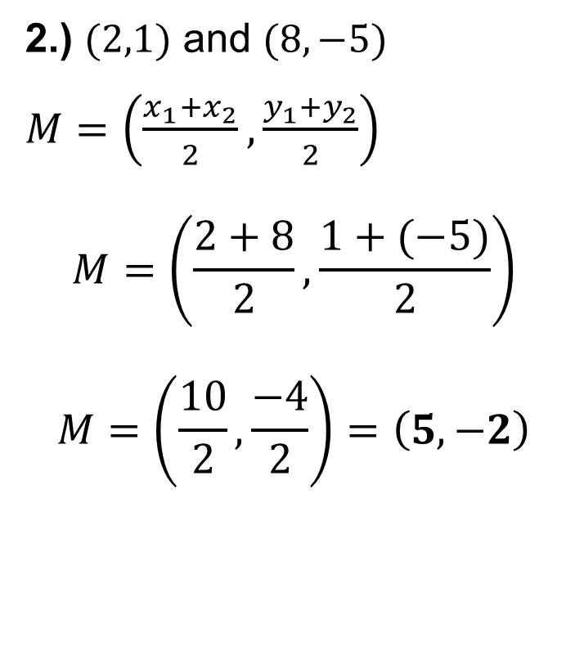
Practice
Find the midpoint of the segment that joins the points given.
2.) $(2,1)$ and $(8,−5)$
$M=$ $\left(\frac{x_{1}+x_{2}}{2}, \frac{y_{1}+y_{2}}{2}\right)$
$$M=\left(\frac{2+8}{2}, \frac{1+(−5)}{2}\right)$$
$$M=\left(\frac{10}{2}, \frac{−4}{2}\right)=\left(5,−2\right)$$
3.) $(1,−3)$ and $(5,1)$
$M=$ $\left(\frac{x_{1}+x_{2}}{2}, \frac{y_{1}+y_{2}}{2}\right)$
$$M=\left(\frac{1+5}{2}, \frac{−3+1}{2}\right)$$
$$M=\left(\frac{6}{2}, \frac{−2}{2}\right)=\left(3,−1\right)$$

Slide 10
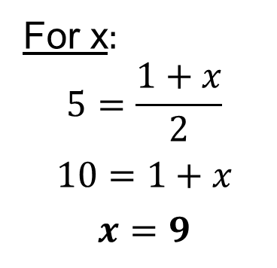
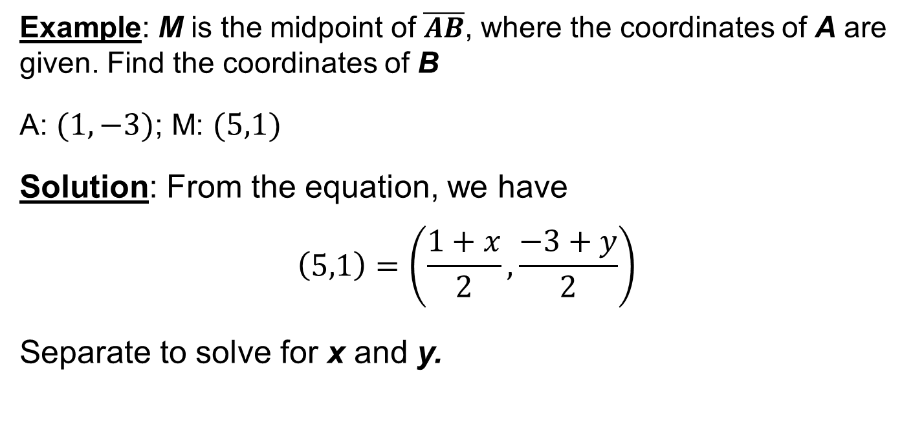
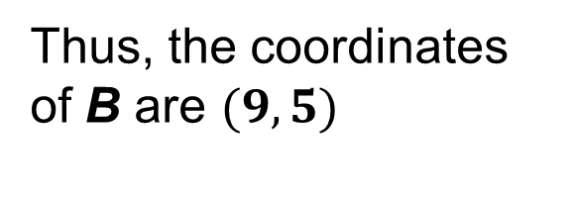
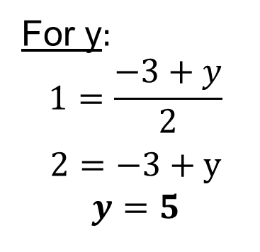
Other use For midpoint
Example: M is the midpoint of $\overline{AB}$, where the coordinates of A are given. Find the coordinates of B
A: $(1,−3)$; M: $(5,1)$
Solution: From the equation, we have
$$\left(5,1\right)=\left(\frac{1+x}{2}, \frac{−3+y}{2}\right)$$
Separate to solve for x and y.
For x:
$$5=\frac{1+x}{2}$$
$$10=1+x$$
$$x=9$$
For y:
$$1=\frac{−3+y}{2}$$
$$2=−3+y$$
$$y=5$$
Thus, the coordinates of B are $(9,5)$

Slide 11
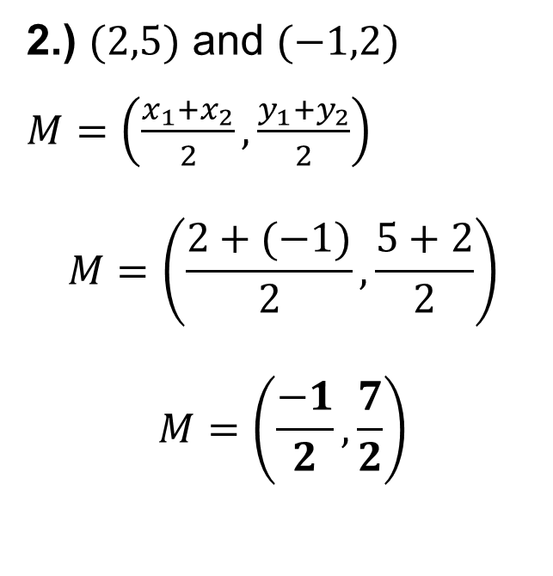
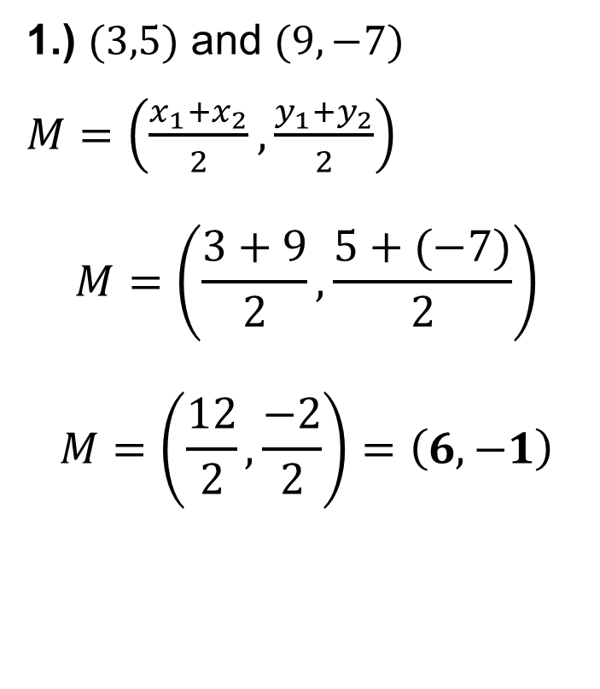
Group Practice – Slopes and Midpoint
Find the midpoint of the segment that joins the points given.
1.) $(3,5)$ and $(9,−7)$
$M=$ $\left(\frac{x_{1}+x_{2}}{2}, \frac{y_{1}+y_{2}}{2}\right)$
$$M=\left(\frac{3+9}{2}, \frac{5+(−7)}{2}\right)$$
$$M=\left(\frac{12}{2}, \frac{−2}{2}\right)=\left(6,−1\right)$$
2.) $(2,5)$ and $(−1,2)$
$M=$ $\left(\frac{x_{1}+x_{2}}{2}, \frac{y_{1}+y_{2}}{2}\right)$
$$M=\left(\frac{2+(−1)}{2}, \frac{5+2}{2}\right)$$
$$M=\left(\frac{−1}{2}, \frac{7}{2}\right)$$

Slide 12

Group Practice – Slopes and Midpoint
Find the midpoint of the segment that joins the points given.
3.) $(0,4)$ and $(4,3)$
$M=$ $\left(\frac{x_{1}+x_{2}}{2}, \frac{y_{1}+y_{2}}{2}\right)$
$$M=\left(\frac{0+4}{2}, \frac{4+3}{2}\right)$$
$$M=\left(\frac{4}{2}, \frac{7}{2}\right)=\left(2,\frac{7}{2}\right)$$

Slide 13

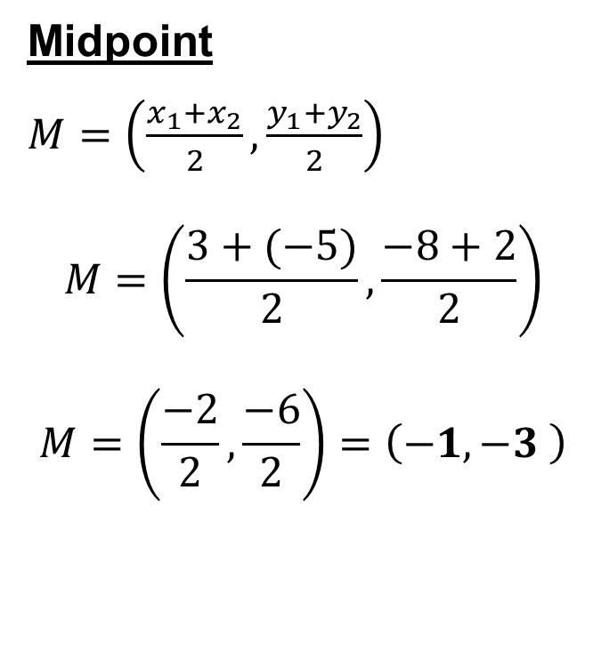
Group Practice – Slopes and Midpoint
Find the slope and midpoint of the segment that joins the points given.
4.) $(3,−8)$ and $(−5,2)$
Slope
$$m=\frac{y_{2}−y_{1}}{x_{2}−x_{1}}$$
$$m=\frac{2−(−8)}{−5−3}$$
$$m=\frac{10}{−8}=−\frac{5}{4}$$
Midpoint
$M=$ $\left(\frac{x_{1}+x_{2}}{2}, \frac{y_{1}+y_{2}}{2}\right)$
$$M=\left(\frac{3+(−5)}{2}, \frac{−8+2}{2}\right)$$
$$M=\left(\frac{−2}{2}, \frac{−6}{2}\right)=\left(−1,−3 \right)$$

Slide 14

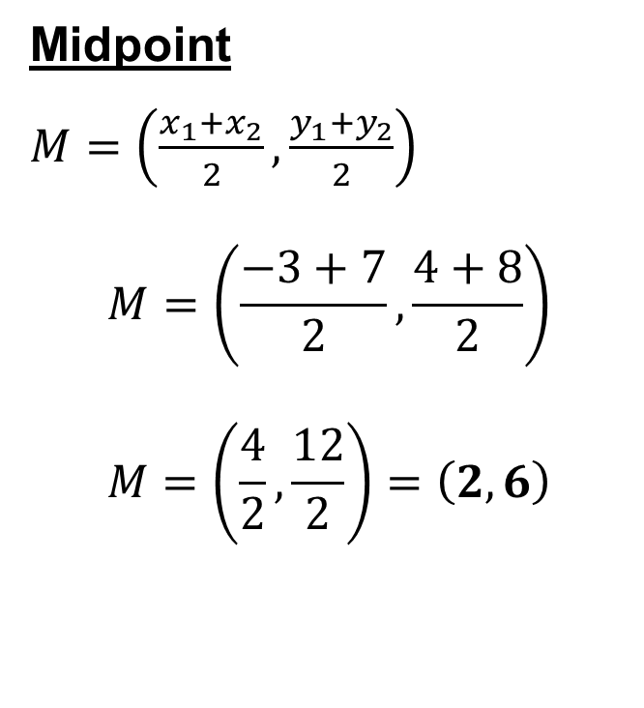
Group Practice – Slopes and Midpoint
Find the slope and midpoint of the segment that joins the points given.
5.) $(−3,4)$ and $(7,8)$
Slope
$$m=\frac{y_{2}−y_{1}}{x_{2}−x_{1}}$$
$$m=\frac{8−4}{7−(−3)}$$
$$m=\frac{4}{10}=\frac{2}{5}$$
Midpoint
$M=$ $\left(\frac{x_{1}+x_{2}}{2}, \frac{y_{1}+y_{2}}{2}\right)$
$$M=\left(\frac{−3+7}{2}, \frac{4+8}{2}\right)$$
$$M=\left(\frac{4}{2}, \frac{12}{2}\right)=\left(2,6\right)$$

Slide 15

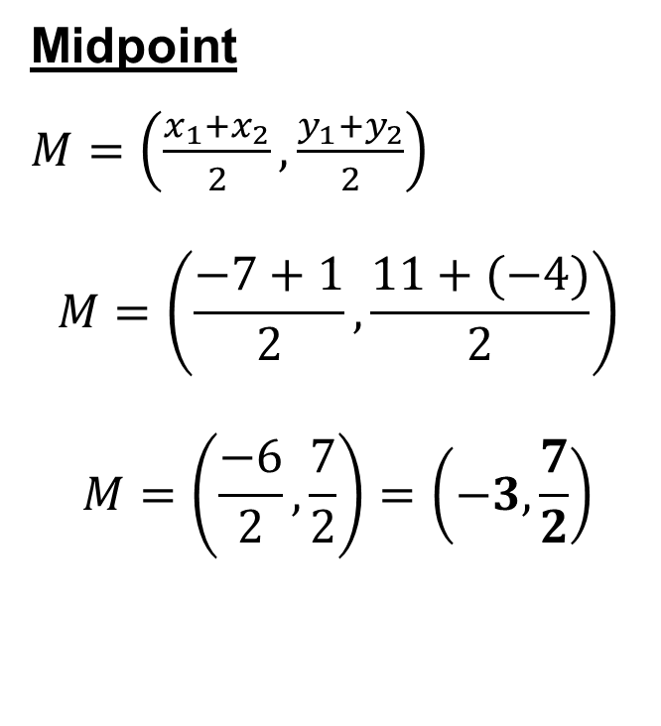
Group Practice – Slopes and Midpoint
Find the slope and midpoint of the segment that joins the points given.
6.) $(−7,11)$ and $(1,−4)$
Slope
$$m=\frac{y_{2}−y_{1}}{x_{2}−x_{1}}$$
$$m=\frac{−4−11}{1−(−7)}$$
$$m=\frac{−15}{8}$$
Midpoint
$M=$ $\left(\frac{x_{1}+x_{2}}{2}, \frac{y_{1}+y_{2}}{2}\right)$
$$M=\left(\frac{−7+1}{2}, \frac{11+(−4)}{2}\right)$$
$$M=\left(\frac{−6}{2}, \frac{7}{2}\right)=\left(−3,\frac{7}{2}\right)$$

