Slide 1
Geometry Unit 12
Slope of a Line

Slide 2
Warm-up: Theorem for Similar Solids
Theorem 12-11: If the scale factor of two similar solids is $a:b$, then
(1) The ratio of corresponding perimeters is
(2) The ratio of the base areas, of the lateral area, and of the total areas is
(3) The ratio of the volumes is
$$a:b$$
$$a^{2}:b^{2}$$
$$a^{3}:b^{3}$$

Slide 3

Warm-Up from 12-5
1.) Given the following measurements for similar solids, identify the reduced ratio for each of the following.
Given height 4 and height 7
*When given heights/slant heights /radii /perimeter /circumference, you use a reduced ratio of the values given as your scale
(a.) Scale Factor __________
(b.) Total Area _______________
$$4/7$$
$${4^{2}}/{7^{2}}={16}/{49}$$

Slide 4

Warm-Up from 12-5
Given the following measurements for similar solids, identify the reduced ratio for each of the following.
Given areas 18$π$ and $50π$.
Pay attention to the fact that it gives AREAS, which have an $a^{2}/b^{2}$ relationship to the $a/b$ scale factor
To solve for the scale factor, first reduce the current ratio, then take the square root of both values to get the scale factor
(a.) Scale Factor (b.) Volume
${18π}/{50π}=9/{25}$
${\sqrt{9}}/{\sqrt{25}}=3/5$
$${3^{3}}/{5^{3}}={27}/{125}$$

Slide 5
Slope of a Line
Content Objective: Students will be able to identify slopes in straight lines
Language Objective: Students will be able to calculate the slope of a line with two or more given points.

Slide 6
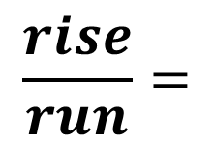
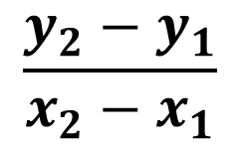
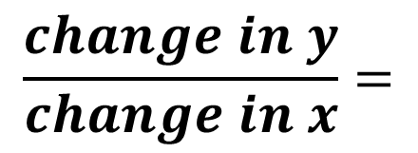
Slope
The Slope of a line is the ratio of change in y
to the change in x
Symbolically, the slope is denoted by an m.
Algebraically, the slope can be defined using the following equation, with points ($x_{1},y_{1}$) and ($x_{2},y_{2}$).
(vertical change, or rise)
(horizontal change, or run).
$$\frac{change in y}{change in x}=$$
$$\frac{rise}{run}=$$
$$\frac{y_{2}−y_{1}}{x_{2}−x_{1}}$$
$m=$

Slide 7


Example: Calculate the slope of each Line
$$y$$
$$y$$
1.)
Solution:
$m=\frac{y_{2}−y_{1}}{x_{2}−x_{1}}=\frac{4−(−1)}{5−3}$
$$=\frac{5}{2}$$
2.)
Solution:
$$m=\frac{y_{2}−y_{1}}{x_{2}−x_{1}}=\frac{2−5}{7−(−2)}$$
$$=\frac{−3}{9}=−\frac{1}{3}$$
$$(5,4)$$
$$(−2,5)$$
$$(7,2)$$
$$x$$
$$x$$
$$(3,−1)$$

Slide 8
Slope
When you are given several points on a line, you can use any two of them to compute the slope.
Example: Find the slope of this line using every combination of pairs of points
First combination: (1,1) and (4,3)
$$m=\frac{y_{2}−y_{1}}{x_{2}−x_{1}}=\frac{3−1}{4−1}=\frac{2}{3}$$
$$(7,5)$$
$$(4,3)$$
Second combination: (1,1) and (6,4)
$$m=\frac{y_{2}−y_{1}}{x_{2}−x_{1}}=\frac{5−1}{7−1}=\frac{4}{6}=\frac{2}{3}$$
$$(1,1)$$
Third combination: (4,3) and (7,5)
$$m=\frac{y_{2}−y_{1}}{x_{2}−x_{1}}=\frac{5−3}{7−4}=\frac{2}{3}$$

Slide 9
Slopes of Multiple Lines
When looking for the slopes of two or more lines, we can find them in one of two ways (depending on the information given to us):
1.) Calculate the slopes of each individual line is only points are given.
2.) Use the relationship between the lines (if there is one) to get the slope of the other line(s) from a given slope.
If you recall, there are two major relationships between lines that we have discussed in the past:
They are either __________ or ___________.
Parallel
Perpendicular

Slide 10
Parallel Lines
As a reminder, Parallel Lines ( ll lines) are coplanar lines that
do not intersect.
l
Notation: $l ‖ n$
n
Key Question: From the image given, and from what you know about slopes, can you determine the relationship between the slopes of parallel lines? Discuss this question in your groups

Slide 11
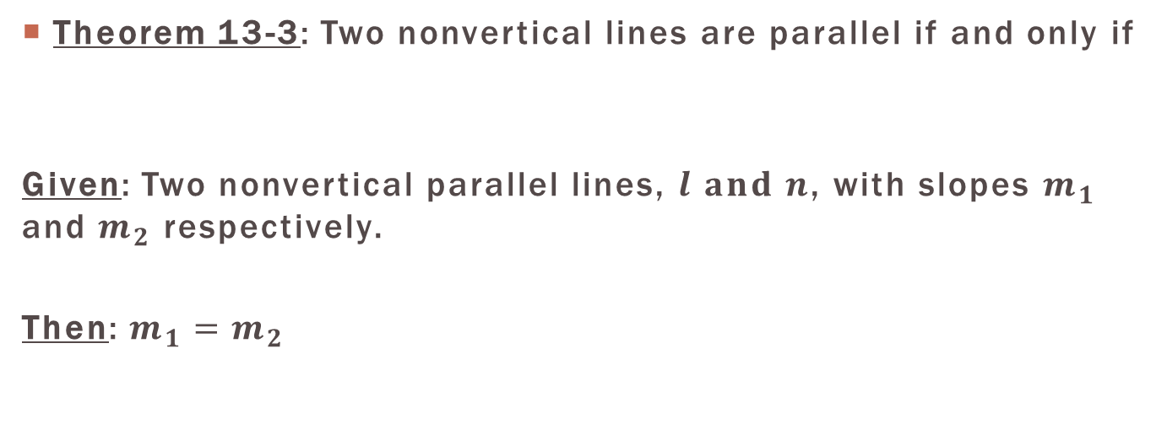
Slopes in Parallel Lines
Theorem 13-3: Two nonvertical lines are parallel if and only if
Given: Two nonvertical parallel lines, $l and n$, with slopes $m_{1}$ and $m_{2}$ respectively.
Then: $m_{1}=m_{2}$
their slopes are equal.
l
Slope: $m_{1}$
n
Slope: $m_{2}$

Slide 12
Perpendicular Lines
As a reminder, Perpendicular Lines (⊥ lines) are lines that
intersect to form right angles.
l
Notation: $l ⊥n$
With $m<1, m<2,m<3,m<4=90°$
n
Key Question: From the image given, and from what you know about slopes, can you determine the relationship between the slopes of perpendicular lines? Discuss this question in your groups

Slide 13
Slope in Perpendicular Lines
Theorem 13-4: Two nonvertical lines are perpendicular if and only if
Given: Two nonvertical perpendicular lines, $l and n$, with slopes $m_{1}$ and $m_{2}$, respectively.
Then: $m_{1}×m_{2}=−1$
Or
$m_{1}=\frac{−1}{m_{2}}$
Or
$m_{2}=\frac{−1}{m_{1}}$
the product of their slopes is $−1$.
l
Slope: $m_{1}$
n
Slope: $m_{2}$

Slide 14
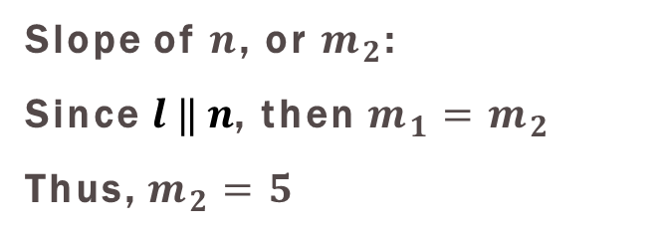
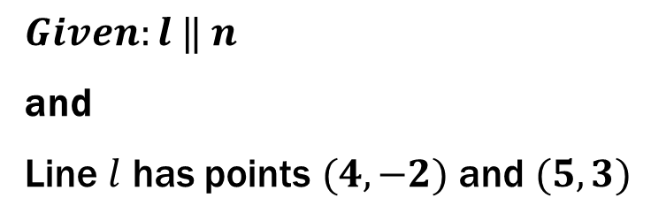
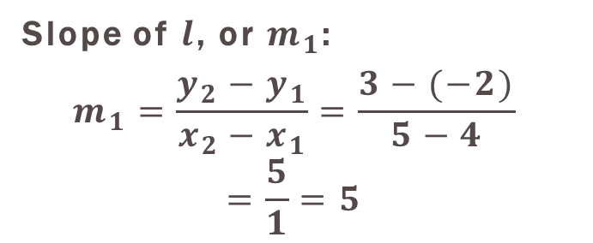
Practice: Calculate the slope of each Line
$$y$$
1.)
$Given:l ‖ n$
and
Line $l$ has points $(4,−2)$ and $(5,3)$
$$n$$
$$x$$
$$l$$
Slope of $l$, or $m_{1}$:
$$m_{1}=\frac{y_{2}−y_{1}}{x_{2}−x_{1}}=\frac{3−(−2)}{5−4}$$
$$=\frac{5}{1}=5$$
Slope of $n$, or $m_{2}$:
Since $l ‖ n$, then $m_{1}=m_{2}$
Thus, $m_{2}=5$

Slide 15
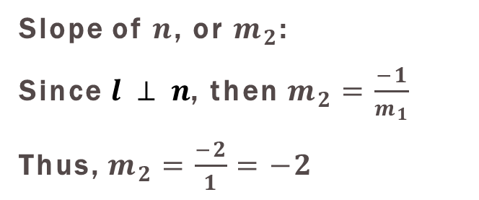
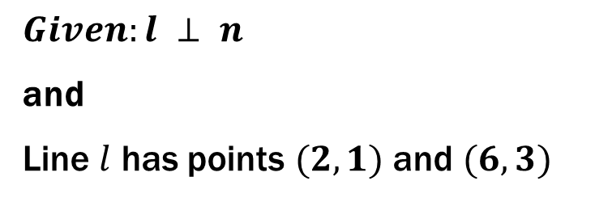
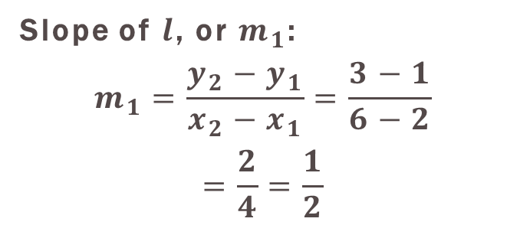
Practice: Calculate the slope of each Line
$$y$$
2.)
$$n$$
$Given:l ⊥ n$
and
Line $l$ has points $(2,1)$ and $(6,3)$
$$l$$
$$x$$
Slope of $l$, or $m_{1}$:
$$m_{1}=\frac{y_{2}−y_{1}}{x_{2}−x_{1}}=\frac{3−1}{6−2}$$
$$=\frac{2}{4}=\frac{1}{2}$$
Slope of $n$, or $m_{2}$:
Since $l ⊥ n$, then $m_{2}=\frac{−1}{m_{1}}$
Thus, $m_{2}=\frac{−2}{1}=−2$

Slide 16


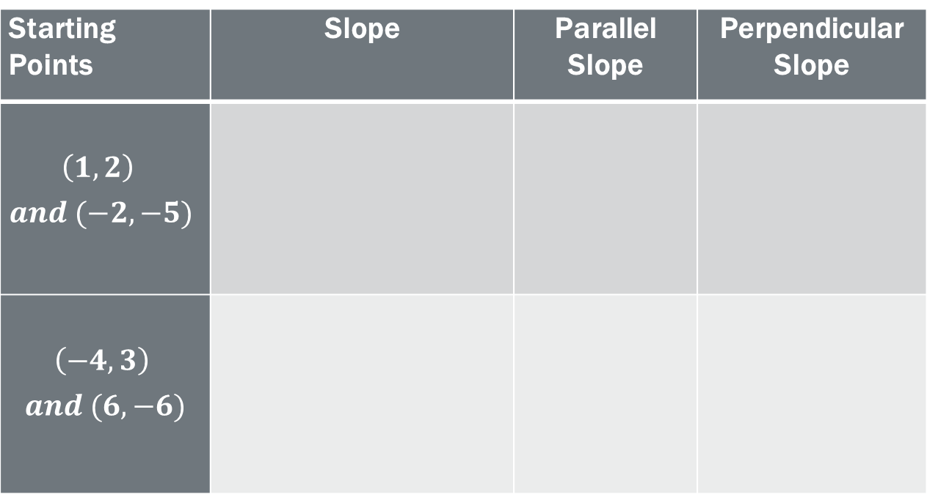





Group Practice
Complete the able of slope values:
Starting Points | Slope | Parallel Slope | Perpendicular Slope
$$\left(1,2\right)$$ $$and (−2,−5)$$
$$\left(−4,3\right)$$ $$and (6,−6)$$
$$m=\frac{y_{2}−y_{1}}{x_{2}−x_{1}}$$
$$\frac{7}{3}$$
$$\frac{−3}{7}$$
$$=\frac{−5−2}{−2−1}=\frac{7}{3}$$
$$m=\frac{y_{2}−y_{1}}{x_{2}−x_{1}}$$
$$\frac{−9}{10}$$
$$\frac{10}{9}$$
$$=\frac{−6−3}{6−(−4)}=\frac{−9}{10}$$

