Slide 1
Algebra Review
Study Guide

Slide 2

Study Guide – Order of Operations
Problem #4: Simplify the Expression
$$24÷(8−5∙2)$$
$$24÷(8−10)$$
$$24÷(−2)$$
$$−12$$

Slide 3
Study Guide – Order of Operations
Problem #5: Simplify the Expression
$$2[6÷3+{\left(−1\right)}^{2}]$$
$$2\left[2+1\right]$$
$$2\left[3\right]$$
$$6$$

Slide 4
Study Guide – Solving Equations
Problem #10: Solve the Equation
$$−9\left(4x+6\right)=18$$
$$−36x−54=18$$
$$−36x=72$$
$$x=−2$$

Slide 5
Study Guide – Solving Equations
Problem #14: Solve the Equation
$$−3\left(x−\frac{1}{3}\right)=−3$$
$$−3x+1=−3$$
$$−3x=−4$$
$$x=\frac{4}{3}$$

Slide 6
Study Guide – Solving Equations
Problem #16: Solve the Equation
$$12x+40+3x+50=180$$
$$15x+90=180$$
$$15x=90$$
$$x=6$$

Slide 7

Study Guide - Evaluate
Problem #18: Evaluate the expression for the given value
$$−3\left(2x+9\right) ;x=2$$
$$−3(2\left(2\right)+9)$$
$$−3\left(4+9\right)$$
$$−3\left(13\right)$$
$$−39$$

Slide 8


Study Guide – Factoring
Problem #22: Factor the Polynomial
${3x}^{2}−10x−8$
${3x}^{2}−12x+2x−8$
$3x\left(x−4\right)+2(x−4)$
$(x−4)(3x+2)$
$ac=−24$ $b=−10$
(1,-24) -23
(2,-12) -10

Slide 9

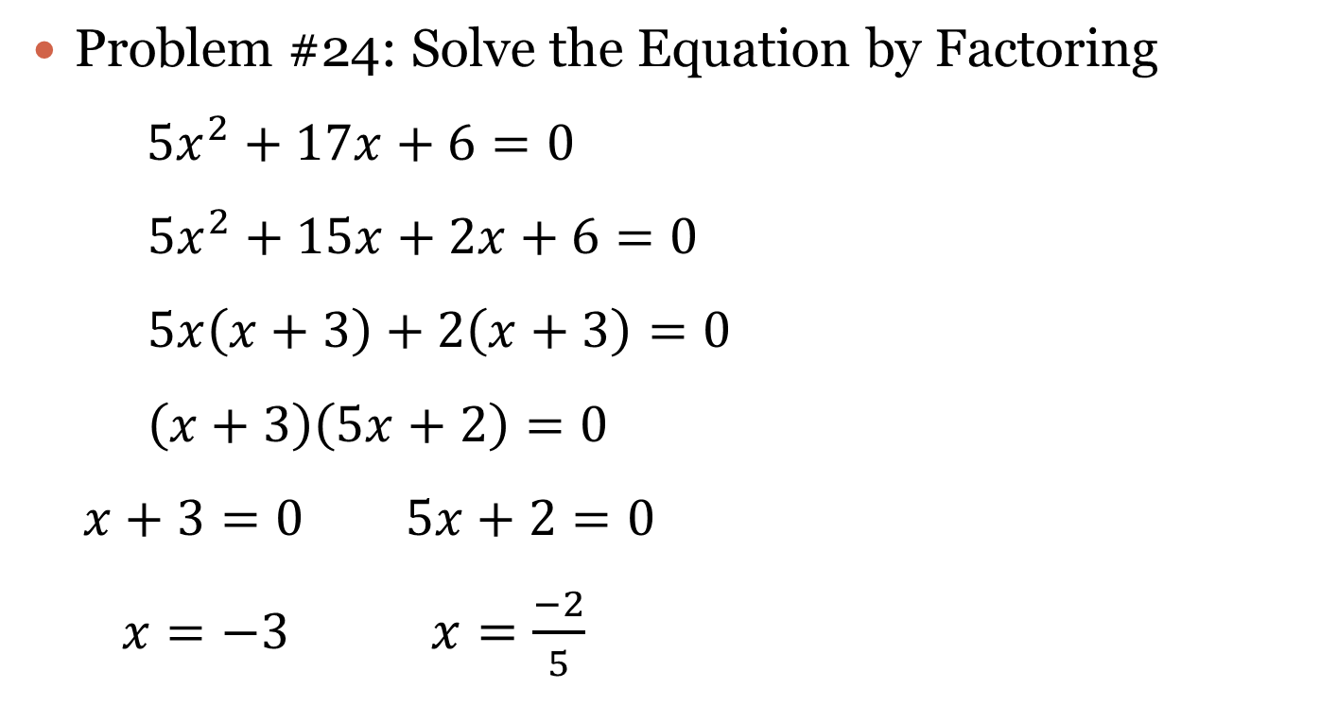
Study Guide – Solve by Factoring
Problem #24: Solve the Equation by Factoring
${5x}^{2}+17x+6=0$
${5x}^{2}+15x+2x+6=0$
$5x\left(x+3\right)+2\left(x+3\right)=0$
$\left(x+3\right)\left(5x+2\right)=0$
$x+3=0$ $5x+2=0$
$x=−3$ $x=\frac{−2}{5}$
$ac=30$ $b=17$
(1,30) 31
(2,15) 17

