Slide 1
Geometry Unit 5
The Isosceles Triangle Theorems

Slide 2
The Isosceles Triangle Theorems
Content Objective: Students will be able to solve problems and proofs involving isosceles triangles.
Language Objective: Students will be able to write equations for isosceles triangles, solving for variables.

Slide 3
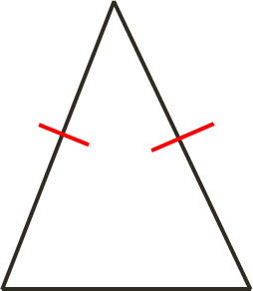
Isosceles Triangles
An Isosceles Triangle has the following properties
2 Congruent Sides (known as the legs)
1 Side with its own measure (known as the base)
The angle included between the legs is known as the vertex angle
Angles connected to the base are known as the base angles
Vertex Angle
Leg
Leg
Base Angles
Base

Slide 4
Theorem 4-1
The Isosceles Triangle Theorem: Base angles of a isosceles triangle are congruent.
Given: $\overline{AB}≅\overline{AC}$
Prove: $<B≅ <C$
Plan for Proof:
$<B$ and $<C$ are ___ by using __________.
To get the two triangles we need, we have to bisect $<A$ with $\overline{AD}$.
Thus, the Diagram suggests that you first prove ______ $≅$ _______.
A
C
B
D
$$≅$$
$$CPCTC$$
$$∆BAD$$
$$∆CAD$$

Slide 5
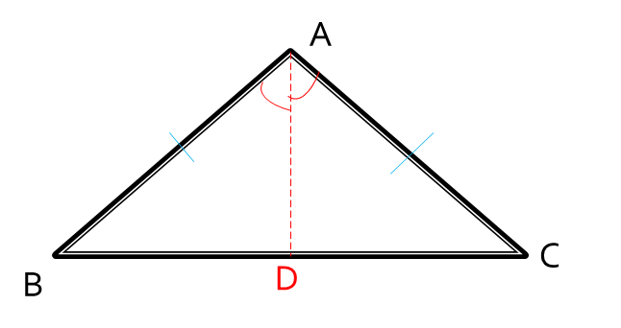
Example : Complete this Proof
With this setup, we can prove this theorem in the following way:
Statements ________ _______ Reasons
1. $\overline{AB}≅\overline{AC}$
1. Given
2. $\overline{AD}$ bisects $<A$
2. Each angle has unique bisector
3. $<BAD≅ <CAD$
3. Def. Angle Bisector
4. $\overline{AD}≅\overline{AD}$
4. Reflexive Property
5. $∆BAD≅∆CAD$
5. SAS Postulate
6. $<B≅ <C$
6. CPCTC

Slide 6
Theorem 4-1: The Corollaries
Theorem 4-1 produces 3 Corollaries:
Corollary 1: An equilateral triangle is also equiangular.
Corollary 2: An equilateral triangle has three $60°$ angles.
Corollary 3: The bisector of the vertex angle of an isosceles triangle is perpendicular to the base at its midpoint.

Slide 7
Theorem 4-2
Theorem 4-2: If two angles of a triangle are congruent, then the sides opposite those angles are congruent.
Given: $<B≅ <C$
Prove: $\overline{AB}≅\overline{AC}$
Plan for Proof:
$\overline{AB}$and $\overline{AC}$ are ___ by using __________.
To get the two triangles we need, we have to bisect $<A$ with $\overline{AD}$.
Thus, the Diagram suggests that you first prove ______ $≅$ _______.
A
C
B
D
$$≅$$
$$CPCTC$$
$$∆BAD$$
$$∆CAD$$

Slide 8
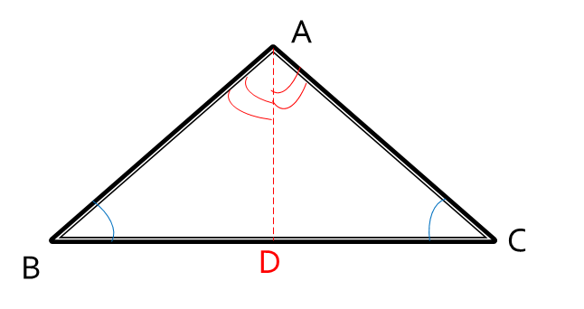
Example : Complete this Proof
With this setup, we can prove this theorem in the following way:
Statements ________ _______ Reasons
1. $<B≅ <C$
1. Given
2. Each angle has a unique bisector
2. $\overline{AD}$ bisects $<A$
3. $<BAD≅ <CAD$
3. Def. of Perp. Lines
4. $\overline{AD}≅\overline{AD}$
4. Reflexive Property
5. $∆BAD≅∆CAD$
5. AAS Theorem
6. $\overline{AB}≅\overline{AC}$
6. CPCTC

Slide 9
Theorem 4-2: The Corollaries
Theorem 4-2 produces 1 Corollary:
Corollary: An equiangular triangle is also equilateral.
But enough about proofs…
Now that we know some properties of Isosceles triangles, we can use this knowledge to solve for variable in them.

Slide 10
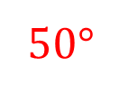
Examples with Isosceles Triangles
Solve for the value of x.
Using Theorem 4-1, we can say that the third angle in this triangle has measure ____.
With that, we can make an equation and solve:
$$x°$$
50$°$
50$°$
50$°$
$$x+50+50=180$$
$$x+100=180$$
$$x=80$$

Slide 11
Examples with Isosceles Triangles
Solve for the value of x.
Using Theorem 4-2, we can set the sides opposite our congruent angles equal to each other, making the following equation:
16
$$4x−6$$
$$18$$
$$18=4x−6$$
$$24=4x$$
$$x=6$$

