Slide 1
Geometry Unit 1: Transformations
Quiz/Test Review

Slide 2
Quiz Breakdown – 38 Questions
Identify the transformation – 6 Questions
Given an image and pre-image, you only have to state what transformation the picture is demonstrating (no notation required)

Slide 3
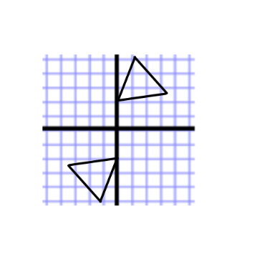
Identify Transformations by Image.
Identify and state the Transformation being demonstrated be the following shapes.
Transformation: Rotation

Slide 4
Quiz Breakdown – 38 Questions
Explain the movement of points for a given transformation – 3 Questions
Explain, in words with a complete sentence, how points would be moved for a transformation given its notation (must start by saying “Every Point” or “All Points”)

Slide 5
Explain Transformations in Words
For each Transformation, describe how each point should move.
1. T:(x, y) → (x + a, y + b):
Every point moves a units (left if a is negative/right if a is positive) and b units (down if b is negative and up if b is positive.
2. $R_{m}:$
Every point maps to its image, forming a line that is perpendicular to the line “m” (you would put the specific line for your problem in place of “m”), with both image and pre-image being equidistant (same distance) from the line “m”.

Slide 6
Quiz Breakdown – 38 Questions
Using a translation on points – 3 Questions
Given two points, complete the notation for the translation that moves the first given point to the second given point.
Given an image, use the notation you made to find the its pre-image.
Given a pre-image, use the same notation to find its image.

Slide 7
Translation: From Pre-Image to Image, and Vice versa
You are Given a translation that moves the point $(1,−5)$ to the point $(4, −7)$
Complete the translation that describes the movement above. $T:(x,y)→(x_______,y_________)$,
Use the above translation you found to answer the next problem:
Find the image of (-4,-4)
Since you are finding the image, you simply apply the above notation to the point (-4,-4): $T:(−4,−4)→(−4+3,−4−2)$
$$(x+3,y−2)$$
Image: (-1,-6)

Slide 8
Quiz Breakdown – 38 Questions
Given a point, state its image under a given transformation – 9 Questions
You will be asked to reflect a point under 3 different reflections
You will be asked to rotate a point under 3 different rotations
You will be asked to dilate a point under 3 different dilations

Slide 9
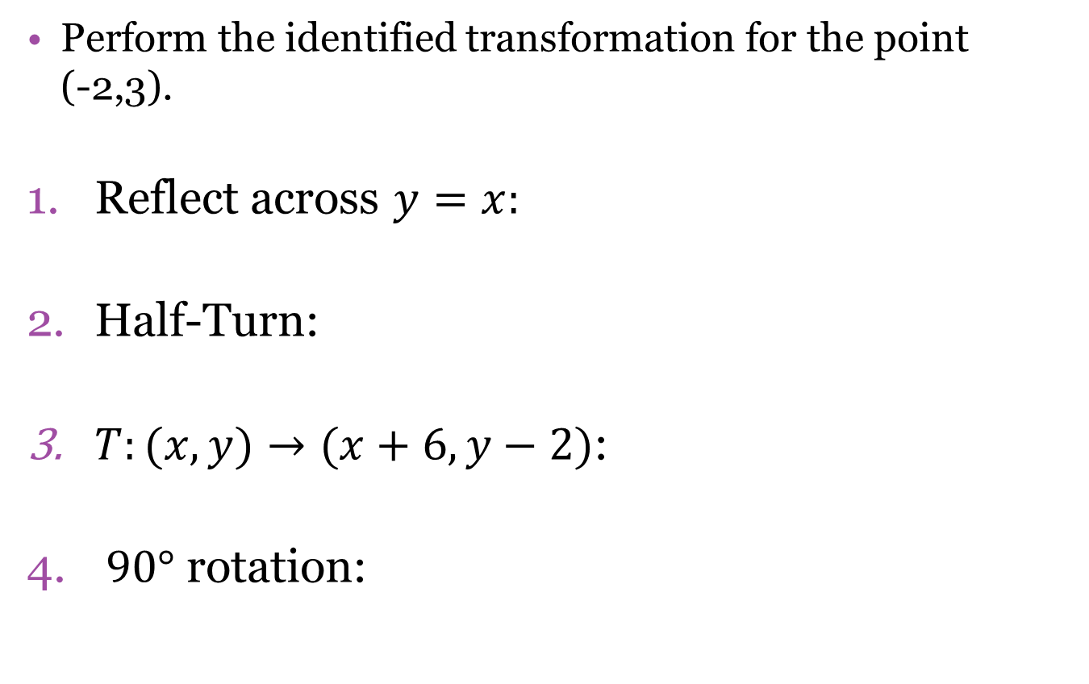
Practice Using the Rules
Perform the identified transformation for the point (-2,3).
Reflect across $y=x:$
Half-Turn:
$T:(x,y)→(x+6, y−2)$:
$90°$ rotation:
(3,-2)
(2,-3)
(4,1)
(-3,-2)

Slide 10
Quiz Breakdown – 38 Questions
Using a graph to find images under a given transformation– 10 Questions
You will be given a graph, with many points on it, labeled with various letters.
Each question will ask you to move a point under a specific transformation (described in notation)
You will use the graph to identify another point that matches the moved of the point given under the original transformation.

Slide 11
Quiz Breakdown – 38 Questions
Draw images of graphs – 6 Questions
Given a pre-image, draw its image on the graph given a specific transformation.
Remember notations.
Remember the Rules for each transformation.

Slide 12
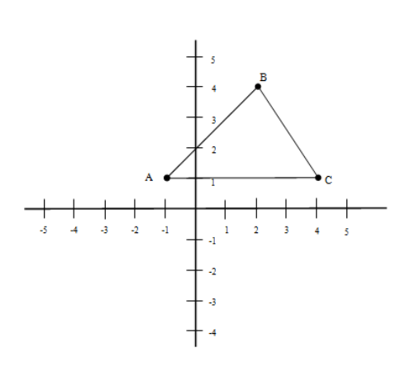
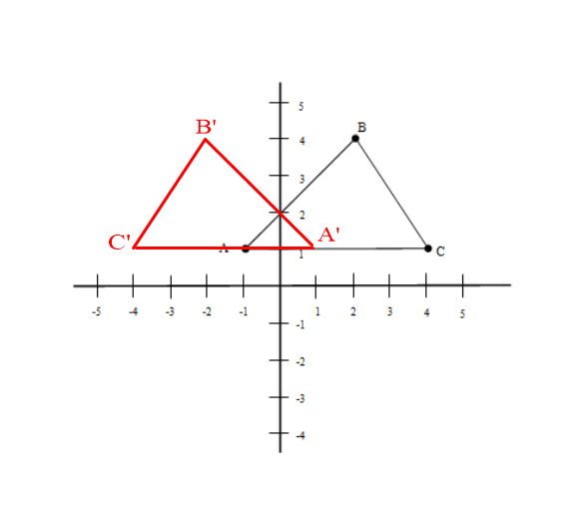
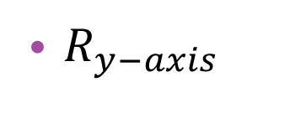
Using a given shape, graph its image under the given transformation.
$R_{y−axis}$
Image

Slide 13
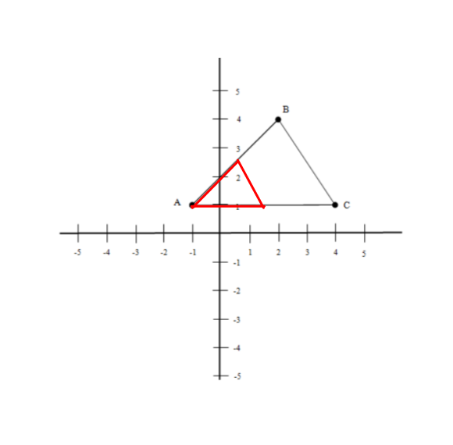
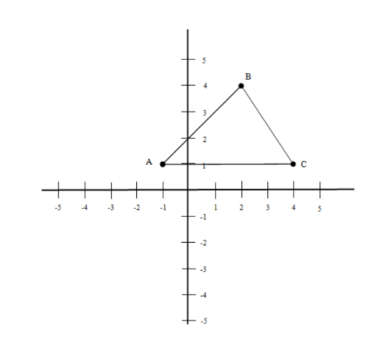
Using a given shape, graph its image under the given transformation.
$D_{A,\frac{1}{2}}$ When the center is not the origin, you must measure distances and multiply them by the scale factor to find the correct image (Remember that the center is its own image.)
Image

