Slide 1
Geometry – Unit 2
Test Review/Breakdown

Slide 2
Identify By Notation – 4 Problems
You will be given the notation of an object (Line, Ray, Segment, etc.). All you have to do is identify what type of object is being described.
Object Answer
$$\overset{⃡}{AB}$$
$$<ABC$$
AB
$$m<ABC$$
Line
Angle
Segment Length
Angle Measure

Slide 3
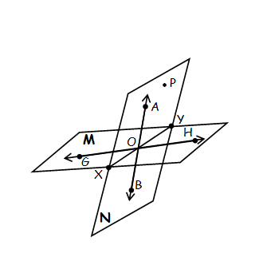
Using A Diagram (First Set) – 7 Problems
You will be given a Diagram, along with a word bank. Use the words given to fill in statements regarding the diagram.
Non-Coplanar
1.) A, O, H, and P are ____________
2.) Plane M ________ $\overset{⃡}{XY}.$
contains
Coplanar
3.) H, O, and B, are ____________

Slide 4
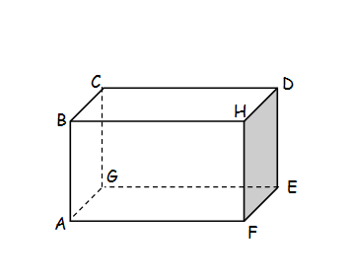
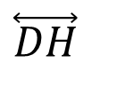
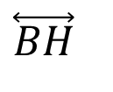
Using A Diagram (Second Set) – 5 Problems
You will be given a second Diagram. You will have to identify and write correct terms based off of the diagram.
1.) Points E, G, F and ______ are coplanar.
2.) Name two lines that intersect at point H. ______ ______.
3.) Name a plane that does not intersect with plane DEFH. ___________.
A
$$\overset{⃡}{DH}$$
$$\overset{⃡}{BH}$$
ABCG

Slide 5
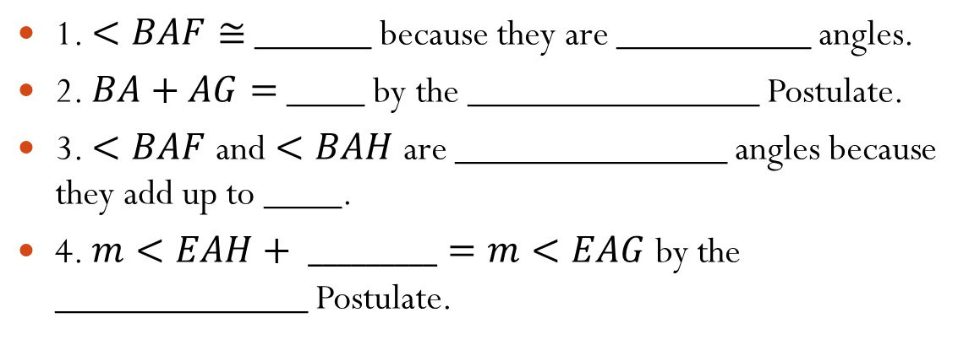
Using A Diagram (Third Set) – 5 Problems
You will be given a third Diagram, along with a word bank. You will fill in statements using the words in the word bank.
E
B
F
H
A
G
$$<HAG$$
Vertical
1. $<BAF≅$ ______ because they are __________ angles.
2. $BA+AG=$ ____ by the _______________ Postulate.
3. $<BAF$ and $<BAH$ are ______________ angles because they add up to ____.
4. $m<EAH+ _________=m<EAG$ by the _____________ Postulate.
$$BG$$
Segment Addition
Supplementary
$$180°$$
$$<HAG$$
Angle Addition

Slide 6
Using A Diagram (Fourth Set) – 2 Problems
You will be given a fourth Diagram, which will be the same diagrams as the one in the previous set. You will complete statements (similar to the warm-ups).
E
B
F
H
A
G
1.) $\vec{BG}$ is the segment ________ of $\overline{FH}$ passing through ________ A creating __________ segments $AF$ and $AH$.
2.) If $\vec{AB}$ was the angle________ of $<EAF$, then $<EAB$ and $<BAF$ would be __________ angles.
Bisector
Midpoint
Congruent
Bisector
Congruent

Slide 7
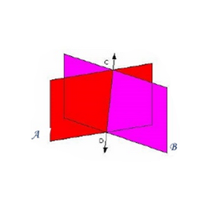
Correcting the Statement – 3 Problems
You will be given a statement that is given to be False. You will have to correct the statement using a complete sentence, as well as sketch a diagram of what the correct statement should be.
1.) A plain is made up of exactly 3 points.
2.) If two lines intersect, then at least one plane contains the lines.
3.) If two planes intersect, then their intersection is a line segment.
A plane is made up of AT LEAST 3 points (There could be more)
A
B
D
C
Exactly one plane contains the lines (Theorem 1-3).
The intersection of two planes is a line (Postulate 9)

Slide 8


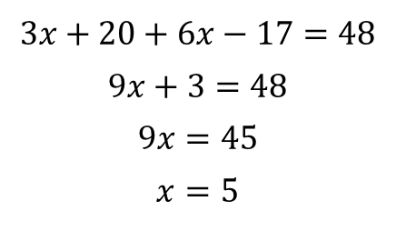
Using A Diagram (Final Set) – 4 Problems
You will be given one last Diagram. You will use the diagram to set up equations and solve for x.
B
E
1.) $<BKF=5x+12$ and $<HCG=4x+22$
2.) $DA=3x+20$, $AE=6x−17$, and $DE=48$
A
$$5x+12=4x+22$$
$$x=10$$
F
K
H
C
D
G
$$3x+20+6x−17=48$$
$$9x+3=48$$
$$9x=45$$
$$x=5$$
Main Idea: Use any combination of Segment Addition, Angle Addition, Complementary, Supplementary, and Vertical Angles to set up equations.

